Slide 1
The communication challenge: being heard
By Shamiso Banda

Slide 2
“I would venture to guess that Anon, who wrote so many poems without signing them, was often a woman.” Virginia Woolf

Slide 3
“Feminism is the radical notion that women are human beings.” Cheris Kramarae
“A feminist is anyone who recognizes the equality and full humanity of women and men.” Gloria Steinem

Slide 4
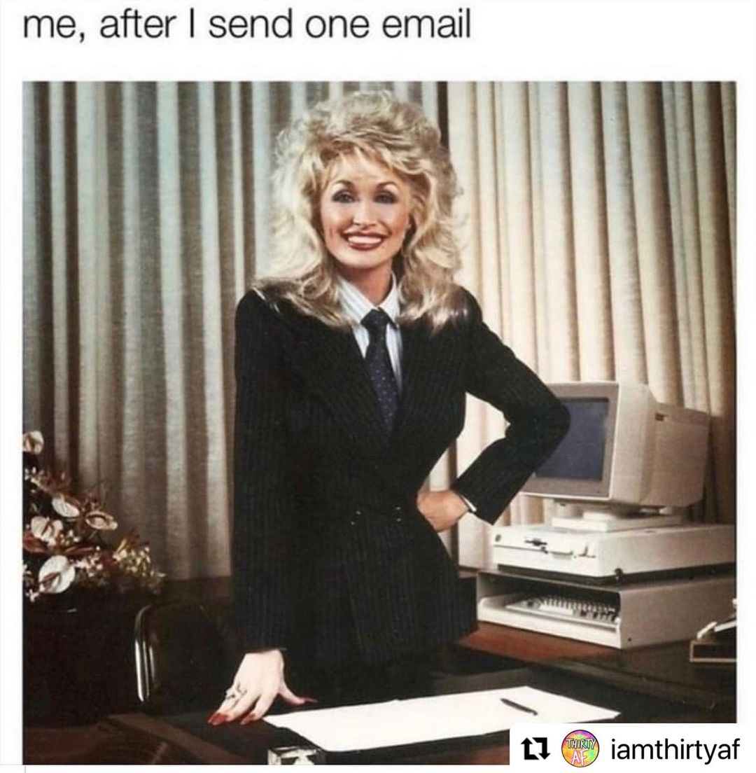

Slide 5
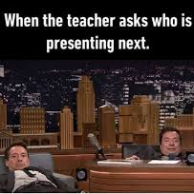
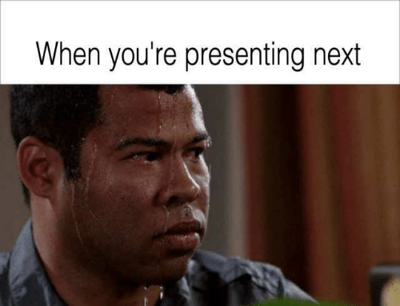

Slide 6
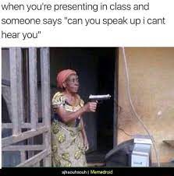

Slide 7
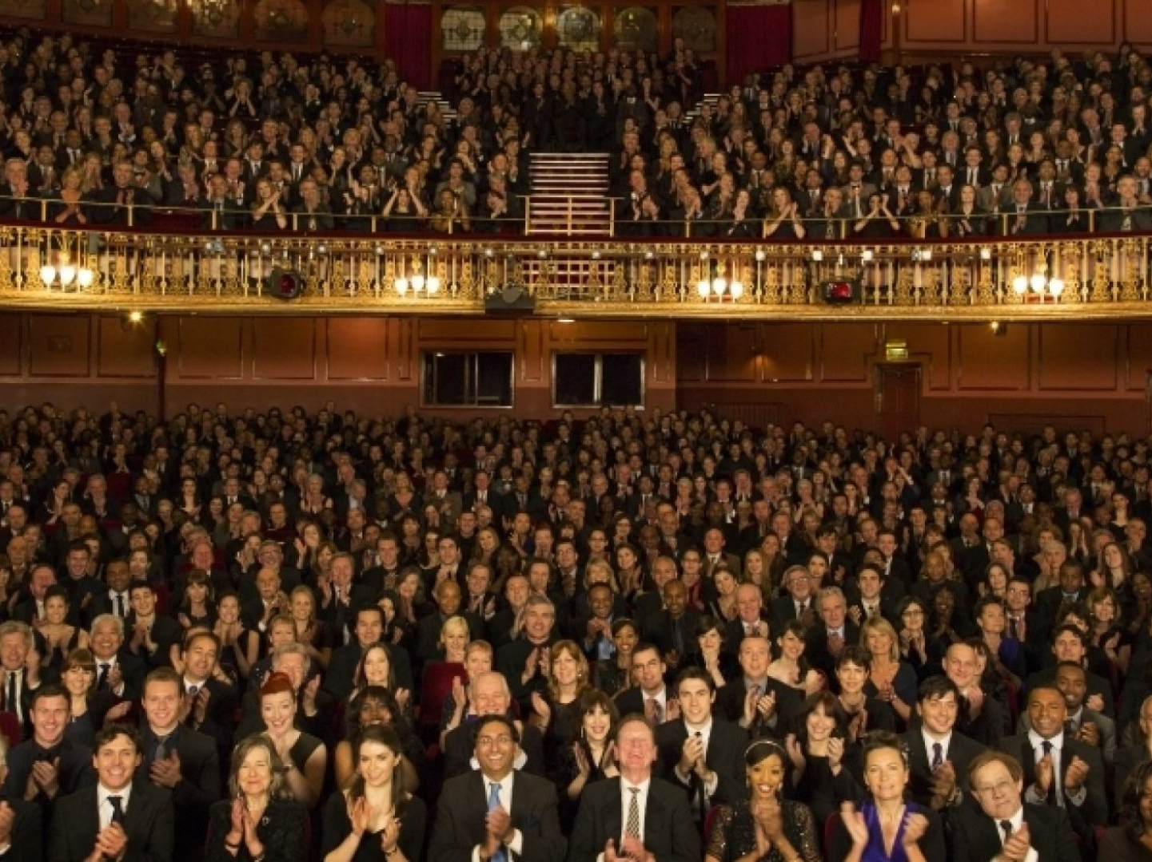
“Designing a presentation without an audience in mind is like writing a love letter and addressing it to whom it may concern.” Ken Haemer

Slide 8
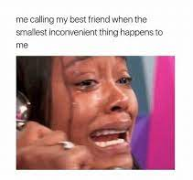
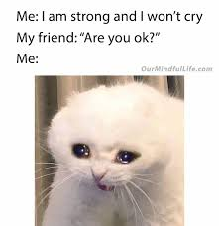

Slide 10
“Don’t waste your energy trying to change opinions.” Tina Fey

