Slide 1
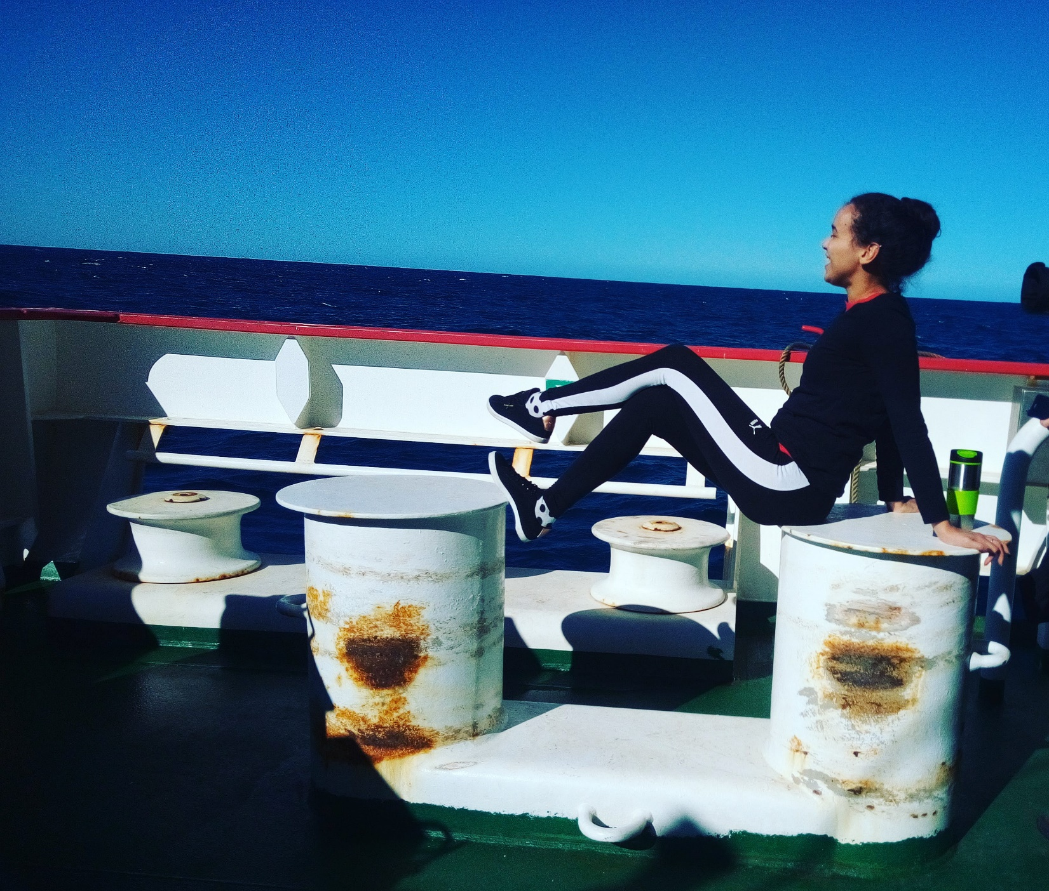
The Confidence Challenge
Believing in Yourself

Slide 2
Who is Tarryn and how did she get here?
Notes:
Who am I? How did I get here? The best context I can give is to start with a short timeline to my present point.

Slide 3
Career Background
Triomf Primary (1998-2004)
Bethelsdorp HS (2005 – 2009)
Ndip. Analytical Chemistry _ extended (2010-2014)
Kansai Plascon (2014)
Btech Chemistry (2015)
MSc Chemistry (2016 – 2019)
NMMU chem demi
SAEON (2018-present)
NMB water analyst
Educator
Notes:
One can describe the process as baking. Each life experience adds an ingredient. An absence of any step or ingredient and you end up with a bland flat cake. Each stop along the way I was blessed with mostly females who are inspiring, supportive and strong.

Slide 4
High School 2005 - 2009
Cons
Pros
Quintile 1 high School
No lab
Limited to no resources
Crime, drugs, gangsterism
Lack of rules
Lack of resources lead to creativity
Vigilant
Empathetic toward different worldviews
No survivor bias
Understanding that different privileges exist
Notes:
Normally one would have the Pros listed first. But in the real life sense a pro has to be drawn from con in order to succeed. The silver lining needs to be identified and used, innovate, adapt, improvise. I did not allow the circumstances I was born into determine my future. With support from parents and an amazing LO and maths (room teacher) I made it out. High School taught me that fitting in and conforming to the majority will not benefit your journey.

Slide 5
Analytical Chem (Ndip)
Cons
Pros
APS below required, placed in extended course (Ndip)
Poor math comprehension skill (Ndip)
One year added to a 3 year course
Academic life skills and Scientific English compulsory module
Foundation math retaught becoming one of my strongest subjects.
Go on to doing mathematics for engineers.
Additional time to adjust to real world
Notes:
The large class sizes from school did not work in my favour and having a love for playing sport did not help either. My APS fell below required and placed me in the extended course. However, circling back to the cake analogy this was just another necessary ingredient to learn confidence and speaking up for what you want to be.

Slide 6
Chemistry (Btech)
Cons
Pros
Rejected with first application
Bridged into new topic outside of chemistry
One year out from work force
Learn how to write motivations using skills from Ndip
Know and understand that outcomes can be challenged.
Graduate at top of class
Found my passion and future studies in Science education
The time was used to acquire new analytical and people skills.
Notes:
Because of the previous cake ingredient the next academic step was not daunting. Constructive criticism was welcomed and rejection always challenged.

Slide 7
Master in Science (Chem Education)
Con
Pro
Ethical clearance took 2,5 years
Worked full time
Constructive criticism is welcomed and no longer dreaded
Arguing a point inform of a panel is not daunting
No gap in work experience
Got to be a demi
Water quality analyst at NMB
A high school science teacher
A marine biogeochemist at SAEON
Notes:
It is not ideal to work full time while studying but it is a reality for most of us. The change in study path was also quite a jump, but I felt a strong connection to finding ways of making science accessible to learners who do not have the resources but are motivated enough to try. In this study I found learners just want the opportunity to learn about science and that in turn makes them want to pass it on to community and peers. You only need to spark one for the light to shine.

Slide 8
Uniquely Different
Notes:
With all of the aforementioned combined, it has afforded me the opportunity to work in my dream job and meet so many new and different individuals.

Slide 9
Together We Grow
Notes:
Each individual adding layers to the cake making it unique, outspoken and understanding to differences.
Each person has added an ingredient to making me, me and together us. All our sparks together make a beautiful flame to look at. Us meeting each other inspires each other, our work uniquely inspiring others to do more, do better and understand each other. Stay being you, keep being amazing and accept how significant your spark is and always will be.

Slide 10
Together - Us
Notes:
Each person has added an ingredient to making me, me and together us. All our sparks together make a beautiful flame to look at.

Slide 11
Spark - Inspire
Notes:
Us meeting each other inspires each other, our work uniquely inspiring others to do more, do better and understand each other. Stay being you, keep being amazing and accept how significant your spark is and always will be. We draw confidence from one other and cement it within by believing in ourselves.

Slide 12
Thank you for listening ☺ Questions?

