Slide 1
Research is gender neutral …
#EachForEqual Dr. Jessica Fraser

Slide 2
MY Universal truth
There will always be someone
richer, skinnier and more eloquent than me…

Slide 3
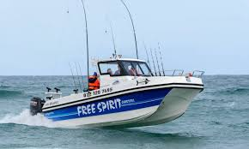
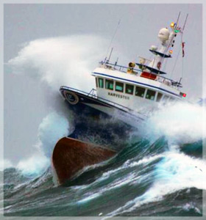
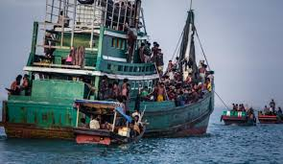
Thanks to Covid-19, we are all in this together,
yet not quite in the same boat….

Slide 4
MBA research projects supervised & graduated (2015-2020)
Internet Fraud
Automotive Manufacturing
Port congestion
Lean warehousing
ERP in bakeries
Eskom maintenance
Africa & mobile payment
Freight forwarding
Sustainable Louis Vuitton
Port MIS risks
Port B2B efficacy

Slide 5
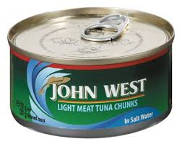
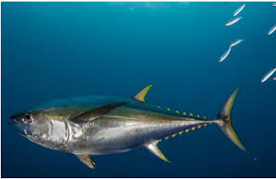
Personal research
Supply chain management from points of origin, to points of consumption and the reverse logistics
Nature/Environment
Processing in industry
Ports and Shipping
Wholesale and Retail
End Users and waste management

Slide 6
Research is gender neutral , but more effective when it includes and benefits everybody
#EachForEqual Dr. Jessica Fraser

