Slide 1
The Flexibility Challenge: Leading a Balanced Life
PAULA PATTRICK

Slide 2
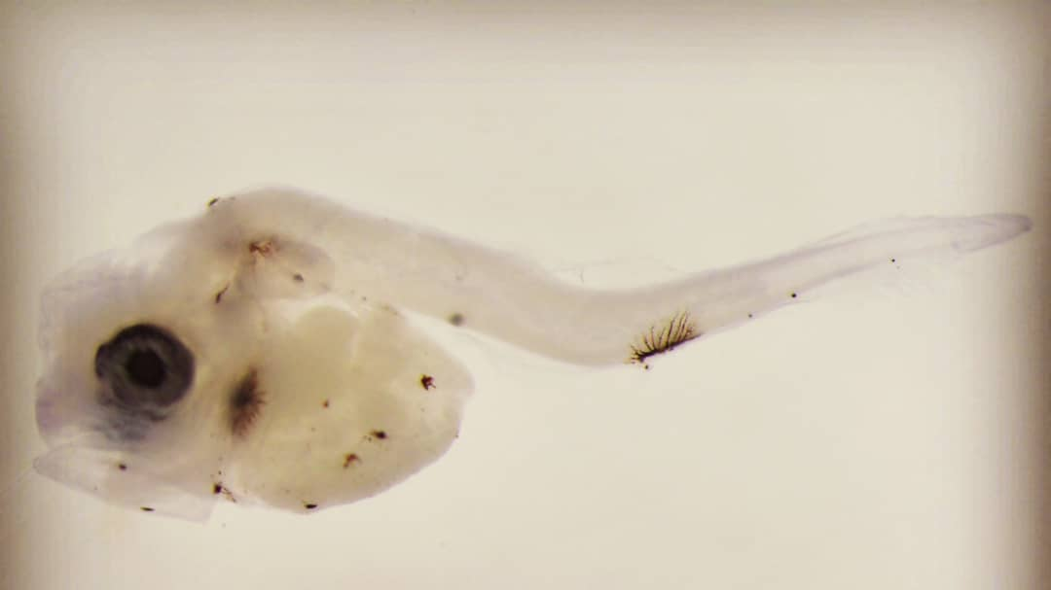
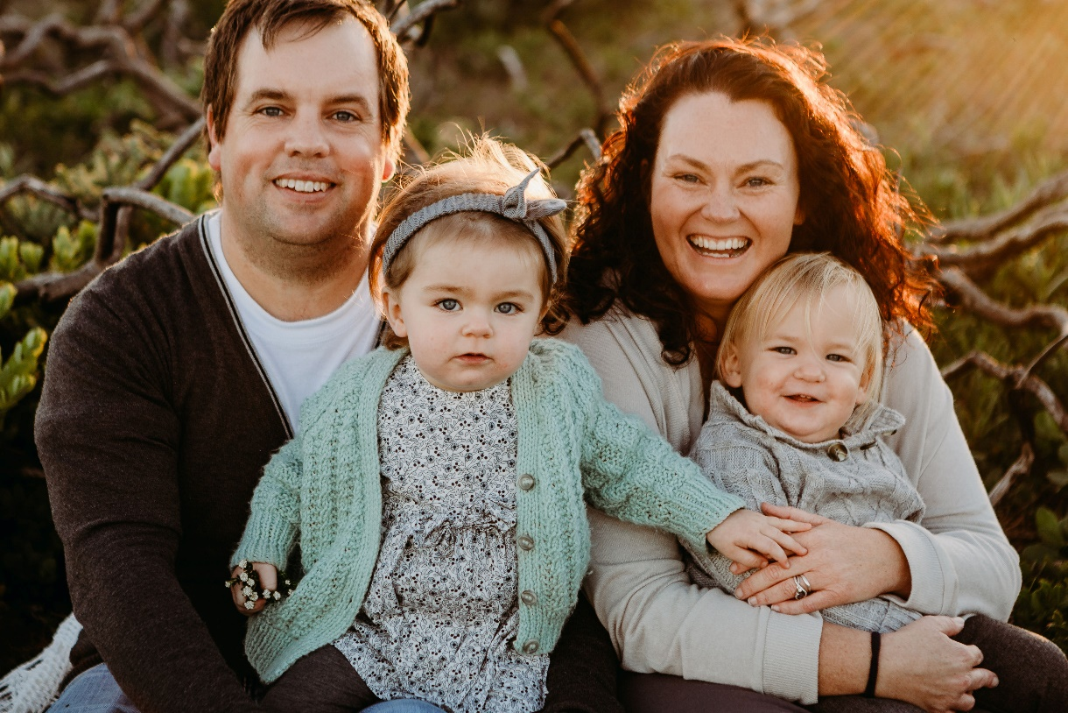

Slide 3
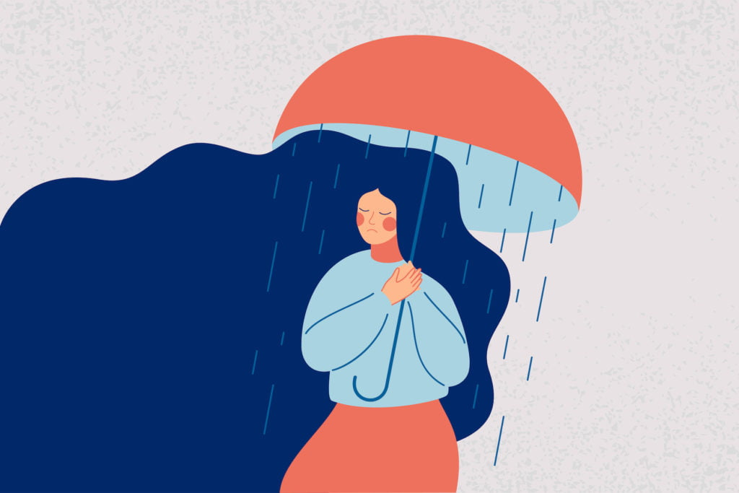
R15 BILLION

Slide 5
work-life balance
Definition
The amount of time you spend doing your job compared with the amount of time you spend with your family and doing things you enjoy
Cambridge Advanced Learner’s Dictionary

Slide 7
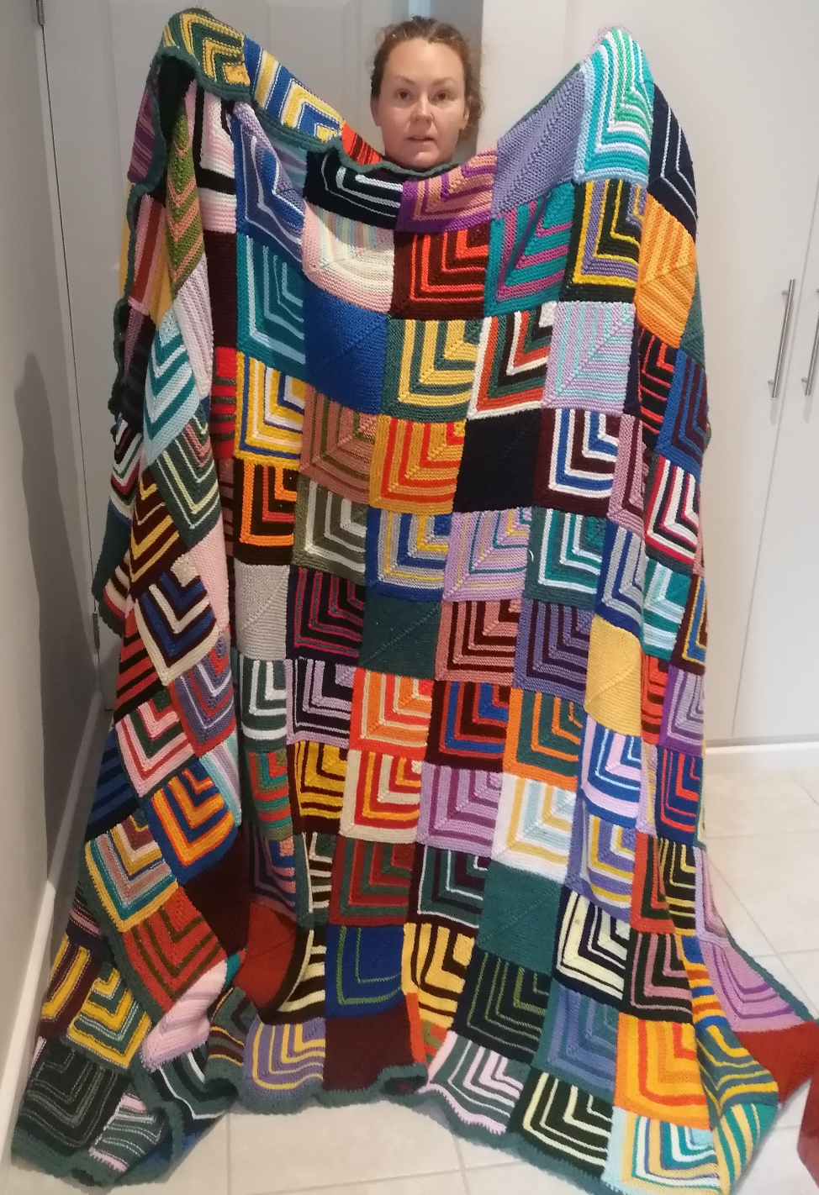

Slide 8
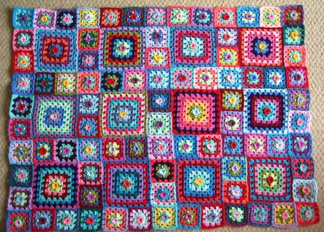

Slide 9
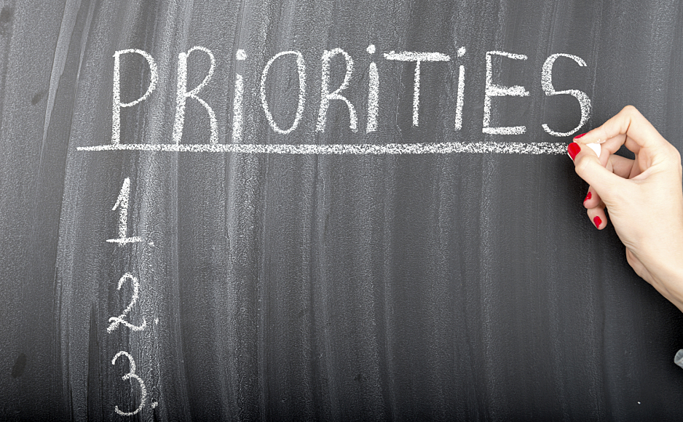

Slide 10
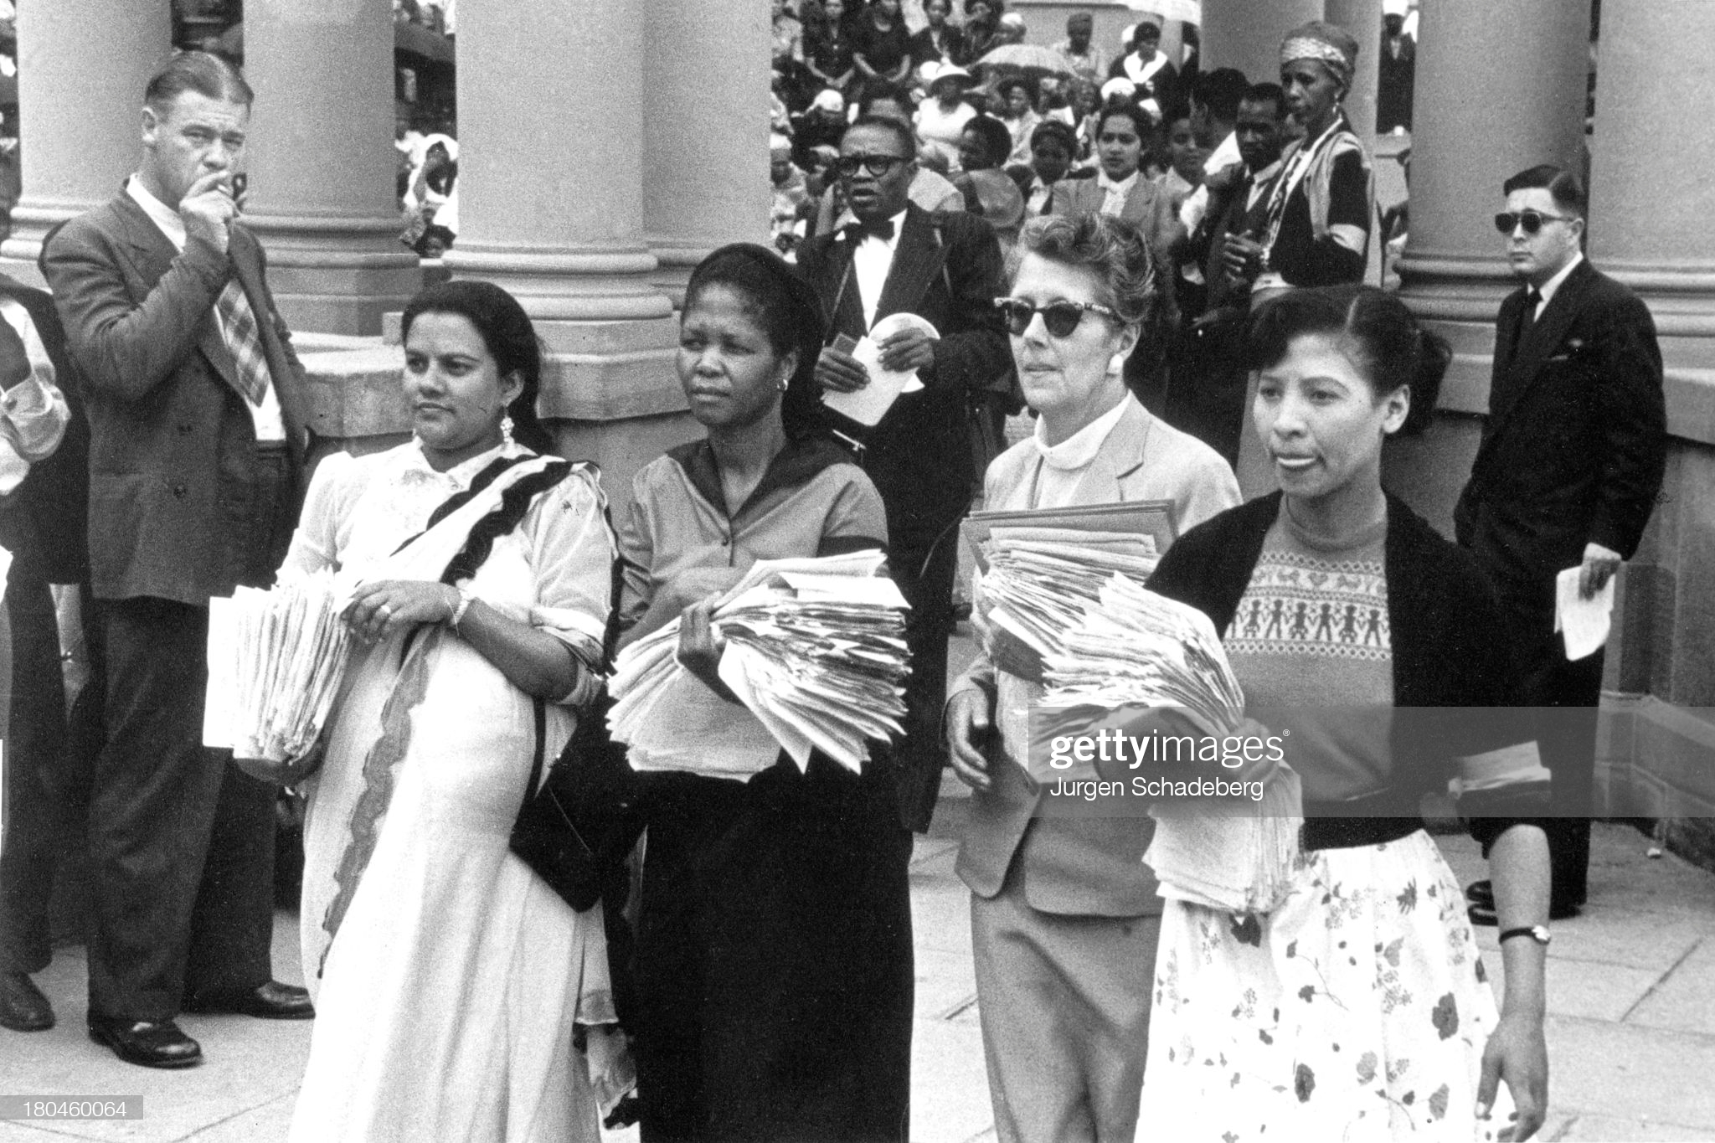

Slide 11
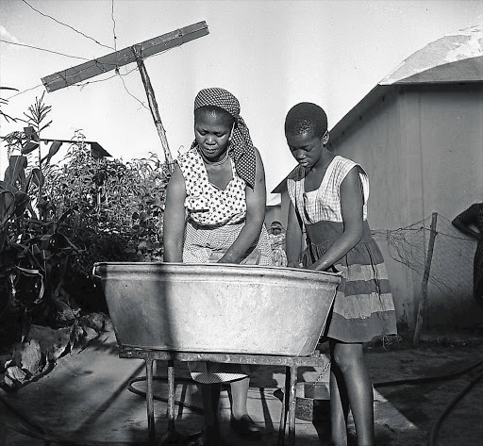

Slide 12
