Slide 1

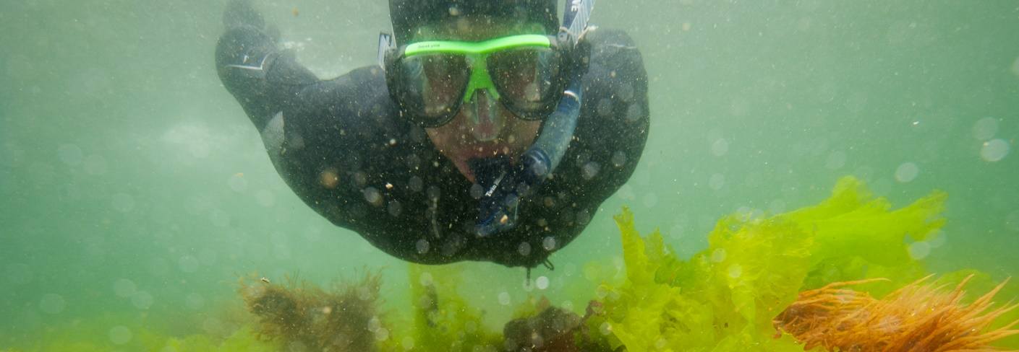

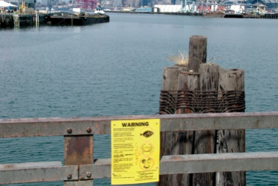
Our oceans, our selves
Philip Levin
The Nature Conservancy & University of Washington
@ConsLevin

Slide 2
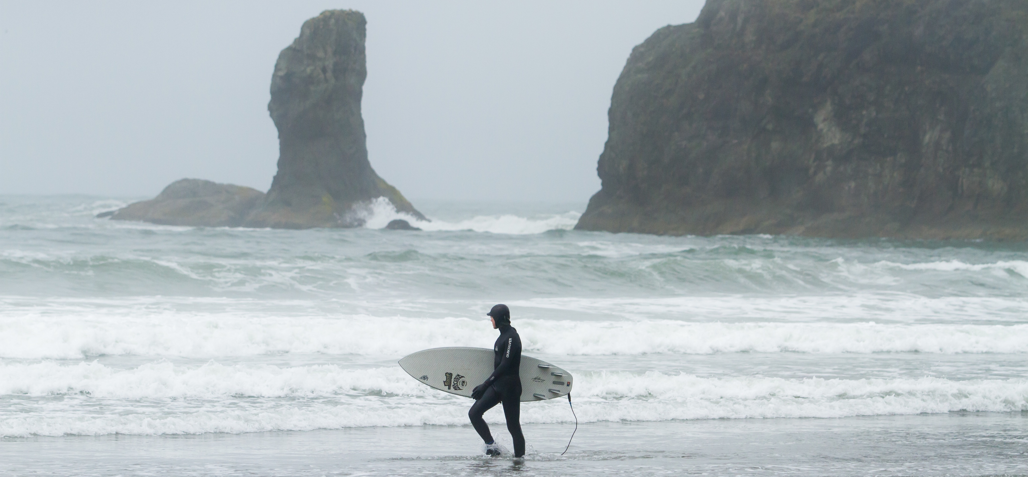
Connected

Slide 3
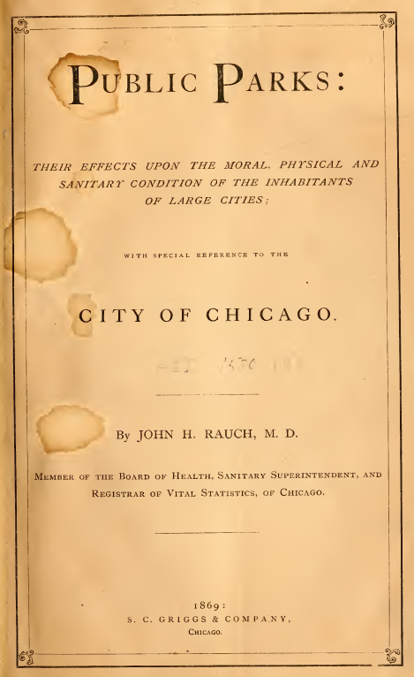

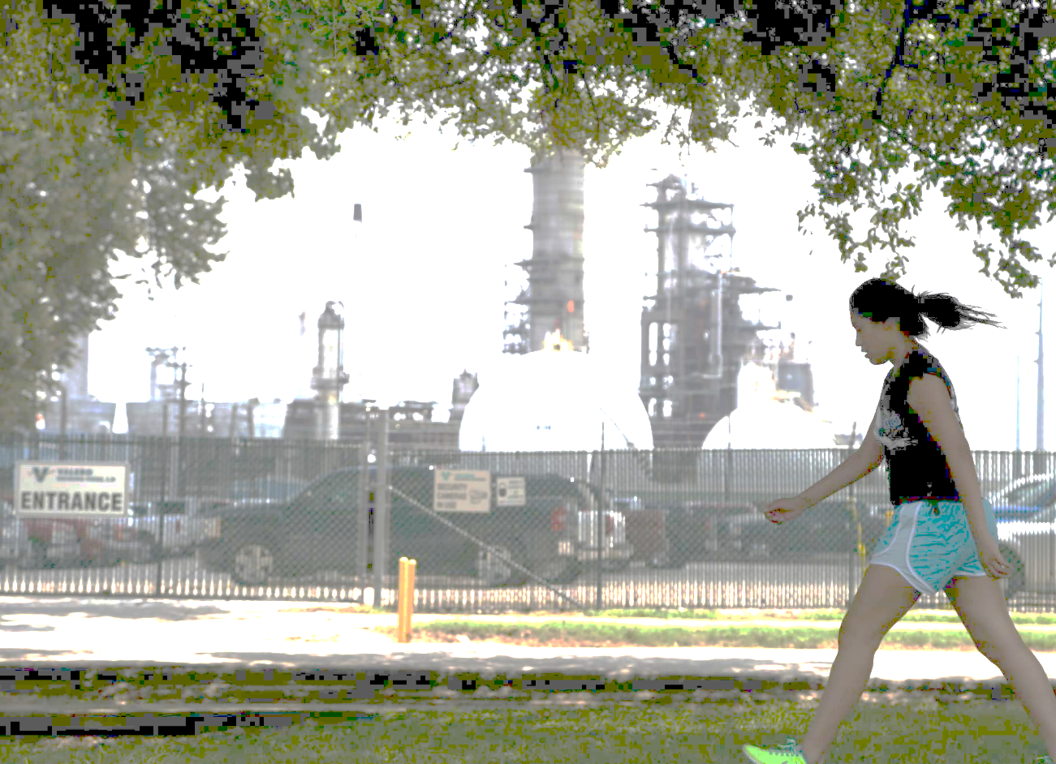

An old idea
Notes:
The idea that nature contact may benefit health has a long history. Research on this topic isn’t new; here’s an example of a study carried out almost exactly 150 years ago.

Slide 4
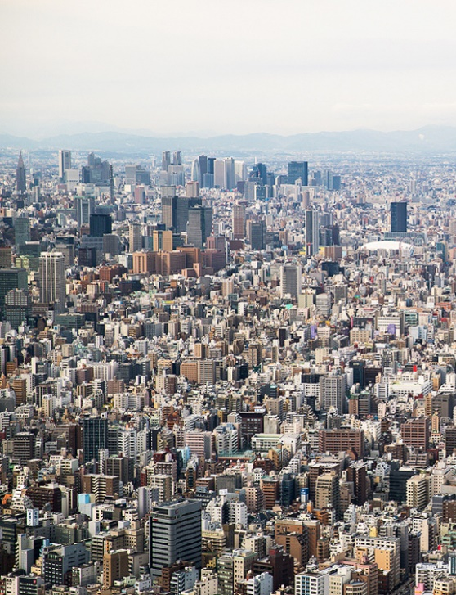

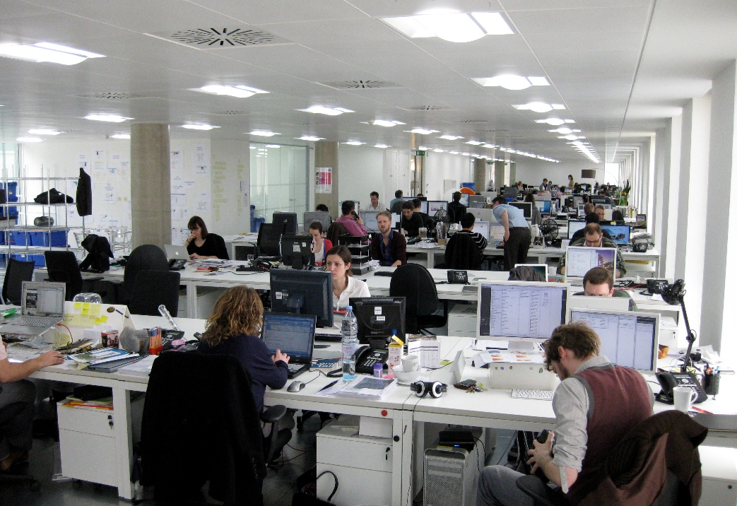
Resurgence
Notes:
Three portrait photos with text; create variation for each program area; swap text placement to right for some variations too

Slide 5
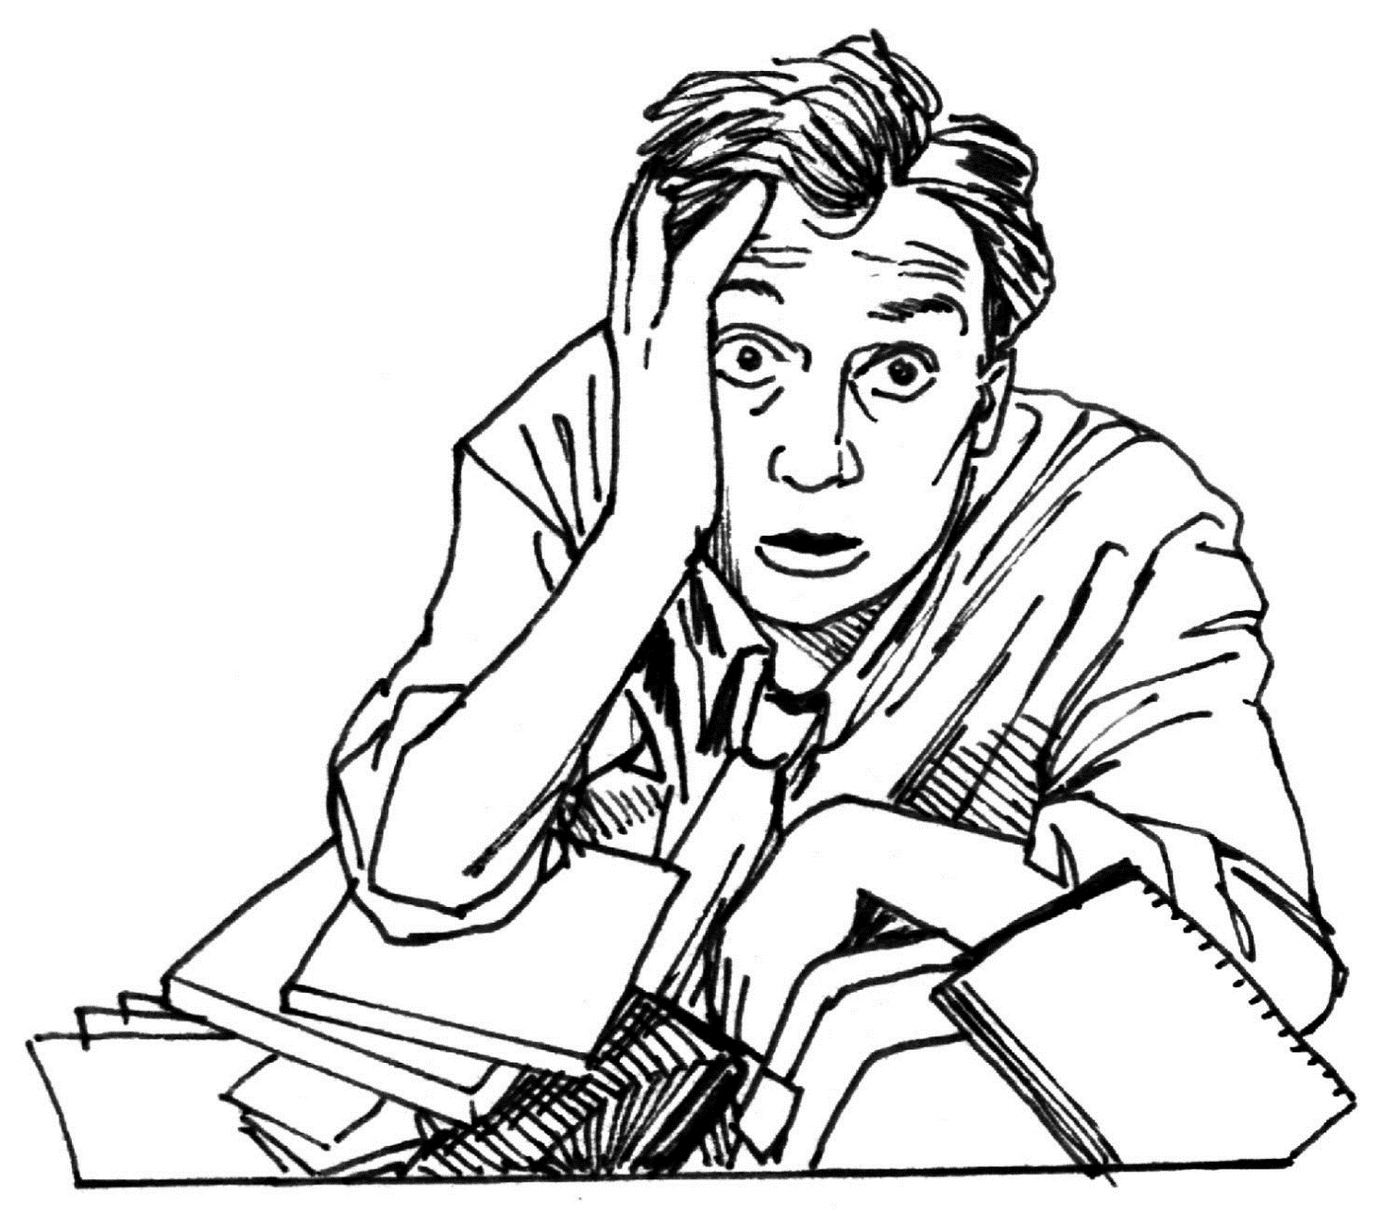
Research explosion
Notes:
The literature has grown considerably in recent years—so much so that it’s a challenge to keep up. Interestingly, results are published in a range of literatures—biomedical, environmental, psychological, parks and rec, and design professions such as landscape architecture. Let me summarize it briefly in terms of predominant study types.

Slide 6
The environmental health paradigm
EXPOSURE
OUTCOME
NATURE CONTACT
HEALTH BENEFIT
Notes:
In the Environmental Health field, much research is grounded in the proposition that exposures can lead to health outcomes. Often these are unhealthy: asbestos leading to lung cancer, endocrine disrupters interfering with child development.
CLICK But in the context of today’s discussion, there’s a happier kind of association: nature contact leading to health benefits.
In both scenarios, we need to be precise and quantitative about both the exposure and the outcomes we study.

Slide 7
Scales of exposure
Notes:
With regard to exposure, that’s a tall order. Nature contact occurs in many forms, as shown here. The spatial scale varies from as small as flowers or potted plants in a room, to as large as vast national parks. The temporal scale varies from brief, occasional encounters to ongoing lifestyle attributes. And this display doesn’t begin to capture the varieties of nature contact—the sensory modes at play, the cultural filters people bring to bear, and so on.

Slide 8
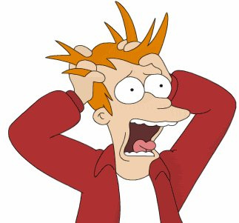
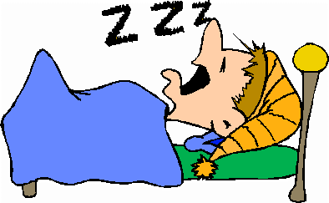
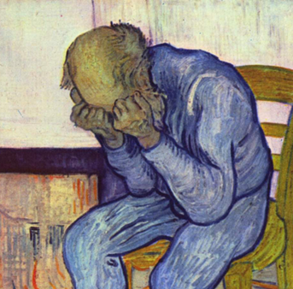

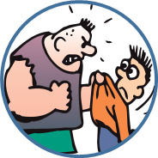


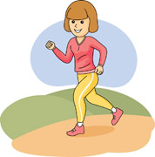
REDUCED STRESS
IMPROVED SLEEP
REDUCED ANXIETY & DEPRESSION
GREATER HAPPINESS
REDUCED AGGRESSION
PROSOCIAL BEHAVIOR
REDUCED ADHD SYMPTOMS
PHYSICAL ACTIVITY
Frumkin et al. 2017 Environmental Health Perspectives
Bratman et al. 2019 Science Advances
Notes:
Turning from exposure to outcome, an extraordinarily broad range of benefits has been associated with nature contact. They are shown schematically on this slide.
A few comments.
First, some of the benefits generally fall into the mental health domain, others fall into the physical health domain, and others relate to general well-being—although of course these three domains are inseparable.
Second, this display is incomplete. There is evidence for still other benefits, such as in ameliorating psychotic illness..
Third, the strength of evidence for these benefits is widely variable—very convincing in some cases, and more equivocal in other cases.

Slide 9
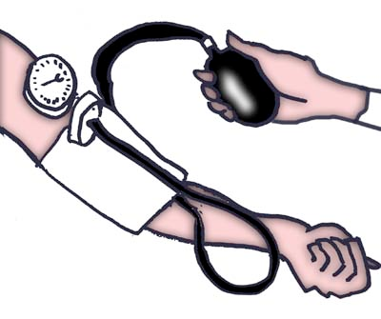
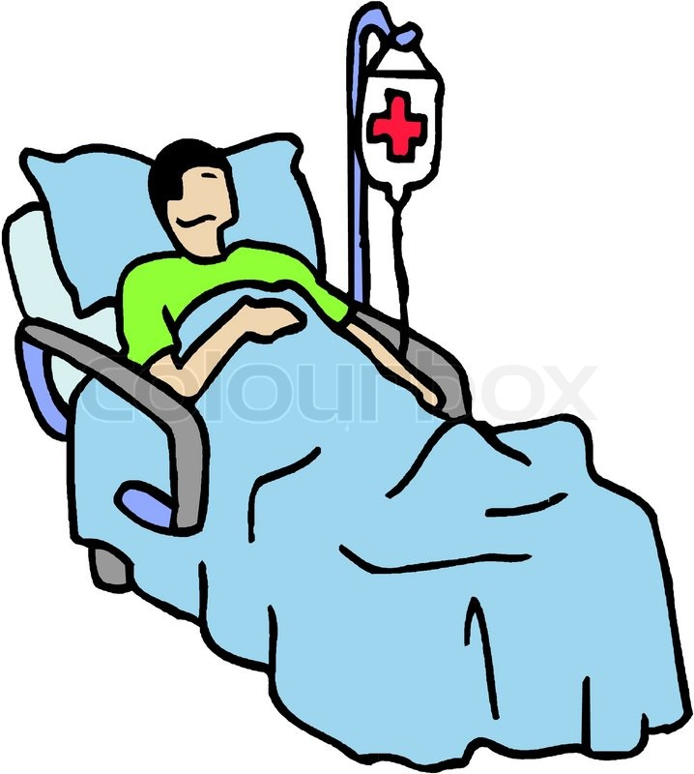


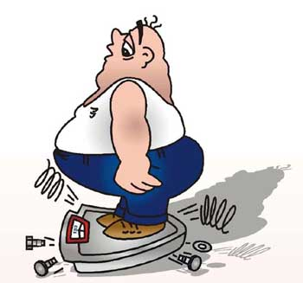
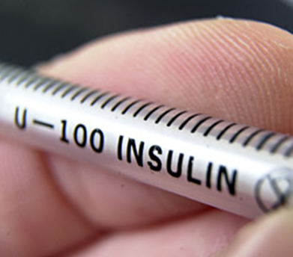

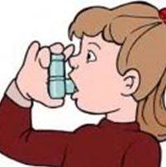
REDUCED STRESS
IMPROVED SLEEP
REDUCED ANXIETY & DEPRESSION
GREATER HAPPINESS
REDUCED AGGRESSION
PROSOCIAL BEHAVIOR
REDUCED ADHD SYMPTOMS
PHYSICAL ACTIVITY
LOWER BLOOD PRESSURE
FASTER POST-OP RECOVERY
IMPROVED BIRTH OUTCOMES
PAIN CONTROL
LESS OBESITY
LESS DIABETES
BETTER EYESIGHT
+/- ASTHMA IMPACTS
Frumkin et al. 2017 Environmental Health Perspectives
Bratman et al. 2019 Science Advances
Notes:
Turning from exposure to outcome, an extraordinarily broad range of benefits has been associated with nature contact. They are shown schematically on this slide.
A few comments.
First, some of the benefits generally fall into the mental health domain, others fall into the physical health domain, and others relate to general well-being—although of course these three domains are inseparable.
Second, this display is incomplete. There is evidence for still other benefits, such as in ameliorating psychotic illness..
Third, the strength of evidence for these benefits is widely variable—very convincing in some cases, and more equivocal in other cases.

Slide 10


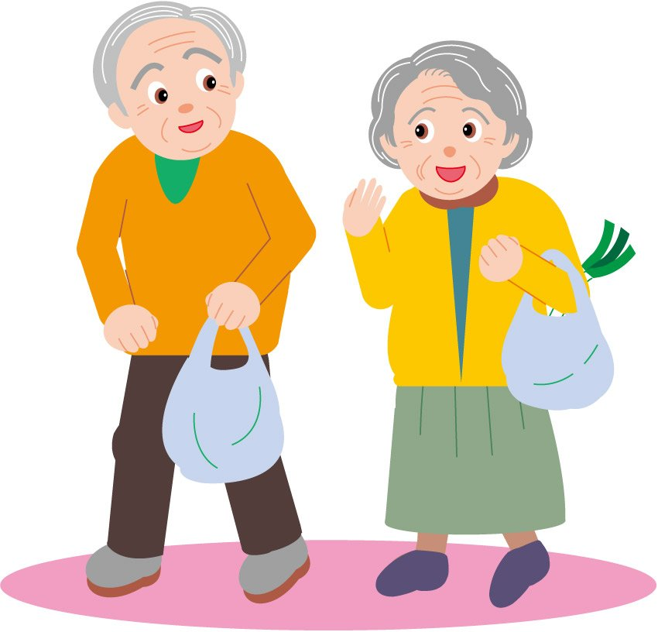
REDUCED STRESS
IMPROVED SLEEP
REDUCED ANXIETY & DEPRESSION
GREATER HAPPINESS
REDUCED AGGRESSION
PROSOCIAL BEHAVIOR
REDUCED ADHD SYMPTOMS
PHYSICAL ACTIVITY
LOWER BLOOD PRESSURE
FASTER POST-OP RECOVERY
IMPROVED BIRTH OUTCOMES
PAIN CONTROL
LESS OBESITY
LESS DIABETES
IMPROVED HEALTH IN CANCER PATIENTS
IMPROVED GENERAL HEALTH
LONGER LIVES
BETTER EYESIGHT
+/- ASTHMA IMPACTS
Frumkin et al. 2017 Environmental Health Perspectives
Bratman et al. 2019 Science Advances
Notes:
Turning from exposure to outcome, an extraordinarily broad range of benefits has been associated with nature contact. They are shown schematically on this slide.
A few comments.
First, some of the benefits generally fall into the mental health domain, others fall into the physical health domain, and others relate to general well-being—although of course these three domains are inseparable.
Second, this display is incomplete. There is evidence for still other benefits, such as in ameliorating psychotic illness..
Third, the strength of evidence for these benefits is widely variable—very convincing in some cases, and more equivocal in other cases.

Slide 11
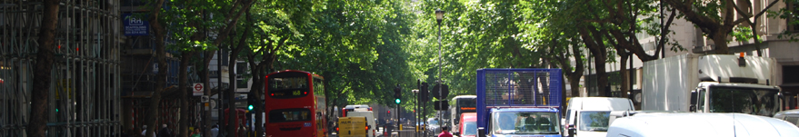
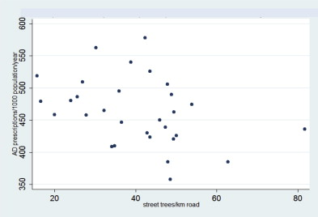
An observational study: Street trees and depression
Setting: London’s 33 boroughs
Street tree census from Greater London Authority
Antidepressant Rx data from NHS
Each ↑1 tree /street km associated with ↓2.4 antidepressant Rx / 1,000 pop’n
Taylor et al. Urban street tree density and antidepressant prescription rates—A cross-sectional study in London, UK. Landscape and Urban Planning 2015;136:174–179.
Notes:
But most of our evidence consists of observational studies. These are relatively inexpensive and very large. Disadvantages include the need to use data developed for other purposes, such as satellite or other geolocated data on greenspace, and the fact that it’s often hard to avoid confounding, bias, and questions about the direction of causation. In this example, the independent variable was exposure to street trees, using data from the Greater London Authority street tree census, and the dependent variable was the level of antidepressant prescribing, using NHS data, both at the block level. The investigators found a fairly strong negative association between street tree density and antidepressant prescription density.

Slide 12
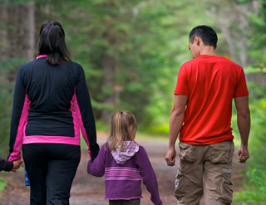
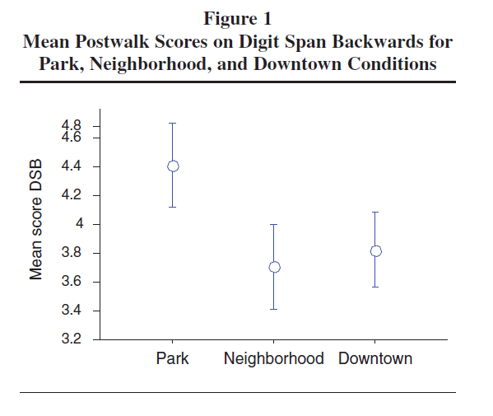
Experimental evidence: Nature contact and ADHD
Children aged 7-12 with diagnosed ADHD
20-minute guided walks in 3 environments:
  Park
  Neighborhood
  Downtown
Outcome: Post-walk Digit Span Backwards test
Faber Taylor A & Kuo FE. Children with attention deficits concentrate better after walk in the park. J Attention Disord 2009;12,:402-09.
Notes:
First, there are some true experiments. In this example, a small number of children with diagnosed ADHD were taken on guided walks in three different environments: a park, a residential neighborhood, and a dense downtown area. The outcome of interest was their level of attention, as measured by the Digit Span Backwards test. CLICK The scores were substantially better after the park walk than after walks in the other two settings. In the last few years, experimental studies have utilized innovative outcome measures, such as brain imaging, yielding intriguing results. Epidemiologists will be disappointed with the small sample sizes, and child psychologists will be disappointed with the very short-term nature of the outcomes measured. Unfortunately these features are typical of the true experiments in this arena.

Slide 13
A true experiment:
Nature contact and ADHD
17 children aged 7-12 with diagnosed ADHD
20-minute guided walks in 3 environments:
  Park
  Neighborhood
  Downtown
Outcome: Post-walk Digit Span Backwards test
Result: Significant improvement with park compared to others
Faber Taylor A & Kuo FE. Children with attention deficits concentrate better after walk in the park. J Attention Disord 2009;12,:402-09.
Notes:
First, there are some true experiments. In this example, a small number of children with diagnosed ADHD were taken on guided walks in three different environments: a park, a residential neighborhood, and a dense downtown area. The outcome of interest was their level of attention, as measured by the Digit Span Backwards test. CLICK The scores were substantially better after the park walk than after walks in the other two settings. In the last few years, experimental studies have utilized innovative outcome measures, such as brain imaging, yielding intriguing results. Epidemiologists will be disappointed with the small sample sizes, and child psychologists will be disappointed with the very short-term nature of the outcomes measured. Unfortunately these features are typical of the true experiments in this arena.

Slide 14
Research explosion
Notes:
The literature has grown considerably in recent years—so much so that it’s a challenge to keep up. Interestingly, results are published in a range of literatures—biomedical, environmental, psychological, parks and rec, and design professions such as landscape architecture. Let me summarize it briefly in terms of predominant study types.

Slide 17
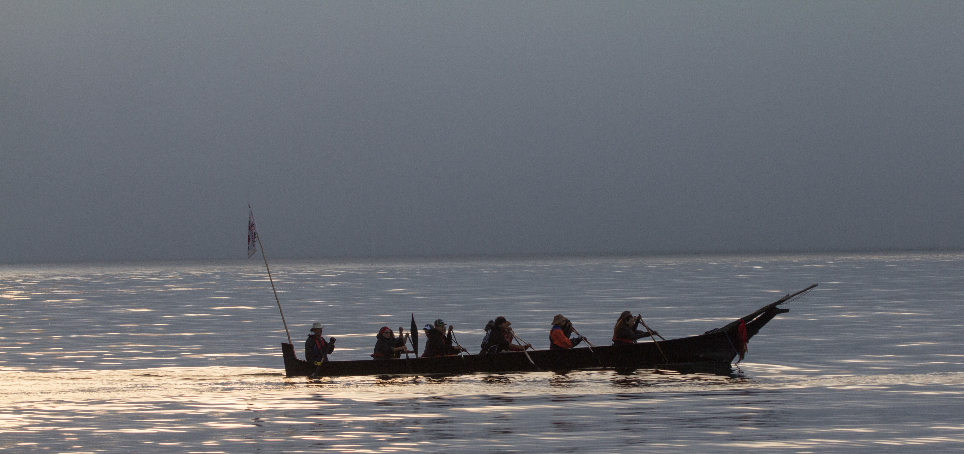
Beyond
The Medical Establishment

Slide 18
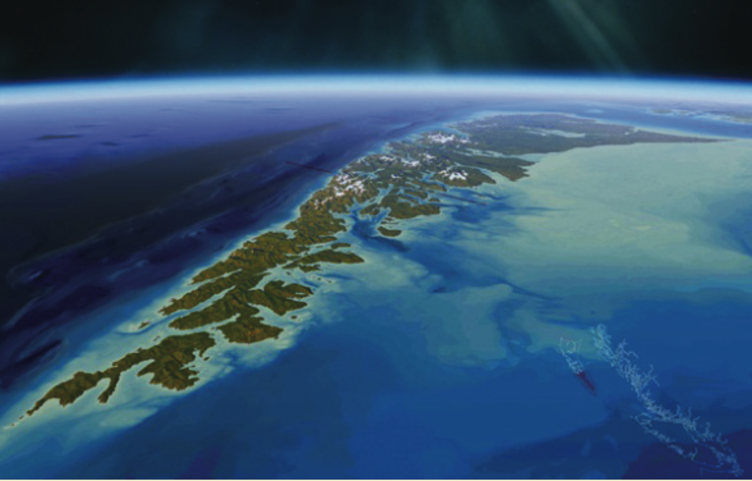
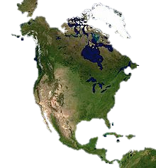
Haida Gwaii

Slide 19


Slide 20
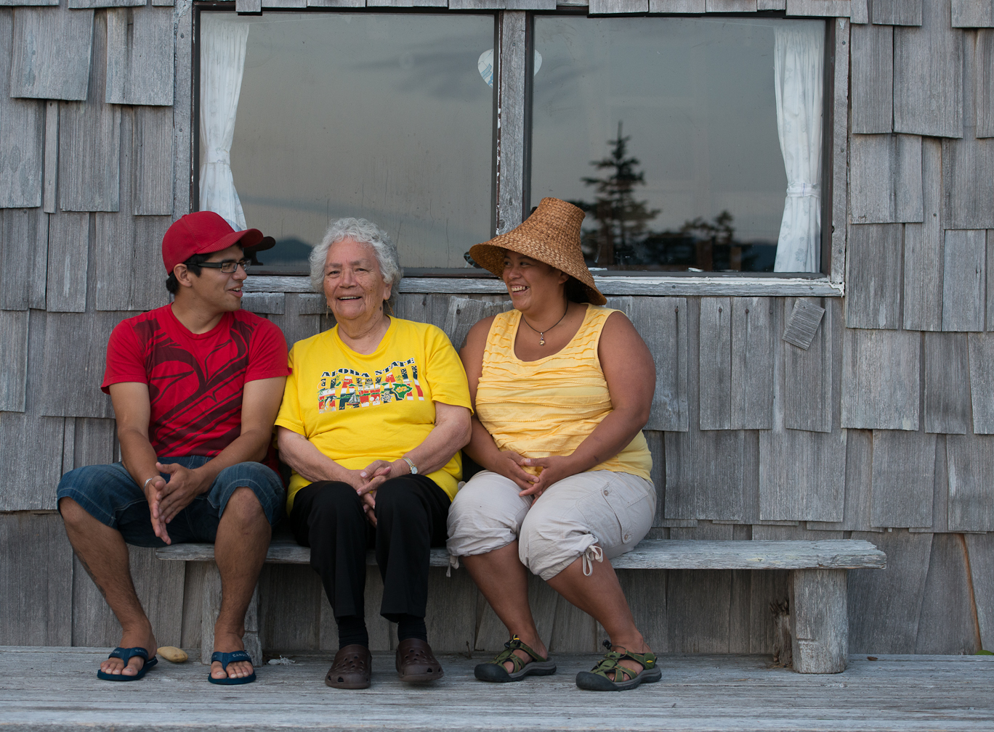
Melissa Poe et al. in prep; Donatuto et al. 2014
What is health?

Slide 21
Melissa Poe et al. in prep; Donatuto et al. 2014
Physical Health
What is health?
What is health?

Slide 22
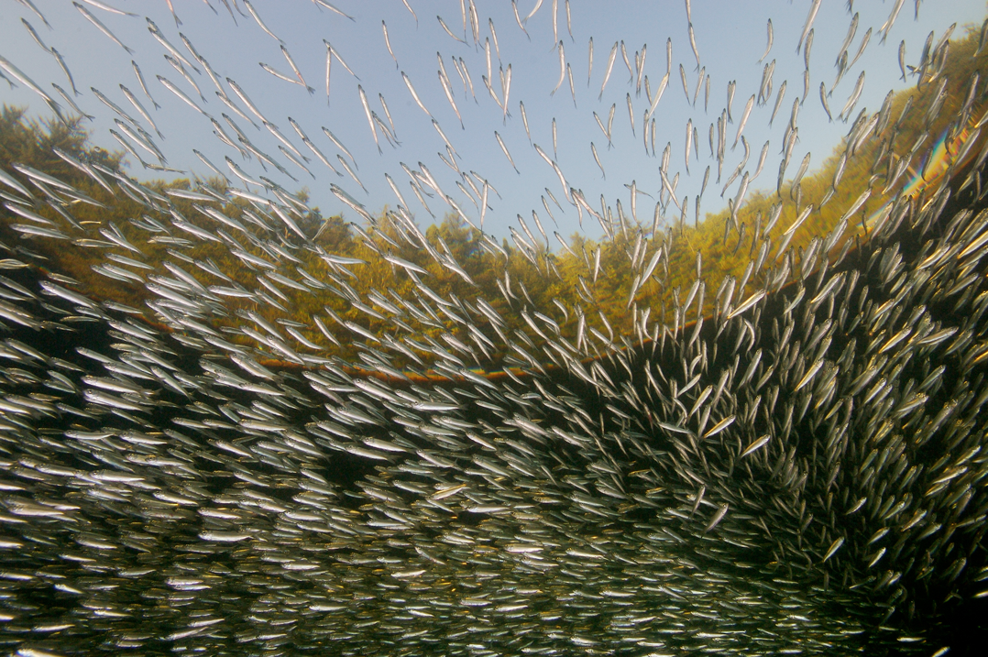
Pacific
Herring

Slide 23
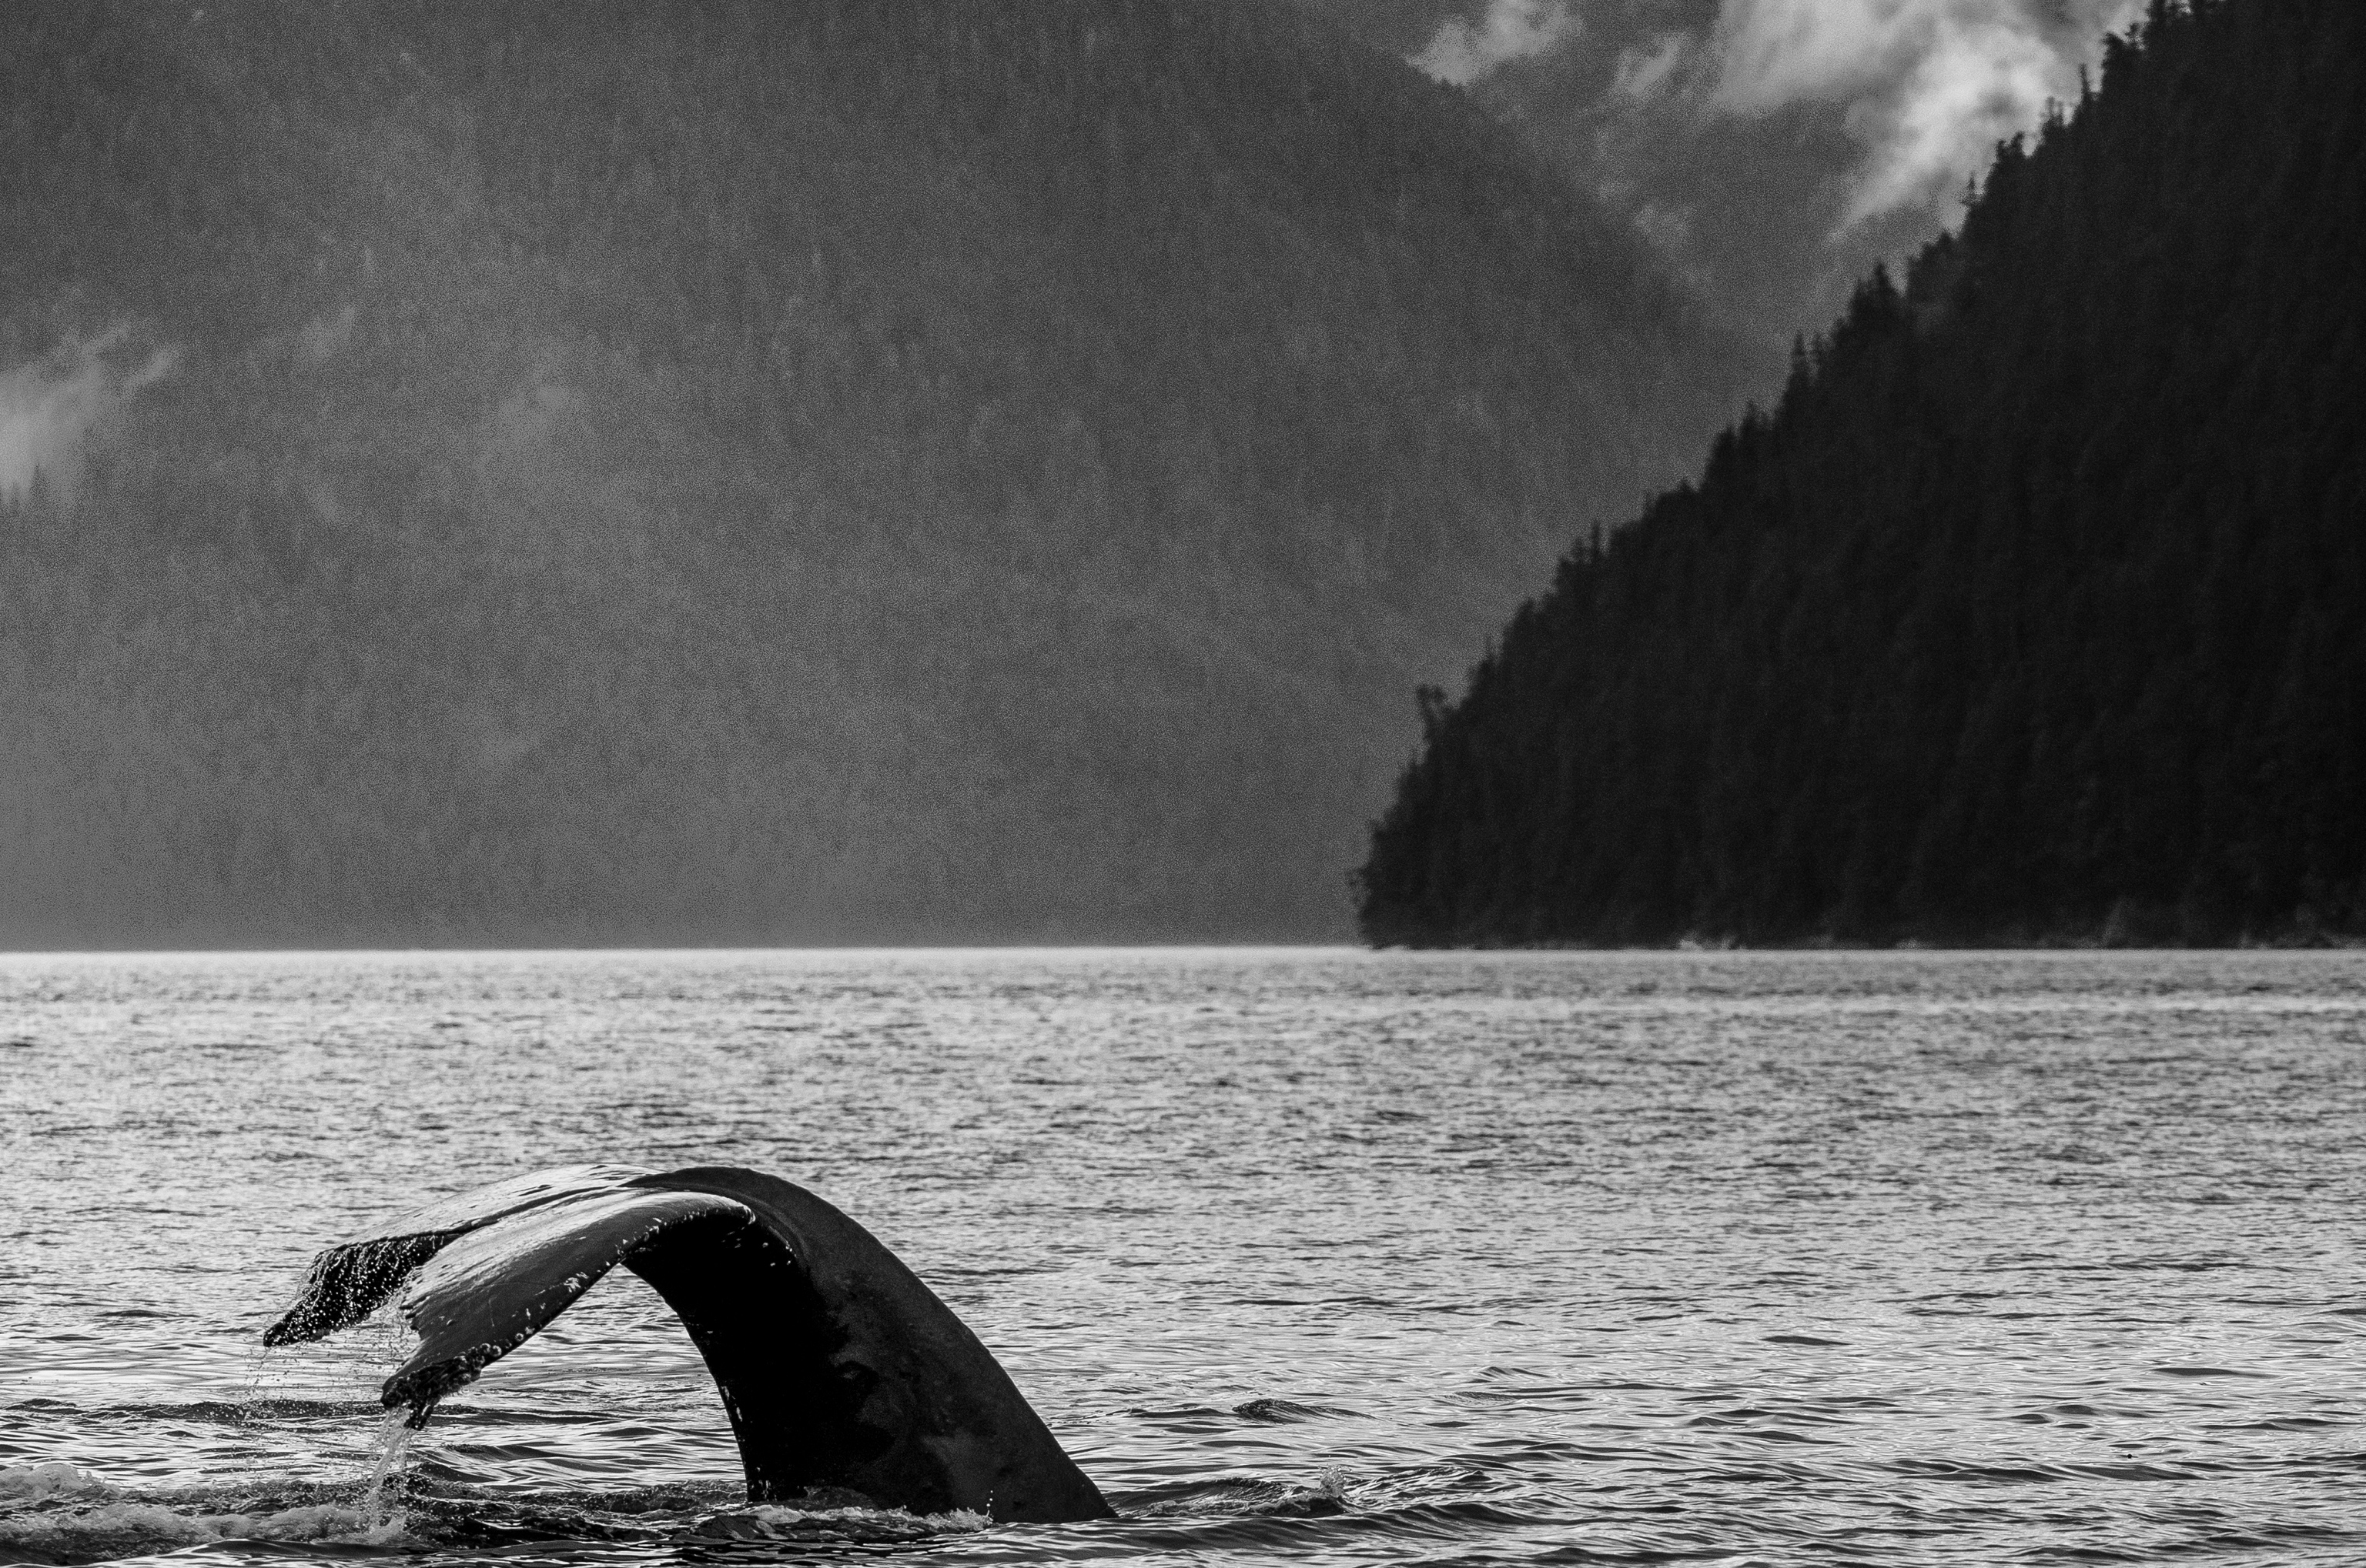
Herring have a central cultural, social,
and ecological role

Slide 24
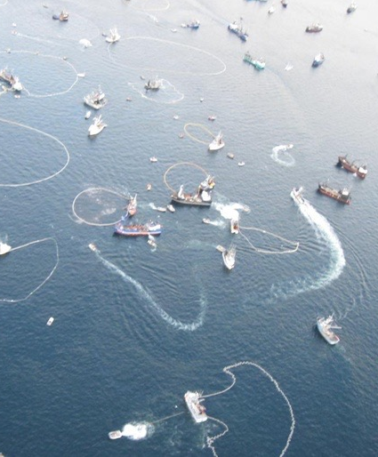
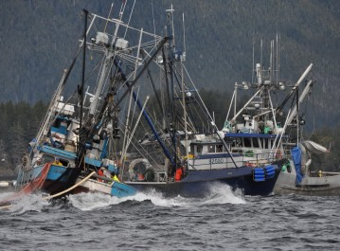
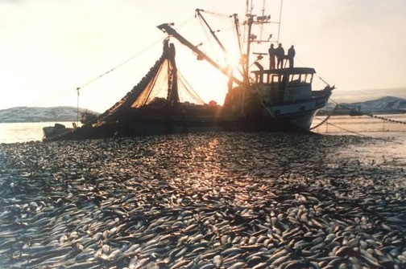
Herring have a central cultural, social,
and ecological role

Slide 25
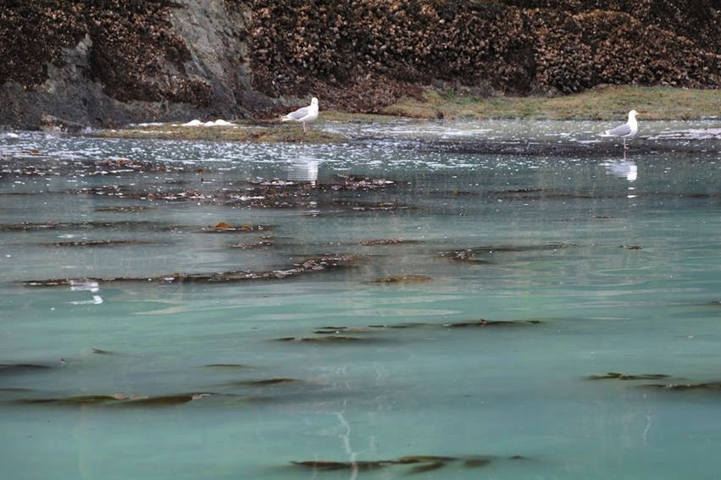
Herring have a central cultural, social,
and ecological role

Slide 26
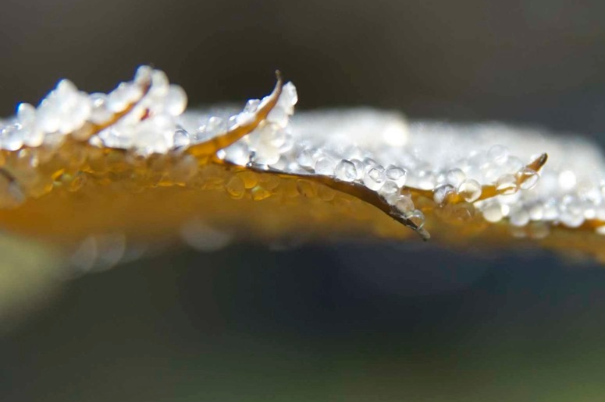
Herring have a central cultural, social,
and ecological role

Slide 27
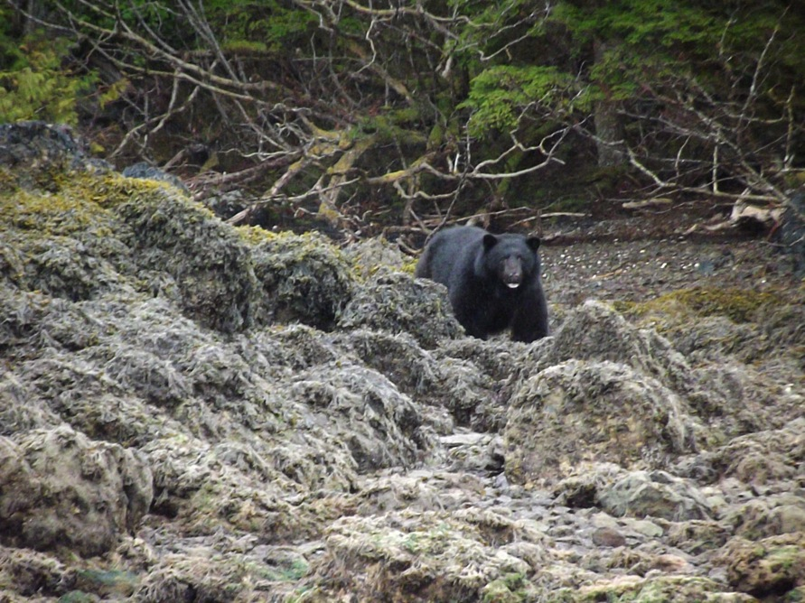
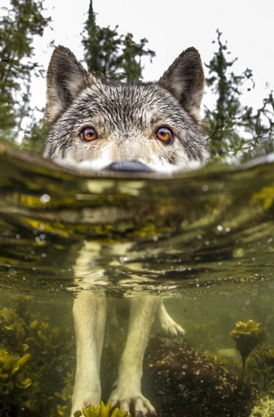
Herring have a central cultural, social,
and ecological role

Slide 28
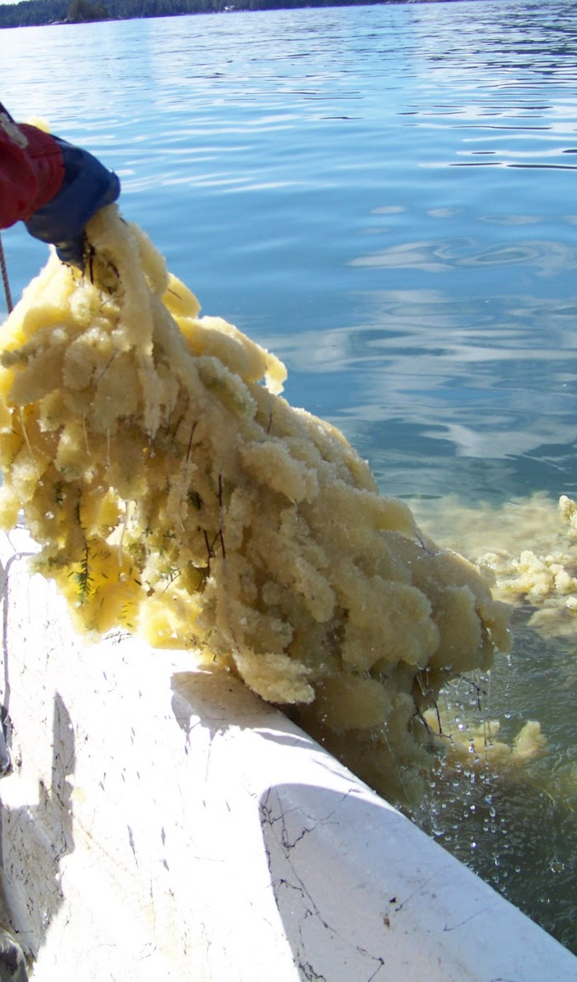
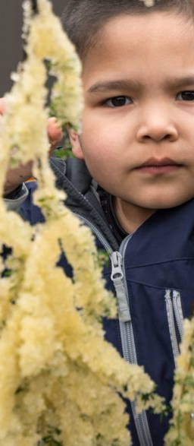
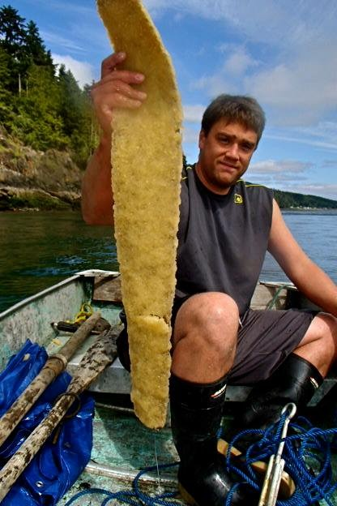
Herring have a central cultural, social,
and ecological role

Slide 29
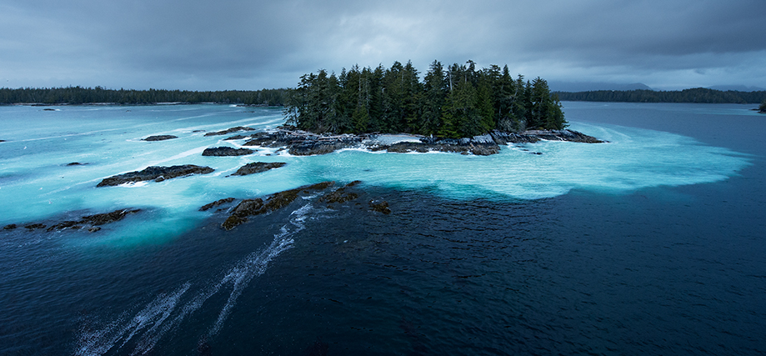
“You just look at a map; everywhere you used to get herring spawn.” - Roy Jones Sr.

Slide 30
0 = “sustainable”
Standardized herring biomass
A Herring
Stock Portfolio
Herring abundance
Notes:
Resilience depends on a portfolio effect.

Slide 31
First Nation members occupy DFO office to
Protest herring fishery

Slide 32
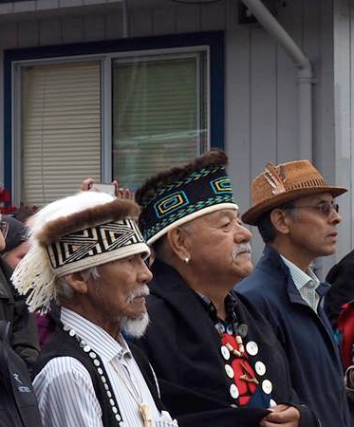
“We used to run out …and see boat after boat after boat getting loaded off one set…It was common to catch 90,000 tons in a day”
-Percy Williams
“They fished every fish out of Rennell Sound and Inskip…”
-Vince Pearson

Slide 33


Only sites that were actually fished
The entire region
Proportion of herring harvested
“sustainable”

Slide 34
A
A
B
B
Gwaii Haanas
60 km

Slide 35


Health

Slide 36
K’aaw (Herring roe on kelp) fills my belly, but mostly it feeds my Haida soul
- Cindy Boyko

Slide 37
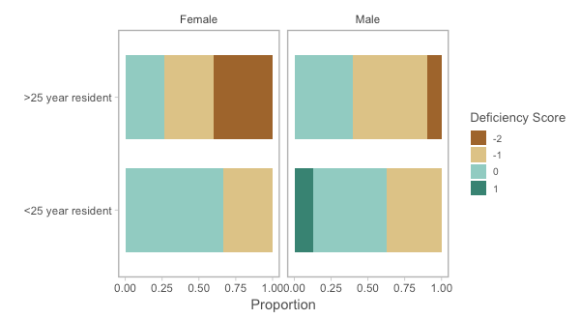
Sufficient
herring?

Slide 38
Sufficient
herring?

Slide 39
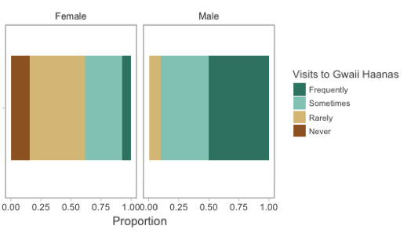
Sufficient
herring?

Slide 40
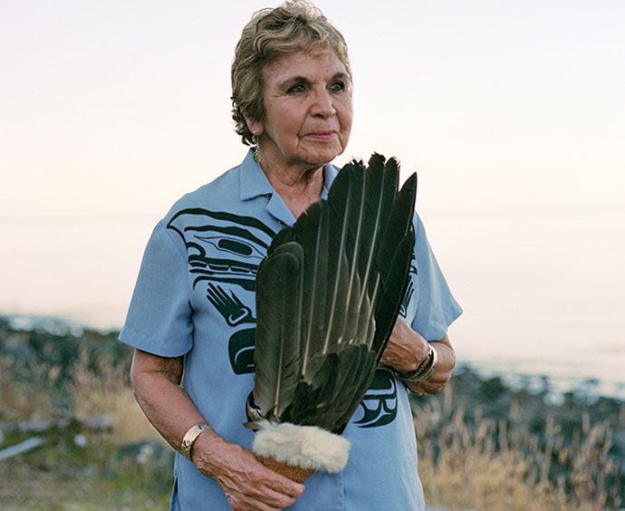
... when I was a kid growing up, all the elders... mostly women got it; it was just women. They used to row out to the different places and load up their little skiffs and row back home and spread it all on the beach at low tide and have it dry on the rock, and then bundle it up and put it away for the winter.
Roberta Olson

Slide 41
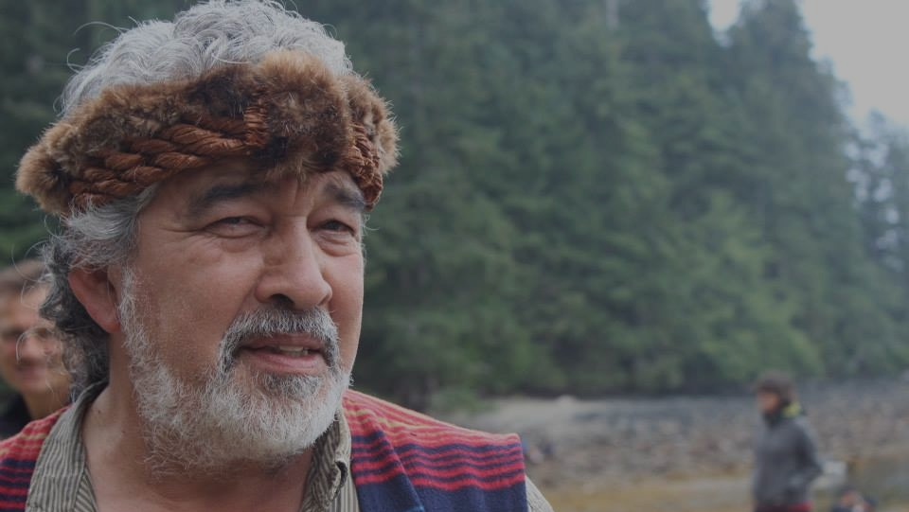
“Herring is central to everything”
-Guujaaw
Keep in touch
with nature.

Slide 42
“The main thing about surviving is to be by the ocean.” – Stephen Brown, Haida Elder
My hopes and dreams for the future are that my grandchildren, my future grandchildren, and their grandchildren will be able to go out on the low tide, harvest herring roe on kelp, and continue to live as we are, on the bounties of the heathy ocean.” – Diane Brown, Haida Elder

Slide 43
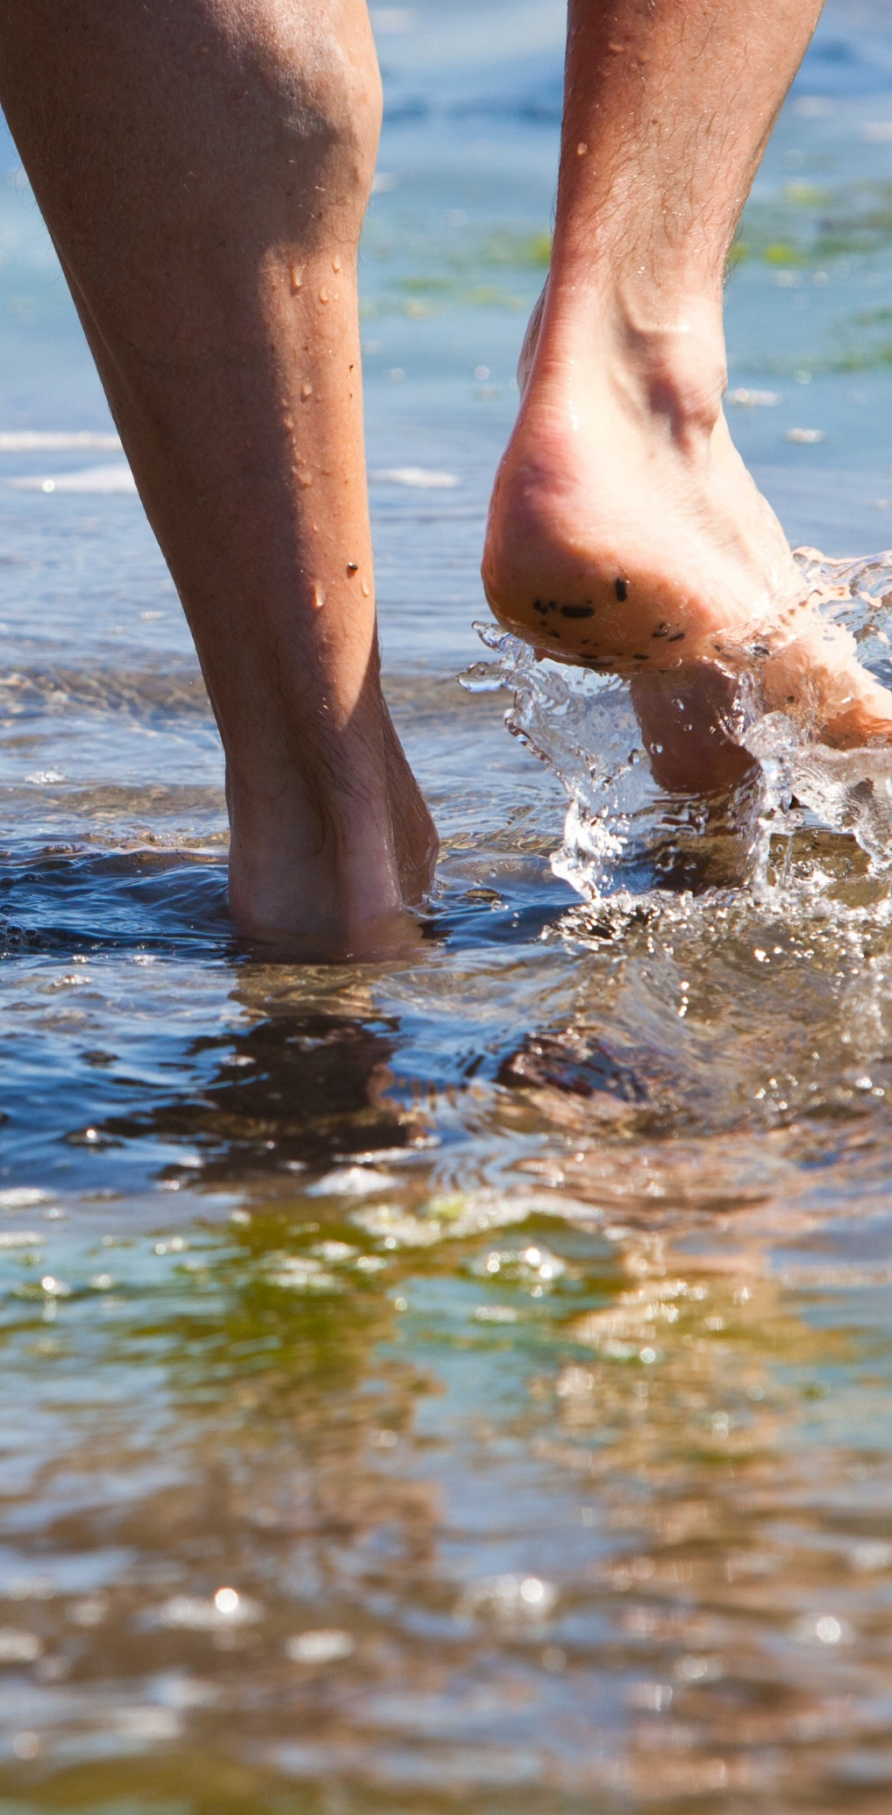
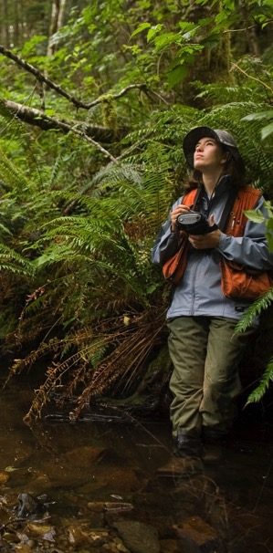
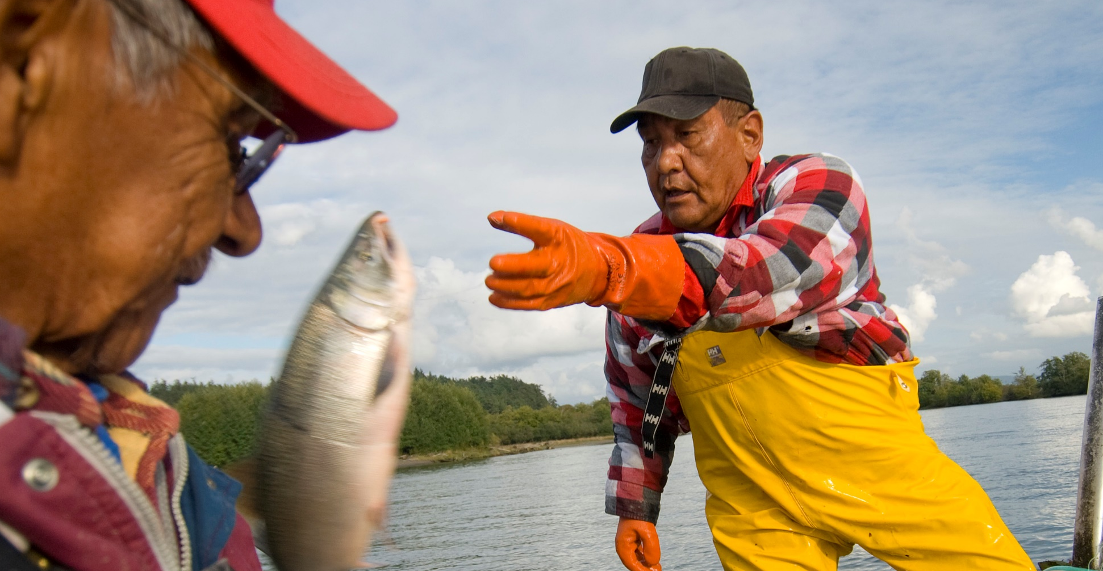
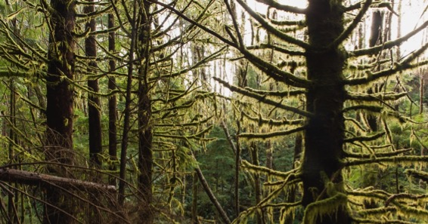
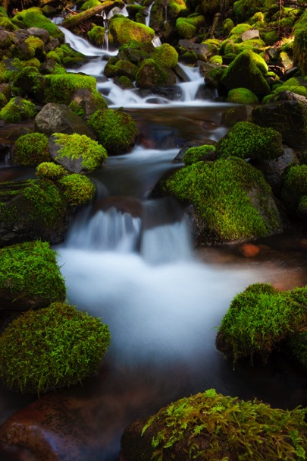


Notes:
And we ALL are not so different from the haida.
Yes, saving our oceans is about the fish and mammals and corals and thousands and thousands of invertebrate species that live there.
But we are all connected.
To the ocean
Ensuring that our oceans are heathly
Ensures that we. Ourselves our also healthy

Slide 44

“Once herring lost the elders, they lost their way to their spawning grounds”
-Chief Gidansta

Slide 45



Slide 46

Use computer models
to ask
what happens to herring stocks if they follow their elders vs. diffuse to closest sites

Slide 47


Slide 49
A Herring
Stock Portfolio
Notes:
Resilience depends on a portfolio effect.

Slide 50
Notes:
Four photo collage; create a few versions, not necessarily representing just one program area in a single version

Slide 51




Notes:
Four photo collage; create a few versions, not necessarily representing just one program area in a single version

Slide 52


