Slide 1
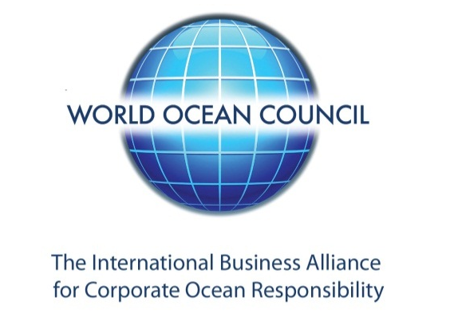
THE BLUE ECONOMY:
Ocean Governance and Private Sector
Leadership, Collaboration and Action
WOC 8th
Sustainable Ocean Summit (SOS)
2020 Dates and Location TBD
Paul Holthus, CEO
World Ocean Council
paul.holthus@oceancouncil.org
www.oceancouncil.org
WOC – the Global “Blue Economy” Business Organization

Slide 2
WOC - the Global Blue Economy Business Organization
Creating Leadership, Collaboration and Action on
Sustainable Development, Science and Stewardship
Private sector is a fundamental, essential partner in ocean sustainable development – understanding the problems and implementing the solutions – and the science supporting sustainable development
Ocean sustainable development and cannot succeed without constructive collaboration with those undertaking ocean economic activities, i.e. ocean business community
Many companies are making significant efforts and progress in responsible ocean economic activity, including science and observations
Leadership companies are increasingly working on international, multi-sectoral ocean sustainability leadership through the World Ocean Council

Slide 3
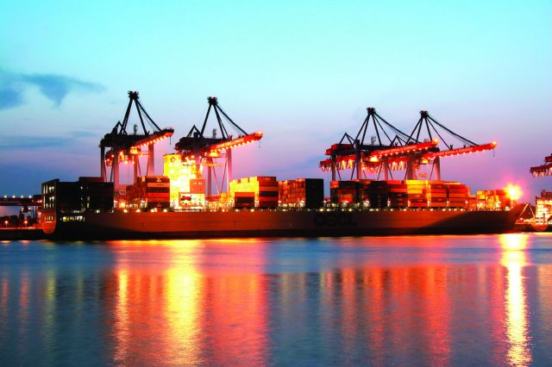
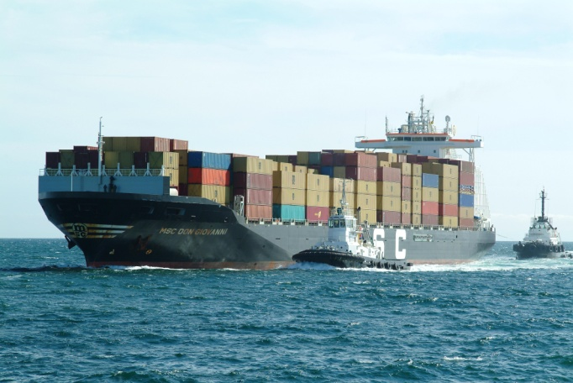
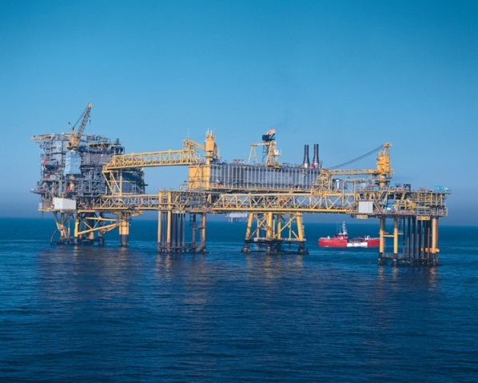
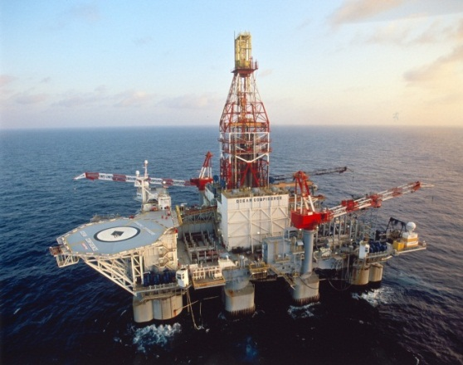
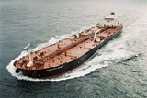
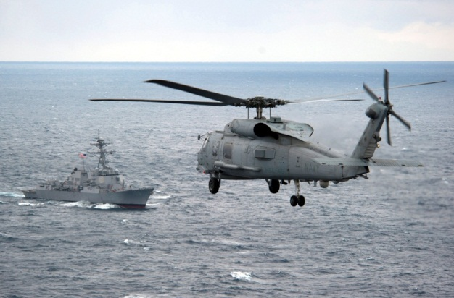
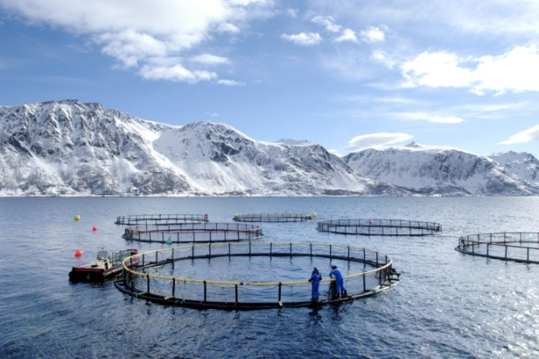
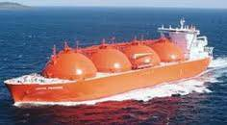
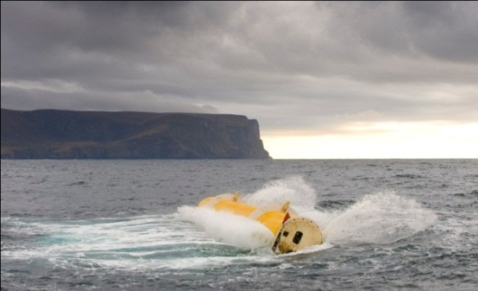
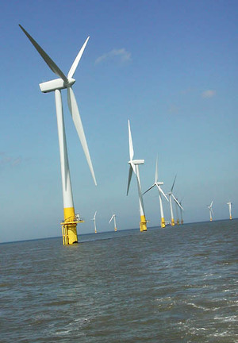
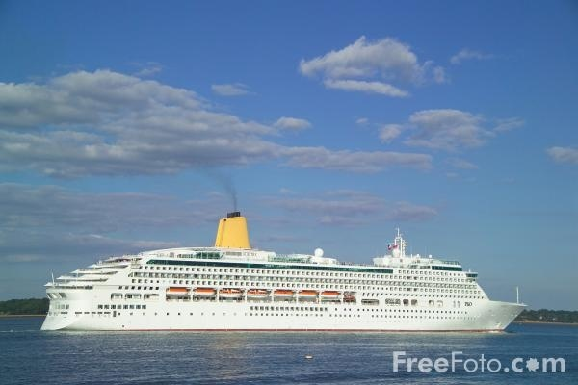
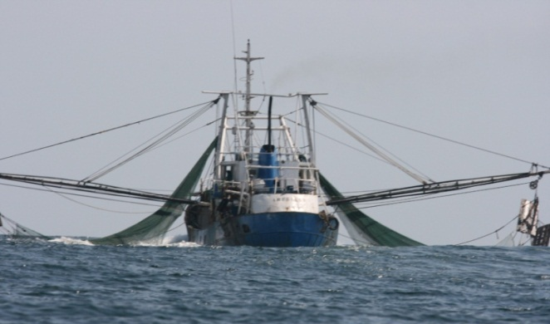

The Multiple Use Ocean
Notes:
As a result of increased ocean use marine areas are becoming more and more crowded.

Slide 4
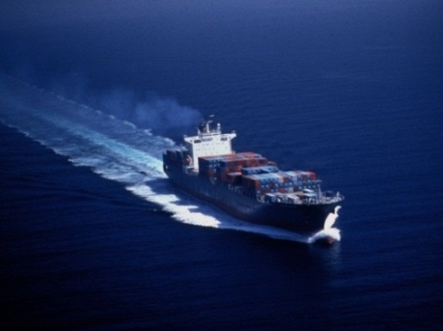

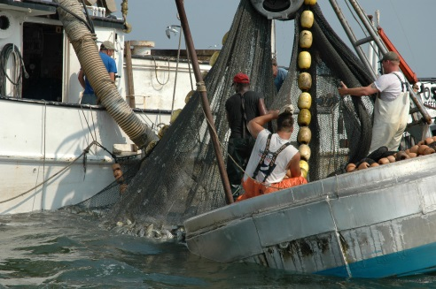
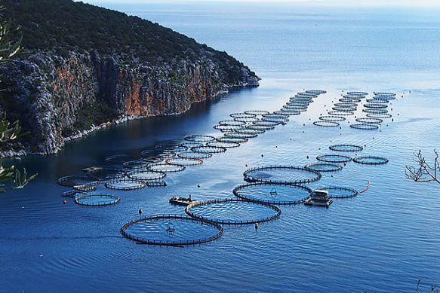



What is Ocean Economy Activity Worth?
Est. $ 4+ trillion/year ocean economic activity
Ocean is critical to economic development
Ocean business community is the primary ocean user
US: $ 282 billion/yr, 2.8 million jobs
China: 9.4% of GDP, 35.5 million jobs
Ireland: € 3.4 billion/yr ocean economy
Pacific Small Island States: $ 3.3 billion/yr for fisheries/tourism
Notes:
When added together ocean economic activity is worth more than $4 trillion dollars per year and accounts for tens (is it more than a hundred million??) of millions of jobs around the world.

Slide 5
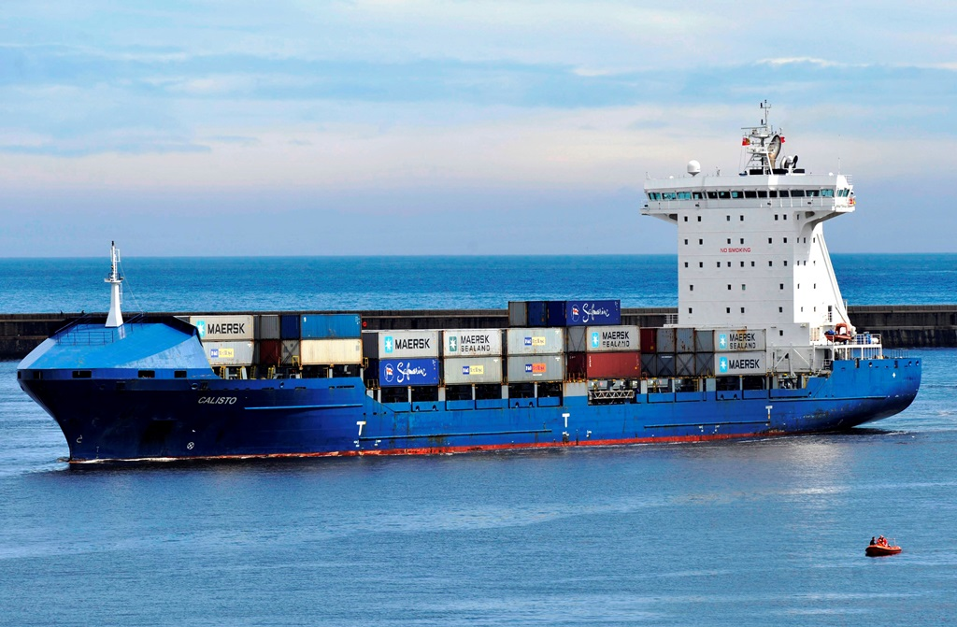
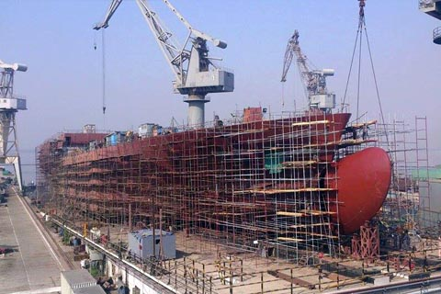
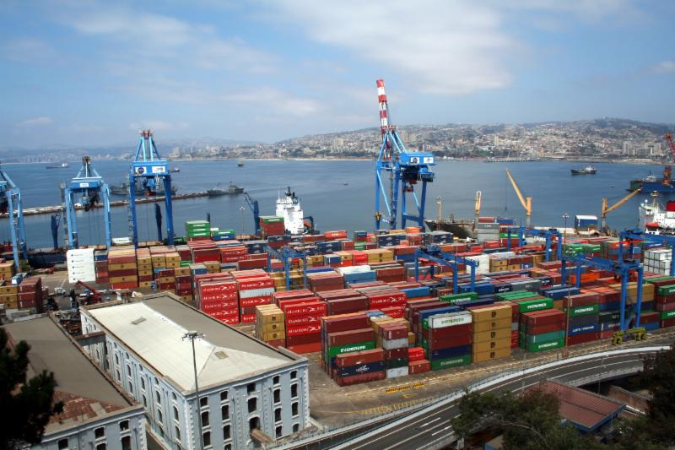
A diverse Ocean Business Community
1. Direct Ocean Users
  Industries that depend on the ocean for the extraction or production of goods (living, non-living, energy) and the provision of services (transport, tourism, etc.)
2. Ocean User Support Industries
  Industries that depend on direct users for their existence (e.g. shipbuilders) or drive ocean industry growth (e.g. extractors, manufacturers, retailers that transport materials or products by sea)
3. Essential Ocean Use “Infrastructure”
  Insurance, finance, legal and other essential services that enable ocean industries to operate
Notes:
When we talk about the ocean economy, remember that we are not just talking about businesses directly operating in the ocean. We also have to include:
Ocean user support industries who build vessels and infrastructure for ocean use (shipbuilders, renewable energy designers)
Drivers of ocean industry growth who depend on the ocean for transportation (huge manufacturing and retail companies)
Essential insurance, financial and legal services that enable ocean industries to operate.

Slide 6
Growing Ocean Use
Cruise and coastal tourism
Shipping
Mariculture/Aquaculture
Offshore oil and gas
Mining / Seabed mining
Fisheries
Dredging
Submarine cables/pipelines
Offshore wind energy
Wave/tidal energy
Ports/marinas
Recreational boating/use
Desalination
Navy/military use
Carbon sequestration
Expanding
Kinds of use
Levels of activity
  Duration
  Intensity
  Frequency
Location of activity
  Geographical Extent
  Frequency
Finance/Investment
Insurance
Maritime Legal
Diverse ‘ecosystem’
of support sectors
Notes:
Here you can see the diverse sectors of ocean industry that are driving growing ocean use. The kinds of use, levels of activity and location of activity are growing.

Slide 7

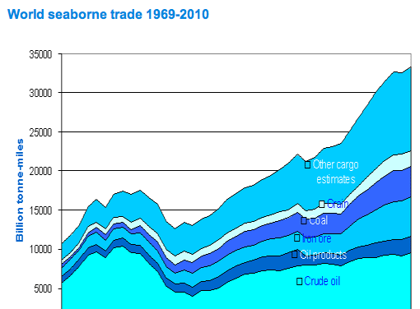
SHIPPING
90% of global trade
Container shipping has increased by 10% / year since 1985
50,054 ships (2010)
Bulk carriers, container ships, tankers, passenger ships
Notes:
These slides are relatively self explanatory and don’t require a great deal of explanation…

Slide 8
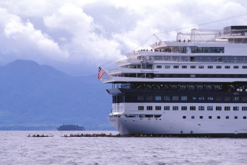
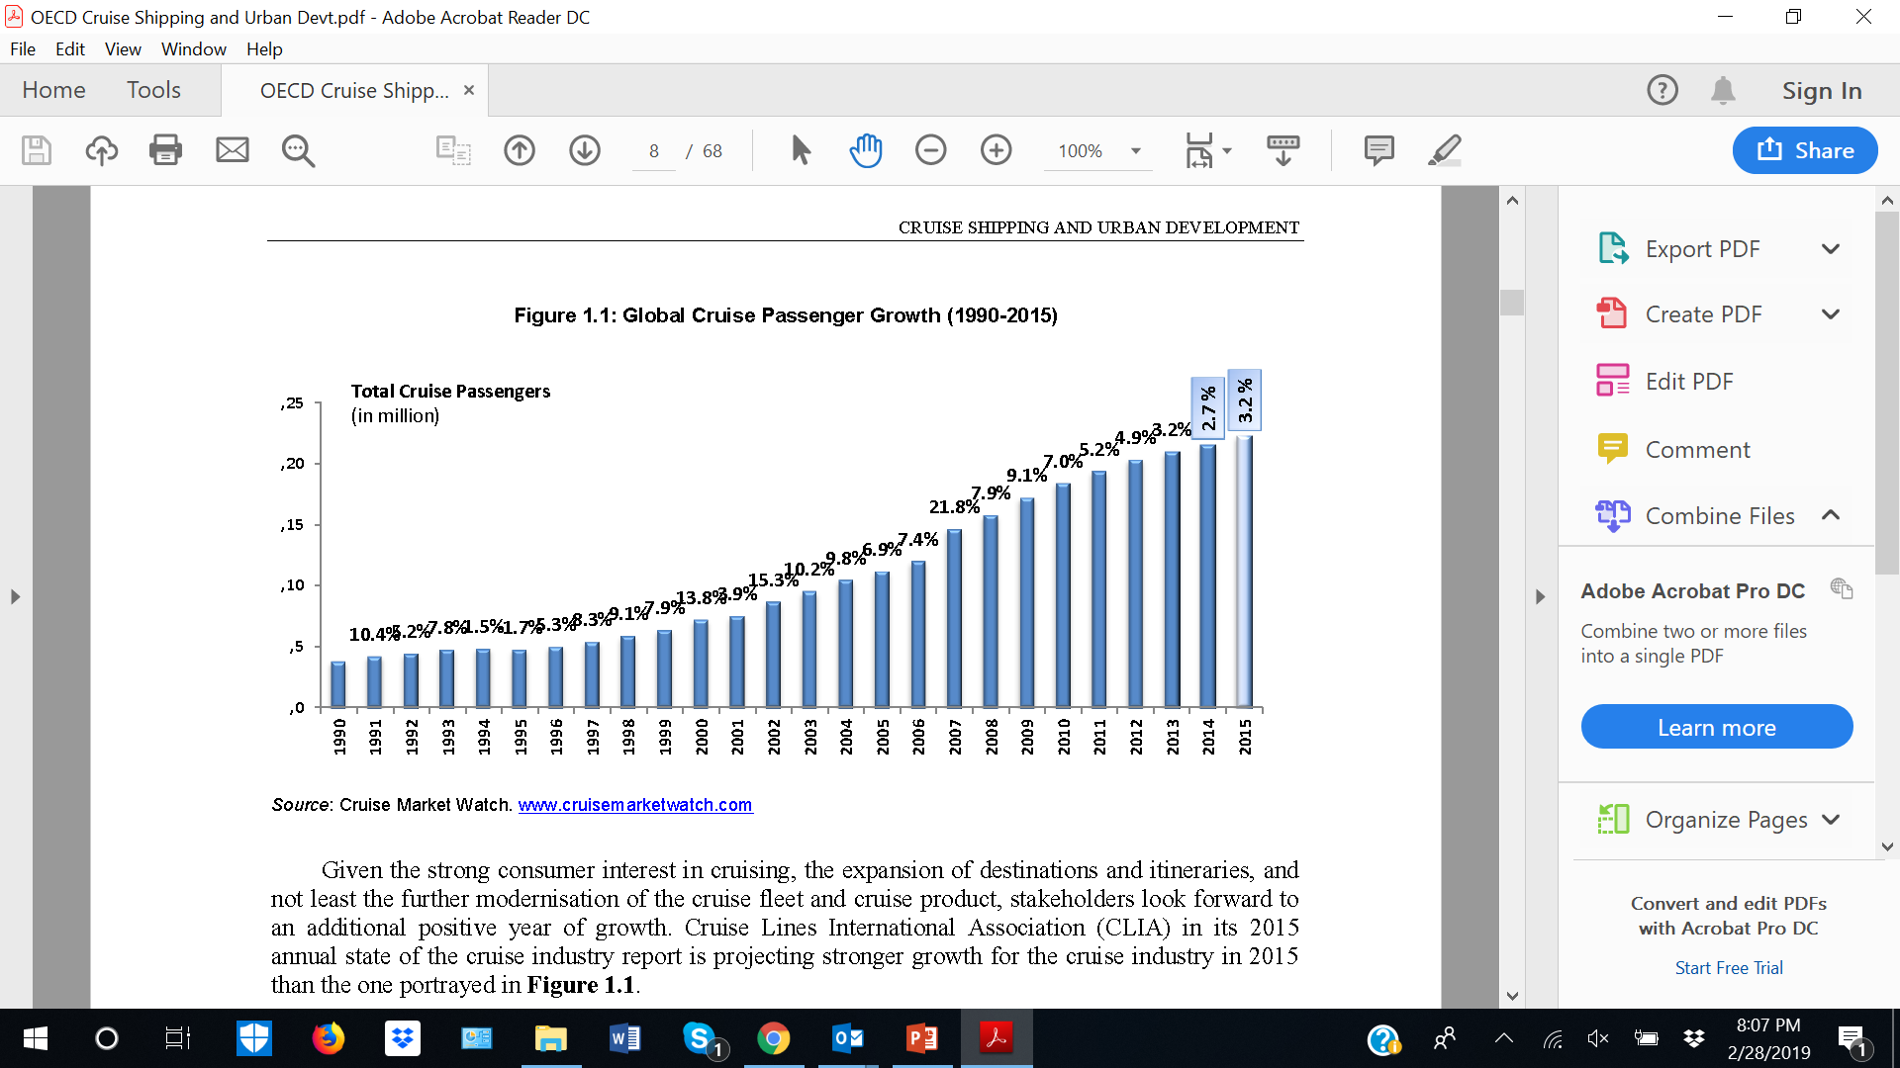
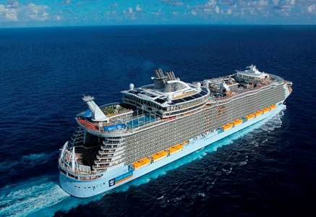
CRUISE LINE TOURISM
25 million passengers in 2017
Demand grew at 20.5% per year over past 5 years
Global fleet: 341 ships (92 megaships, > 2000 berths)
50 ships on order for 2018-2023
Europe: up 12% from 2009, now 33% of global market
Asia: up 10-40% from 2009 in various countries
New destinations: Africa, Australia, Indonesia, Arctic
Cruise line passengers

Slide 9
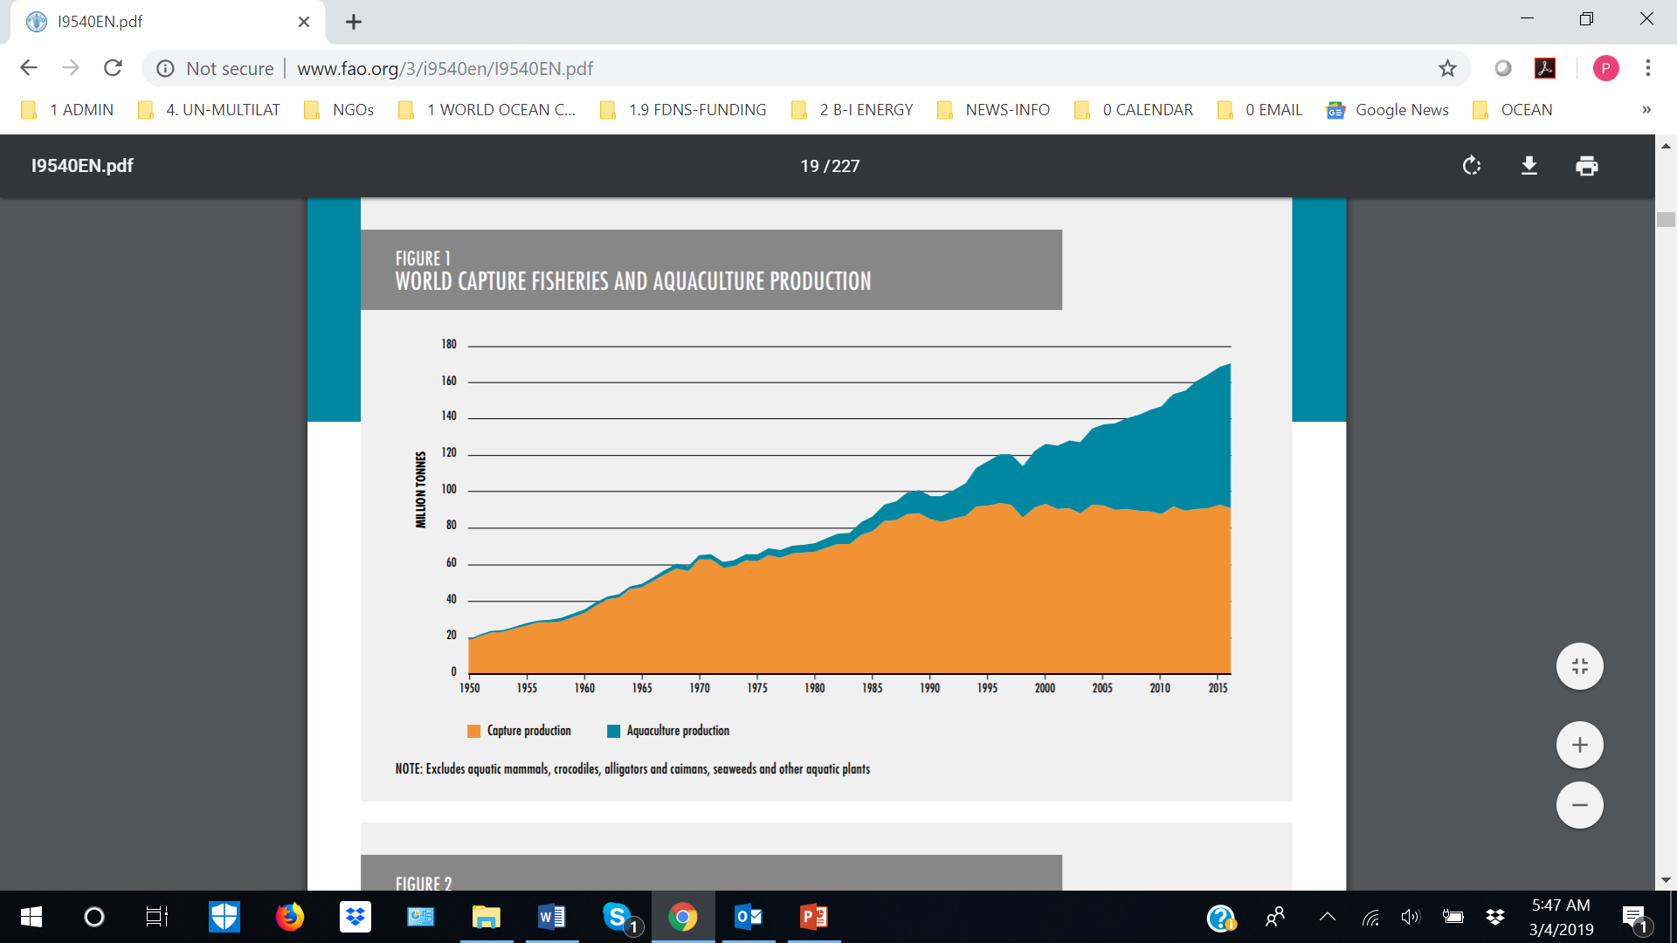
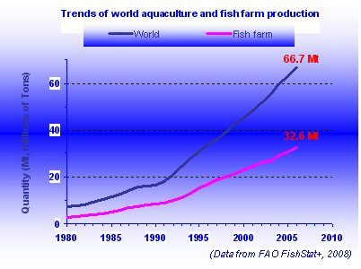
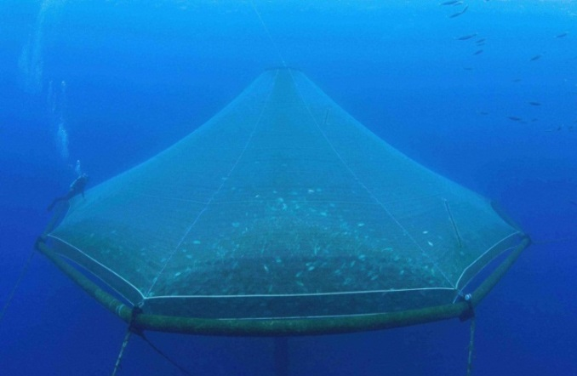
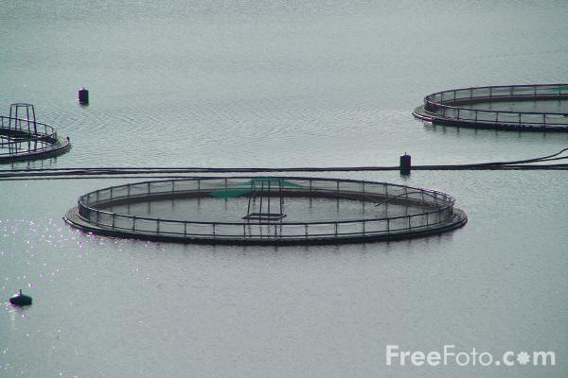
AQUACULTURE
Fastest growing food production system
7.5%/year growth over past twenty years
By 2030, 65% of fish protein
Further offshore, deeper
By 2050, 30 Mt/year of extra aquatic products required to feed the planet

Slide 10
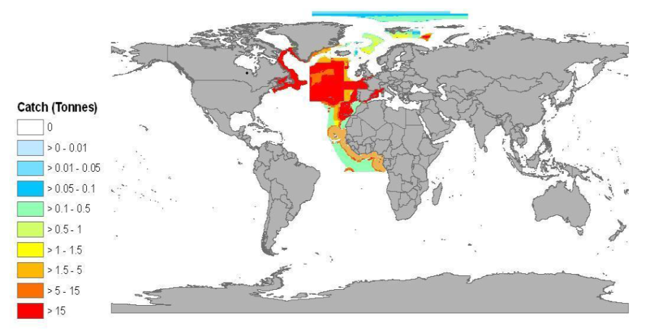
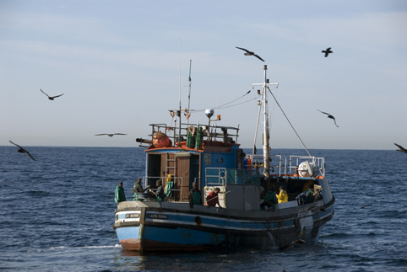
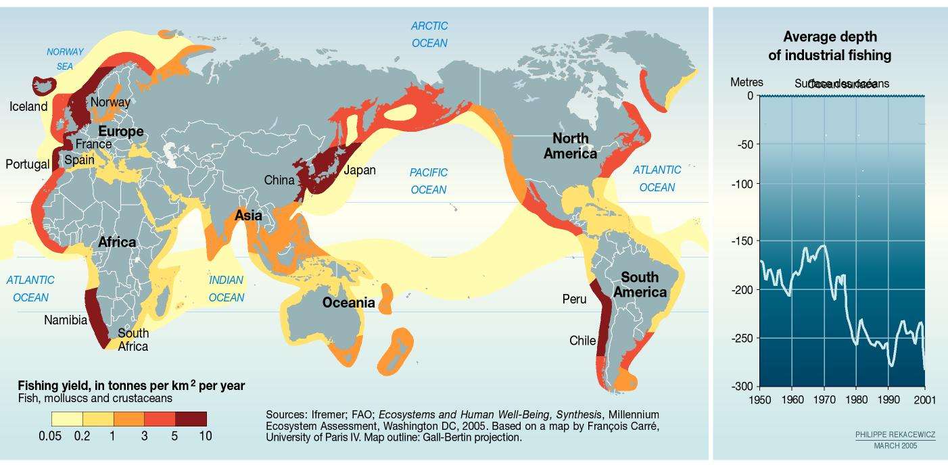
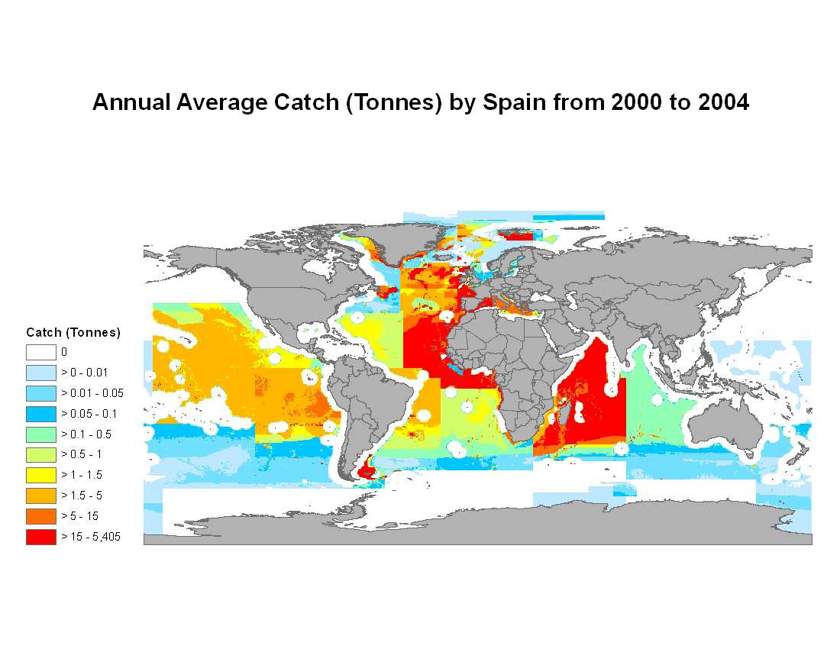
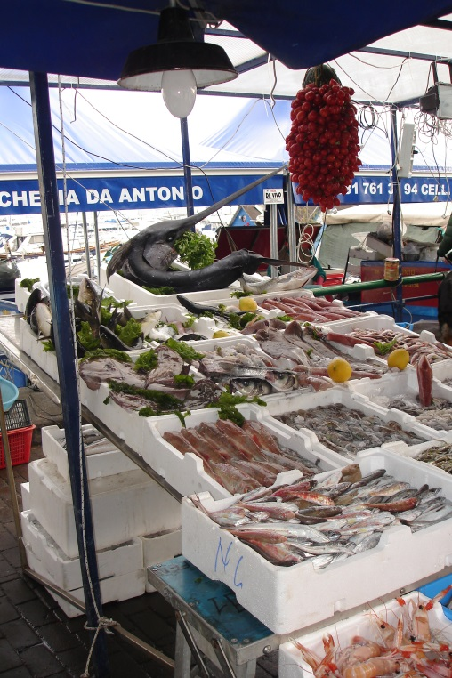
FISHERIES
Fisheries are moving further
offshore and deeper
79 million tons produced marine capture fisheries in 2016
35 million directly linked jobs
Livelihoods for 300 million
Average catch areas: 1950s
Average catch areas: 2000s

Slide 11
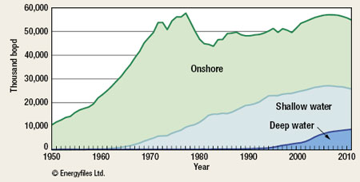
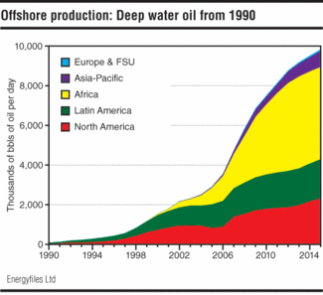
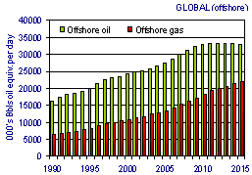
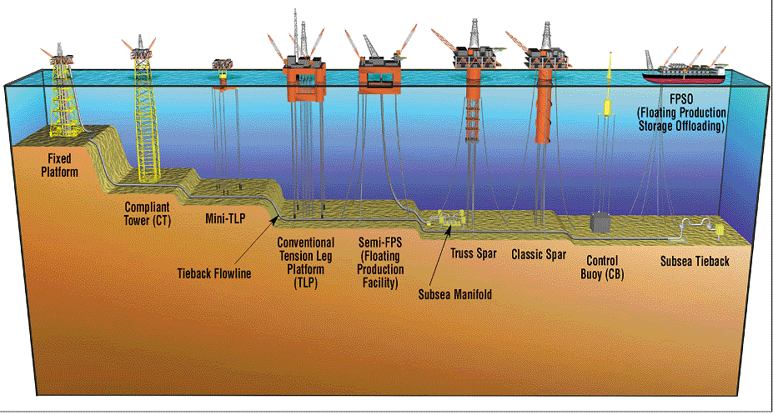
OFFSHORE OIL AND GAS
Currently, 32% of global hydrocarbon production
45% of recoverable oil is offshore
By 2035, deep-sea oil and gas production will double

Slide 12
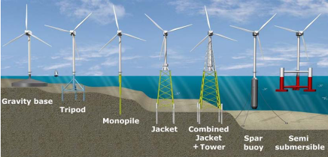
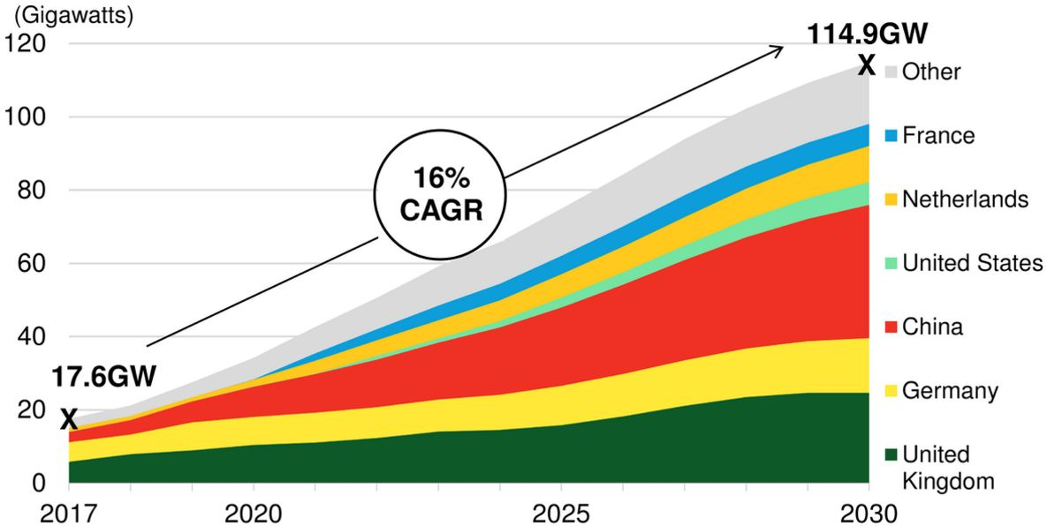
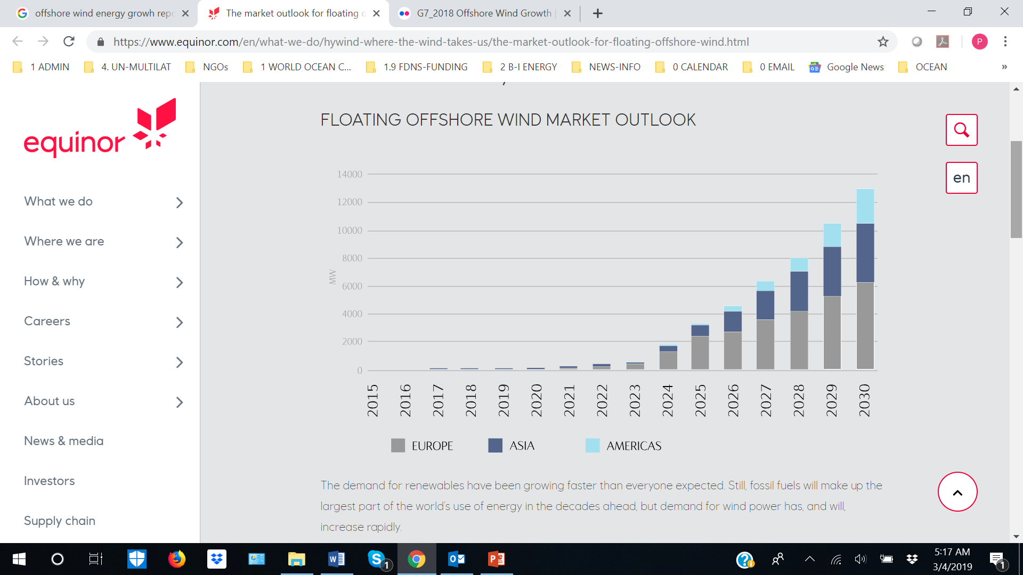
OFFSHORE WIND ENERGY
Offshore farms in 15 countries
By 2020, Europe will need:
20 turbine installation ships
200-300 support vessels
By 2024, market will exceed USD $ 60 billion
From 2020, significant growth in floating wind

Slide 13
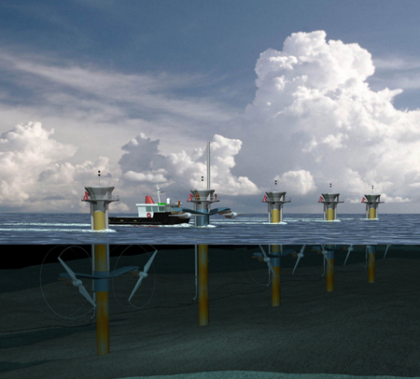
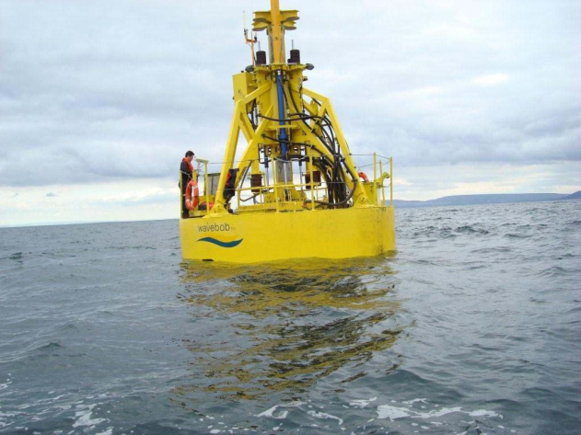

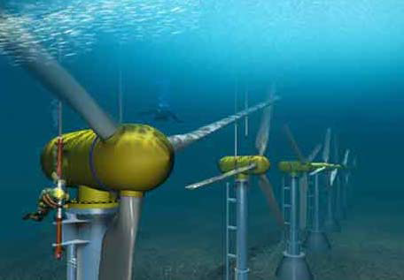
OCEAN ENERGY
Ocean energy potential
Wave: 45,000 TWh/year
Tidal: 1,800 TWh/year
Thermal: 33,000 TWh/year
Salinity gradient: 20,000 TWh/year
EU
By 2020, 1% of E demand
By 2050, 15% of E demand (188 GW)

Slide 14
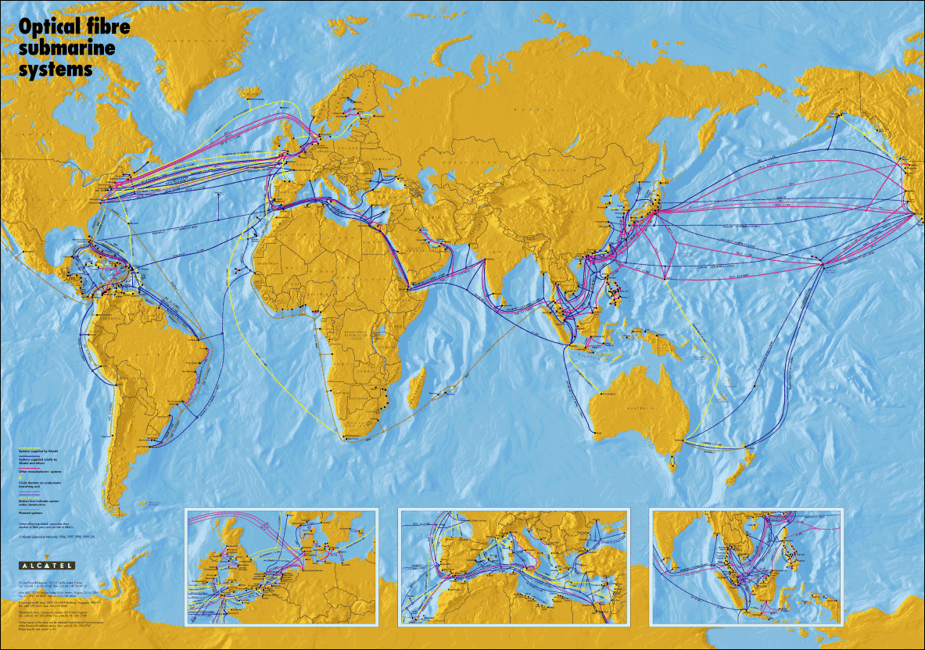
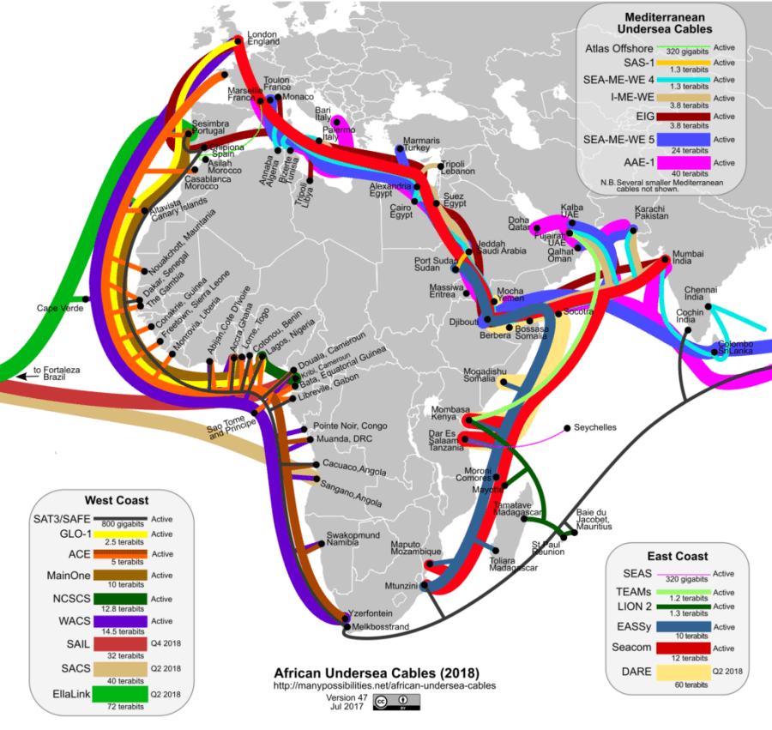
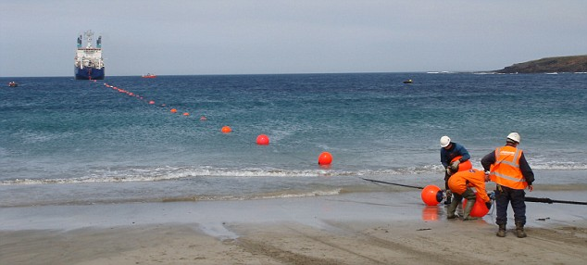
SUBMARINE TELECOM CABLES
More than 1 million km of cables
98% of international internet traffic

Slide 15
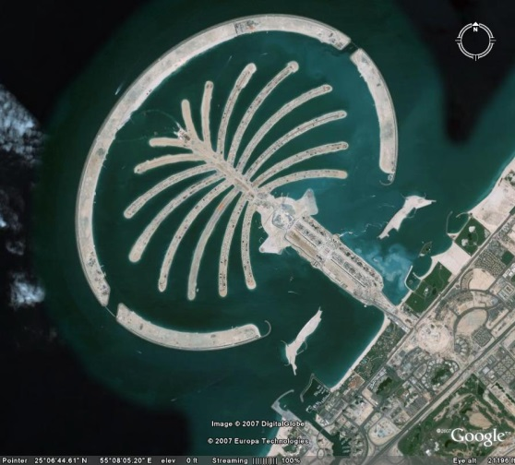
PORTS / COASTAL CONSTRUCTION DESALINATION
Ports: new, expansion, improvement, deepwater, offshore
Coastal: Piers/jetties, shoreline protection
Dredging: extraction, maintenance, landfill, reclamation

Slide 16
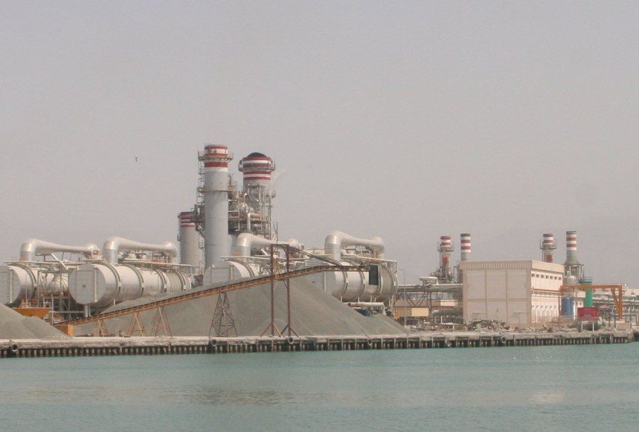
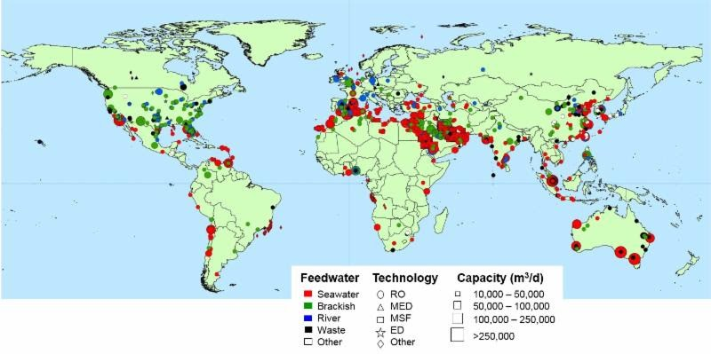
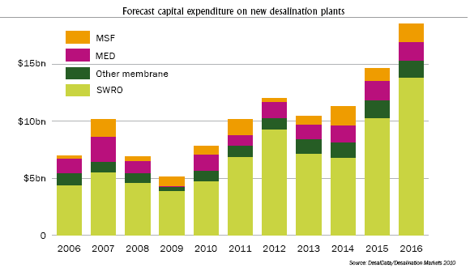
OCEAN WATER: DESALINATION
Desalination:
Doubling every twenty years
By 2025 demand is expected to exceed supply by 56%
Desalination

Slide 17
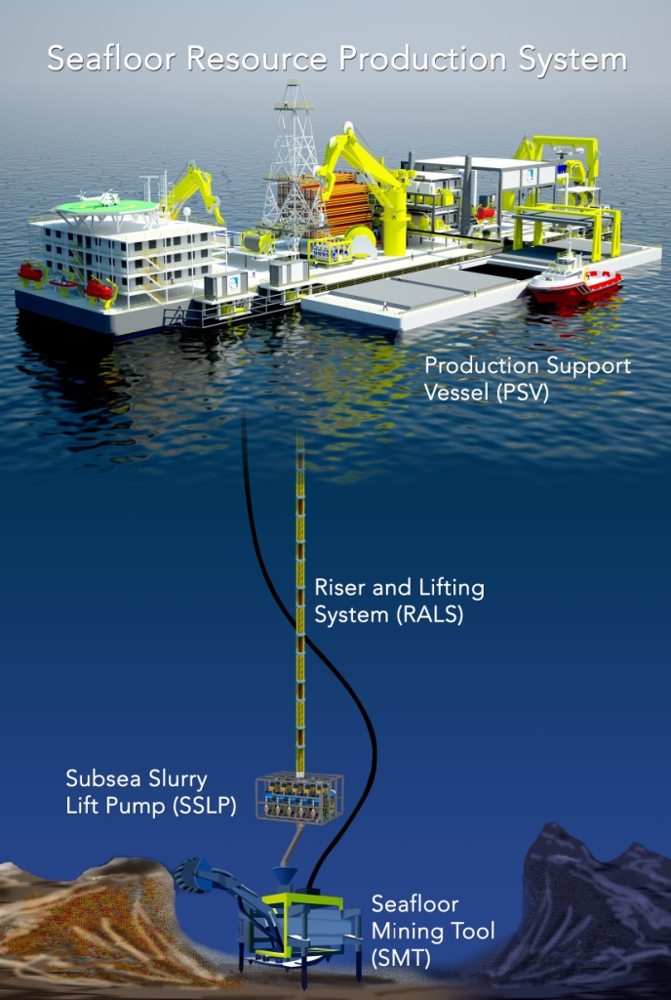


SEABED MINING
By 2030:
10% of world's minerals
$12 billion in economic value
International Seabed Authority leases

Slide 18









LIVING ON THE OCEAN: Present -> Future

Slide 19






Global Ocean Industry Activity
Seabed Minerals
Offshore
Wind
Submarine Cables
Shipping
Offshore Oil/Gas
Aquaculture
Fisheries
Notes:
To understand the role of the World Ocean Council it is important to have a clear picture of international ocean business activity. Over the years ocean use has grown and the types of use have expanded. Human activity in the ocean has grown tremendously in duration, intensity and frequency. The location of these activities has extended geographically all around the world.
[EXTRA – FOR MORE DETAIL] Examples of expanding use are the development of offshore renewable energies, subsea mining, and cruise and coastal tourism – these industries have rapidly blossomed into economic powerhouses.
[EXTRA] Each industry has it’s own sense of what amount/parts of the ocean it needs. As industry use of the ocean has increased, interaction among the different business sectors has grown as well.

Slide 20

Global Ocean Ecosystem Impacts
Notes:
This map is very important for the ocean business community, governments, international organizations and other ocean stakeholders to understand. The ocean is one interconnected ecosystem and therefore ALL of the ocean (at some level or another) is impacted by human activity.
Examples:
Gulf of Mexico 2010 oil spill exemplified how even the best managed fisheries can become exposed to the impacts of other commercial activities by no fault of their own.
The sources of impacts are often much less visible. For example, pathogens accidently introduced from shipping ballast water in the Arabian Gulf have created harmful algal blooms which have completely shut down some fisheries in the region.

Slide 21
New Risks / Opportunities for Ocean Industries
Precautionary Approach
+ Marine Protected Areas
+ Ecosystem Based Management
+ Marine Spatial Planning/Ocean Zoning
+ Marine Biodiversity/ Marine Mammal Concerns
+ High Seas/Deep Seabed Concerns
+ Ocean Governance Changes
+ Sustainable Development Goals (SDGs)
+ Climate Change/Sea Level Rise
+ Plastics
= an increasingly complex and challenging business environment for ocean industries
Smart companies realize the policy, planning and operational risks and opportunities that these trends create
Notes:
These trends that have resulted from the “clash of cultures” are affecting the future of all types of ocean industries. Smart companies will realize that there are both risks and opportunities for dealing with these trends.
At the same time, the ocean operating context is becoming more and more complex. Overall, the health of the marine environment is declining thus explaining converging marine environment and sustainability trends like those listed: (precautionary approach, marine protected areas, ecosystem based management, marine spatial planning, marine biodiversity and deep seabed and high seas concerns).

Slide 22
The Ocean Business Community Challenge
Ocean industries require access and social license to use ocean space and resources
Many of the critical issues creating impacts and affecting access and social license are cross-cutting or cumulative
Sustaining ocean health and productivity requires responsible use and stewardship by all users
Best efforts by a single company, or an entire industry sector, are not enough to secure ocean health
Ocean industries will benefit from collaboration with other sectors to create synergies and economies of scale to address impacts and ensure access and social license
Need structure/process for ocean industry leadership, collaboration and action
Notes:
The “ocean business community challenge”, if you will, is that ocean industries require access and the social license to use ocean space and resources, but most critical environmental issues creating impacts and affecting access and social license are cross-cutting or cumulative. Therefore the best efforts by a single company, or even an entire industry sector, are not enough to secure ocean health. Ocean industries need to create synergies and economies of scale to address impacts and ensure access and social license, and there is a need for a structure/process for this leadership and collaboration.

Slide 23
World Ocean Council (WOC)
International, Cross-Sectoral Business Leadership Alliance
  Bringing ocean industries together, e.g. shipping, cruise tourism, fisheries, aquaculture, offshore renewables, oil/gas, investment, etc.
  Catalyzing private sector leadership, collaboration and action in:
    Advancing “Corporate Ocean Responsibility”
    Responsible ocean business and investment
  75+ members globally; 100’s of actively engaged companies; 34,000+ in global network
    WOC Membership includes Research, Scientific and Academic institutions
Goal: Healthy, productive global ocean and its sustainable use and stewardship by responsible ocean business community
Creating business value for responsible companies
  Access and social license for responsible ocean use
  Synergies and economies of scale in addressing issues
  Stability and predictability in ocean operations
Notes:
The World Ocean Council is an international business leadership alliance bringing together leadership companies from across the spectrum of ocean users to collaborate on stewardship of the seas. The different sectors working with WOC include fishing, shipping, oil & gas, renewables, maritime law, and many others. WOC is working collectively with these different business sectors on a range of policy, planning, technical and scientific issues that affect the future of the ocean and business in the marine space. We have a growing numbers of members currently comprising over 80 companies big and small from around the world and a growing network of over 35 thousand ocean industry stakeholders.
It is important to understand that there are people working to make a living in ocean industries that care about the future of the ocean for their children and grandchildren, and in order to protect the ocean we need to work with these people. Our members share the goal of a healthy and productive ocean and the responsible use of marine space. The goal of the WOC is also driven by common business interest. Companies want access to marine space and the “social license” to operate – in other words the agreement of society and pressure groups that you can responsibly conduct business in the ocean space. Businesses need access to marine space and derive value from showing the public that they are responsible ocean stakeholders.
(Suggestion – perhaps this slide could be broken up into two slides. There is a huge amount of data on this one slide and all of it is very important to the overall presentation so we don’t want to leave any of it out. This could be separated into two slides, one saying who the WOC is and the second saying what we do)
(A second comment – I don’t understand exactly how WOC provides companies with access to marine space. I think this is important to an overall understanding of the organization so I would really appreciate if either Christine/Paul could explain this to me in an e-mail or something. Thanks!)

Slide 24

WOC Partnerships and Formal Recognition
UNESCO Intergovernmental Oceanographic Commission (IOC) – Partnership Agreement
UN World Meterological Organization (WMO) – MOU
Group on Earth Observations (GEO) – Accredited Partner
International Hydrographic Organization (IHO) – Official Observer
UN International Seabed Authority (ISA) – Accredited Observer
UN Convention on Biological Diversity (CBD) – Accredited to SBSTTAs and COPs
International Whaling Commission (IWC) – Accredited Observer
UN Framework Convention on Climate Change (UNFCC) – Accredited to COPs
Ocean Climate Platform – Accredited Partner
China Belt and Road Network – Partner
International Standards Organization (ISO) – Underwater Acoustics Sub-Committee
Global Business Alliance for Sustainable Dev’t, Int’l Chamber of Commerce (ICC) – Member
Federation of Indian Chambers of Commerce and Industry (FICCI) – MOU
WOC: First ocean industry organization invited to address
UN General Assembly

Slide 25

WOC: Industry Leadership, Collaboration, Action
  Cross-Cutting Framework for Leadership, Collaboration and Action:
Sustainable Development Goals (SDGs)
Coordinated, proactive business community efforts to develop ocean industry SDG targets and indicators
Ocean Investment Platform
A forum for industries, innovators, investors to accelerate investment in ocean sustainable development
Young Ocean Professionals Network
Bringing together future leaders in Corporate Ocean Responsibility from across the sectors worldwide
Regional Ocean Industry Leadership and Collaboration
Arctic, Mediterranean, W. Indian Ocean, etc.
Sustainable Ocean Summit (SOS)
The only annual global, multi-industry gathering developed by and for
the business community, focused on sustainable development
(7th SOS, Paris, 20-22 Nov, 2019)

Slide 26

SDGs and Ocean Business Action
What do the SDGs and the Ocean SDG 14 mean for the ocean business community ?
For the ocean business community as a whole ?
  Especially the broad, cross-cutting Ocean SDG targets:
    Reducing pollution, avoiding ecosystem impacts, increasing protected areas ?
How can ocean industries provide leadership and collaboration to ensure the DGs for the ocean…
  …are practical and implementable ?
  …support responsible economic activity ?
  …advance development that can be sustained ?
How can industry, governments,
and other ocean stakeholders
best collaborate on ocean sustainable development ?
Notes:
WOC is conducting a detailed analysis of the SDGs and what they mean to ocean industries. We are working with the ocean business community to identify specific targets and indicators to provide a more operational interpretation of the SDGs for business and to link up with the international commitment undertaken by all of our governments through the UN.

Slide 27
WOC Ocean SDGs Initiative
2015
Inform ocean business community about SDGs (ongoing)
Analyze SDGs re ocean industries (report completed)
2016
Begin developing draft targets/indicators with/for ocean business community
Ocean SDG Targets for Business: WOC Sustainable Ocean Summit
2017
Develop draft targets/indicators with/for ocean business community
UN global event Ocean/SDG 14 conference (5-9 June)
- WOC partnership with President of UN General Assembly for industry involvement
Ocean industry SDG 14 Global event: WOC Sustainable Ocean Summit
2018
Continue to develop draft targets/indicators with/for ocean business community
Engage/consult other stakeholders for input
Ocean industry SDG Global event: WOC Sustainable Ocean Summit
Notes:
In 2015 WOC completed a full report of the impact of SDGs for business. In 2016 WOC is developing targets and indicators for the ocean business community to create incentives and tangible goals for businesses to pursue in compliance with the SDGs. We are also working on specific SDG targets for the arctic and have a workshop around the SDGs planned at our annual conference later this year (I’ll discuss this conference more at the end).

Slide 28

Ocean Business and Investment Action
WOC Ocean Investment Platform
An international structure and process to bring together:
Leadership companies from major ocean use sectors
Enterprises that provide the solutions
The investment community
WOC Ocean Investment Platform is bringing value by:
Catalysing interaction among ocean users, solution
providers and investors
Facilitating synergies and economies of scale among investors, innovation initiatives and challenge competitions to more effectively address ocean sustainable development needs and opportunities
Providing a common process to identify, articulate and evaluate ocean industry priorities for investment in innovative sustainability solutions
Creating a network of ocean innovation accelerators, incubators, etc.
Notes:
Similar to the smart ocean/smart industry program, a great deal of the ocean investment platform’s value lies in its ability to provide a common process or system for investors and innovators to link up with each other. This forum will facilitate synergies and economies of scale among these two groups.

Slide 29

Ocean Investment Platform: Progress, Plans
Ocean Investment Platform development is underway:
WOC Sustainable Ocean Summit sessions on Investment and Innovation:
SOS 2015 Singapore, SOS 2016 Rotterdam, SOS 2017 Halifax, SOS 2018 Hong Kong
WOC presentation at Sovereign Wealth Fund Institute Summit (SWFI):
Singapore, Apr 2016; Scottsdale, Feb 2017
WOC “Ocean Day” at SWFI Institutional Investor Forum, Santa Monica, 2018
SOS 2019: “Investing in Ocean Futures: Finance and Innovation for the Blue Economy”
Initial investment portfolio areas under consideration:
Waste reduction/reuse on vessels
Port adaptation/Resilient coastal infrastructure
Marine debris/Port reception facilities
Sustainable aquaculture
Offshore renewable energy
Technology for ocean data collection
Notes:
The platform has been developed to this point at a number of workshops which you can see here. Our initial portfolio areas under consideration include:
Marine debris and port reception facilities
Sustainable aquaculture
Offshore renewable energy
Technology for ocean data collection

Slide 30

Collaboration on Regional Ocean Sustainability
Bringing together the range of marine industries at the regional scale to create cross-sectoral business collaboration on sustainable development, science and stewardship
Priority issues in various regions include:
  Collaborating with inter-governmental bodies
  Reducing water pollution, protecting biodiversity
  Preventing maritime accidents
  Avoiding the introduction of invasive species
  Reducing/cleaning up marine debris
  Improving marine science and observations
Priority regions include:
Arctic, W Africa, W Indian Ocean, Caribbean, Mediterranean, Coral Triangle
Notes:
At the regional level we are bringing together ocean leadership companies to coordinate on region-specific issues. Businesses have expressed great interest in regional coordination as each region has it’s own particular set of issues and concerns.
We have a number of priority regions including the Arctic, Africa (this seems incredibly general…), West Indian Ocean, and the Caribbean.

Slide 31


Priority Areas for Action (1)
Improving Ocean Governance, Policy and Planning
- UNCLOS/BBNJ, UNFCCC, SDGs, Convention on Biological Diversity …
- Marine Spatial Planning
      Inter-industry Conflicts/Synergies
Reducing Anthropogenic Impacts
- Biofouling/Invasive species
- Marine sound
- Plastics/Port Reception Facilities
Conserving Marine Biodiversity
- Marine protected areas
- Marine mammal ‘Ship strikes’
Ensuring Food Security
- Sustainable fisheries/reduced IUU fishing
- Sustainable aquaculture
Notes:
The WOC is bringing the ocean business community together to work on these key areas, or global issues platforms:
Ocean policy and Governance: informing and involving business in major ocean policy and decision making processes such as the Convention on Biological Diversity (CBD) and the amendments to the Law of the Sea such as the ongoing discussions on a legally binding agreement on Biodiversity Beyond National Jurisdiction (BBNJ).
MSP: Marine Spatial Planning.
Operational Environmental Issues: A range of cross-cutting environmental issues including marine sound, marine mammal interactions and biofouling.
Regional Councils: Developing regional ocean business councils around the world, particularly in the arctic.
Smart Ocean/Smart Industries: WOC is connecting the ocean business community with research organizations with the goal of using business vessels as tools for scientific data collection.
Sea Level Rise/Extreme Weather: Getting business involved in international environmental threats such as sea level rise and extreme weather events.
→ SDG Goals: Working with the ocean business community to collectively identify targets and indicators for the next 15 years in order to try and meet the sustainable development goals.
→ Ocean Investment Platform: A platform to bring the investment community together with industries and innovators providing solutions to ocean challenges in order to accelerate investment and cash-flow into these projects.

Slide 32


Priority Areas for Action (2)
Improving Ocean Knowledge (SDG14a)
- SMART Ocean - SMART Industries:
      Data collection from Industry “Ships/Platforms of Opportunity”
Reducing Disaster Risk
- Port/coastal infrastructure adaptation and resilience
Addressing Climate Change
- Ocean NETs: Negative Emissions Technologies in the ocean
- Ocean acidification
Advancing Low Carbon Energy from the Sea
- Ocean-based renewable energy
Notes:
The WOC is bringing the ocean business community together to work on these key areas, or global issues platforms:
Ocean policy and Governance: informing and involving business in major ocean policy and decision making processes such as the Convention on Biological Diversity (CBD) and the amendments to the Law of the Sea such as the ongoing discussions on a legally binding agreement on Biodiversity Beyond National Jurisdiction (BBNJ).
MSP: Marine Spatial Planning.
Operational Environmental Issues: A range of cross-cutting environmental issues including marine sound, marine mammal interactions and biofouling.
Regional Councils: Developing regional ocean business councils around the world, particularly in the arctic.
Smart Ocean/Smart Industries: WOC is connecting the ocean business community with research organizations with the goal of using business vessels as tools for scientific data collection.
Sea Level Rise/Extreme Weather: Getting business involved in international environmental threats such as sea level rise and extreme weather events.
→ SDG Goals: Working with the ocean business community to collectively identify targets and indicators for the next 15 years in order to try and meet the sustainable development goals.
→ Ocean Investment Platform: A platform to bring the investment community together with industries and innovators providing solutions to ocean challenges in order to accelerate investment and cash-flow into these projects.

Slide 33


Action on Ocean Policy and Governance
WOC is providing consistent, comprehensive industry presence in inter-governmental negotiations affecting future of the Ocean Economy
UN Law of the Sea
Negotiating new binding “Implementing Agreement” re Biodiversity in Areas Beyond National Jurisdiction (BBNJ), including proposed EIA for commercial activities and area based management in high seas
Convention on Biological Diversity (CBD)
Identifying Ecologically / Biologically Significant Areas (EBSAs) for management, especially for international waters
Notes:
In terms of policy and governance there are a number of key international treaties and conventions that deal with marine space and marine issues. The most important of these is UNCLOS(UN Convention on the Law of the Sea), the major international treaty governing the ocean. There is also the Convention on Biological Diversity which among other things has called for the establishment of Ecologically and Biologically Significant Areas (EBSAs), and the Sustainable Development Goals (SDGs), which were adopted by the UN in 2015 to guide the next 15 years of international economic development. One of the SDGs is specific to the ocean. The World Ocean Council has been the only entity representing the ocean business community in these processes.

Slide 34

Ocean Governance and International Waters
Notes:
In terms of policy and governance there are a number of key international treaties and conventions that deal with marine space and marine issues. The most important of these is UNCLOS(UN Convention on the Law of the Sea), the major international treaty governing the ocean. There is also the Convention on Biological Diversity which among other things has called for the establishment of Ecologically and Biologically Significant Areas (EBSAs), and the Sustainable Development Goals (SDGs), which were adopted by the UN in 2015 to guide the next 15 years of international economic development. One of the SDGs is specific to the ocean.

Slide 35
WOC Ocean Policy Program / Working Group
Increase the level of informed, coordinated, proactive involvement of private sector in ocean governance and policy developments that affect business:
Monitor, analyze and report on ocean policy developments
Ensure industry input to key ocean policy fora, e.g. UN, CBD
Provide updates on ocean governance and policy at key industry events
First-ever Business Forum on Ocean Policy and Planning (New York, 2014)
First-ever “Ocean Policy Review and Analysis for Industry” http://www.oceancouncil.org/site/business_forum/index.php?page=report
WOC UNCLOS-BBNJ Coalition formed (early 2016)
Providing consistent private sector presence: BBNJ PrepComs (2016-2017)
White Paper: “Ocean Governance and the Private Sector” (2017)
Providing consistent private sector presence: BBNJ Negotiations (2018-2020)
Notes:
WOC seeks to increase the level of informed, coordinated and proactive private sector involvement in ocean governance and policy developments that impact business.
The two most important aspects of the Ocean Policy and Governance global issue platform are:
Informing industry by monitoring, analyzing and reporting on ocean policy developments.
Representing the ocean business community and ensuring industry input in key ocean policy events

Slide 36
Ocean Governance and Private Sector
Issues, Needs and Opportunities for Engaging
Industry Involvement In Ocean Governance Development
Ocean Governance Based On Sector-By-Sector Approach
Ocean Data And Monitoring in Support of Ocean Governance
Ocean Surveillance And Maritime Domain Awareness
Cross-Sectoral And Cumulative Impacts To The Ocean
Global Standards For Management Tools And Approaches In Support Of Ocean Governance
Multiple UN And Intergovernmental Agencies And Processes Dealing With Ocean Governance
Regional Institutions And Approaches To Ocean Governance
New And Emerging Ocean Uses
Ocean Geopolitical Challenges To Peace, Security And Stability
(see WOC White Paper: “Ocean Governance and the Private Sector”)
Notes:
The next two important steps for the smart ocean-smart industries global issues platform are:
To develop a joint industry and science steering committee to advice the program.
To further organize and define the program into a structured system for interaction between science and industry by taking some of the steps listed here.

Slide 37
Action on Marine Spatial Planning
Ensure ocean business community is informed of ocean planning process and plans
Examine how ocean planning has worked and review the role of industry
Define and examine the potential business impacts
and benefits of ocean planning
Determine how industry can optimize potential
ocean planning benefits and minimize the impacts
Develop coordinated business community engagement
in ocean planning
Ensure that ocean planning takes into account the viability of responsible ocean economic activities
Notes:
In an increasingly crowded ocean marine spatial planning is essential to mitigate environmental impacts and to ensure operational efficiency and safety. The ocean business community MUST be involved in marine planning as it is the primary operator in the ocean.

Slide 38
















The Sea is Crowded with Many Uses
Tourism
Oil & gas
Coastal defence
Submarine cables
Ireland
UK
Ports & navigation
Fishing
Renewable energy
Military activities
Marine recreation
Culture
Conservation
Mineral extraction
Dredging & disposal
Mariculture
38
Notes:
This map of the Irish Sea is an example of the crowded nature of the ocean and the incredibly high level of marine activity taking place around the world today. As you can see there is clearly a need for MSP to coordinate between the different industries and ensure safety, operational efficiency, and environmental stewardship.

Slide 39


WOC Program on MSP
Create a clear industry understanding about MSP
Examine how MSP has worked and the role of industry
Define and examine the potential business impacts and benefits of MSP
Determine how industry can optimize potential MSP benefits and minimize the impacts
Ensure the ocean business community is fully informed of MSP process and plans
Develop a coordinated business community strategy and action plan for engaging in MSP
Ensure MSP takes into account responsible ocean economic activities
Notes:
(same as previous slide…)

Slide 40



Action on Marine Pollution & Biodiversity
Marine Pollution Reduction
- Plastics/Marine Debris and Port Reception Facilities
- Biofouling/invasive species
- Marine sound
Marine Biodiversity Conservation
- Marine protected areas
    - Ship strikes on marine mammals
Notes:
WOC is actively working with the ocean business community on a number of operational environmental issues, including marine debris, marine invasive species, marine sound, and marine mammal-vessel interactions.

Slide 41



Action on Plastics/Marine Debris
Port Reception Facilities
Need for Adequate (and economical) Port Reception Facilities (PRF’s)
Regional network of PRF’s
Base PRF plans on numbers, types of vessels and waste stream characterization
Create multisectoral ocean business leadership to press for Adequate PRF’s
Notes:
The WOC is bringing the ocean business community together to work on these key areas, or global issues platforms:
Ocean policy and Governance: informing and involving business in major ocean policy and decision making processes such as the Convention on Biological Diversity (CBD) and the amendments to the Law of the Sea such as the ongoing discussions on a legally binding agreement on Biodiversity Beyond National Jurisdiction (BBNJ).
MSP: Marine Spatial Planning.
Operational Environmental Issues: A range of cross-cutting environmental issues including marine sound, marine mammal interactions and biofouling.
Regional Councils: Developing regional ocean business councils around the world, particularly in the arctic.
Smart Ocean/Smart Industries: WOC is connecting the ocean business community with research organizations with the goal of using business vessels as tools for scientific data collection.
Sea Level Rise/Extreme Weather: Getting business involved in international environmental threats such as sea level rise and extreme weather events.
→ SDG Goals: Working with the ocean business community to collectively identify targets and indicators for the next 15 years in order to try and meet the sustainable development goals.
→ Ocean Investment Platform: A platform to bring the investment community together with industries and innovators providing solutions to ocean challenges in order to accelerate investment and cash-flow into these projects.

Slide 42
Action on Biofouling/Invasive Species
Prevention
Coatings
Research and development
Monitoring, data and metrics
Cleaning
New technologies emerging
Testing and increasing use
Monitoring, data and metrics
GloFouling Partnership
GEF, IMO, UNDP, IOC, World Ocean Council
5 year project starting in 2019
Notes:
The WOC is bringing the ocean business community together to work on these key areas, or global issues platforms:
Ocean policy and Governance: informing and involving business in major ocean policy and decision making processes such as the Convention on Biological Diversity (CBD) and the amendments to the Law of the Sea such as the ongoing discussions on a legally binding agreement on Biodiversity Beyond National Jurisdiction (BBNJ).
MSP: Marine Spatial Planning.
Operational Environmental Issues: A range of cross-cutting environmental issues including marine sound, marine mammal interactions and biofouling.
Regional Councils: Developing regional ocean business councils around the world, particularly in the arctic.
Smart Ocean/Smart Industries: WOC is connecting the ocean business community with research organizations with the goal of using business vessels as tools for scientific data collection.
Sea Level Rise/Extreme Weather: Getting business involved in international environmental threats such as sea level rise and extreme weather events.
→ SDG Goals: Working with the ocean business community to collectively identify targets and indicators for the next 15 years in order to try and meet the sustainable development goals.
→ Ocean Investment Platform: A platform to bring the investment community together with industries and innovators providing solutions to ocean challenges in order to accelerate investment and cash-flow into these projects.

Slide 43


Action on Marine Sound
Technical solutions to reduce radiated noise from vessels
Reducing cavitation drastically reduces sounds
Cost impact can be moderate if addressed when designing vessels
It can also be envisaged to replace a vessel’s propeller by a better one
Reducing machinery noise reduces underwater noise (and improves comfort on board)
Coatings reduce drag by enhancing hydrodynamics and may also reduce sound radiation
Notes:
The WOC is bringing the ocean business community together to work on these key areas, or global issues platforms:
Ocean policy and Governance: informing and involving business in major ocean policy and decision making processes such as the Convention on Biological Diversity (CBD) and the amendments to the Law of the Sea such as the ongoing discussions on a legally binding agreement on Biodiversity Beyond National Jurisdiction (BBNJ).
MSP: Marine Spatial Planning.
Operational Environmental Issues: A range of cross-cutting environmental issues including marine sound, marine mammal interactions and biofouling.
Regional Councils: Developing regional ocean business councils around the world, particularly in the arctic.
Smart Ocean/Smart Industries: WOC is connecting the ocean business community with research organizations with the goal of using business vessels as tools for scientific data collection.
Sea Level Rise/Extreme Weather: Getting business involved in international environmental threats such as sea level rise and extreme weather events.
→ SDG Goals: Working with the ocean business community to collectively identify targets and indicators for the next 15 years in order to try and meet the sustainable development goals.
→ Ocean Investment Platform: A platform to bring the investment community together with industries and innovators providing solutions to ocean challenges in order to accelerate investment and cash-flow into these projects.

Slide 44
Action on Ocean Knowledge
WOC SMART Ocean-SMART Industries (SO-SI) Program
Ensure a wide range of industry vessels and platforms are:
Providing routine, sustained, standardized information on ocean and atmosphere
Contributing to describing the status, trends and variability of oceanographic and atmospheric conditions
Improving the understanding, modeling and forecasting of oceanic ecosystems, resources, weather, climate variability and climate change
The SO-SI program is working to:
Foster, facilitate and broker interaction between scientists needing data and companies with vessels and platforms that could collect data
Expand the number of vessels and platforms that collect standardized ocean, weather and climate data
Improve the coordination and efficiency of data sharing and input to national/international systems and existing programs
Notes:
Smart Ocean/Smart Industries is our flagship program to engage industries that have infrastructure (both fixed and mobile: ships, fishing boats, oil platforms, aquaculture farms etc.) as hosts for data collection in the form of sensors, observers and measuring instruments.
Businesses like this program as it provides organization and a systematic approach to collaboration, rather than the occasional university or government organization here or there approaching a specific vessel or company. We want to make it easier for business to get involved in data collection. The Smart Ocean/Smart Industries program does this and offers legitimate business value as improved quantity and quality of data means improved forecasting, modelling and mapping, all of which benefit business.

Slide 45


Opportunities of Ships
50,054 ships (Oct 2010)
Tankers: 13,175
Bulk Carriers: 8,687
Container ships: 4,831
Passenger ships: 6,597
Notes:
There are more than 50,000 business vessels operating around the globe – we see these as “ships of opportunity”. There is a tremendous opportunity for these vessels to improve, increase, and expand data collection from the marine space.

Slide 46






Other Ship and Platform Opportunities
Oil and gas
Fisheries
Aquaculture
Ferries
Offshore wind energy
Wave/tidal energy

Slide 47
SMART Ocean-SMART Industries: How it works
WOC…
Engages scientific institutions to identify:
  Priority data collection needs and areas
  Appropriate, cost-effective, ship-suitable technology
Identifies and recruits companies:
  With vessels/platforms operating in the priority areas
  Interested/capable of hosting/depoying instruments or hosting scientists
Instigates and facilitates working relationship between the company and the scientific institution
Monitors, coordinates and supports interaction between company and scientific institution
Ensures industry data collection efforts are efficient, cost effective and contribute to national and international public science programs
Notes:
We are focusing on pilot projects in which WOC serves as a middle man or broker between the science and technology community on one side and companies with platforms and infrastructure on the other side.
Example:
A team of marine scientists from the University of Hawaii developed prototype instruments to detect tsunamis at sea, however they needed ships to host these devices. We found a few different companies willing to host the detection devices on their vessels, and the system is now up and running.

Slide 48
WOC SMART Ocean-SMART Industries at work
Project: Installing Tsunami Detection Instruments on Ships Traversing Pacific
University of Hawaii scientists approach WOC SO-SI program for help
WOC reaches out to shipping industry with information and call to assist
Within weeks, Maersk and Matson volunteer 8 ships for an initial 2 year project
Within a few months, ships are equipped with prototype real-time geodetic GPS systems and satellite communications links
Data begins streaming via satellite to a land-based data center for processing and analysis for tsunami signals in a ground-breaking, far-reaching pilot project
Notes:
The next two important steps for the smart ocean-smart industries global issues platform are:
To develop a joint industry and science steering committee to advice the program.
To further organize and define the program into a structured system for interaction between science and industry by taking some of the steps listed here.

Slide 49
WHY Advance Business and Investment Action in Ocean Sustainable Development
A well-developed ocean business leadership organization such as the WOC furthers ocean sustainable development by…
Serving as the portal and bridge to the entire diverse global ocean business community
Identifying and involving leadership companies and industry organizations from a comprehensive network to participate in programs and projects
Eliciting industry ideas and input early on, e.g. identifying priorities, designing projects, engaging additional sectors and companies, etc. - and then getting to work
Bringing private sector partners together to develop and implement projects
Establishing the institutional basis for continued, sustained interaction with the ocean business community, e.g. identifying additional companies to engage
Developing specific, targeted workshops and seminars with industry
Identifying and facilitating access to where the private sector is gathering, e.g. the annual WOC Sustainable Ocean Summit (SOS)
Notes:
The next two important steps for the smart ocean-smart industries global issues platform are:
To develop a joint industry and science steering committee to advice the program.
To further organize and define the program into a structured system for interaction between science and industry by taking some of the steps listed here.

Slide 50
HOW to Advance Multi-Sector Industry Action
in Ocean Sustainable Development
Working with and though an ocean business leadership organization such as the WOC that…
Is a unique, private sector boundary/intermediary organization
Brings together a global, multi-industry leadership alliance on implementation
Has as its core mission to work with industry on sustainable development
Knows the business community and has the working relationships with industry:
  at individual, company and/or sector level
  at national, regional and/or global scale
Knows the sustainable development issues and how they relate to industry
Provides long term commitment to engaging the business community
Is constantly expanding its international ocean business network of companies informed and engaged on sustainable development, science and stewardship
Is a credible 3rd party business organization known and respected by industry and will be involved in ocean sustainable development over the long term
Notes:
The next two important steps for the smart ocean-smart industries global issues platform are:
To develop a joint industry and science steering committee to advice the program.
To further organize and define the program into a structured system for interaction between science and industry by taking some of the steps listed here.

Slide 51



WOC 8th Sustainable Ocean Summit (SOS)
Dates and Location to be Announced Soon
Paul Holthus, CEO
World Ocean Council
paul.holthus@oceancouncil.org
www.Oceancouncil.org
WOC – the Global “Blue Economy” Business Organization

