Slide 1
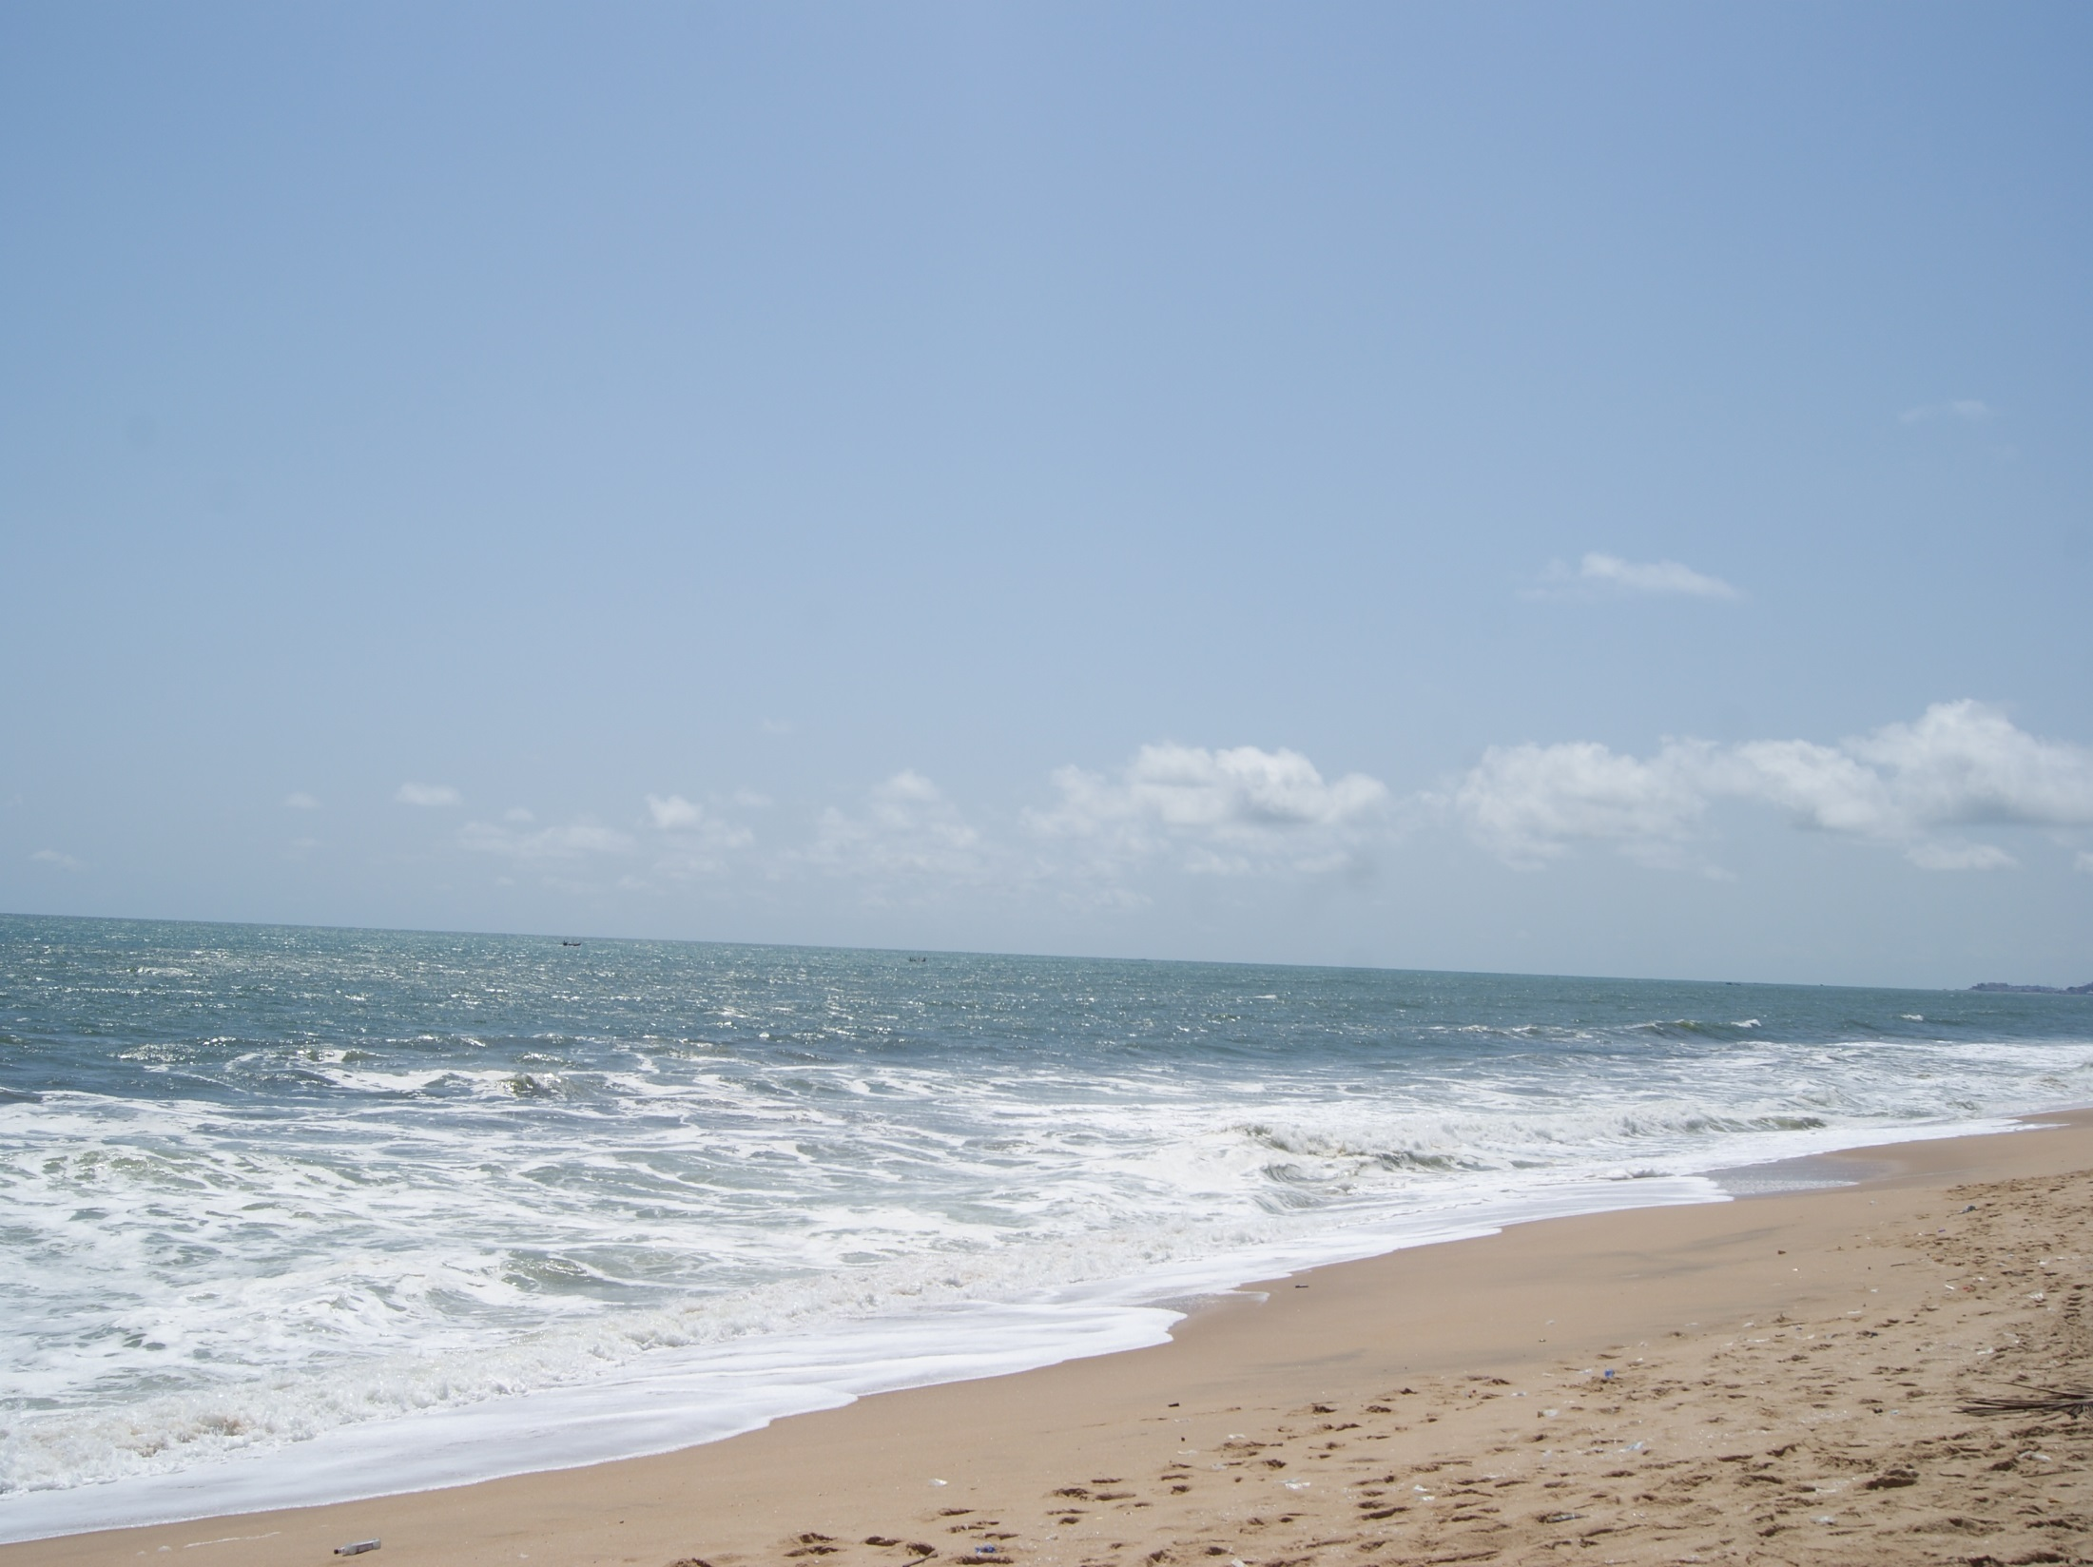
Achieving an Equitable and Inclusive Blue Economy in Ghana: A Human Rights Model for the Protection of Women and Children
Bolanle T. Erinosho & Harrison K. Golo

Slide 2
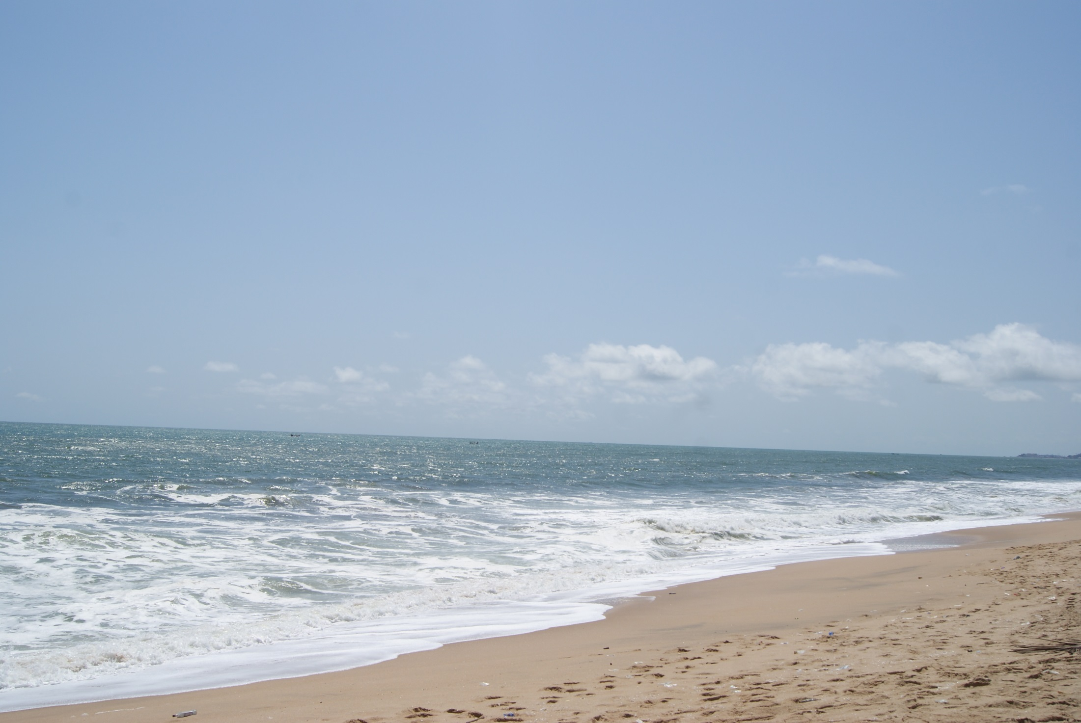
Outline
Introduction
Background to the study
Methodology and Results
Human Rights and the small-scale fishing communities in Ghana
Conclusion

Slide 3
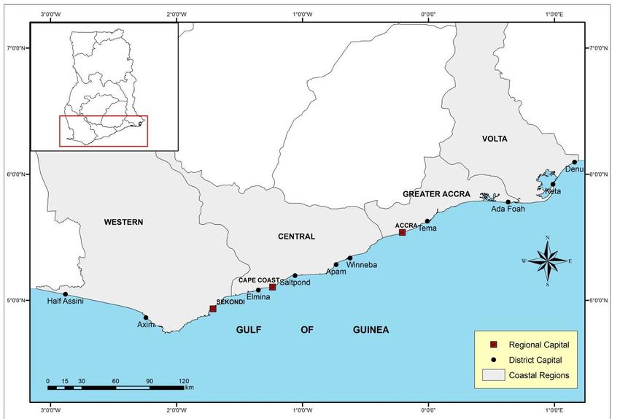
Ghana is a coastal country in west Africa with a population of 28 million.
528 km coastline.
A quarter of the population live along the coast and as such the Atlantic ocean is a significant resource for the country.

Slide 4
The African Union, in its 2050 Africa Integrated Maritime Strategy(AIMS) , notes the need “to foster increased wealth creation from Africa’s oceans and seas by developing a sustainable thriving blue economy in a secure and environmentally sustainable manner”.
The oceans as an economic good capable of generating wealth for Africa.
The oceans as “development spaces” where spatial planning integrates various features including: conservation; sustainable use; oil and mineral wealth extraction; bio prospecting; sustainable energy production and marine transport.
A sustainable development framework for the marine environment.

Slide 5
Background to the Study
The largest sector of the current African aquatic and ocean-based economy, are Fisheries (ECA 2016).
Vital for food and nutritional security and income. 75 % of total domestic fish production is consumed locally, accounting for about 22.4% of household food expenditures.
Ghana Fisheries employs 2.5% of the total population, contributing about 20% to the total labour force.
Small-scale fishery is the largest contributor to national fisheries catch..

Slide 6
Coastal fishing communities in Ghana are among the poorest in the country.(Ghana Living Standards Survey)
Fishing is highly gendered with men and women playing differing roles.
Women traditionally operate in pre-and post-harvest sectors, including processing and marketing of the catch as their major livelihood

Slide 7
Methodology
Study site is Elmina in the Central Region.
A historic fishing community with fishing activities dating back to the 1400s.
It is the third largest fish landing site in Ghana after Tema and Sekondi harbors.
Fisheries activities at Elmina are largely artisanal.

Slide 8
Population size of 32,819.
2500 fishermen and more than 200 canoes operating in the town.
Majority of the population owe their livelihood to fishing activities (2015 Elmina Strategic Report)

Slide 9
The study employed both primary and secondary data.
Primary data from focus group discussions (FGD), involving purposively sampled women fish processors and traders from Elmina.
Other target key informants included the Chief fisherman and five opinion leaders in the community who were purposively selected for in-depth interviews.

Slide 10
Challenges of women and children in a fishing community.
Declining fish catches: the women interviewed linked the declining fish catches to a multiplicity of factors, some of which are light fishing, pair trawling, use of dynamites, increasing fishing effort and climate change.
Participants reported that they were twice as much affected by these challenges that confront the fishing sector, especially because of their responsibility for food security in the home and the implications this had for the nutritional health of the household and to children in particular.

Slide 11
Lack of loan capital: Participants complained of being often marginalized in terms of subsidies, equipment/logistics support, training, and financial support in the fishing industry at the expense of targeted areas which are predominately men.
The women, especially fishmongers also intimated that, the lacked of financial capital was one of the main barriers bedeviling the operation of their business.
They reported difficulties accessing bank loans as they have no collateral or guarantors.

Slide 12
Mary describes the situation. … “our inability to access loan is a major constraint… as we are usually required to make spot payments in recent times for fish at the landing beach, which is against the normal practice of being offered fish on credit in the past”
Sewa “Lack of credit facilities and refusal of fishermen to offer fish on credit had rendered some of us jobless”.

Slide 13
Lack of women participation in capacity-building and decision-making processes
Decisions about the ocean and fishing are taken by the traditional leaders (Chiefs, opinion leaders, chief priests, fisherman) among whom religious and political roles are played.
The ocean governance has also been shaped by a gendered pattern of socialization.

Slide 14
The fishermen, fishmongers and the community members at large hold the belief that just as the Carpenter who don’t allow a women to touch his tools, in the same manner females are not supposed to go close to the fishing canoes when they land.
Females are, by norms, allocated with the responsibility of fish marketing and processing.
The non-involvement or marginalisation of women in terms of technical and capacity-building initiatives, community consultations and fisheries management decision-making processes.

Slide 15
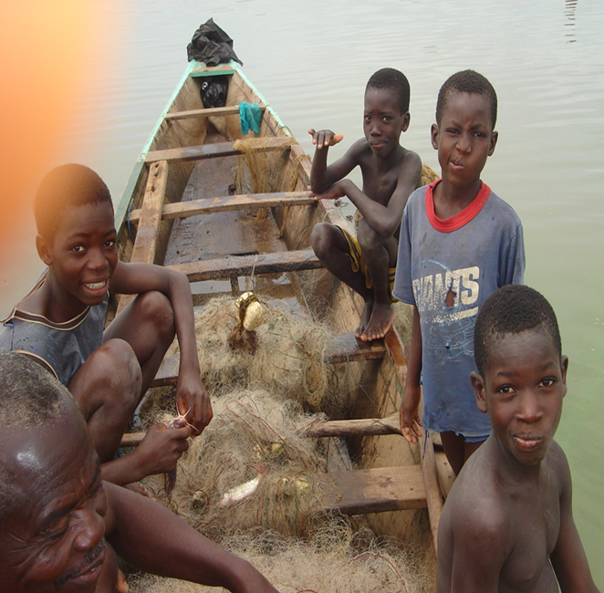
Child Labour and Trafficking
Participants regarded it as part of socialization.
the FGD acknowledged the widespread prevalence of child labour in the community, none of them was able to confirm that children were trafficked out from the community for child labour.

Slide 16
Human Rights Approach to Fisheries
The challenges confronting both women and children within small-scale fishing communities in Ghana as evidenced in this study are rooted in more systemic aspects of marginalization and vulnerability.
Participants had noted pressures of large scale fishing competitors (foreign trawlers) and the impacts of oil exploration as concerns.

Slide 17
The World Commission on Environment and Development in 1987 defined sustainable development as “development that meets the needs of the present without compromising the ability of future generations to meet theirs”.
It recognised that meeting essential needs depends in part on economic growth, however, economic growth in itself is not sufficient as poverty could continue to exist where there is uneven access to the benefits of such growth.
Hence, sustainable development is about ‘meeting human needs by increasing productive potentials and also ensuring equitable access to all’. (WCED 1987)

Slide 18
Equitable and inclusive in the blue economy.
Meeting the needs of all including women and children.
A human rights-based approach builds on the links with sustainable development to create a model which protects vulnerable communities of women and children.

Slide 19
Human rights are integral to development outcomes, as international human rights norms, highlight the freedoms and capabilities of each individual, and are essential components of the human side of development that economic indicators fail to capture (Sen, 2001; United Nations Development Programme, 2000).

Slide 20
Principle 10 of the Rio Declaration notes that ‘Environmental issues are best handled with the participation of all concerned citizens, at the relevant level. ….effective access to judicial and administrative proceedings, including redress and remedy, shall be provided’.
Principle 20 and 21 Rio Declaration go further to specifically secure the participation rights of women, youth, indigenous peoples and local communities.

Slide 21
A human rights approach therefore could potentially secure a participatory, non-discriminatory, transparent and accountable decision making process, which can provide valuable solutions to the challenges confronting women and children.

Slide 22
Rights can be claimed before courts.
It generates enforceable duties.
High level protection (usually constitutional)
Peoples Rights may strengthen local community rights over resources in the face of competing claims.

Slide 23
How does the a human rights model work in Ghana?
These protections include constitutional provisions such as socio and economic rights enumerated in chapter 5 of the 1992 Constitution.
S 25(1a) which guarantees the right to basic education for children, 28 (2) which protects children from engaging in work that constitutes a threat to health, education or development. And 27 (3) ) which guarantees equal rights for women to training and promotion.

Slide 24
S 33(5) of the constitution also potentially allows the inclusion of other rights including the right to a satisfactory environment guaranteed in Article 24 of the African Charter of which Ghana is a party. (New Patriotic Party v Inspector General of Police[1993-94] 2 GLR 459;New Patriotic Party v Attorney-General(1996-97) SC GLR 729 ;Adjei Ampofo v. Attorney-General(2007-2008) SCGLR 676)
Extending the scope of the rights to include participatory rights on environmental decision-making, access to justice, and access to information on environmental matters is paramount for a sustainable fisheries sector.

Slide 25
Conclusion
Accountability of duty bearers
Challenge patterns of established authority
Accountability is not limited exclusively to a matter of judicial enforcement (Uvin, 2004: 134).
Strengthening the role constitutional bodies such as Commission on Human Rights and Administration of Justice.
Rights advocacy and human rights education

Slide 26
Thank You !!
Special thanks to the OOH team at the University of Cape Coast; G. Oduro and J. Ansah

