Slide 1
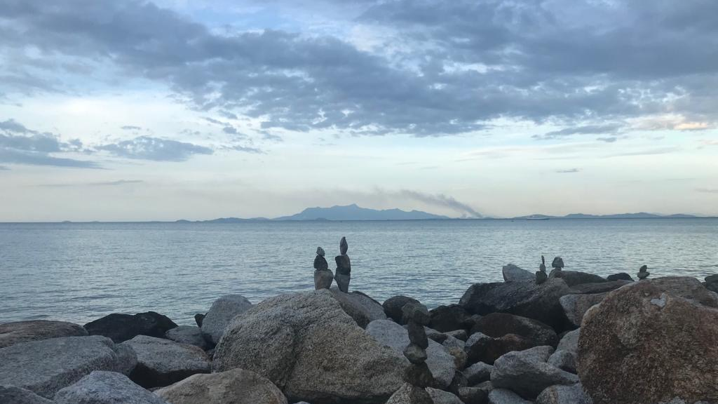
The Transformation Imperative
Profs Christina Hicks & Eddie Allison
Notes:
It is a real honour to be here today. I grew up in Ethiopia in the 80’s and 90’s singing songs like ‘Give me hope Johanna’ and ‘Nkosili si kelili’. We would sing these songs, I am sure we pronounced them terribly, from our bellies and at the top of our voices, thinking of South Africa and feeling deep solidarity. Then, in the early 90’s Nelson Mandela came to Addis Ababa on one of his first trips out of South Africa after his release. So, I feel very lucky to be speaking here today - thank you for inviting me.

Slide 2

#ShowYourStripes
https://showyourstripes.info/
Notes:
Globe (1850-2018)
***
Many of you will be aware of the climate stripes produced by Ed Hawkins. Each stripe represents a year, from 1850-2018, the blue stripes are relatively cooler years and the red warmer years.
I wanted to start with this slide, not because I am going to talk about climate change, as I don’t specifically work on climate change, but as a reminder that this is the back drop to everything that we will discuss over the next few days.
I like these stripes, because they are a simple visual representation of how temperatures have changes over the past 100+ years, with a really clear ramping up in the past ~20 years, and a reminder that all the challenges we will discuss will, year on year, get harder, and the implications of our inactions more severe.
These are global averages
***
For each country, the average temperature in 1971-2000 is set as the boundary between blue and red colours, and the colour scale varies from +/- 2.6 standard deviations of the annual average temperatures between 1901-2000.

Slide 3
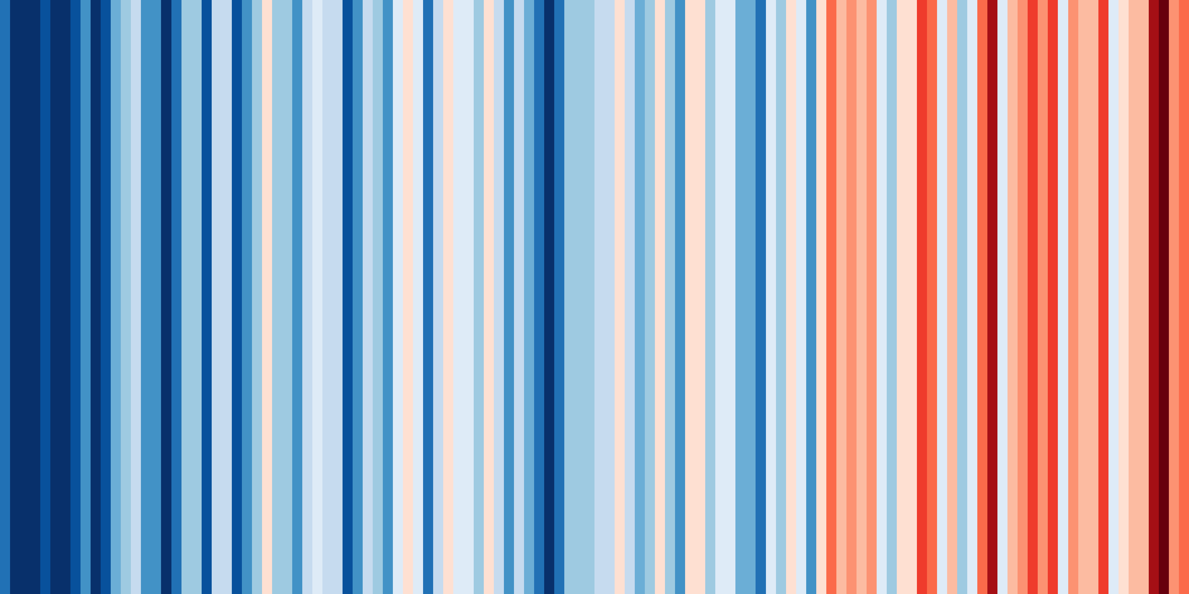
#ShowYourStripes
https://showyourstripes.info/
Notes:
South Africa (first 50 years are the global average)
***
And these are the data for South Africa, South Africa began experiencing warmer years earlier than global averages, but you are yet to experience the year on year warmer than average temperatures.
***

Slide 4
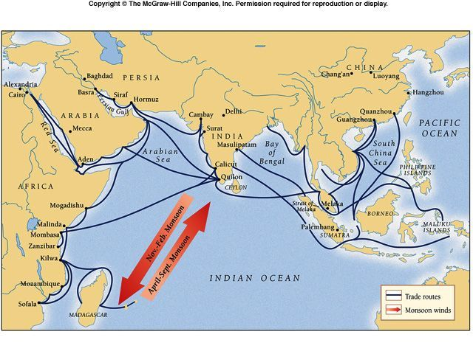
Space
#ShowYourStripes
https://showyourstripes.info/
Notes:
Other material benefits
Human societies have a long history of diverse and complex relations with the oceans, that shape peoples social and cultural identities, and their economic situations, their sense of place, occupational pride and self-respect, spirituality, mental health and emotional wellbeing.
The Oceans have also, for centuries, been a source of food, materials, and income; with Indian Ocean trade networks dating back at least 4000 years.
.

Slide 5
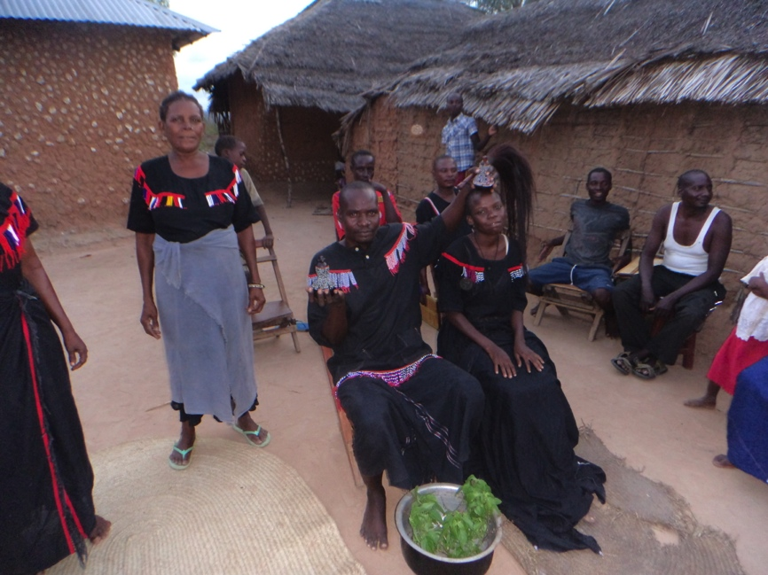
Sociocultural relations
“Matondoo deep in the ocean has the strongest cultural value”
#ShowYourStripes
https://showyourstripes.info/
Notes:
Connections with the sea
***
This long history of engaging with the ocean is reflected in coastal east Africa,
the Mijikenda live on the coast of Kneya, and despite successive waves of colonialization, they maintain a deep spiritual connection to the oceans,
sacred sites on land and sea are used to connect specific elders to god, and traditional medicines are frequently used to exorcise demons and cure ailments.
***

Slide 6
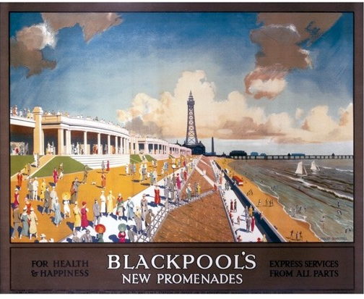
Sociocultural relations
The early 18th the first working-class holidaymakers catering for ‘health-seekers’.
#ShowYourStripes
https://showyourstripes.info/
Notes:
Connections with the sea
***
The UK has for decades promoted the mental health and emotional wellbeing benefits of spending time at the sea side.
***

Slide 7
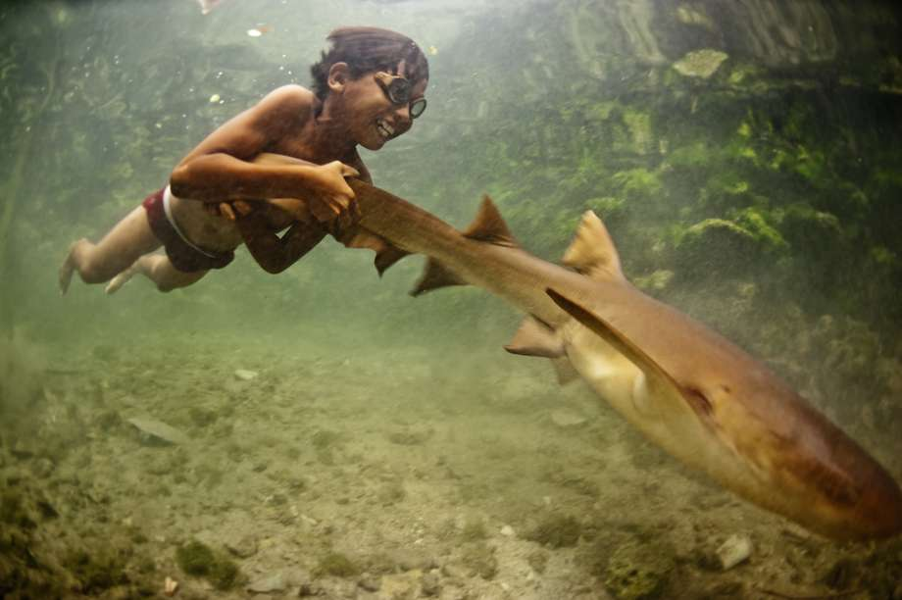
Sociocultural relations
‘For the Moken, the ocean is our entire universe’
“Everything happens at sea. We are not people who are bound to any land.”
#ShowYourStripes
https://showyourstripes.info/
Notes:
Connections with the sea
***
For example, for the Moken from Thailand, who spend most of their lives in the water, the ocean is their entire universe, and central to their social identity.
***

Slide 8
Sociocultural relations
Gabul creation story.
‘Gabul, a giant carpet python carved the landscape’ and so the islands were formed
Photo: A sign on the ethno-botanical trail at Garabarra
#ShowYourStripes
https://showyourstripes.info/
Notes:
Connections with the sea
***
In Australia, for the Wulgurukaba – canoe people- the carpet snake symbolises their creation story, which follows the coastline to place their heritage in the islands off North Queensland, giving them a sense of place and connection to the land and sea.
***
"It’s ok to tell the Gabul story now. Gabul refers to the Wulgurukaba Dreaming story of how the islands off the Townsville coast were formed.
According to the Dreaming, Gabul was a giant carpet python who carved the landscape while travelling from Herbert River, through the Palm Island Group, up Ross River and coming to rest at Magnetic Island.
Gabul’s head can still be seen in the Arcadia headland. The head of Gabul represented at Alma Bay highlights the importance of the area.
The Gabul story connects Yunbenun to Wulgurukaba country on the mainland particularly through the Ross River and to other Aboriginal groups to our north particularly the Manbarra, the custodians of the Palm Island group of Islands."
​
Photo: A sign on the ethno-botanical trail at Garabarra (Kissing Point, Townsville) provides more information on the Gabul creation story.

Slide 9
Materials
#ShowYourStripes
https://showyourstripes.info/
Notes:
In addition to these socio-cultural connections, we have for decades extracted materials form the oceans-.
Historically this has mainly been sand and gravel for building.

Slide 10
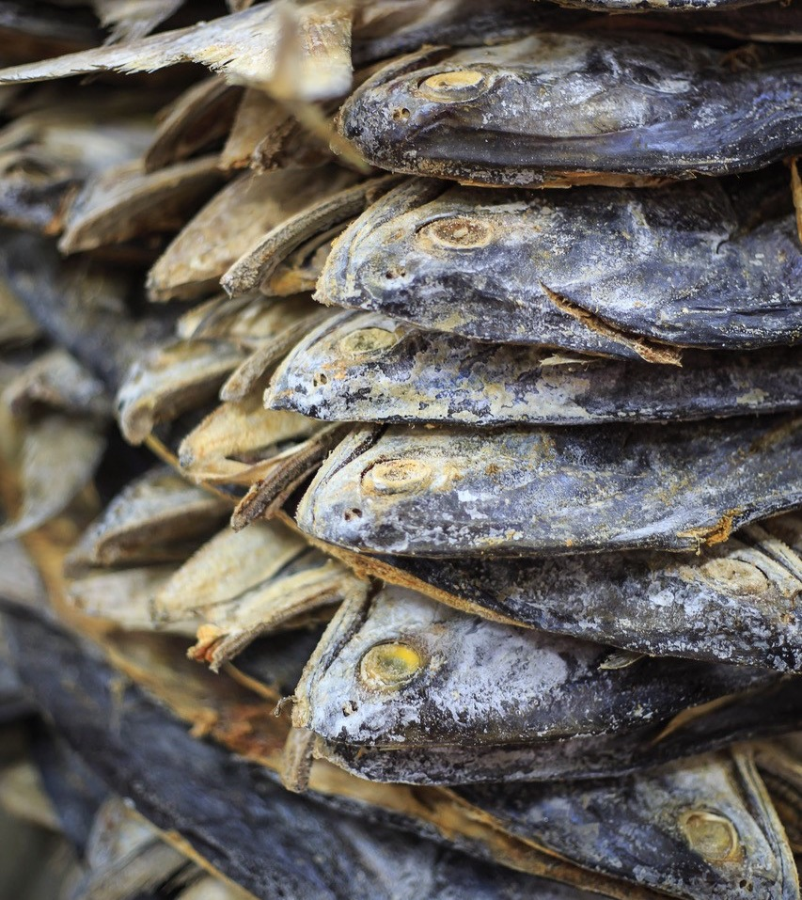
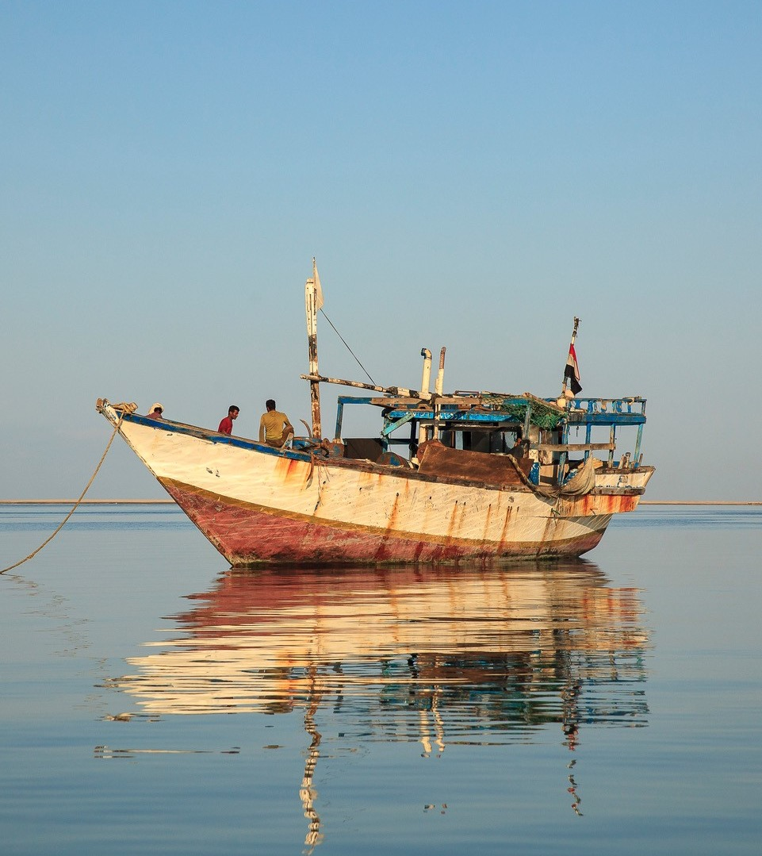
Food
#ShowYourStripes
https://showyourstripes.info/
Notes:
Other material benefits
And ofcourse the Oceans have also, for centuries, been a source of food,
Fish, remains a vital source of animal protein, particularly in places like Africa and Asia where though people on average eat less fish, the fish they do eat makes a greater proportion of their animal protein.
SSF in particular comprise approximately half of global catches, but if we look at their labour contributions they dwarf all other fisheries. They employ >90% of those engaged in fisheries worldwide, the majority of them are in low income countries, and nearly half are women.
Making fisheries a critical source of food and employment.
Fisheries are important for peoples food, livelihood, and cultural needs.
In most of the places in which I work fishers sell their fish for cheaper sources of food.
90% of worlds fishers are SS, predominantly in low income or developing countries
Oceans are responsible for 63% of fisheries production globally – this production contributes to the food security of around four billion consumers
In the developing world marine fisheries provides a critical supply of micro-nutrients and protein for over a billion low-income consumers

Slide 11
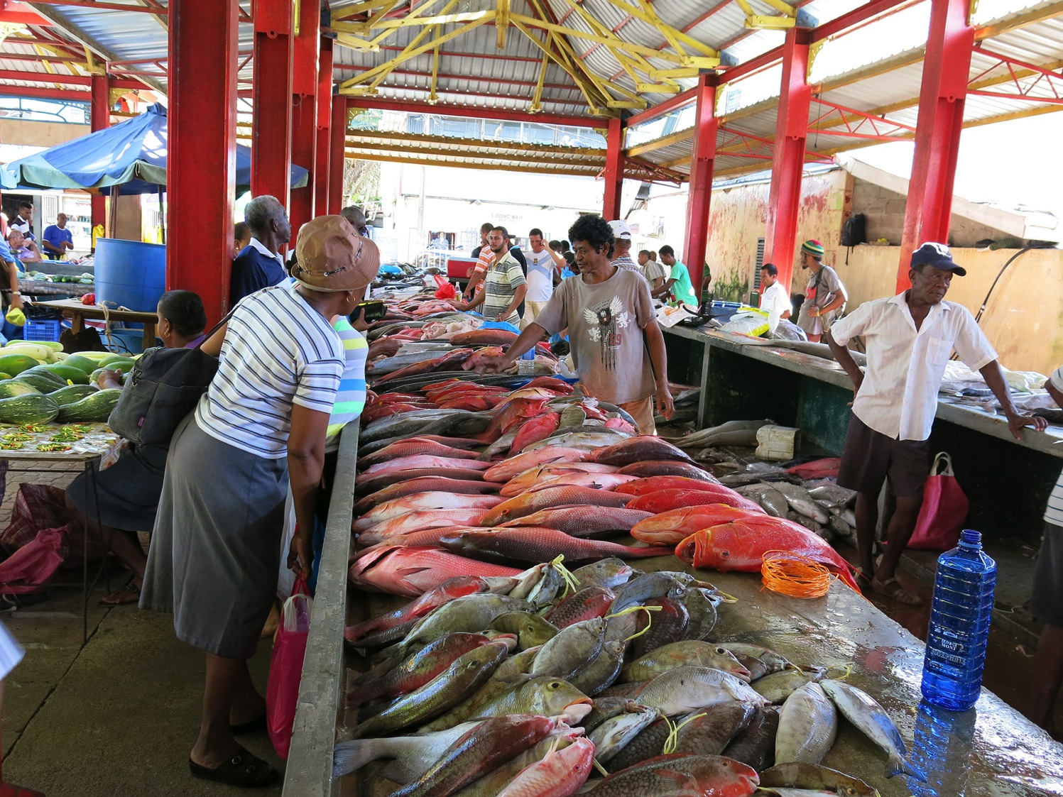
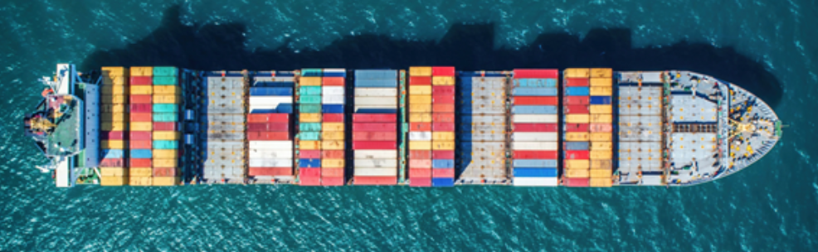
Traditional ocean economies
Sociocultural relations
Diverse
Food
Seafood
Space
Transport
Materials
Sand & gravel
#ShowYourStripes
https://showyourstripes.info/
Notes:
Other material benefits
We can think of these diverse sociocultural relationships shaping how people engage with the oceans as a source of
The Oceans have also, for centuries, been a source of food, materials, and income; with Indian Ocean trade networks dating back at least 4000 years. Recent years have seen these

Slide 12
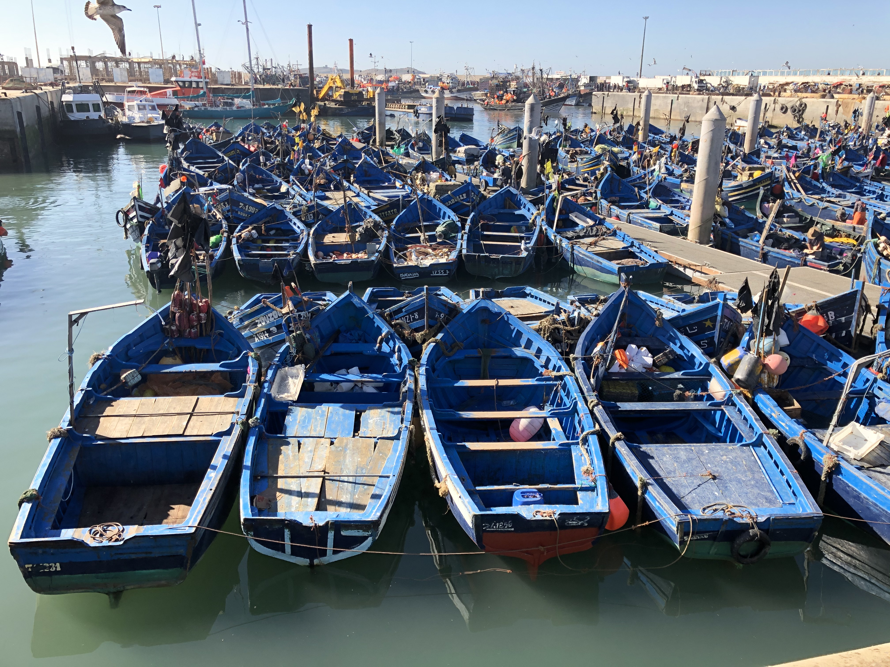
Conventional governance options
Sociocultural relations
Diverse
Food
Seafood
Space
Transport
Materials
Sand & gravel
Command and Control
Community or customary arrangements
Privatization

Slide 13
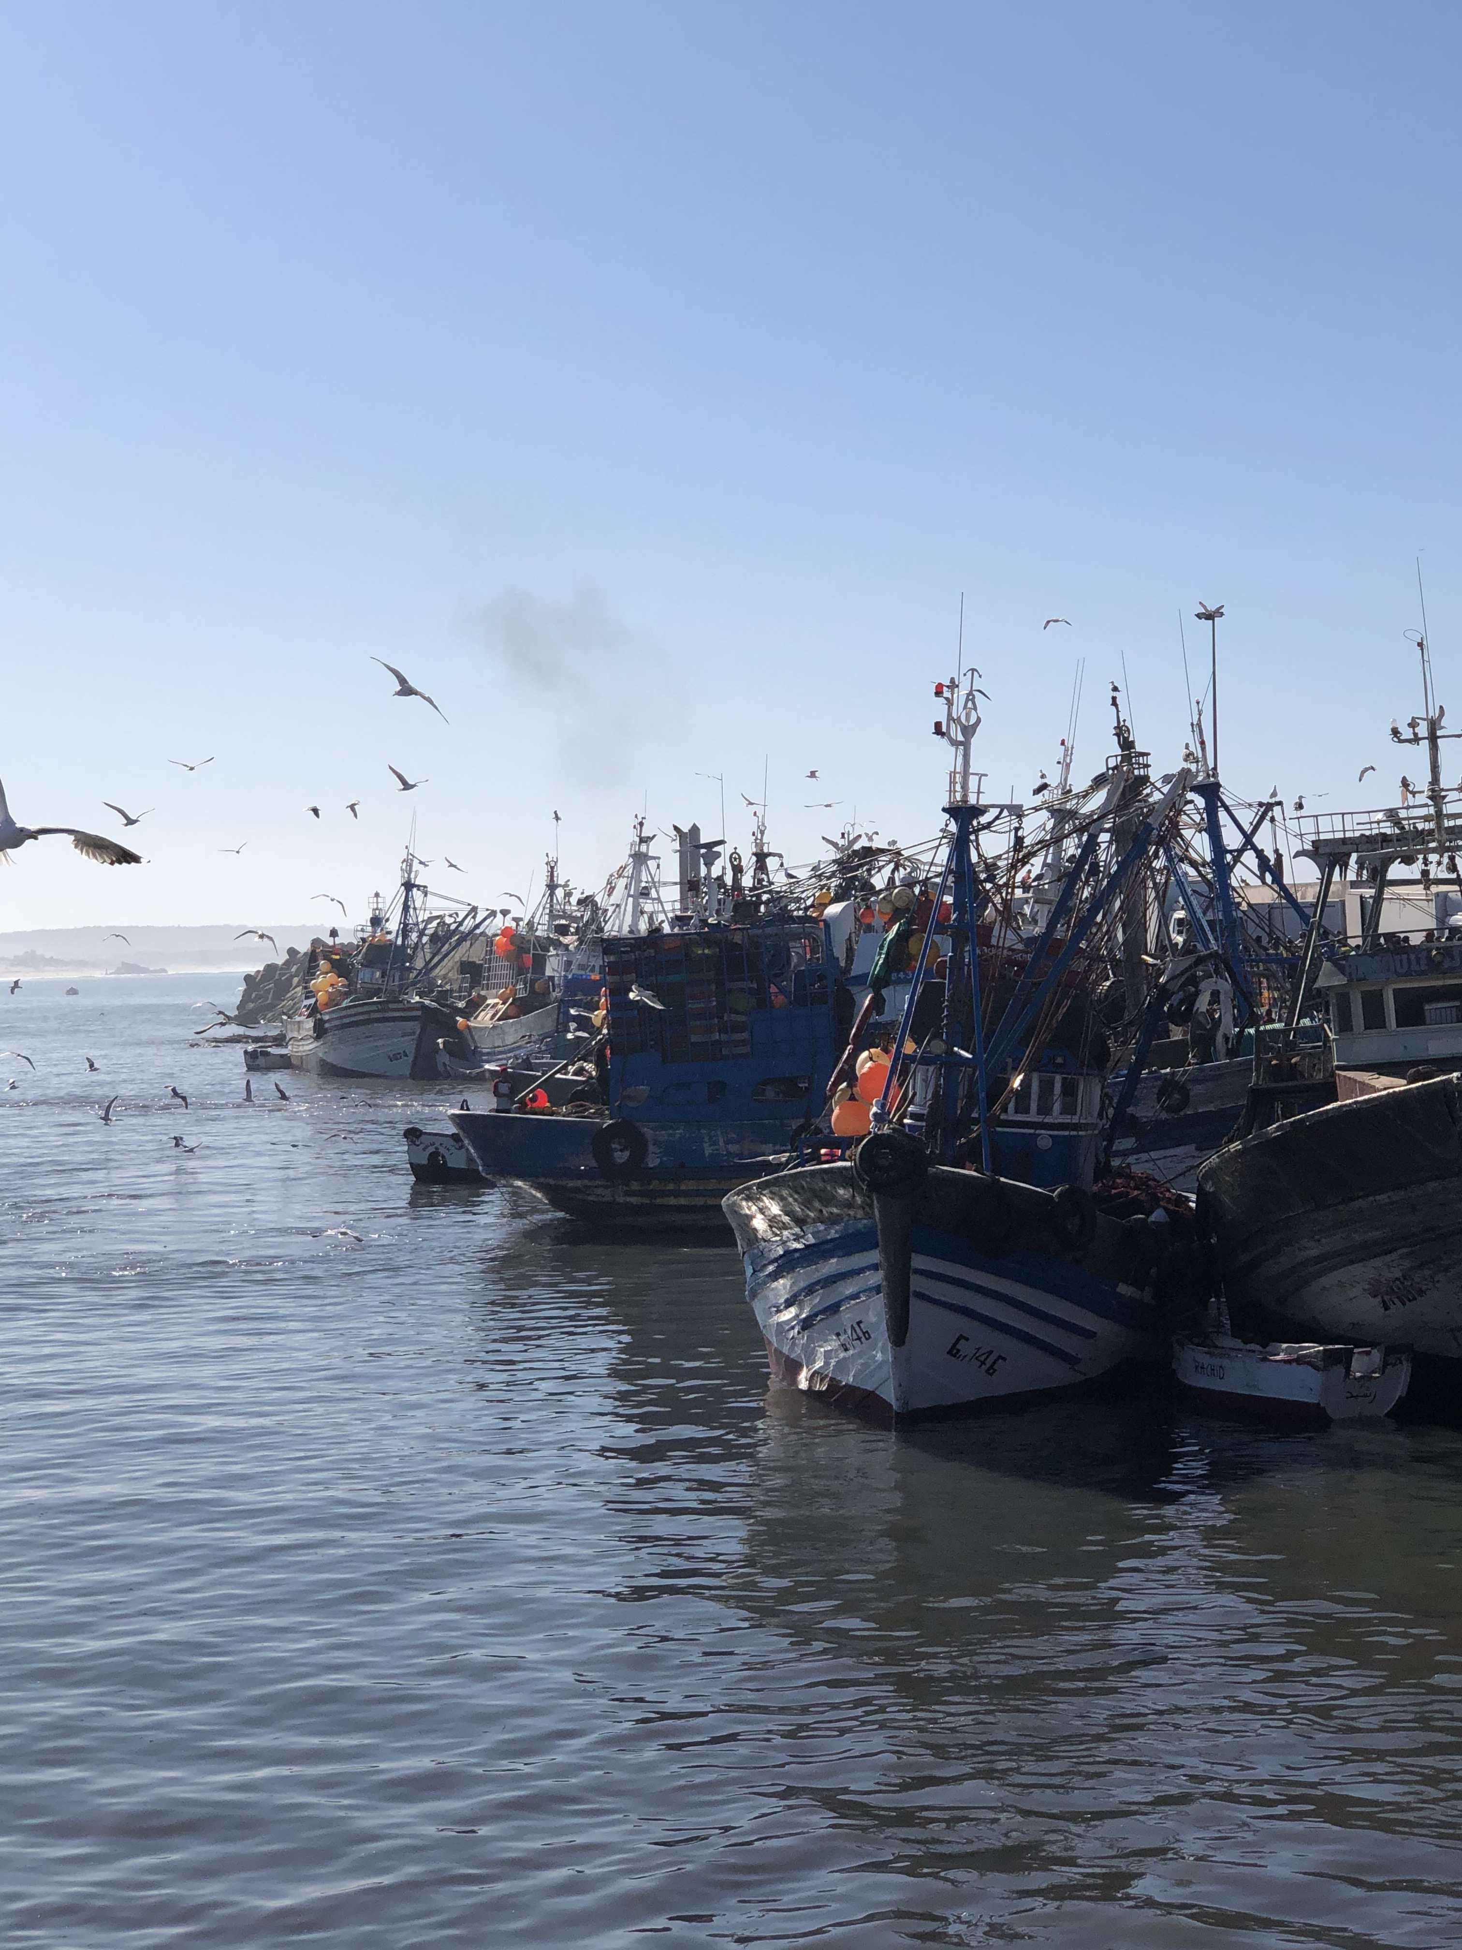
Command & control:
Fisheries management: Global
Biomass Fishing rate
Hilborn et al (2020) PNAS
#ShowYourStripes
https://showyourstripes.info/
Notes:
where fisheries are intensively managed, the stocks are above target levels or rebuilding. Where fisheries management is less intense, stock status and trends are worse.
It took 10 years to compile all the data from 880 fisheries, which together caught almost half of all ocean landings

Slide 14
Command & control:
Fisheries management: Global
Biomass Fishing rate
Hilborn et al (2020) PNAS
#ShowYourStripes
https://showyourstripes.info/
Notes:
where fisheries are intensively managed, the stocks are above target levels or rebuilding. Where fisheries management is less intense, stock status and trends are worse.
It took 10 years to compile all the data from 880 fisheries, which together caught almost half of all ocean landings

Slide 15
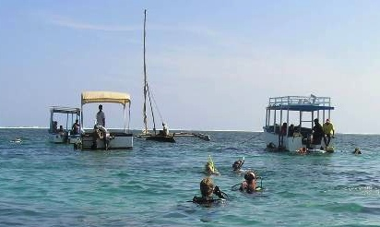
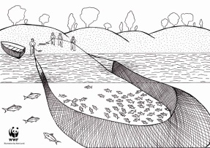

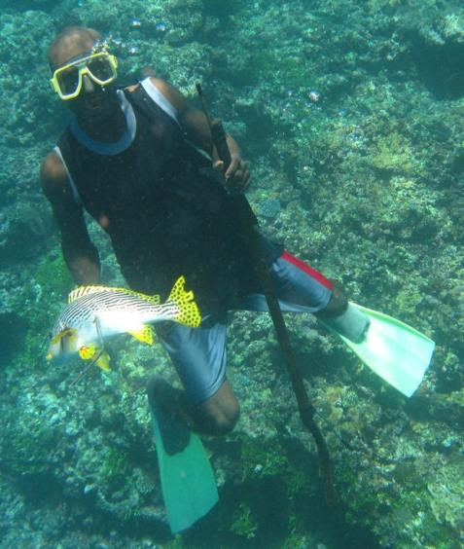
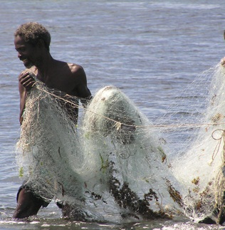
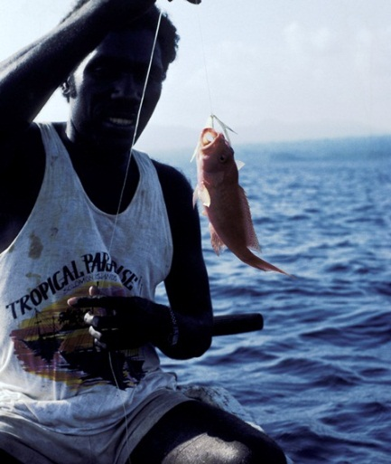
Command & control/ customary:
Fisheries management SSF in Kenya
X
Total fishing bans
Gear restrictions
#ShowYourStripes
McClanahan, et al Ecol Appl 2008
https://showyourstripes.info/
Notes:
Next I wanted to examine the effect over time of removing a destructive gear on fisheries outcomes .
Cpue is our fisheries outcome up the y axis, and along the x is time.
Each point represents a years average catch per fisher per day across all gear types for three clusters of landing sites.
In the first 5 years beach seine was used in all sites and cpue was in decline.
2001 and 2002 saw the removal of BS resulting in rapid cpue increases that were maintained.
We added the yellow sites as control sites where BS were not removed, suggesting

Slide 16
Command & control/ customary:
Fisheries management SSF in Kenya
X
5
4
Total fishing bans
No management
Gear restrictions
CPUE, kg fisher ⁻¹ day ⁻¹
3
2
1
1996
1997
1998
1999
2000
2001
2002
2003
2004
2005
Time, years
#ShowYourStripes
McClanahan, et al Ecol Appl 2008
https://showyourstripes.info/
Notes:
Next I wanted to examine the effect over time of removing a destructive gear on fisheries outcomes .
Cpue is our fisheries outcome up the y axis, and along the x is time.
Each point represents a years average catch per fisher per day across all gear types for three clusters of landing sites.
In the first 5 years beach seine was used in all sites and cpue was in decline.
2001 and 2002 saw the removal of BS resulting in rapid cpue increases that were maintained.
We added the yellow sites as control sites where BS were not removed, suggesting

Slide 17
Traditional ocean economies
Sociocultural relations
Diverse
Food
Seafood
Space
Transport
Materials
Sand & gravel
#ShowYourStripes
https://showyourstripes.info/
Notes:
Other material benefits
We can think of these diverse sociocultural relationships shaping how people engage with the oceans as a source of
The Oceans have also, for centuries, been a source of food, materials, and income; with Indian Ocean trade networks dating back at least 4000 years. Recent years have seen these

Slide 18
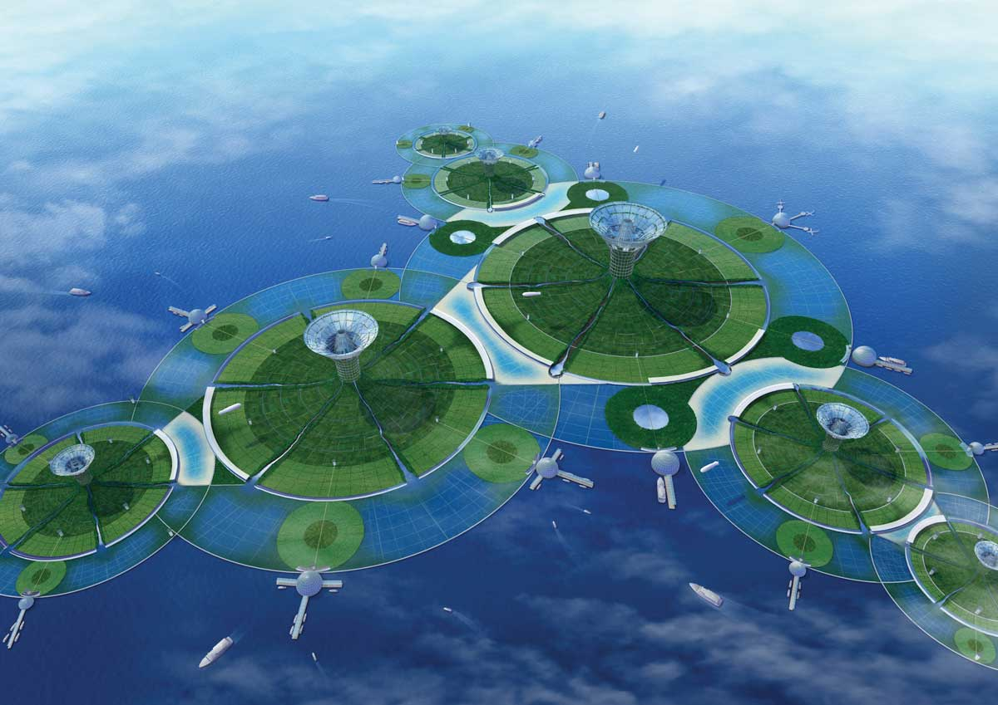
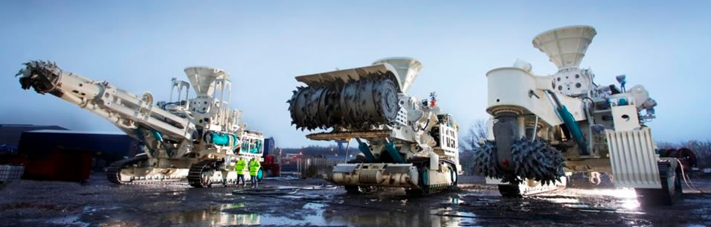
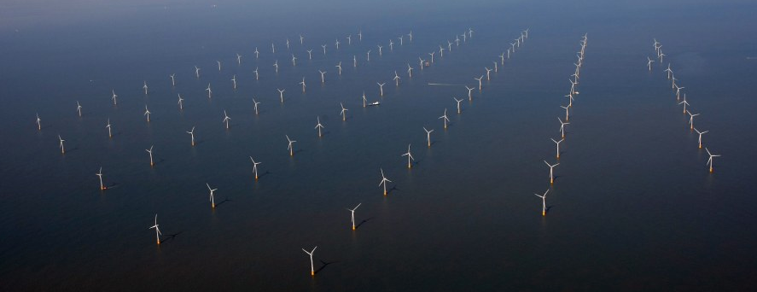
#ShowYourStripes
https://showyourstripes.info/
Notes:
New technologies have meant traditional ocean economies are transforming beyond recognition, in size, and well as character. The way seafood is produced is transforming, Materials once limited to sand and gravel, now includes a whole host of minerals, now scarce on land, but found in the deep sea. And an increasing proportion of our energy comes fomr the oceans.

Slide 19
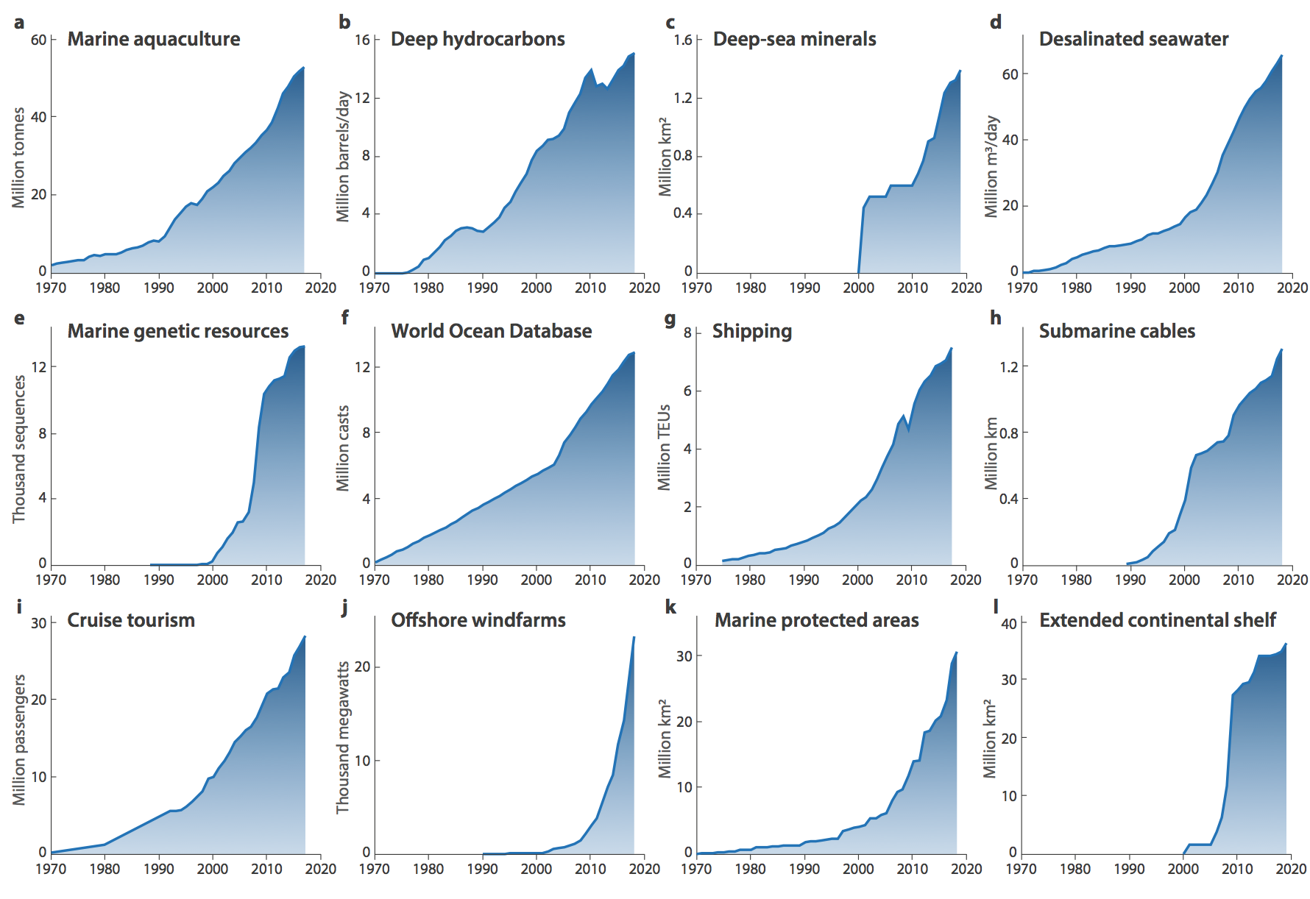
Sociocultural relations
Food
Space
Materials
Jouffrey et al (in press) ONE Earth
#ShowYourStripes
Jouffrey et al (in press) One Earth
https://showyourstripes.info/

Slide 20
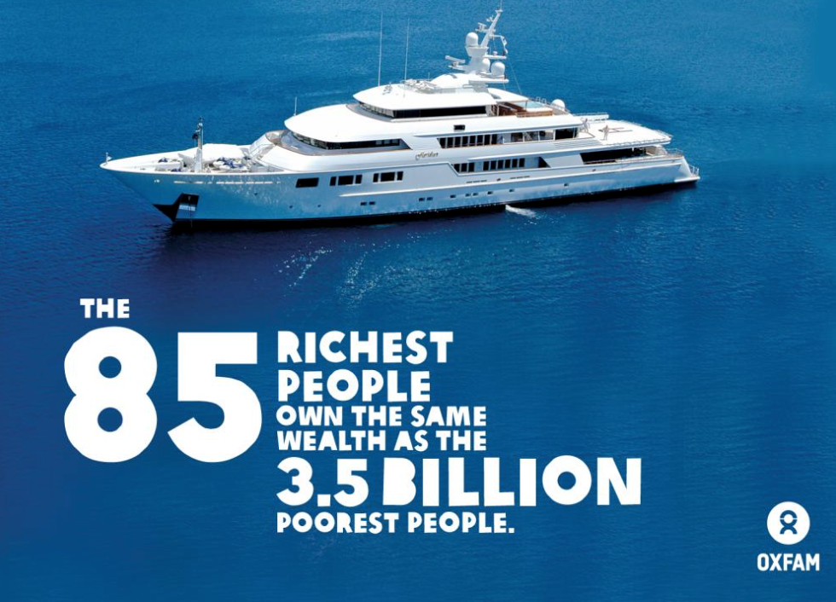
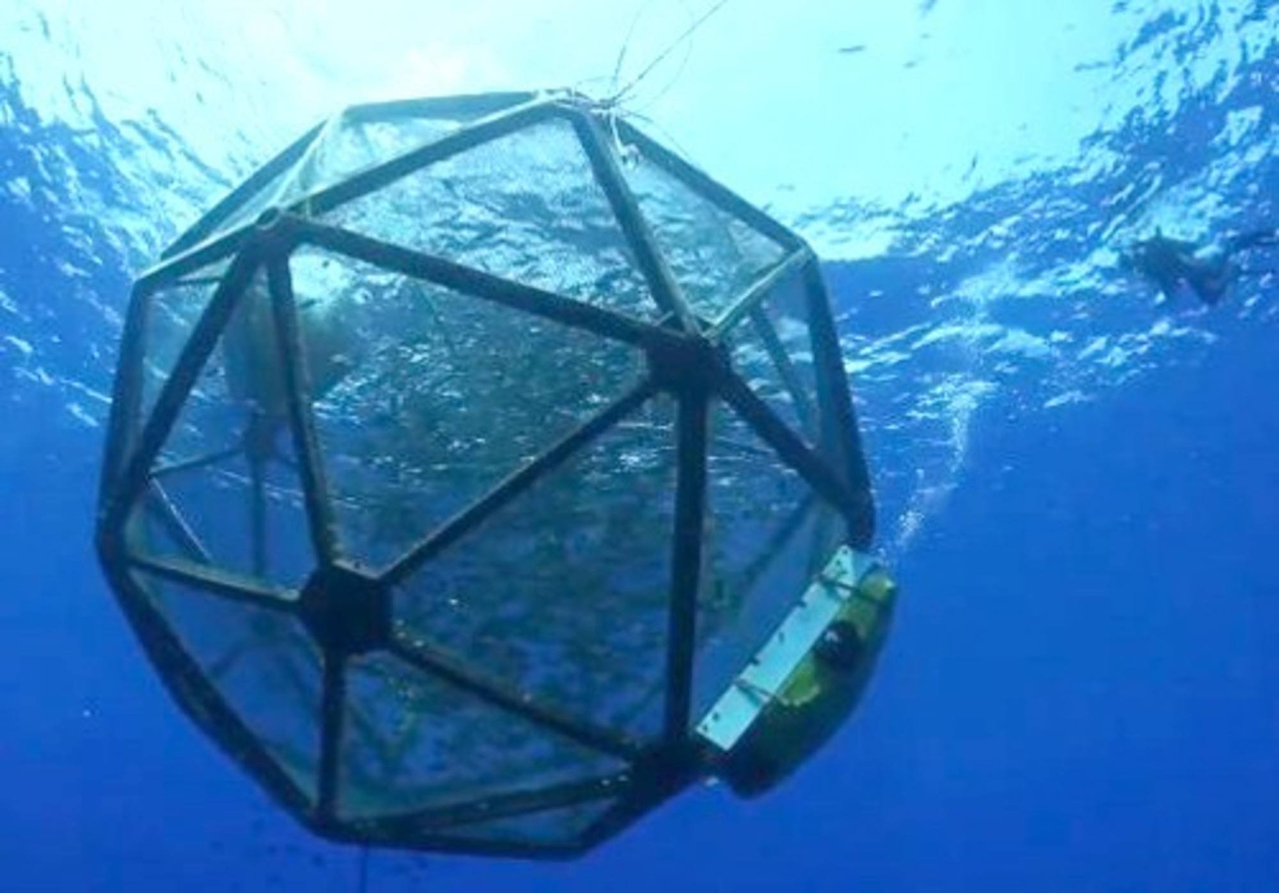
New ‘frontier’ Ocean Economies
Sociocultural relations
Diverse - -
Recreation
Food
Seafood ++
Feeds
Health sup
Space
Transport ++
Land
Waste
Geoengineering
MPA’s
Materials
Sand & gravel
Energy
Genetic resources
#ShowYourStripes
https://showyourstripes.info/
Notes:
Other material benefits
The Oceans have also, for centuries, been a source of food, materials, and income; with Indian Ocean trade networks dating back at least 4000 years. Recent years have seen these

Slide 21
New ‘frontier’ Ocean Economies
Sociocultural relations
Diverse - -
Recreation
Food
Seafood ++
Health sup
Space
Transport ++
Land
Waste
Geoengineering
MPA’s
Resources
Minerals ++
Energy
Genetic resources
Speculative
Finance
Investments
#ShowYourStripes
https://showyourstripes.info/
Notes:
Speculator economy – the investor class is only interested in high rate of return, are we China’s spatial fix,
Finance is laying a claim on future labour
Is Seychelles TNC’s conservation fix?
Conservation is now divided

Slide 22
Speculative economies:
Conservation, debt, and, finance in Seychelles
#ShowYourStripes
https://showyourstripes.info/

Slide 23
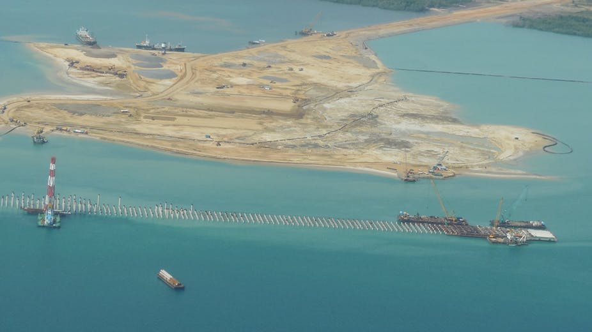
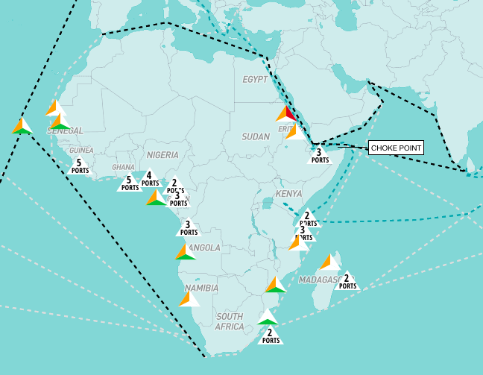
Speculative economies:
Infra structure investment in Africa
#ShowYourStripes
https://showyourstripes.info/
Notes:
46 ports identified in this data align with broader Chinese military, commercial, and political objectives.

Slide 24
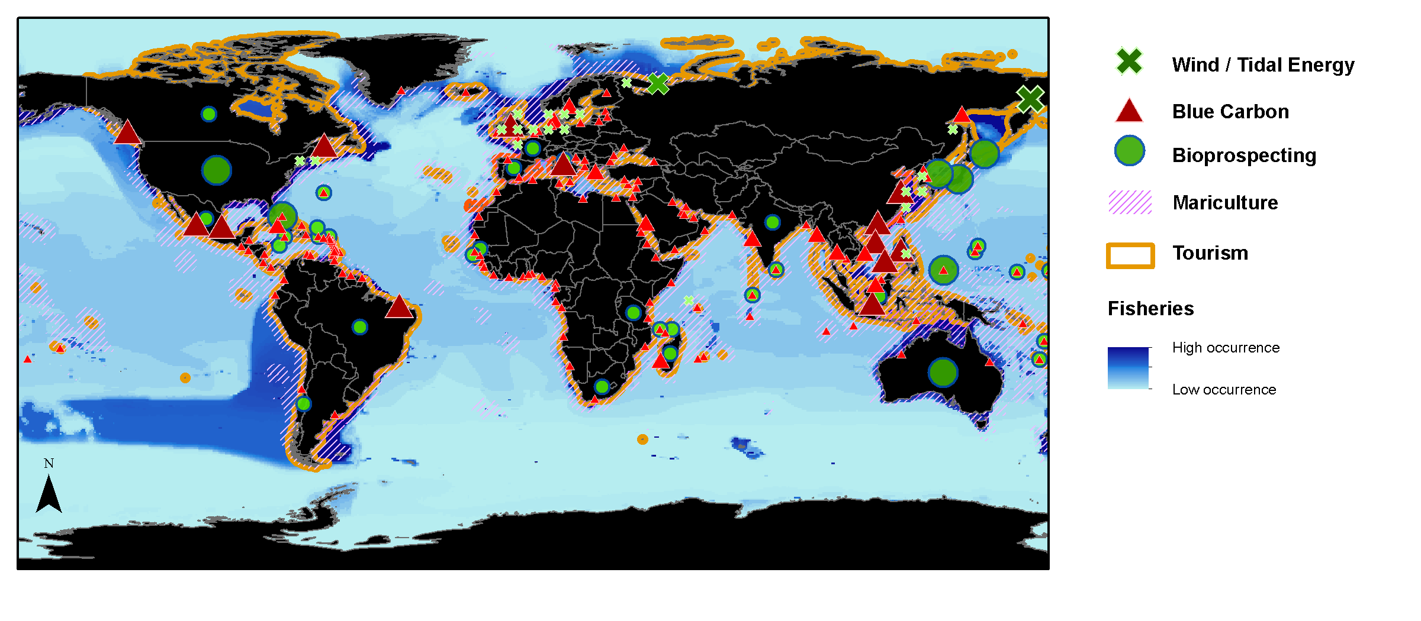
Catching up with the ‘Blue Economy’
(Materials)
(Speculation)
(Materials)
(Food)
(Sociocultural relations)
(Food)
Cisneros-Montemayor et al (in review)

Slide 25
Is this the blue economy moment?
Fisheries and Aquaculture
Much of this is justified within the BE.
  The growth in space (MPA’s) → conservation
  Growth in food (Aquaculture) → relieves pressures on fish stocks
  Growth in materials (Green energy) → tackles climate change
  Finance → needed to support governance
Global energy consumption
Except, this is all happening in addition to, rather than replacing
It also all predated the Blue Economy.
Has the Blue Economy has spurred interest in these industries –ramping them up?.

Slide 26
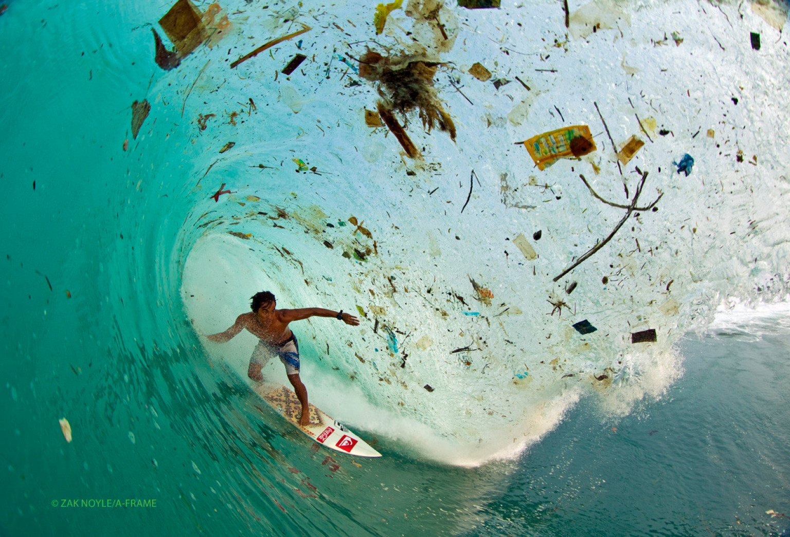
1. Drives Ecosystem collapse: pollution
Notes:
Implications

Slide 27
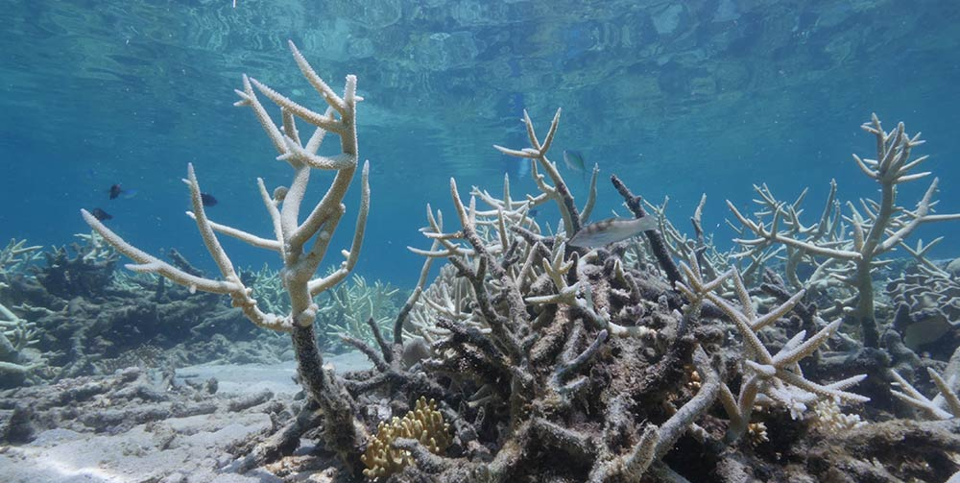
1. Drives Ecosystem collapse: climate change
Notes:
Implications

Slide 28
2. Ignores social justice: drives unequal fish harvest
High Seas
Inequality at sea: who harvests from the high seas and EEZs?
- Five High and upper middle-income countries completely dominate fishing on the high seas (‘the common heritage of mankind’)
In the EEZs of low-income countries, industrial fishing is dominated by foreign fishing vessels from high and middle-income countries
In the EEZs of middle and high-income countries, fishing is dominated by home fleets
EEZ
McCauley, D. J. et al. (2018). Science advances.
Notes:
Implications- exacerbating inequalities

Slide 29
2. Ignores social justice: exacerbates malnutrition
Hicks et al 2019 Nature
Notes:
We can see these differences cause further inequities

Slide 30
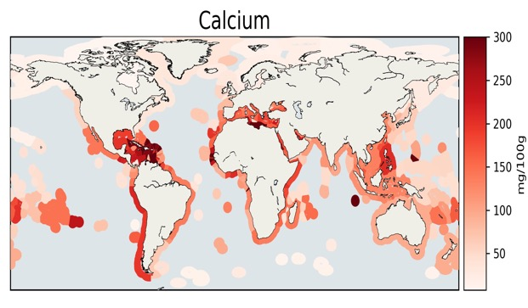
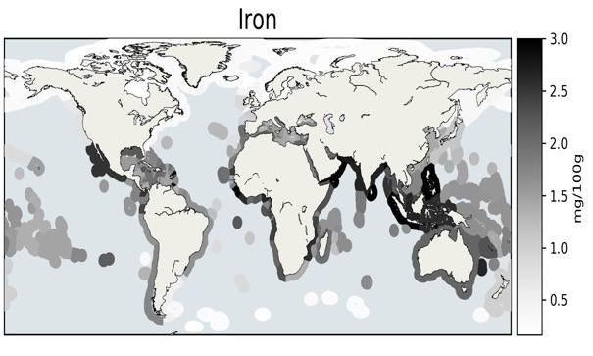
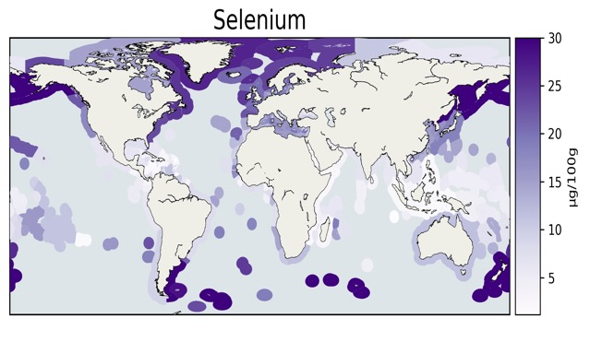
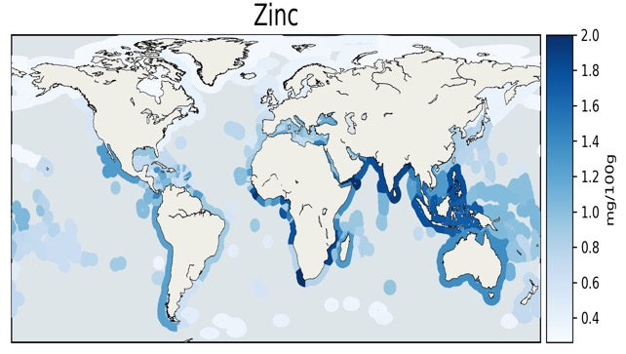
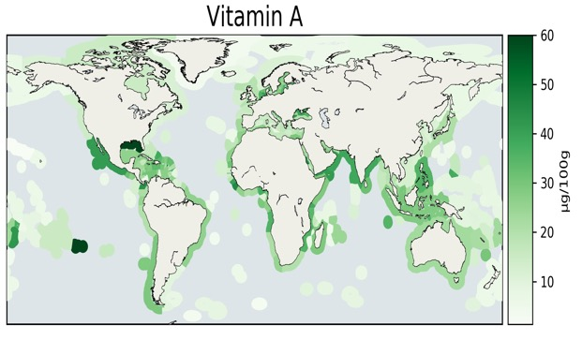
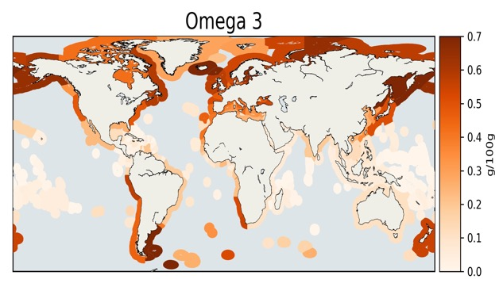
2. Ignores social justice: exacerbates malnutrition
Concentrations of key nutrients in catches within each country’s EEZ
High where MND are most prevalent
High where implicated NCD are prevalent
Hicks et al 2019 Nature
Notes:
We can see these differences cause further inequities

Slide 31
2. Ignores social justice: exacerbates malnutrition
Calcium Iron
Omega-3
Zinc Vitamin A
Hicks et al 2019 Nature

Slide 32
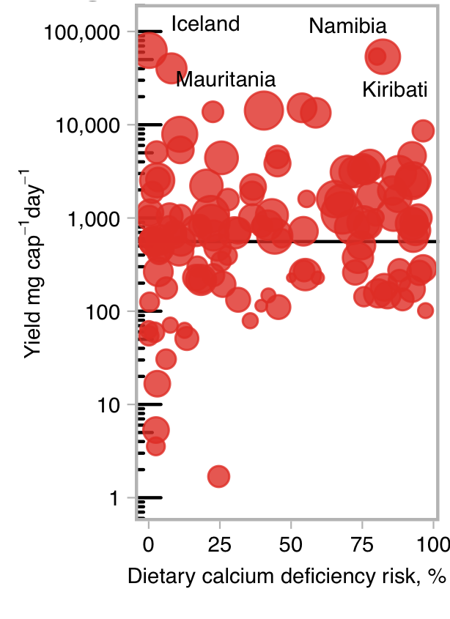
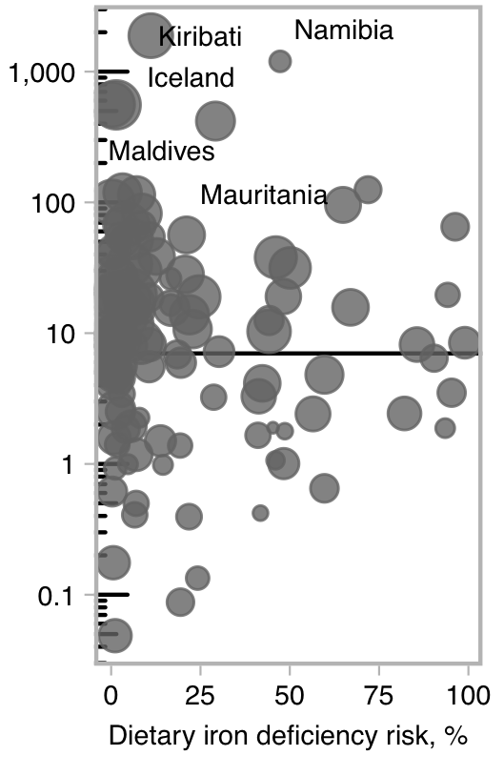
2. Ignores social justice: exacerbates malnutrition
S. Africa (consumption: 9.8kg⁻¹cap⁻¹yr)
Nutrient yield scaled to the population under 5 years old
RDA <5
Kiribati, Ca Def 82%
1% of fish caught = RDA for <5
Namibia Fe def 47%
9% fish caught = RDA coastal pop.
Hicks et al 2019 Nature

Slide 33
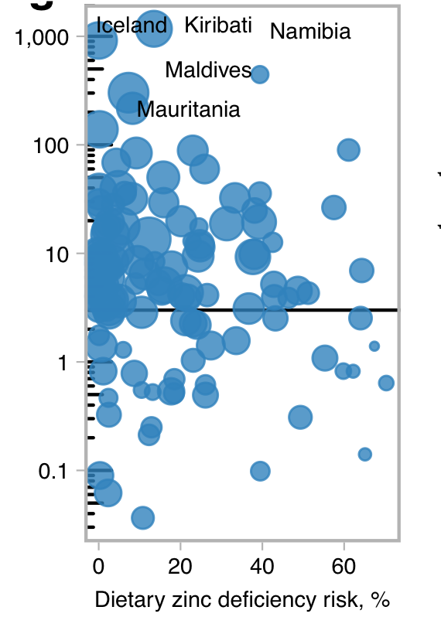
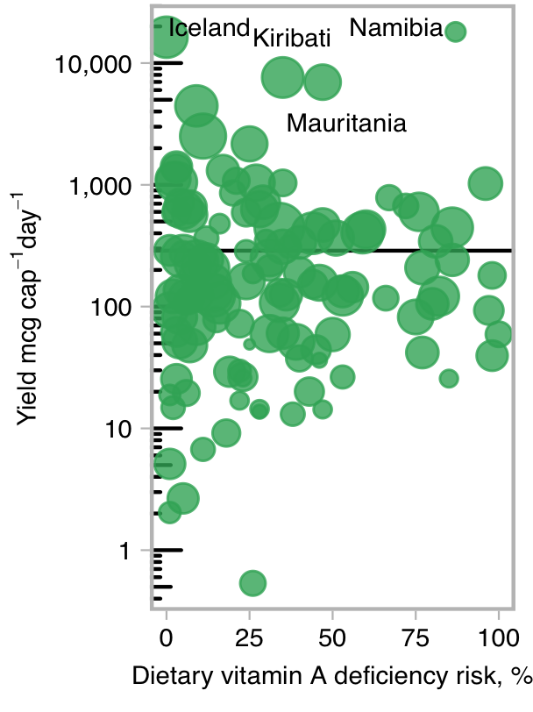
2. Ignores social justice: exacerbates malnutrition
Nutrient yield scaled to the population under 5 years old
S. Africa (consumption: 9.8kg⁻¹cap⁻¹yr)
RDA <5
50% countries def >20%
And yields that exceed RDA >5
22 countries
20% EEZ yields = RDA >5
Hicks et al 2019 Nature
Notes:
Sount Africs 9kg/an

Slide 34
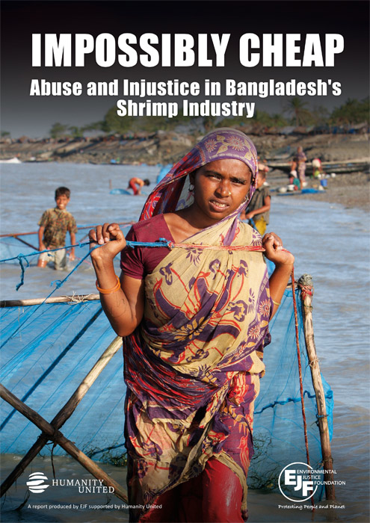
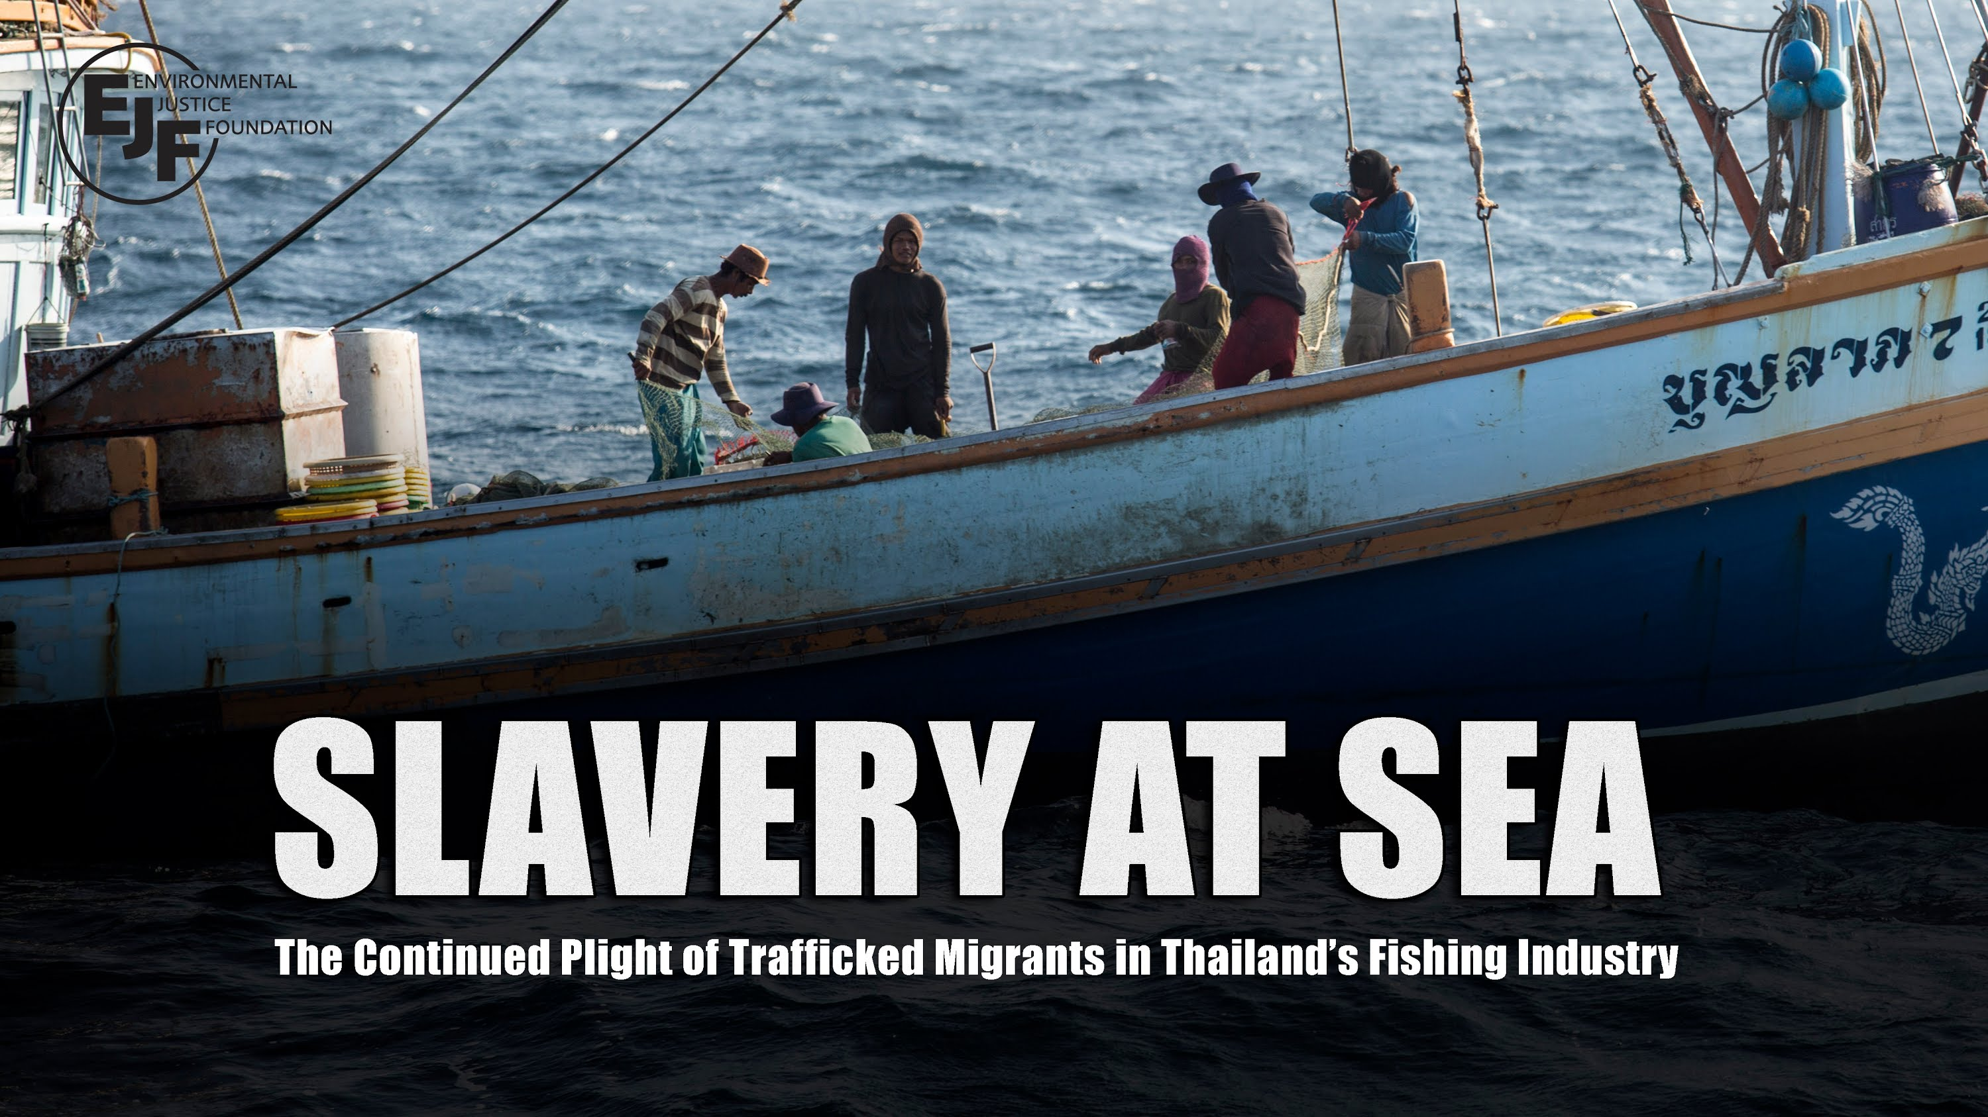
Violations of human rights in global seafood value chains
2. Ignores social justice: slavery at sea
Kittinger. et al. (2018). Science.
Notes:
Under-investment in maintaining the viability of marine systems and the human communities that depend on them, coupled with soaring global demand leads to a race to the bottom, where competition to produce, in the absence of adequate regulation, leads to neglect or deliberate violation of human rights – rights to decent work, children’s rights, women’s rights and so on…

Slide 35
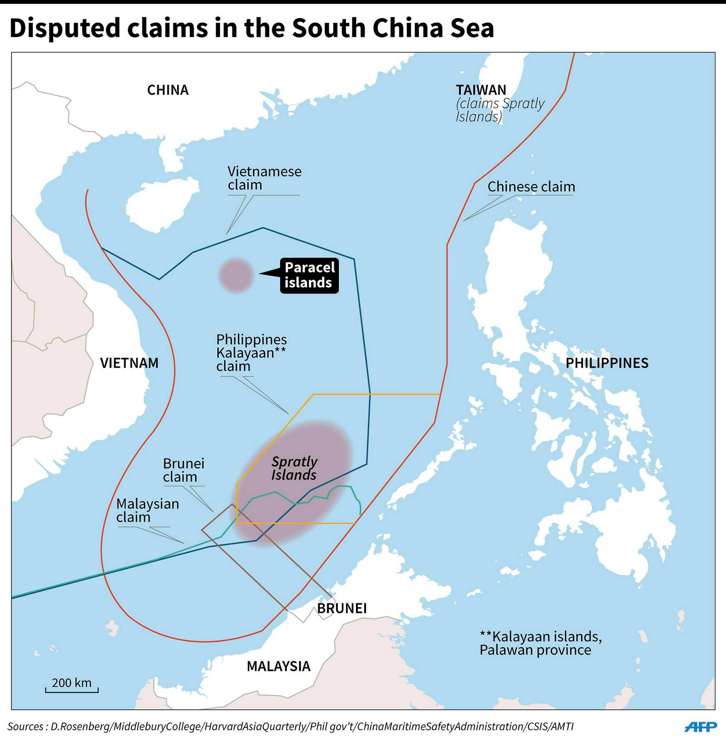
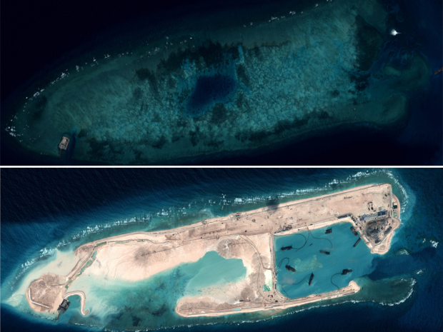
Resource grabs and maritime sovereignty disputes
2. Ignores social justice: fuels conflict
Fabinyi 2019 check
Notes:
Consequences
A potential global flashpoint – South China Sea.

Slide 36
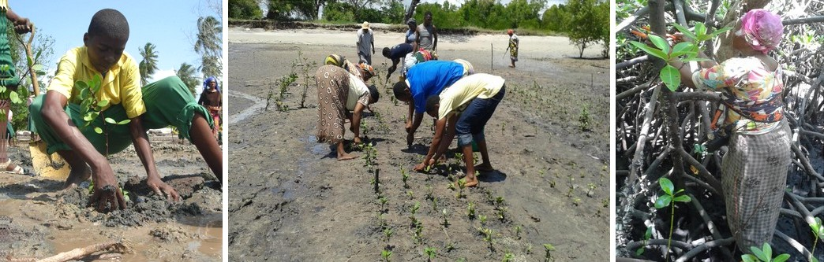
3. Undermines labor
Photos: coast week GEF
Neimark et al (in press) Antipode
#ShowYourStripes
https://showyourstripes.info/
Notes:
Though participation in projects has been around since the 80’s. What is new, is that, despite their contribution to the creation of financial value from ecosystem services, these local contributions often lack formal recognition, conceptualization and appropriate compensation in green economy initiatives.
Despite recent attention to ‘frontier’ green economies and the governance of emerging ecosystem services, the specific division of labour in these economies has been little studied. As many such initiatives are in the global south, labour’s marginality potentially contributes to the existing precariousness of those who are more often identified as ‘participants’. This article examines the roles and vulnerabilities of these actors: the carbon counters, species identifiers, GIS mappers, tree planters and others operating in the shadows. We draw on current understandings of labour and precarity to examine the geographical contours of an apparent and emerging ‘eco-precariat’: a socio-economically diverse group of labourers that address the volatile demands of an ever-expanding environmental service-based economy. We illustrate our analysis through examples from different case studies, including a Blue Carbon project in Kenya, ecosystem services project in the Philippines, and REDD+ scheme in Cambodia. We use these examples to theorize the nature of labour in these frontier economies and put forward a framework for analysing the eco-precariat. We highlight the need to understand the precarity and marginalization potentially created by this green division of labour in the provision of new ecosystem products and services. This framework contributes to ongoing analyses of labour as a central part of the green economy discourse and to larger discussions in the geographies of labour literature around the future of work in the global south and beyond.

Slide 37
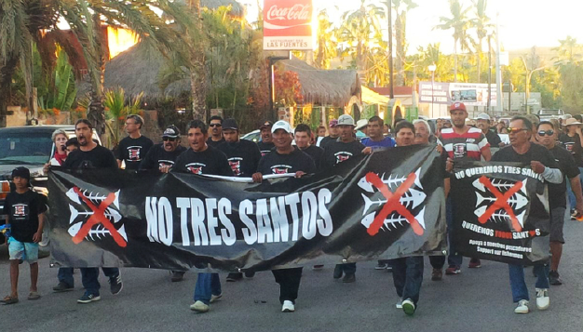
Coastal Squeeze: Displacement of small-scale fishing communities happens on land as well as at sea
3. Undermines labor: Displacement of SSF on land and sea
Cohen et al., 2019 Front. Mar. Sci
#ShowYourStripes
https://showyourstripes.info/
Notes:
e.g. Beach resort development in Baja California, Mexico www.patrimoniofilm.com

Slide 38
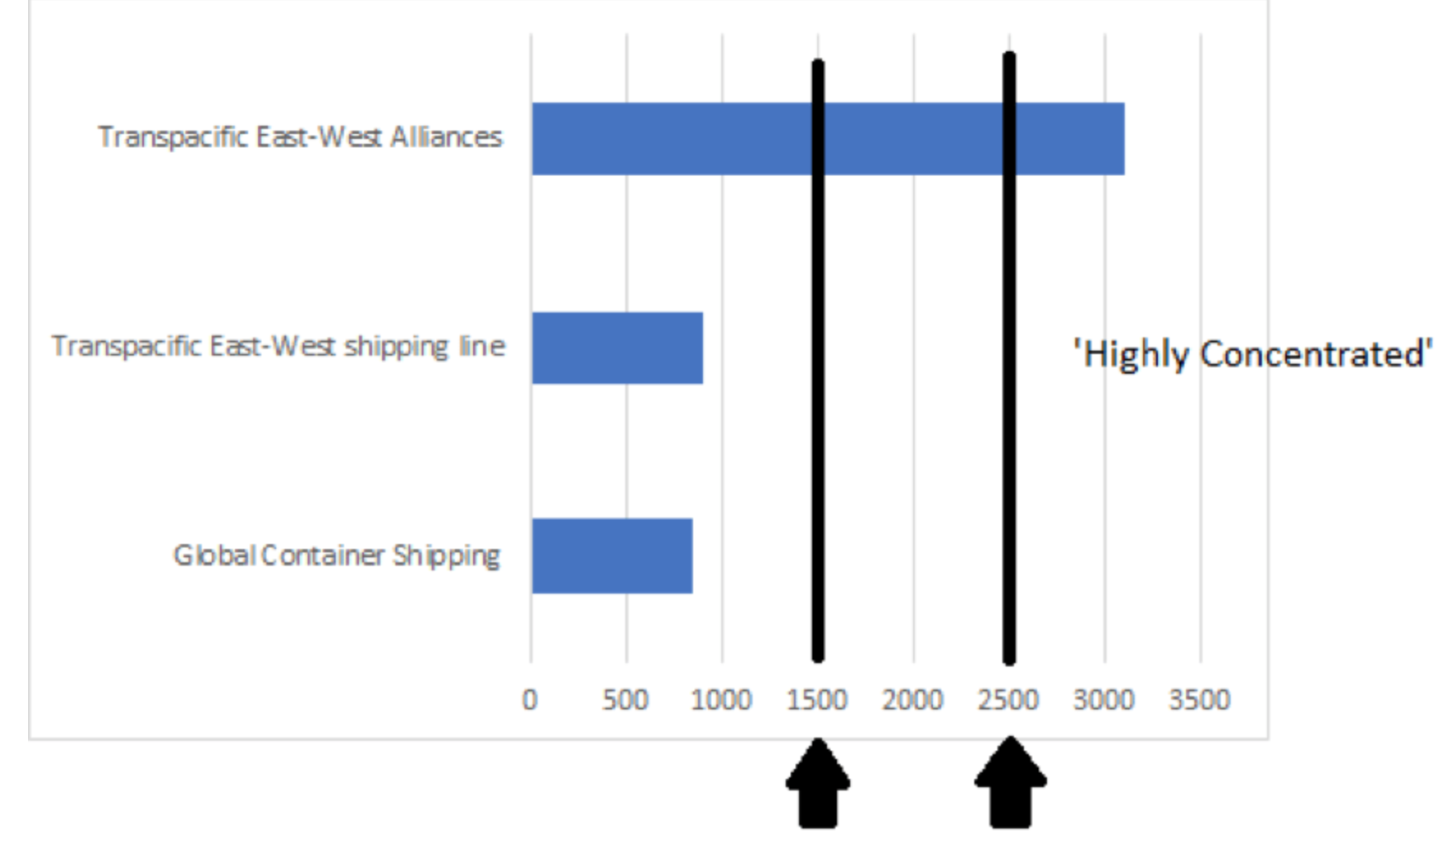
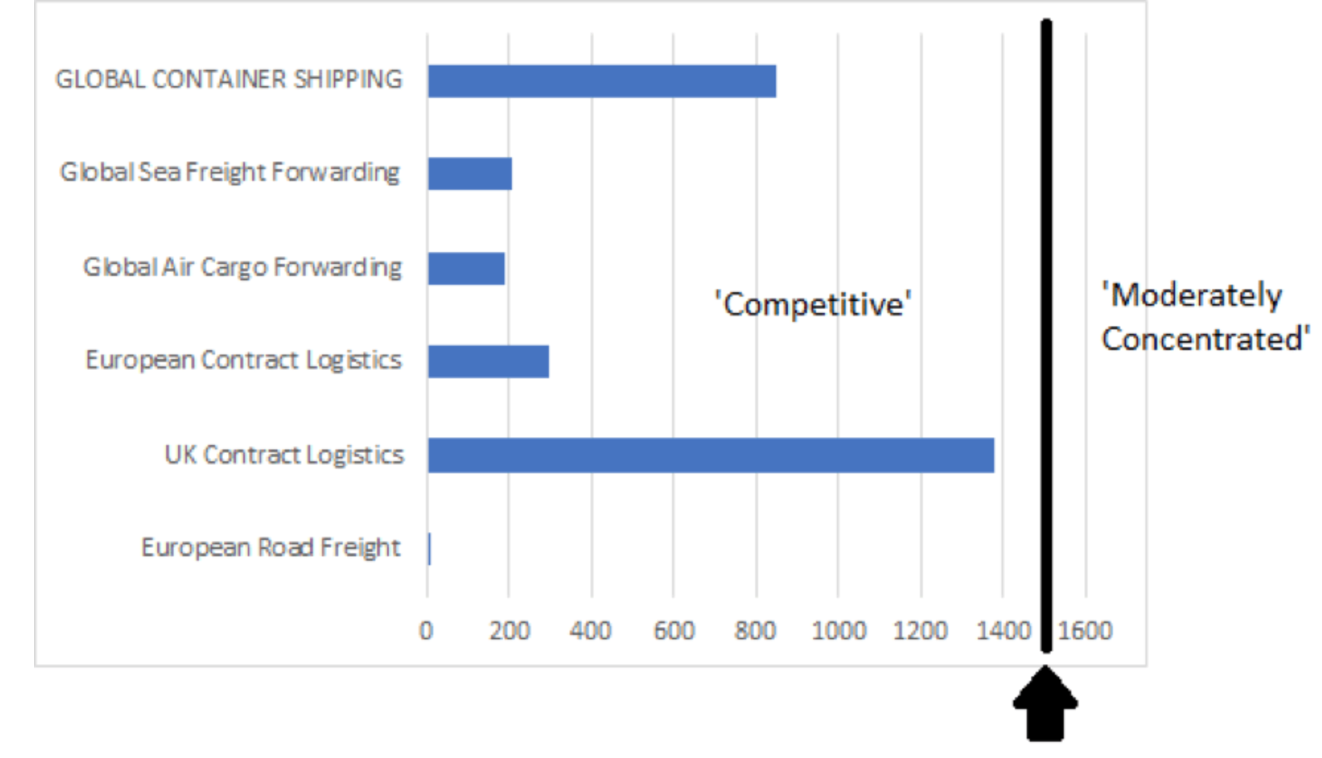
4. Consolidates power: container shipping
IN 2015, 10 companies shipped 65% of the world’s containers.
By 2017, the top 10 companies shipped 80.6%
Herfindahl-Hirschman concentration Index for selected logistics and transportation sectors
H-H index, global and Transpacific shipping
Manners-Bell (2018) Consolidation and trends in the global container shipping industry Ti Market Insights #3

Slide 39
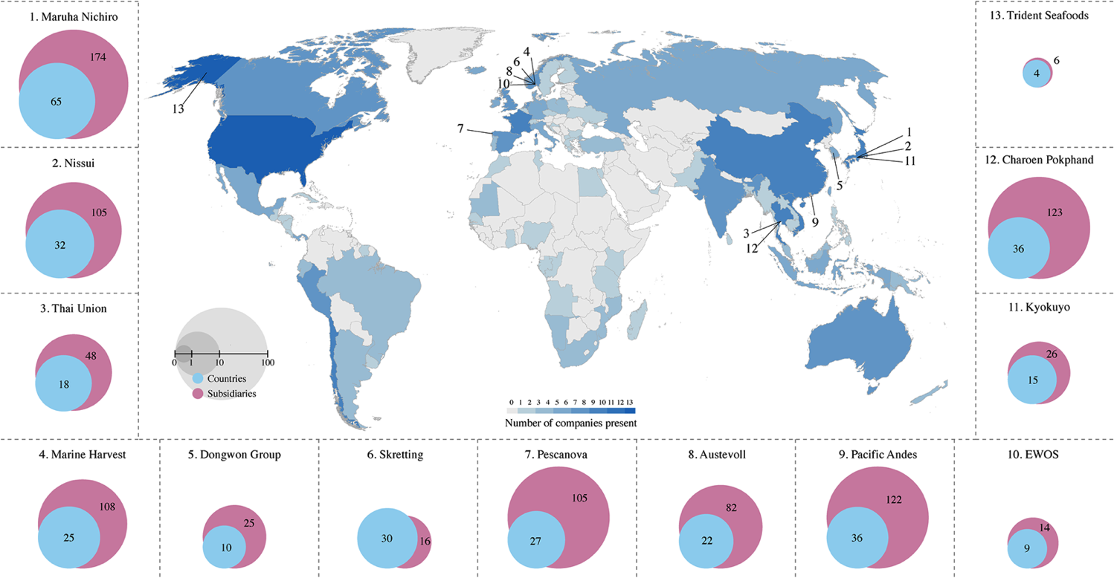
4. Consolidates power: seafood trade
Just eighteen corporations control global trade in seafood
Osterblom et al 2015 PlosONE
#ShowYourStripes
https://showyourstripes.info/

Slide 40
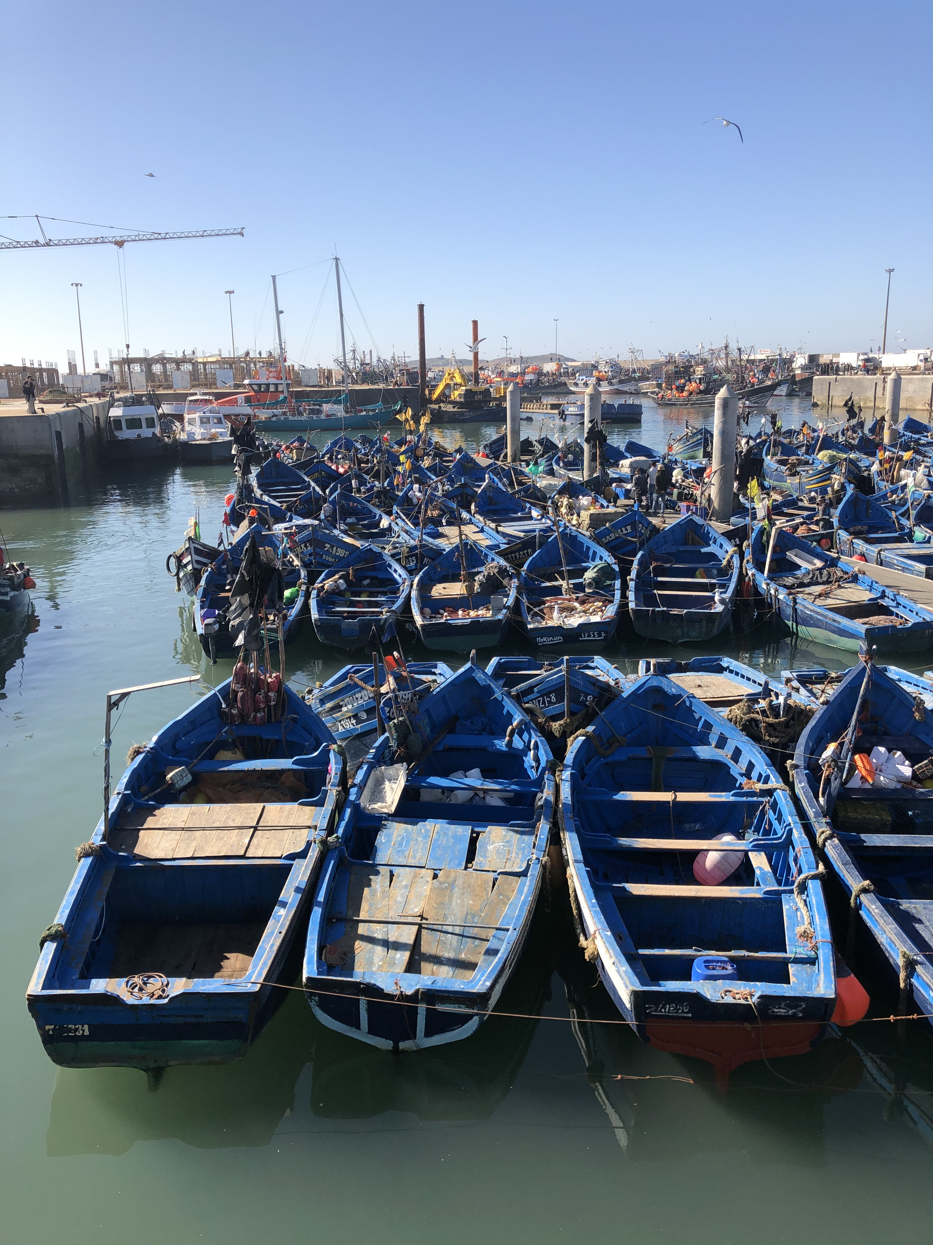
What is happening?
Drives ecosystem collapse
Ignores social justice
  Cerates and exacerbates inequities
  Fuels conflict
Undermines labor
  Precarity
Consolidates power
  Race to capitalizes the oceans- to turn them into capital
#ShowYourStripes
Jouffrey et al (in press) One Earth
https://showyourstripes.info/
Notes:
Homogenizes the ocean at an international scale,
Dependent
Deregulation
Privatization
Competing claims

Slide 41
Transformation imperative
A ‘significant reordering that challenges existing structures to produce fundamentally novel relationships (Brown 2015; O’Brien 2012; Pelling 2010)
  Already under way changing our relationships with the ocean
The promise of prosperity is alluring, but the core contradiction of capitalism is borne out here- that of increased poverty.
  While exacerbating environmental decline
The new values that this transformation reflects lacks legitimacy
  Will the BE provides that legitimacy?
  If these values do not represent the communities and actors we represent then we have a duty to act
#ShowYourStripes
https://showyourstripes.info/
Notes:
Other material benefits
The Oceans have also, for centuries, been a source of food, materials, and income. Fish, remains a vital source of animal protein, particularly in places like Africa and Asia where though people on average eat less fish, the fish they do eat makes a greater proportion of their animal protein.
SSF in particular comprise approximately half of global catches, but if we look at their labour contributions they dwarf all other fisheries. They employ >90% of those engaged in fisheries worldwide, the majority of them are in low income countries, and nearly half are women.
Making fisheries a critical source of food and employment.

Slide 42
The dark side of transformation
(Blythe 2019 Antipode)

Slide 43
Transformation imperative
Access and control is clearly important, but is resistance here enough?
Entanglement of materials and sociocultural relations
Need to:
  challenge hegemonic power
  resist valorization of a homogenized value
Redefine/reclaim what is of value, starting from a social justice foundation, with human society at the core
#ShowYourStripes
https://showyourstripes.info/
Notes:
Other material benefits
The Oceans have also, for centuries, been a source of food, materials, and income. Fish, remains a vital source of animal protein, particularly in places like Africa and Asia where though people on average eat less fish, the fish they do eat makes a greater proportion of their animal protein.
SSF in particular comprise approximately half of global catches, but if we look at their labour contributions they dwarf all other fisheries. They employ >90% of those engaged in fisheries worldwide, the majority of them are in low income countries, and nearly half are women.
Making fisheries a critical source of food and employment.

Slide 44
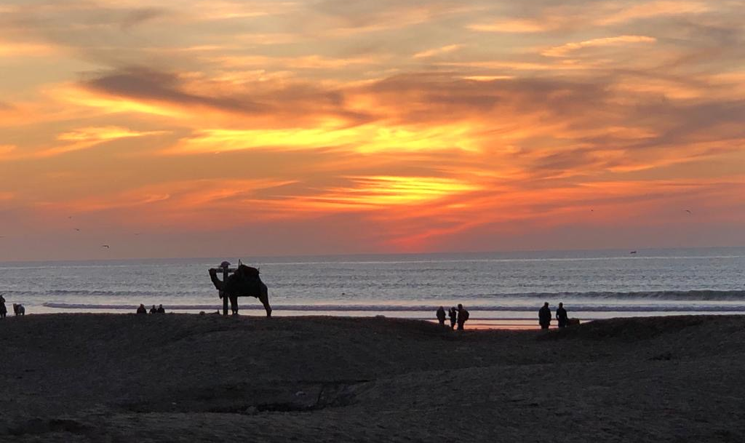
Thankyou
#ShowYourStripes
https://showyourstripes.info/

Slide 45
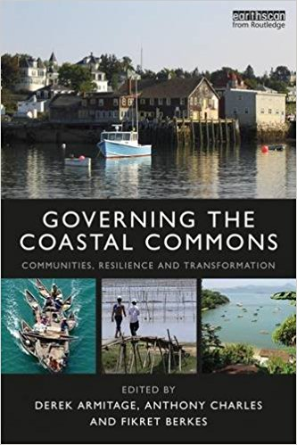


Beyond the blue economy: towards a blue society?
#ShowYourStripes
https://showyourstripes.info/
Notes:
There are encouraging signs that other visions of the future ocean are emerging, New books in 2016/2017 that explore contemporary shifts in ocean and coastal governance and that explore the range of values that links us to the sea. Many are from MARE associated authors.
These are, in a sense, a challenge to the hegemony of the blue economy

Slide 46
#ShowYourStripes
https://showyourstripes.info/
Notes:
Other material benefits
The Oceans have also, for centuries, been a source of food, materials, and income. Fish, remains a vital source of animal protein, particularly in places like Africa and Asia where though people on average eat less fish, the fish they do eat makes a greater proportion of their animal protein.
SSF in particular comprise approximately half of global catches, but if we look at their labour contributions they dwarf all other fisheries. They employ >90% of those engaged in fisheries worldwide, the majority of them are in low income countries, and nearly half are women.
Making fisheries a critical source of food and employment.

Slide 47

#ShowYourStripes
https://showyourstripes.info/
Notes:
Other material benefits
The Oceans have also, for centuries, been a source of food, materials, and income. Fish, remains a vital source of animal protein, particularly in places like Africa and Asia where though people on average eat less fish, the fish they do eat makes a greater proportion of their animal protein.
SSF in particular comprise approximately half of global catches, but if we look at their labour contributions they dwarf all other fisheries. They employ >90% of those engaged in fisheries worldwide, the majority of them are in low income countries, and nearly half are women.
Making fisheries a critical source of food and employment.

Slide 48

#ShowYourStripes
https://showyourstripes.info/

