Slide 1

The Ecosystem approach as frame for the coherent implementation of sdg14
  Daniela Diz, University of Strathclyde
  Transformed and Transformative Ocean Governance Conference
  PE, 22 January 2020

Slide 2
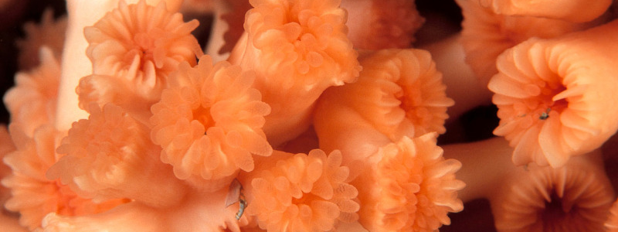
Overview
Law of the Sea and the CBD: Marine biodiversity conservation & the EA
SDG 14: special focus on SDG14.5 and Aichi Target 11
2020 Super Year for Oceans

Slide 3

The law of the sea
A legal order for the seas and oceans to facilitate international communication, and promote the peaceful uses of the seas and oceans, the equitable and efficient utilization of their resources, the conservation of their living resources, and the study, protection and preservation of the marine environment
© Sebastiao Salgado

Slide 4
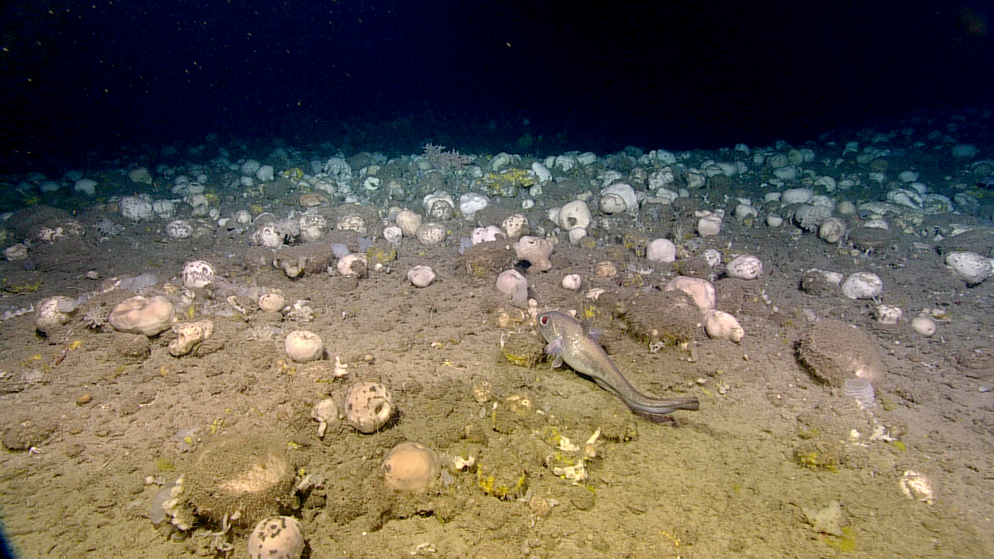
Ecosystem approach reflected in UNCLOS and UNFSA
  Conscious that the problems of ocean space are closely interrelated and need to be considered as a whole (UNCLOS)
  Take into account interdependence of stocks and any generally recommended international minimum standards (regional or global)(UNCLOS and UNFSA)
Notes:
Best scientific evidence
Associated or dependent stocks
generally recommended international minimum standards
UNFSA: ecosystem & precautionary approach
Long-term sustainability & impact assessment
Precautionary reference points
Protection of biodiversity
Ecosystem Approach (UNGA resolutions on Oceans and the Law of the Sea, the Future We Want, etc)
Recognition of competent organisations & delegation of powers.

Slide 5
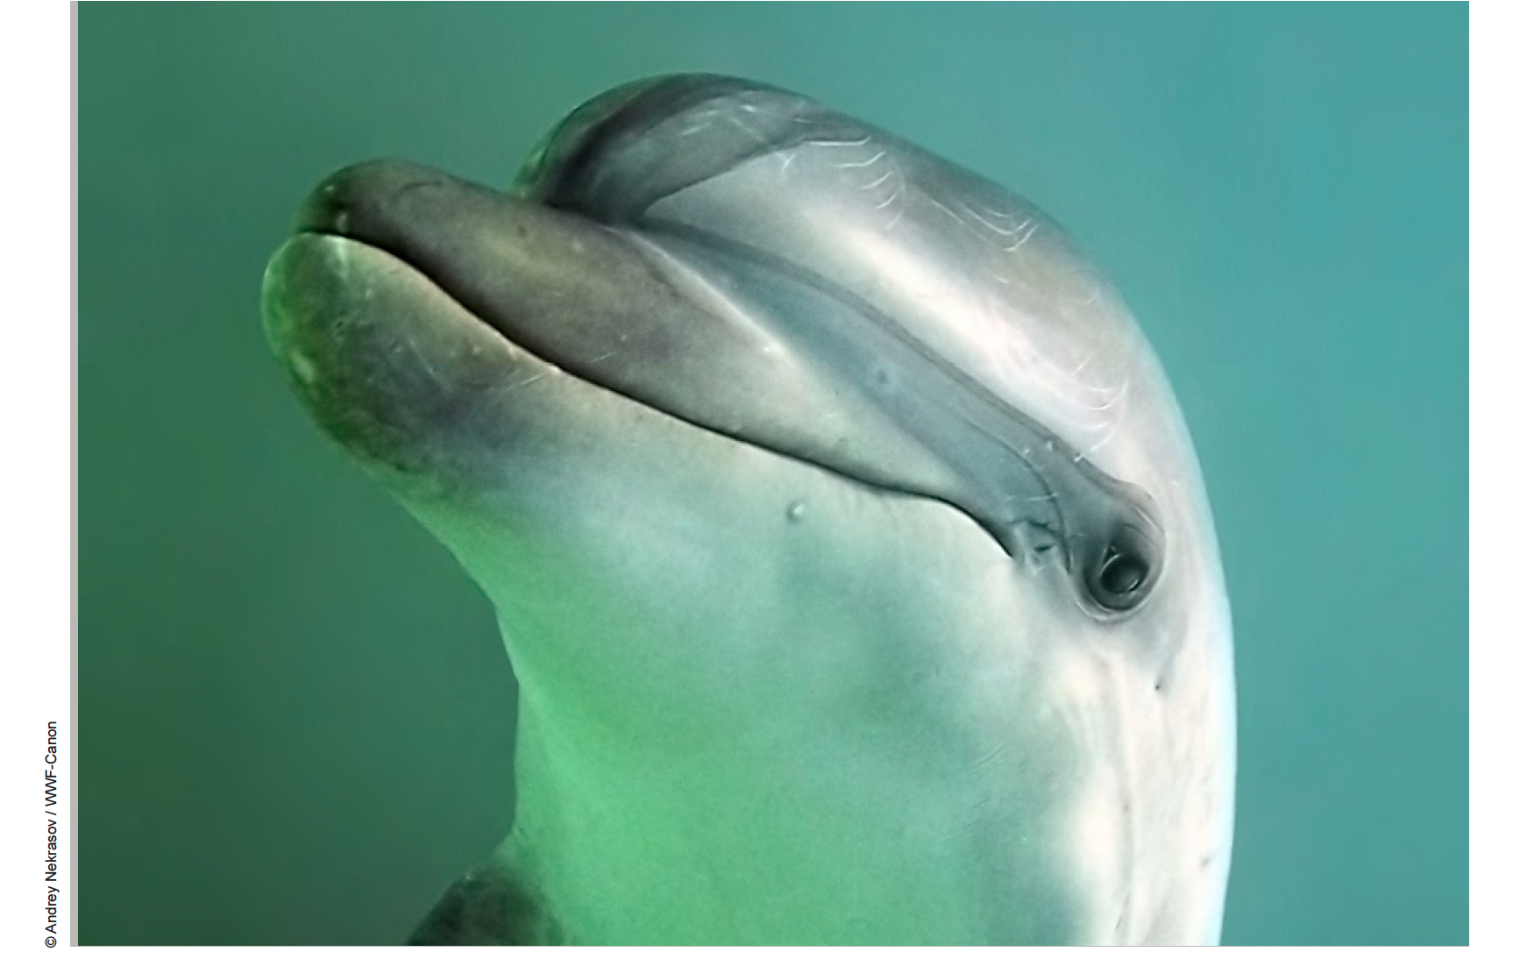
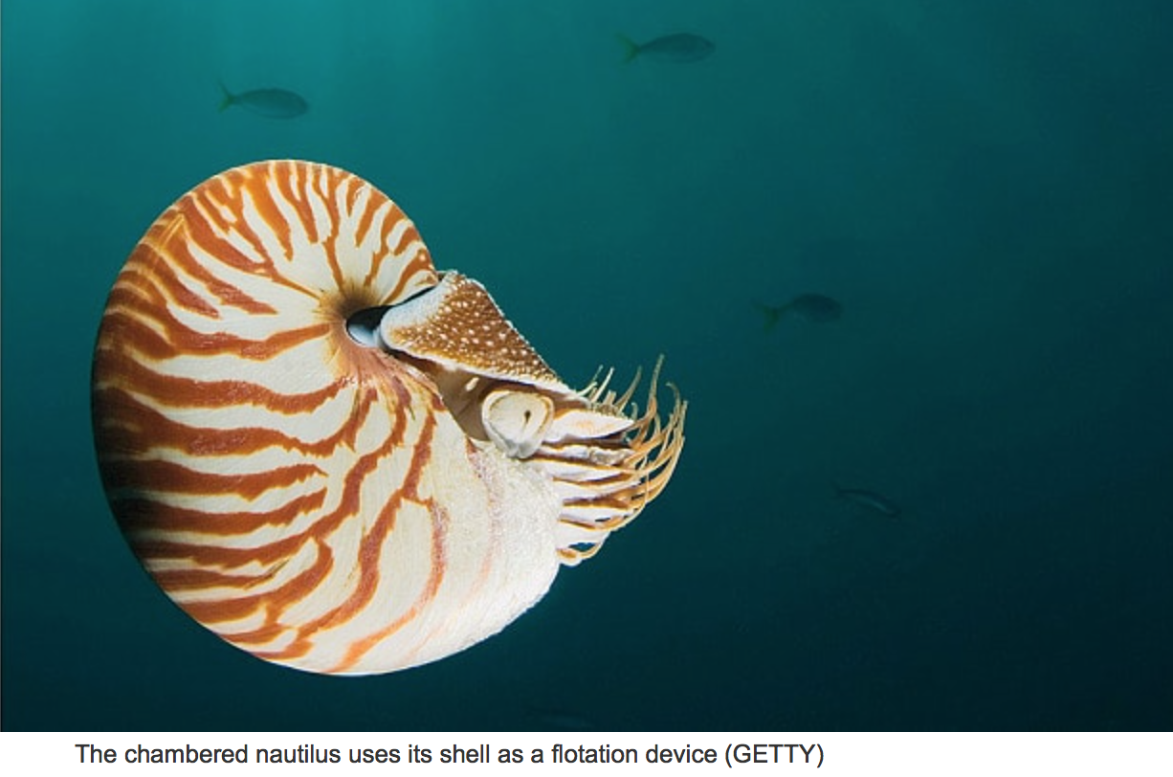
PROTECTION OF THE MARINE ENVIRONMENT
(Part XII)
Such measures shall include those necessary to protect and preserve rare or fragile ecosystems as well as the habitat of depleted, threatened or endangered species and other forms of marine life.
States have the obligation to protect and preserve the marine environment.
States shall take, individually or jointly as appropriate, all measures necessary to prevent, reduce and control pollution of the marine environment from any source
Notes:
Article 208
Pollution from seabed activities subject to national jurisdiction
1 Coastal States shall adopt laws and regulations to prevent, reduce and control pollution of the marine environment arising from or in connection with seabed activities subject to their jurisdiction and from artificial islands, installations and structures under their jurisdiction, pursuant to articles 60 and 80.
2. States shall take other measures as may be necessary to prevent, reduce and control such pollution.
3. Such laws, regulations and measures shall be no less effective than international rules, standards and recommended practices and procedures.
4. States shall endeavour to harmonize their policies in this connection at the appropriate regional level.
5. States, acting especially through competent international organizations or diplomatic conference, shall establish global and regional rules, standards and recommended practices and procedures to prevent, reduce and control pollution of the marine environment referred to in paragraph l. Such rules, standards and recommended practices and procedures shall be re-examined from time to time as necessary.
Article 209
Pollution from activities in the Area
1. International rules, regulations and procedures shall be established in accordance with Part XI to prevent, reduce and control pollution of the marine environment from activities in the Area. Such rules, regulations and procedures shall be re-examined from time to time as necessary.
2. Subject to the relevant provisions of this section, States shall adopt laws and regulations to prevent, reduce and control pollution of the marine environment from activities in the Area undertaken by vessels, installations, structures and other devices flying their flag or of their registry or operating under their authority, as the case may be. The requirements of such laws and regulations shall be no less effective than the international rules, regulations and procedures referred to in paragraph 1.

Slide 6
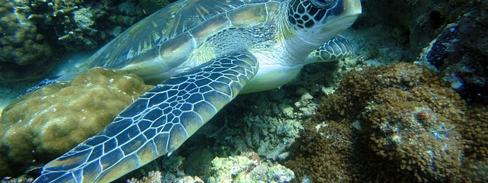
CBD objectives
Conservation of biodiversity
Sustainable use of its components
Fair and equitable access and benefit sharing regarding the utilization of genetic resources
Notes:
Conservation of biodiversity is a common concern of humankind – CBD preambular para.
The objectives of this Convention, to be pursued in accordance with its relevant provisions, are the conservation of biological diversity, the sustainable use of its components and the fair and equitable sharing of the benefits arising out of the utilization of genetic resources, including by appropriate access to genetic resources and by appropriate transfer of relevant technologies, taking into account all rights over those resources and to technologies, and by appropriate funding.
CBD may have modified UNCLOS to the extent that certain activities regulated by UNCLOS (fishing, for instance) cause or threaten serious damage to biodiversity
CBD Art. 5: Each Party shall, as far as possible and as appropriate, cooperate with other Parties, directly or, where appropriate, through competent international organizations, in respect of areas beyond national jurisdiction and on other matters of mutual interest, for the conservation and sustainable use of biological diversity.

Slide 7
CBD Jurisdictional Scope
The CBD provisions apply:
(a) In the case of components of biological diversity, in areas within the limits of its national jurisdiction; and
(b) In the case of processes and activities, regardless of where their effects occur, carried out under its jurisdiction or control, within the area of its national jurisdiction or beyond the limits of national jurisdiction.
Notes:
Conservation of biodiversity is a common concern of humankind – CBD preambular para.
The objectives of this Convention, to be pursued in accordance with its relevant provisions, are the conservation of biological diversity, the sustainable use of its components and the fair and equitable sharing of the benefits arising out of the utilization of genetic resources, including by appropriate access to genetic resources and by appropriate transfer of relevant technologies, taking into account all rights over those resources and to technologies, and by appropriate funding.
CBD may have modified UNCLOS to the extent that certain activities regulated by UNCLOS (fishing, for instance) cause or threaten serious damage to biodiversity
CBD Art. 5: Each Party shall, as far as possible and as appropriate, cooperate with other Parties, directly or, where appropriate, through competent international organizations, in respect of areas beyond national jurisdiction and on other matters of mutual interest, for the conservation and sustainable use of biological diversity.

Slide 8
Ecosystem approach under the cbd
Societal choice
Decentralised management
Effects of activities on adjacent and other ecosystems should be considered
Market distortions that affect biodiversity should be reduced & alignment of biodiversity conservation and sustainable use incentives
Internalisation of costs
Conservation of ecosystem structure and functioning to maintain ES
Ecosystem management within the limits of their functioning
Appropriate spatial and temporal scales
Long-term conservation objectives
Proper balance between conservation and sustainable use
All sources of knowledge should be incorporated (scientific, TK, local)
Involvement of all sectors

Slide 9
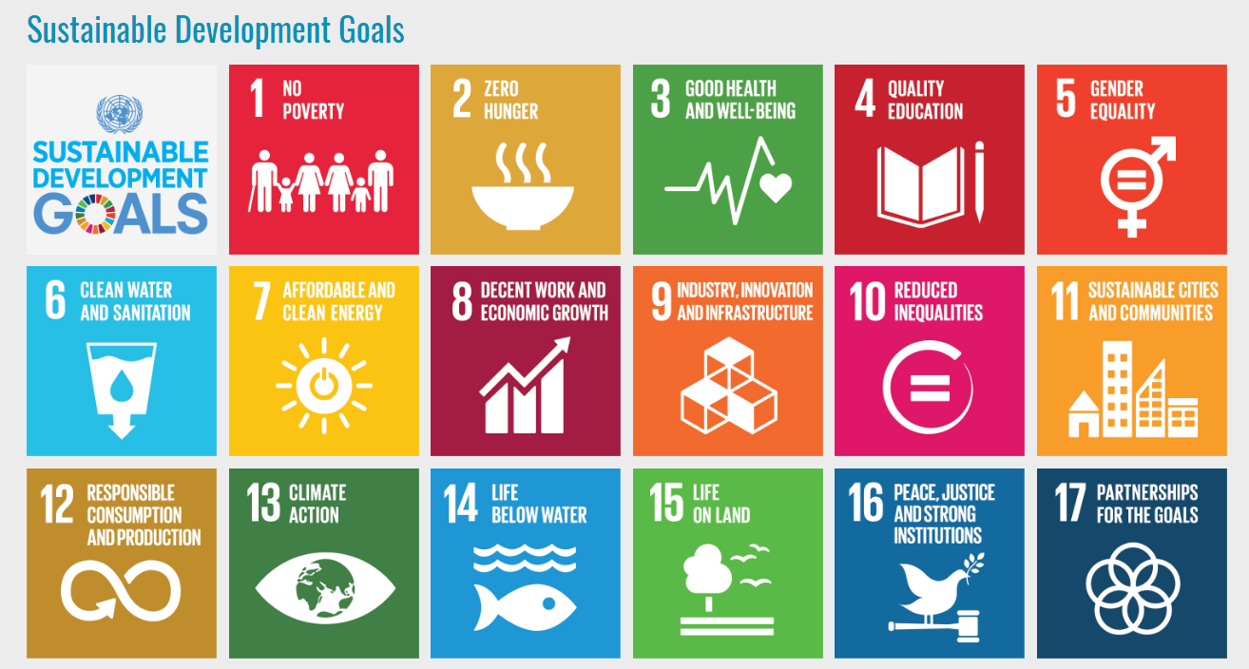
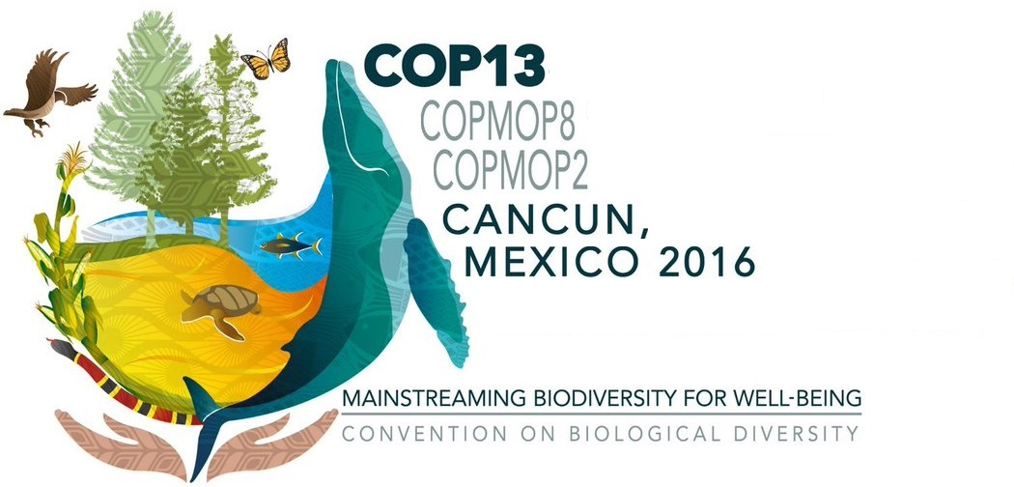
Mainstreaming biodiversity into the sdgs
Notes:
Mainstreaming, para 11: “Calls upon Parties and invites other Governments to take measures to support and ensure close linkages and reinforce synergies among biodiversity-related and other international processes and multilateral environmental agreements, to implement their various goals and commitments in a coherent, clear, and mutually supportive manner, and to include biodiversity considerations in their engagement in these various processes, where relevant, and to implement goals and commitments under the Convention and relevant international processes in a coherent manner;”
Para 14 “Urges Parties, when implementing the 2030 Agenda for Sustainable Development, to mainstream biodiversity in the implementation of all relevant [SDGs] thus promoting linkages between efforts to implement national biodiversity strategies and action plans and [SDGs]
, identify potential measures to contribute to the health and resilience of ecosystems and consider spatial and regional approaches as well as appropriate measures to promote the conservation and restoration of areas of particular importance for biodiversity and ecosystem services and functions, habitats of threatened species, and recovery of endangered species;”
Encourages competent intergovernmental organizations to create opportunities for communities to benefit from alternative uses of those resources, such as ecotourism in parallel with artisanal fishing, where appropriate;

Slide 10
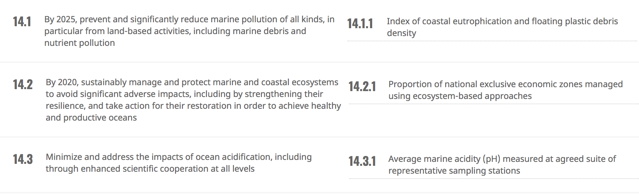
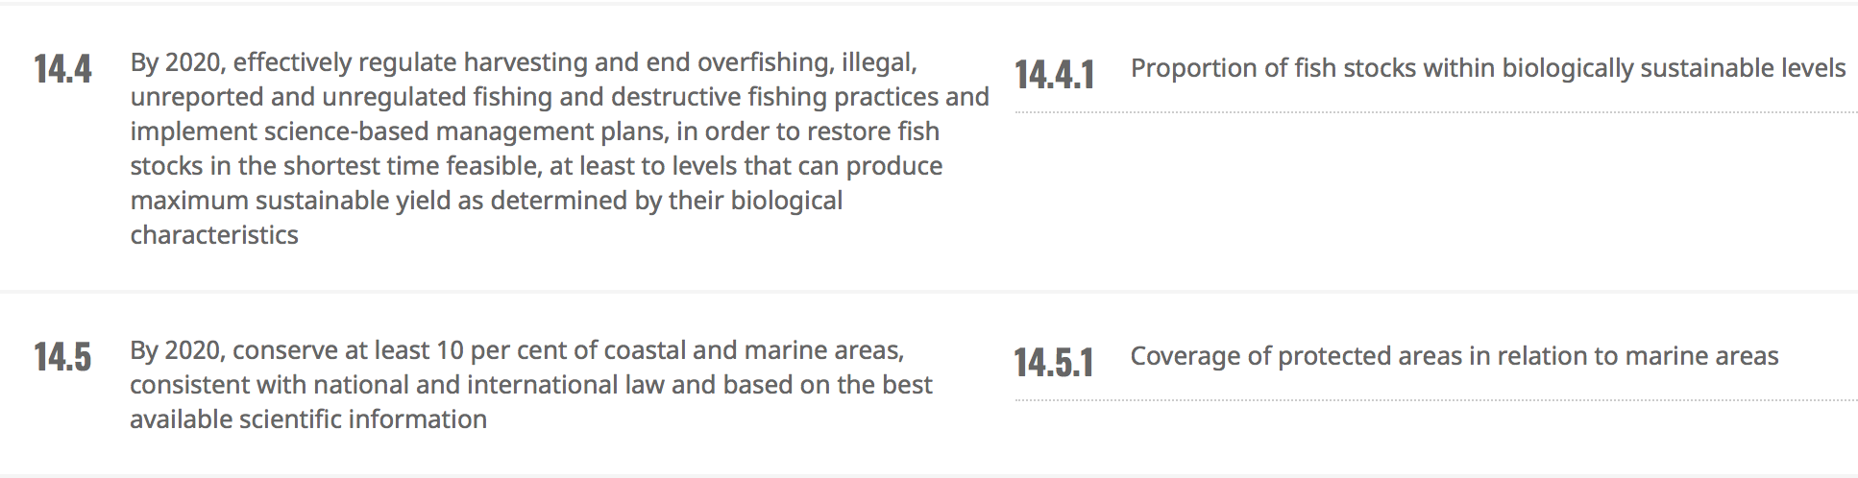
SDG 14

Slide 11
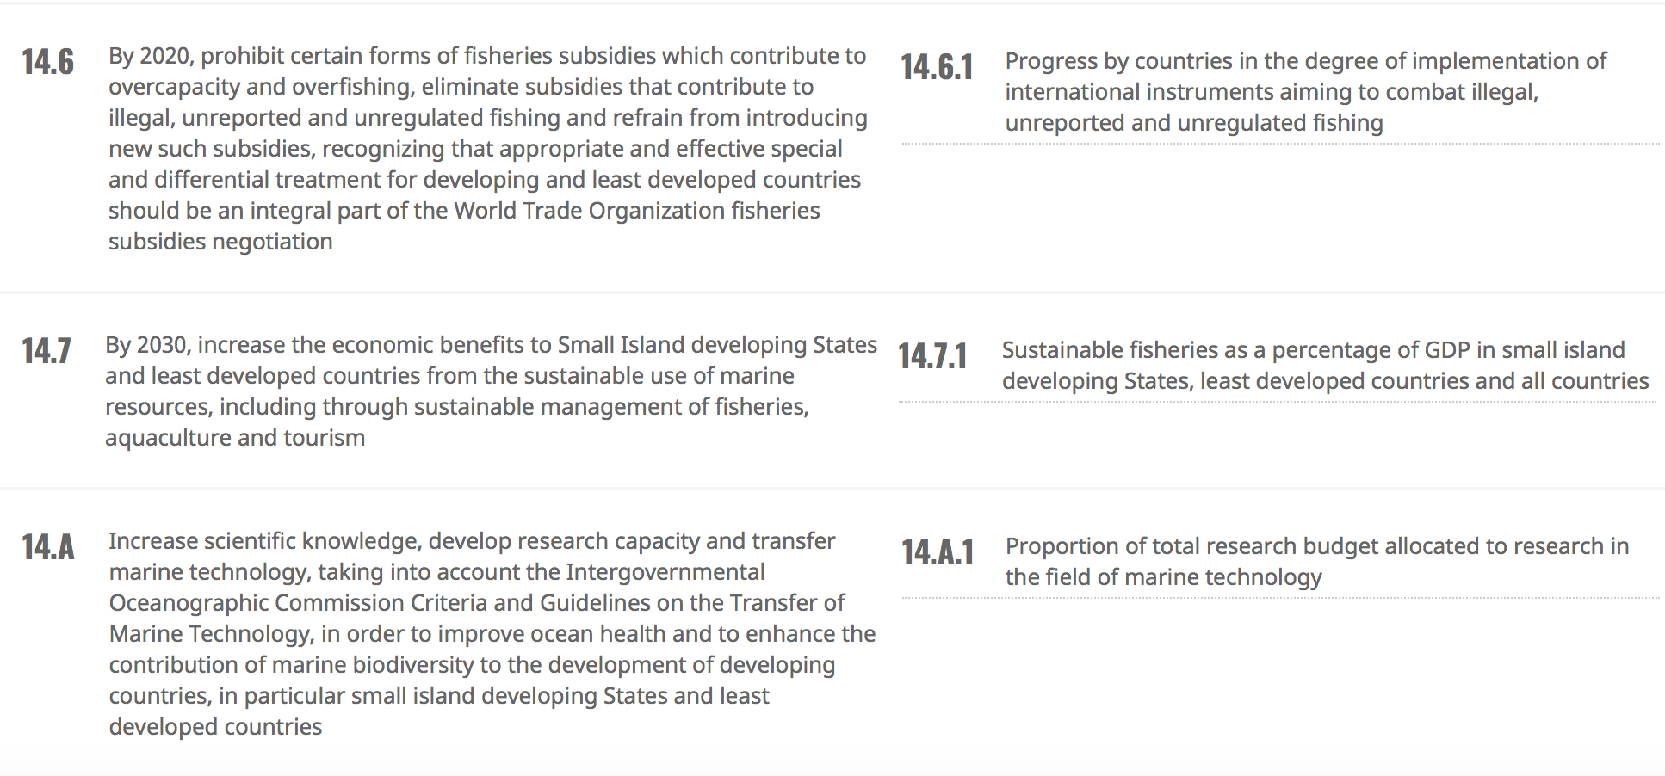
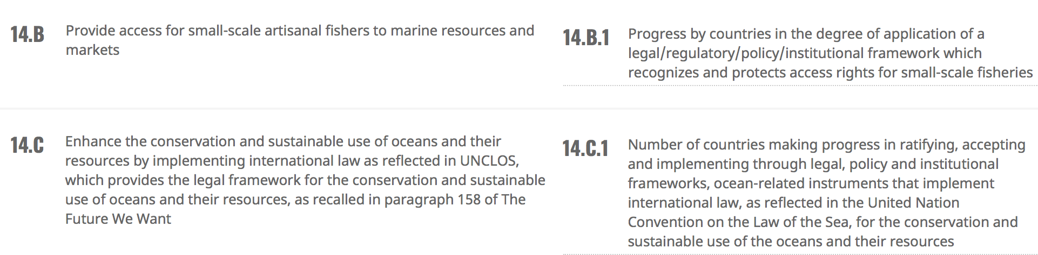

Slide 12



Area-based Management tools
CBD Aichi Target 11
By 2020, at least … 10 % of coastal and marine areas, especially areas of particular importance for biodiversity and ecosystem services, are conserved through
  effectively and equitably managed,
  ecologically representative and
  well connected systems of protected areas and
  other effective area-based conservation measures, and
  integrated into the wider … seascapes.
SDG 14.5
By 2020, conserve at least 10 % of coastal and marine areas, … based on the best available scientific information
Indicator: protected area coverage
Notes:
Mainstreaming, para 11: “Calls upon Parties and invites other Governments to take measures to support and ensure close linkages and reinforce synergies among biodiversity-related and other international processes and multilateral environmental agreements, to implement their various goals and commitments in a coherent, clear, and mutually supportive manner, and to include biodiversity considerations in their engagement in these various processes, where relevant, and to implement goals and commitments under the Convention and relevant international processes in a coherent manner;”
Para 14 “Urges Parties, when implementing the 2030 Agenda for Sustainable Development, to mainstream biodiversity in the implementation of all relevant [SDGs] thus promoting linkages between efforts to implement national biodiversity strategies and action plans and [SDGs]
, identify potential measures to contribute to the health and resilience of ecosystems and consider spatial and regional approaches as well as appropriate measures to promote the conservation and restoration of areas of particular importance for biodiversity and ecosystem services and functions, habitats of threatened species, and recovery of endangered species;”
Encourages competent intergovernmental organizations to create opportunities for communities to benefit from alternative uses of those resources, such as ecotourism in parallel with artisanal fishing, where appropriate;

Slide 13
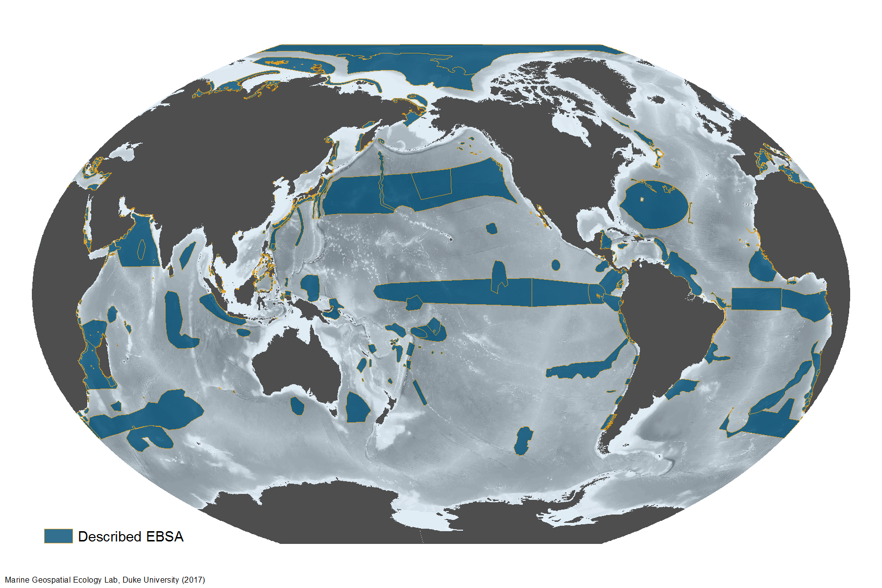
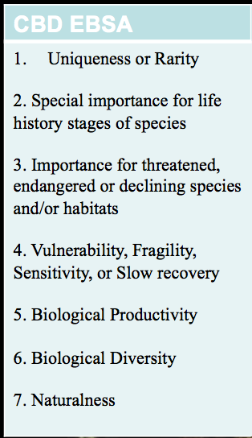
Areas important for biodiversity & ecosystem services

Slide 14
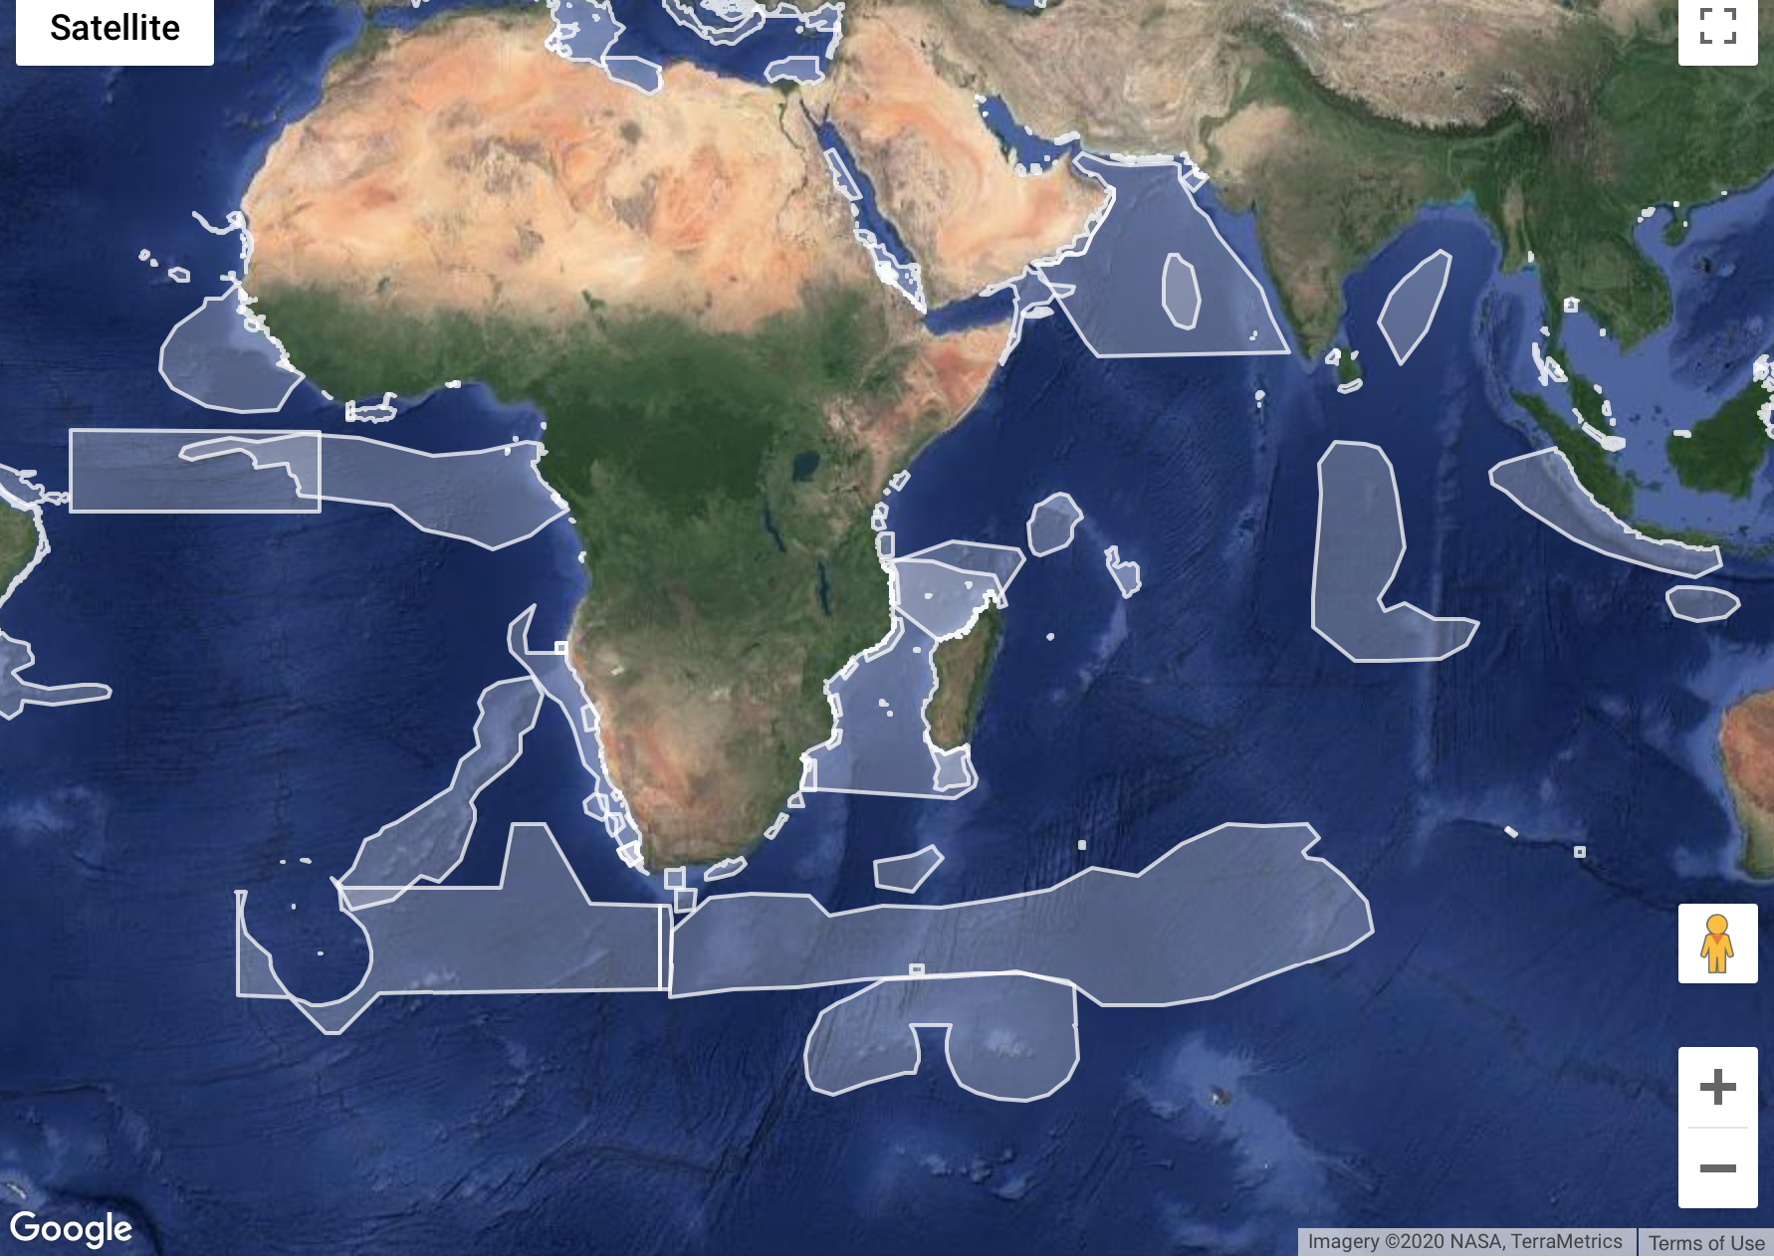

Slide 15
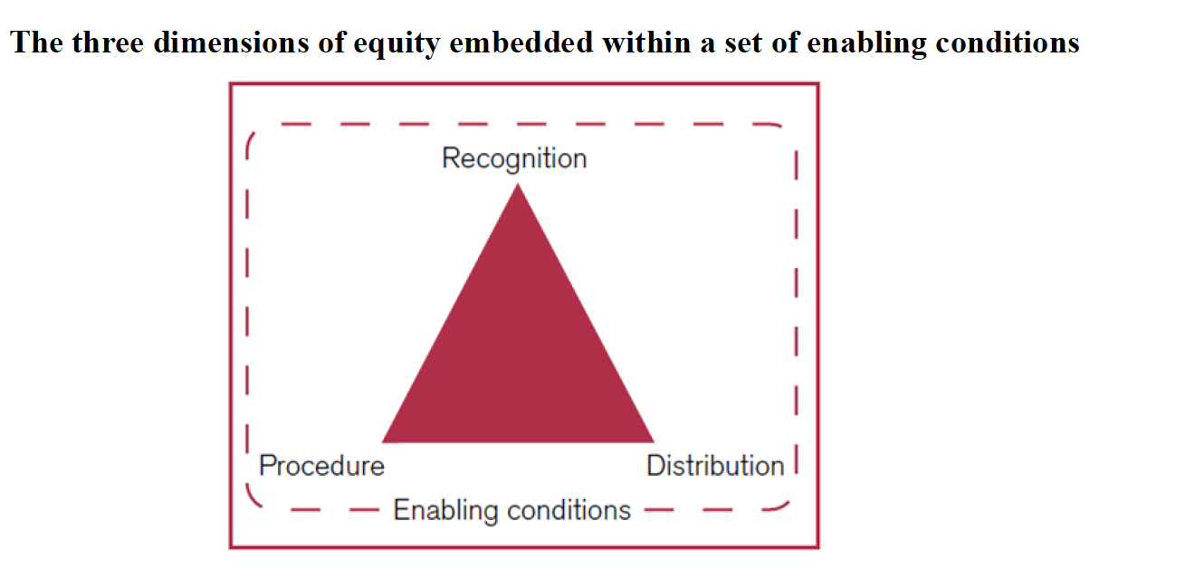
effectively and equitably managed
CBD Decision 14/8 (2018)
Notes:
See also WCMC indicators on this.

Slide 16
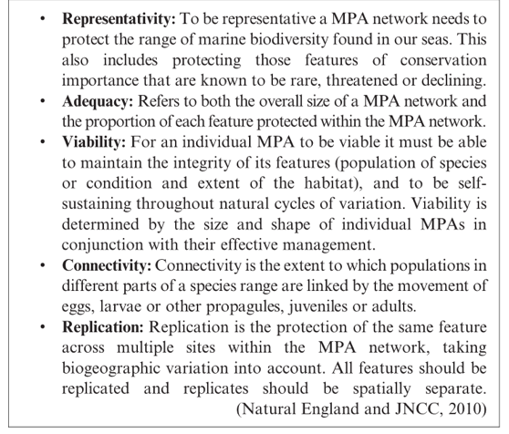
Ecologically representative MPA networks:
CBD Decision IX/20, Annex 2
EBSAs (CBD Decision IX/20, Annex 1)
Representativity
Connectivity
Replication
Adequate & viable sites

Slide 17
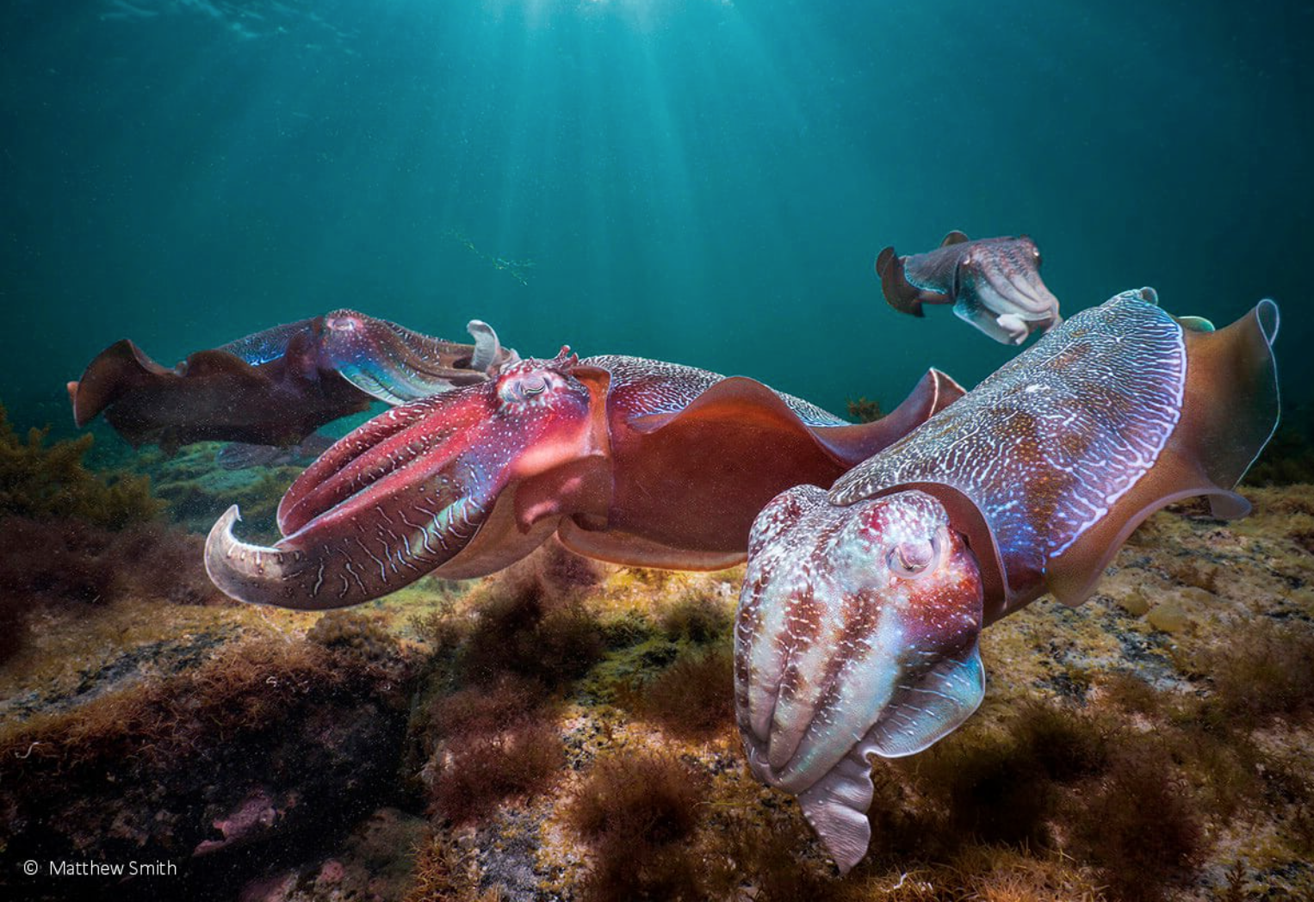
ABMT: Definition
“Area-based management tool” means a tool, including a marine protected area, for a geographically defined area through which one or several sectors or activities are managed with the aim of achieving particular conservation and sustainable use objectives [and affording higher protection than that provided in the surrounding areas].
(Rev draft text, Art 1 (3).

Slide 18
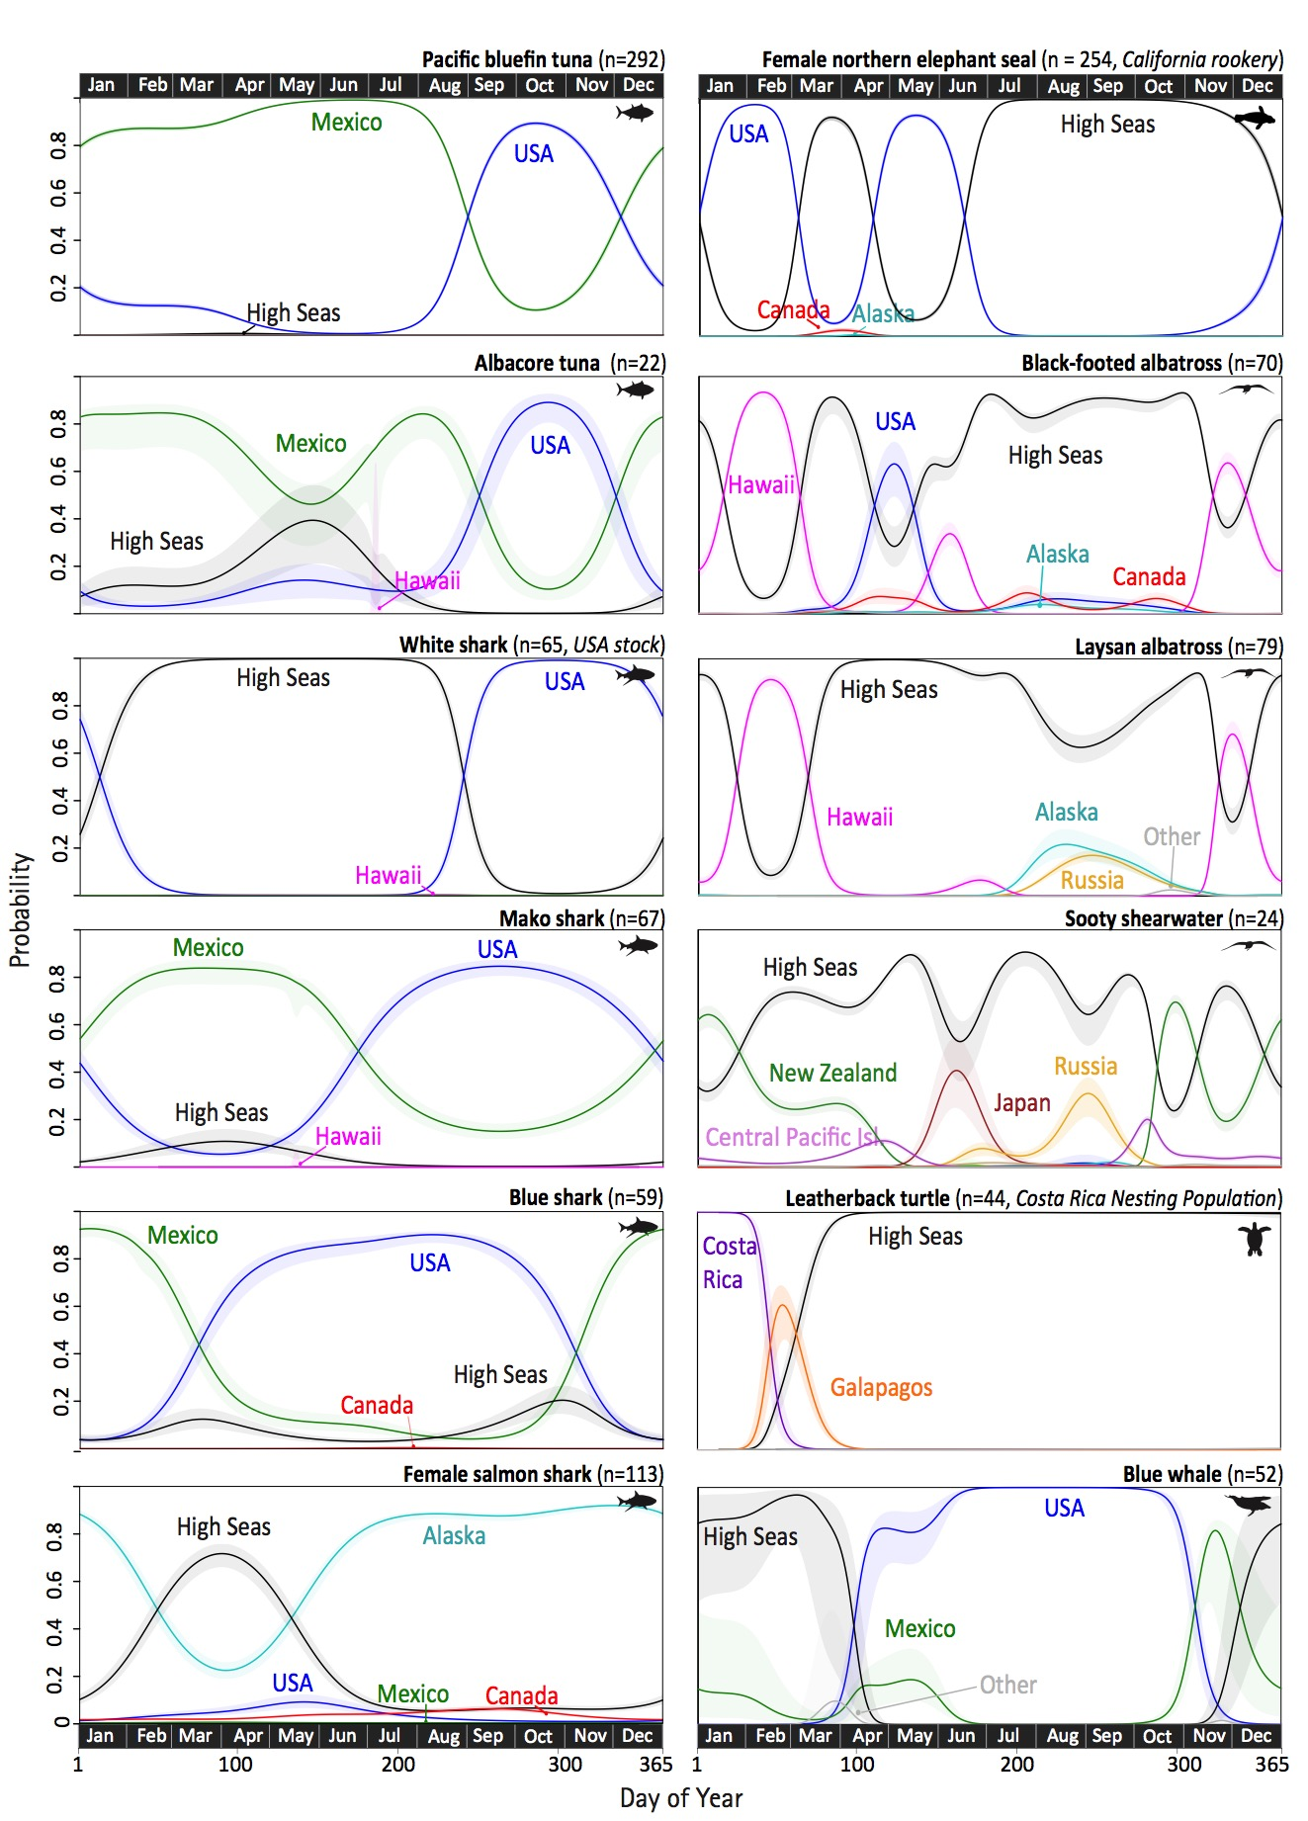
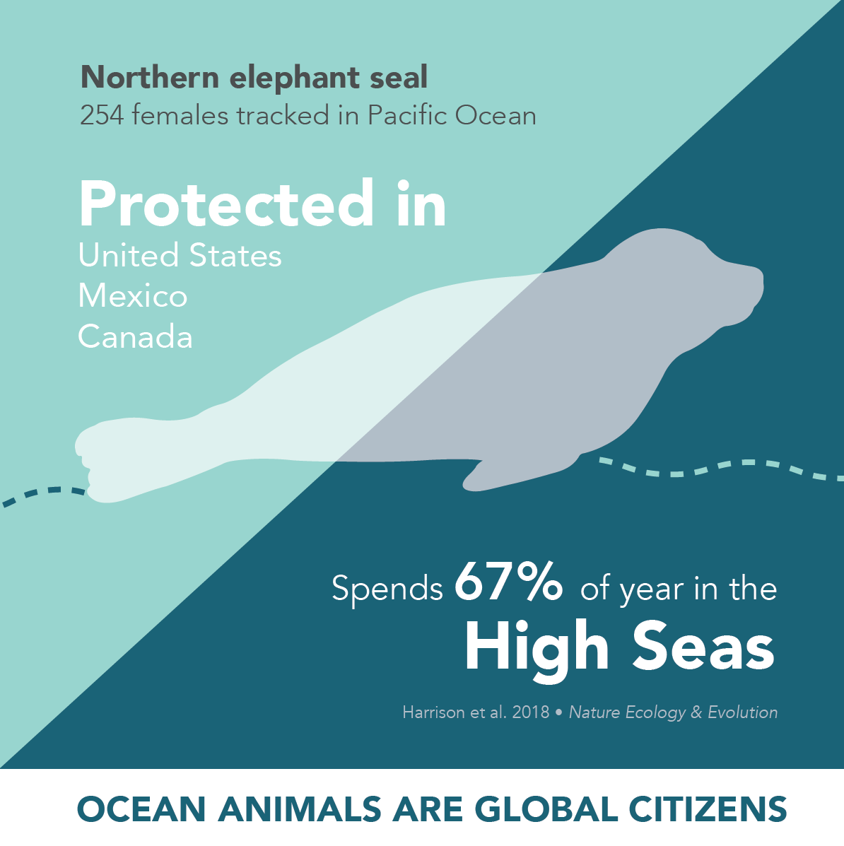
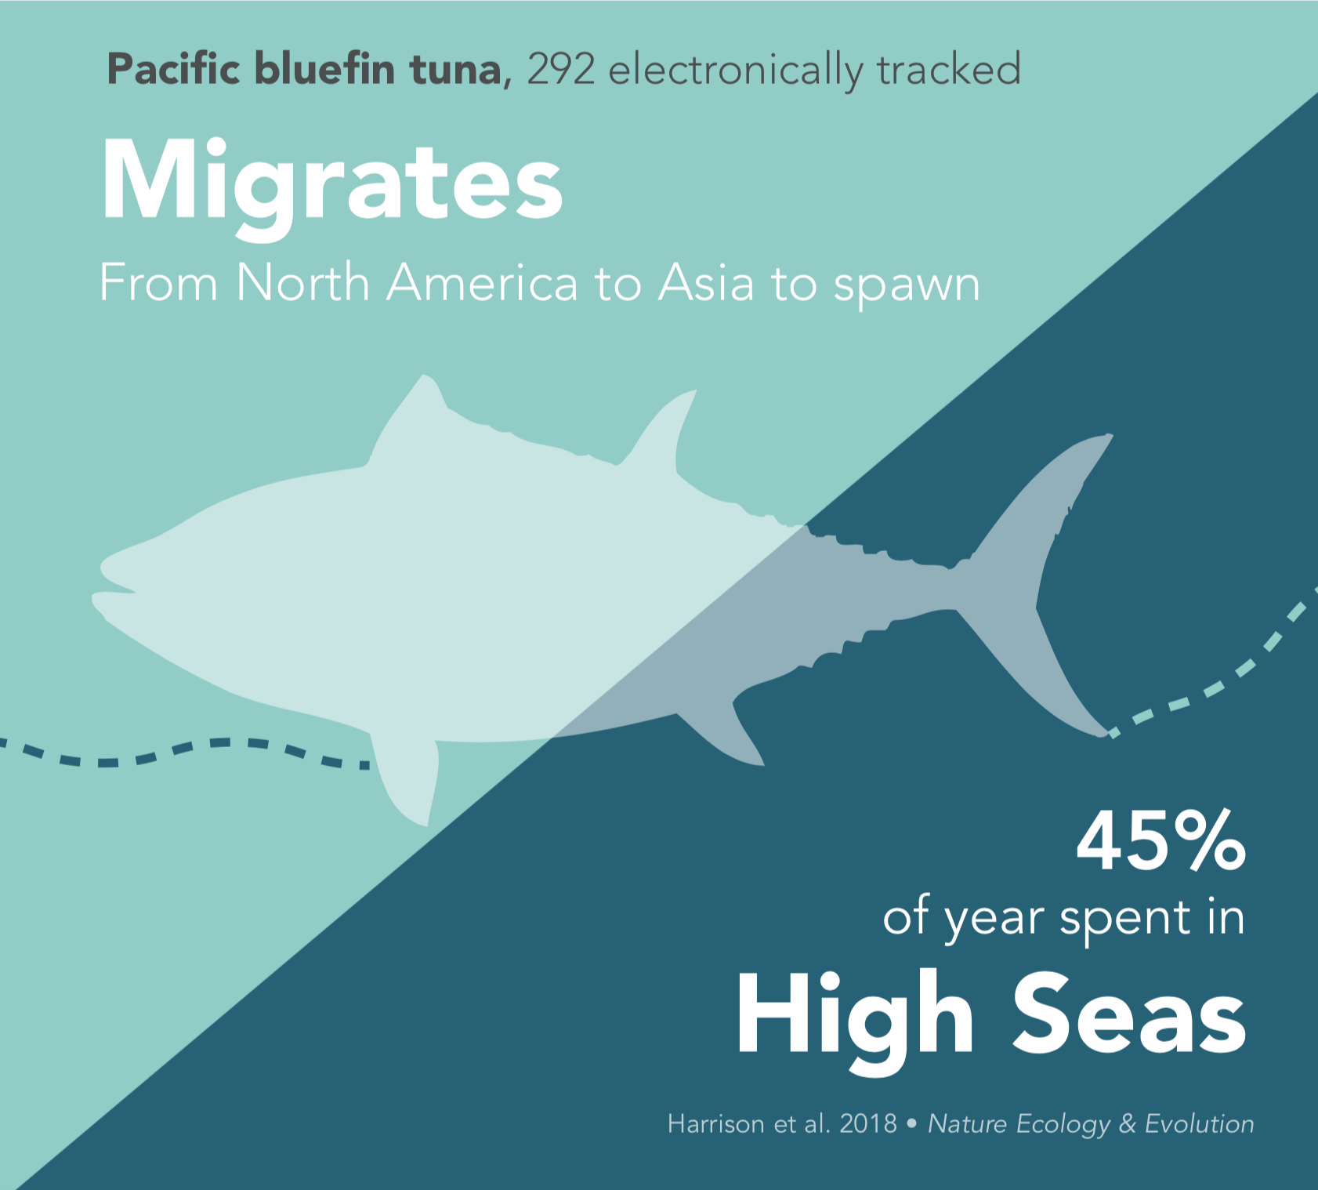
Connectivity
Notes:
https://rdcu.be/5J90

Slide 19
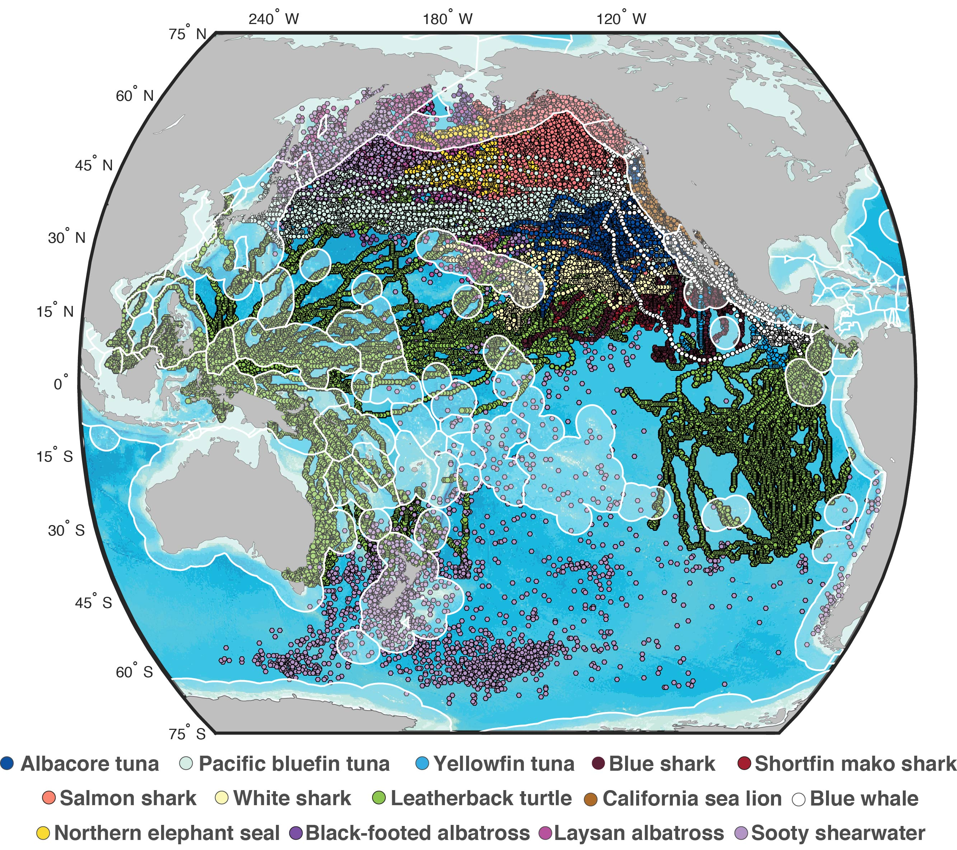
Slide by Autumn-Lynn Harrison
Notes:
Cumulatively, these 14 species visited 37 countries (86%)
All spent time in the high seas
Some spent over ¾ of their annual cycles in the high seas

Slide 20
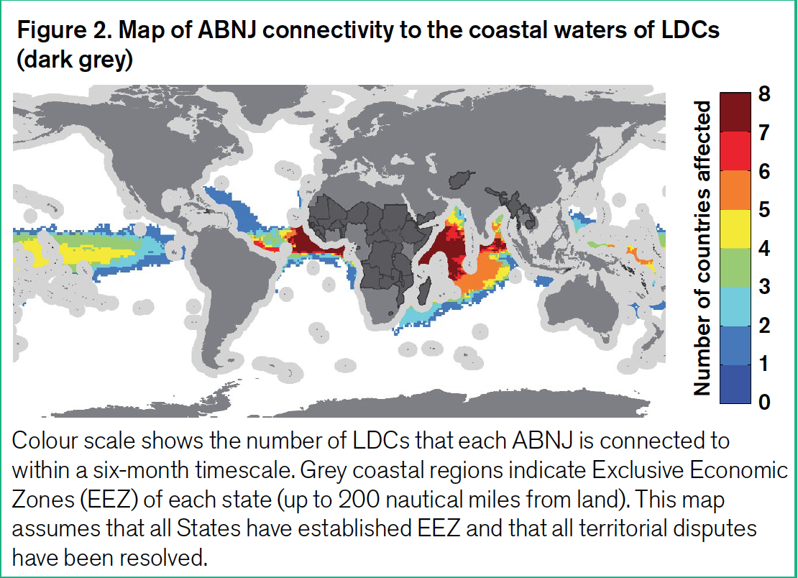
Connectivity
IIED, NOC, Rhodes University, 2019

Slide 21

Marine Protected areas
“Any defined area within or adjacent to the marine environment, together with its overlaying waters and associated flora, fauna and historical and cultural features, which has been reserved by legislation or other effective means, including custom, with the effect that its marine and/or coastal biodiversity enjoys a higher level of protection than its surroundings”

Slide 22
other effective area-based conservation measures (OECMS)
“A geographically defined area other than a Protected Area, which is governed and managed in ways that achieve positive and sustained long-term outcomes for the in situ conservation of biodiversity, with associated ecosystem functions and services and where applicable, cultural, spiritual, socio-economic, and other locally relevant values” (CBD decision 14/8, para 2)

Slide 23
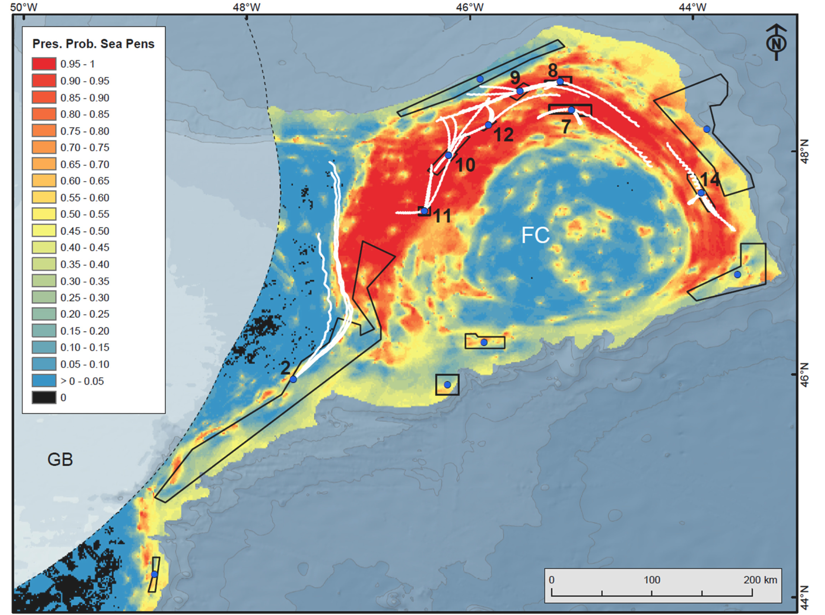
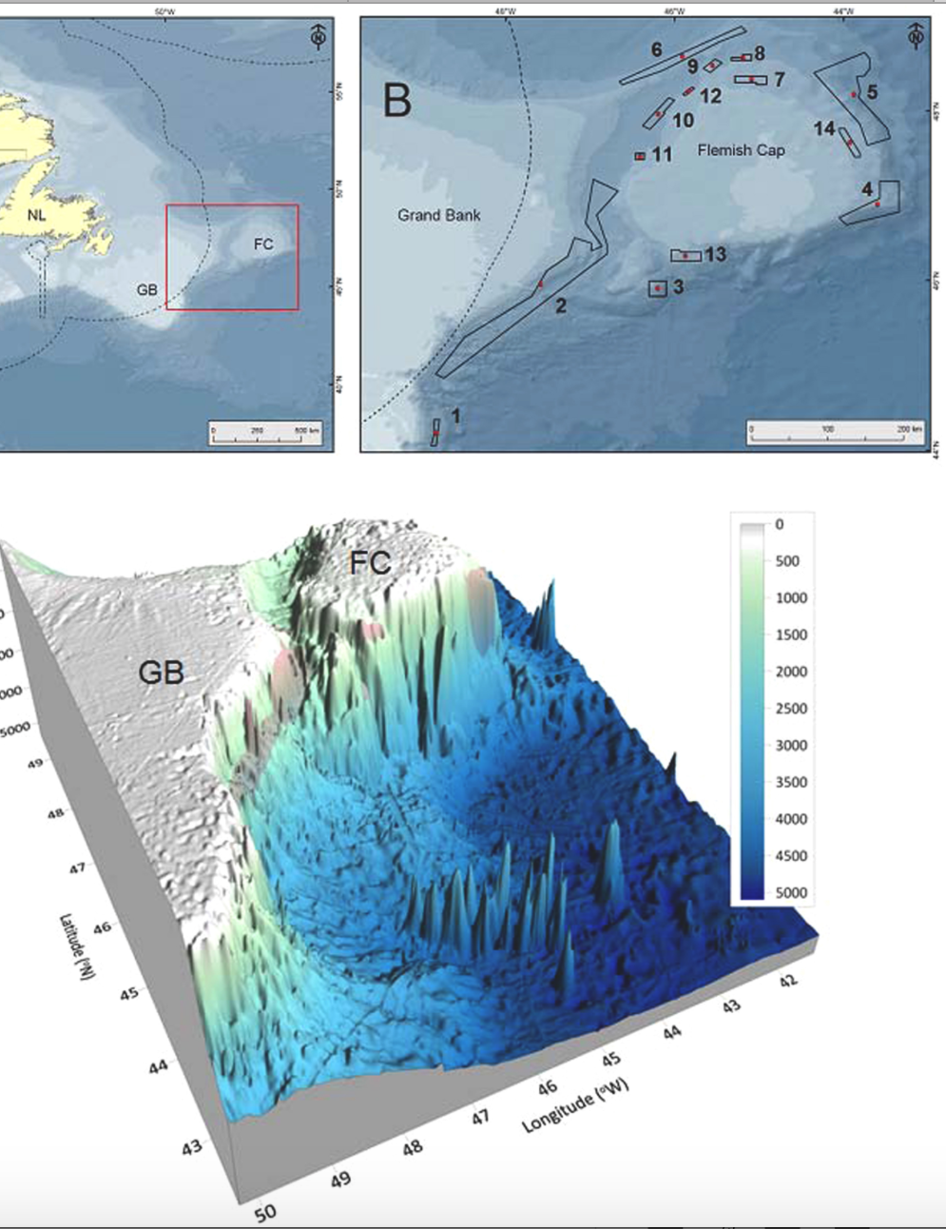
Possible OECMs: VMEs, LMMAs, PSSAs, etc
Kenchington et al 2019

Slide 24
The Need for cross-sectoral approaches
“Notes with concern that vulnerable marine ecosystems may also be impacted by human activities other than bottom fishing, and encourages in this regard States and competent international organizations to consider taking action to address such impacts;” (UNGA Resolution 71/123 (2016): para 184.)
Notes:
Sea pen area closure by NAFO – drilling activities by Statoil on Canada’s extended continental shelf.
UNGA Resolution 71/123 – called for

Slide 25
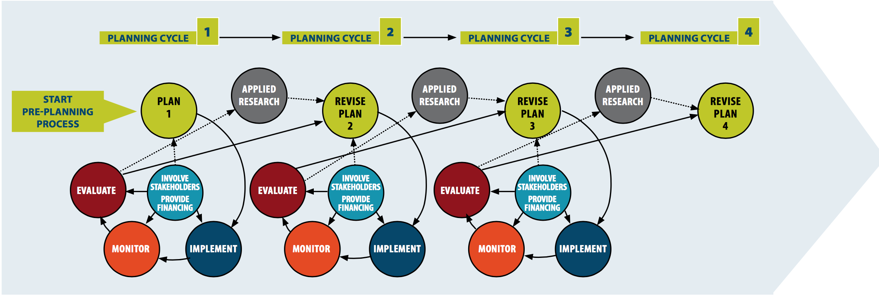
Integrated into Seascapes: Marine spatial planning
As participatory tool to facilitate the application of the ecosystem approach and expedite progress towards the Aichi Targets in marine and coastal areas including through
  Linking MSP with MPAs, OECMs, and EIAs (CBD, 2016)
  As an integrative tool to enhance synergies between SDG 14 and other SDGs at different scales (Ntona and Morgera, 2017)
  Due regard obligation under UNCLOS

Slide 26

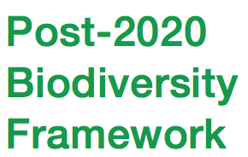

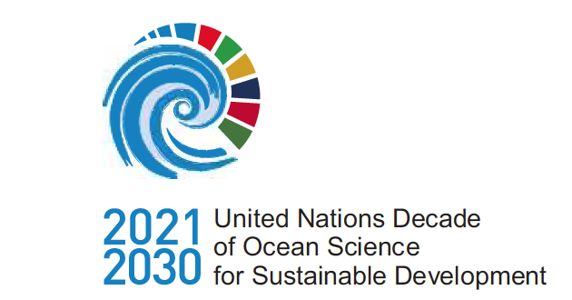




2020: a Super year for oceans

Slide 27
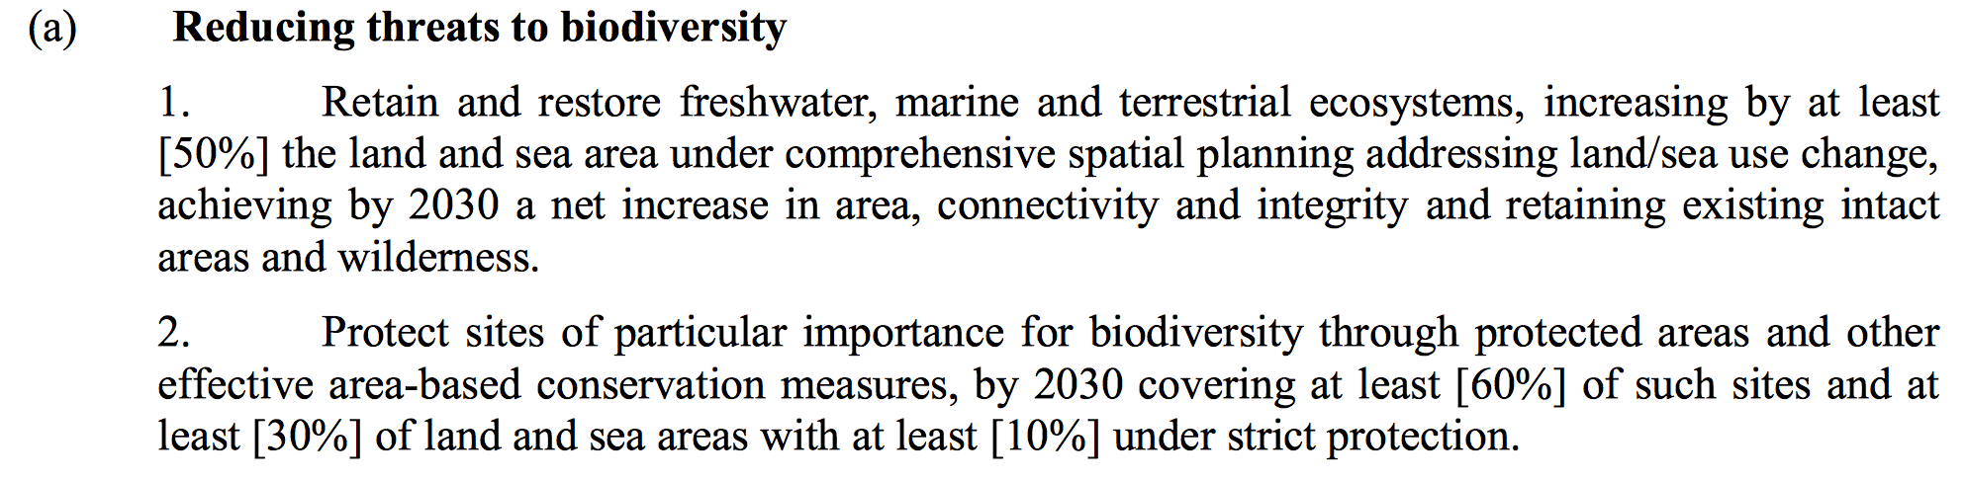
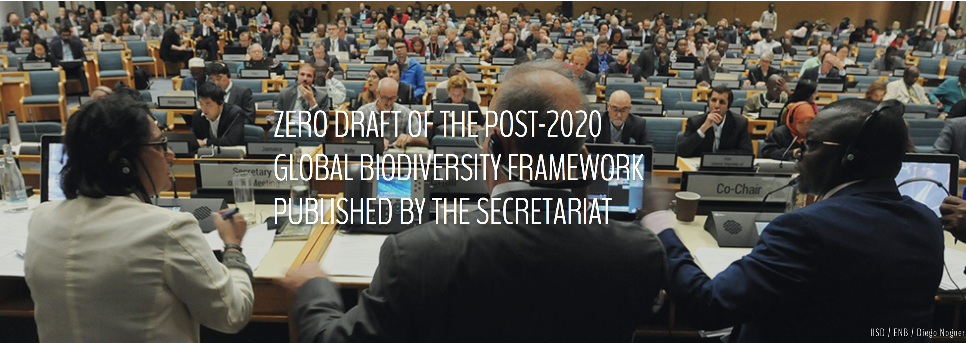
Post-2020 Global biodiversity framework

Slide 28

Thank you
Daniela.diz@strath.ac.uk

