Slide 1
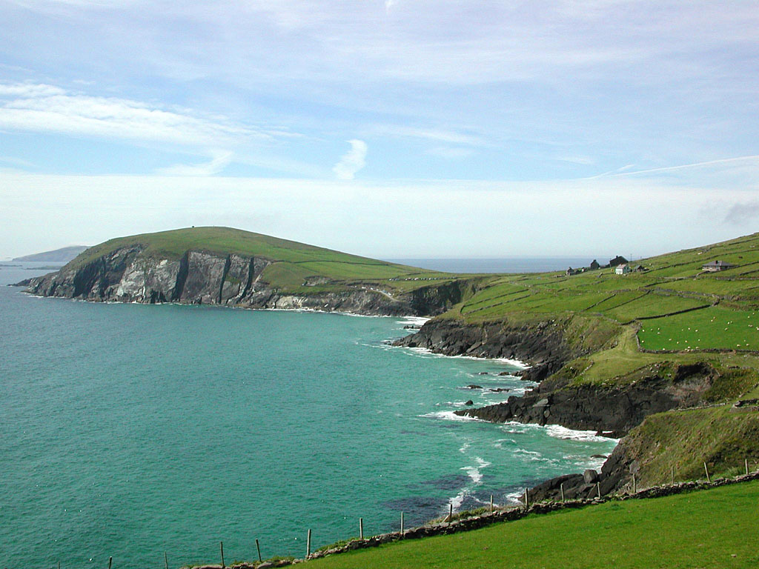
Politicising marine spatial planning to realise transformative ocean governance
Wesley Flannery
With thanks to: Christina Kelly,
Ben McAteer & Jane Clarke
Queen’s University Belfast
Email: w.flannery@qub.ac.uk
Twitter: @WesleyFlannery
Notes:
Outline the talk and present yourself

Slide 2
Outline
What do we mean by transformative governance?
MSP as a transformative concept – but regressive practice.
How do we recapture MSP’s radical potential?
Questions for social scientists evaluating transformative gov.

Slide 3
Transforming Ocean Governance
Coastal states urged to reform governance (MSP, EBM, ICZM etc.)
New governance mechanisms are facilitated within existing regime.
This results in:
  policy layering (Vince 2015),
  path dependency (Kelly et al 2019),
  institutional drift (Morrison, 2017), and
  resistance by powerful actors (Blythe et al 2018; Bennett et al 2019).
Assimilation negates their transformative capacity (O’Brien 2012).
Transformative Gov. needs to focus on intentional regime change.

Slide 4
Transforming regimes
Adapted from Geels, 2002

Slide 5
(Governance) Innovation
Adapted from Rotmans and Loorbach, 2010

Slide 6
Transformative Governance
Adapted from Geels, 2002

Slide 7
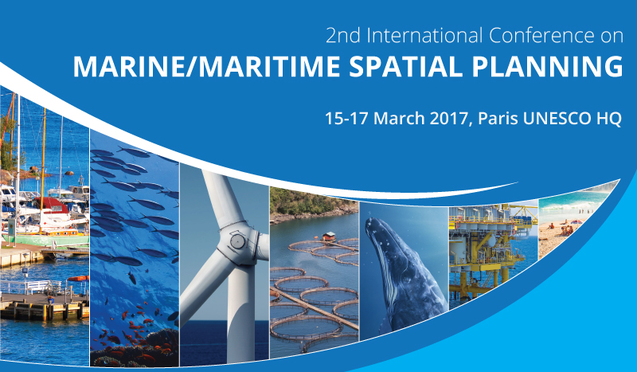
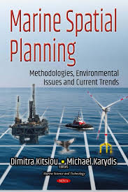
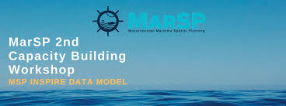
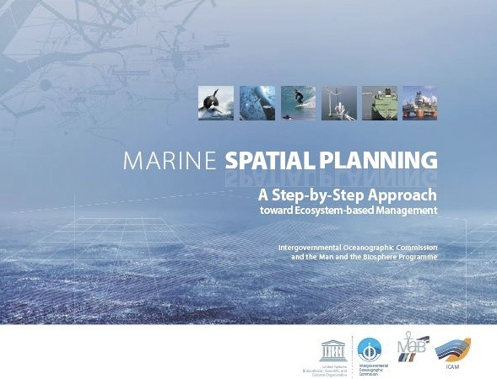
Transformative Potential of Marine Spatial Planning
MSP: An ‘idea whose time has come’ (Elher, 2018)…
Rapidly becoming the most accepted approach to reforming marine governance.
Should facilitate a radical shift in marine governance
  Addressing sectoral and fragmented gov. issues.
  Closing democratic deficit in marine gov.

Slide 8
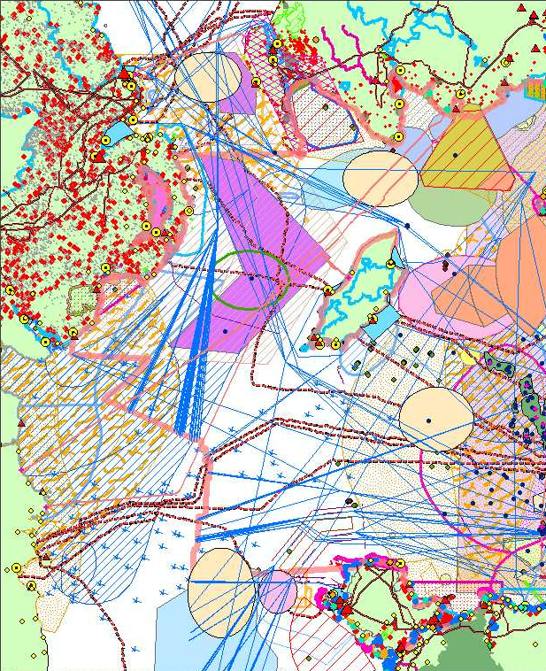
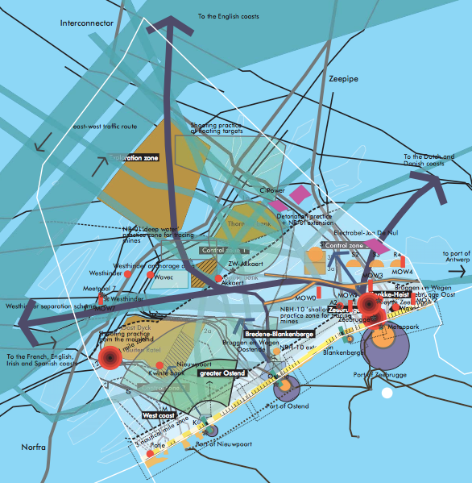
Sectoral Management
The Irish Sea
North Sea
Source: AMPMER, 2004
Source: Flood of Sea Project

Slide 9
Sectoral Management
Gov.
Dept
Gov.
Dept
Gov.
Dept
Gov.
Dept
Gov.
Dept
Gov.
Dept
Fishing
Renewable Energy
Tourism
Oil & Gas
Nature Conservation
Offshore Aquaculture
Decision
Decision
Decision
Decision
Decision
Decision

Slide 10
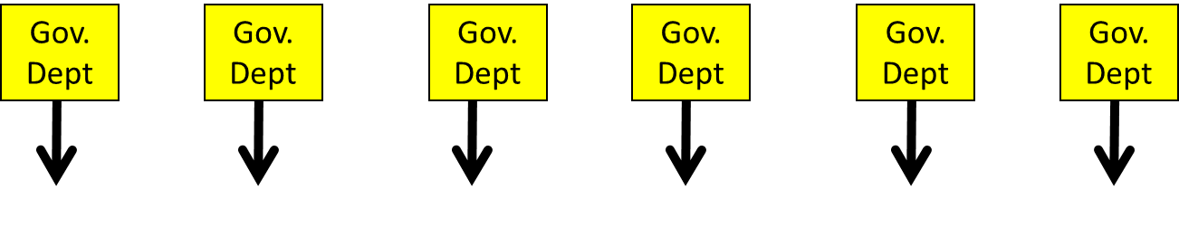
MSP
INTEGRATED MANAGEMENT AUTHORITY
Fishing
Renewable Energy
Tourism
Oil & Gas
Nature Conservation
Offshore Aquaculture
Public Participation
Marine Spatial Plan
Decision
Decision
Decision
Decision
Decision
Decision

Slide 11
Transformative potential of MSP
MSP provides a window of opportunity to:
  Reimagine the role of the State
  Reframe how we view the Marine Environment
  Address the democratic deficit in marine governance
In essence, MSP :
  Empty concept
  invites us to reimagine State – Marine Environment –Society nexus
  Should not assume that this will be better…

Slide 12
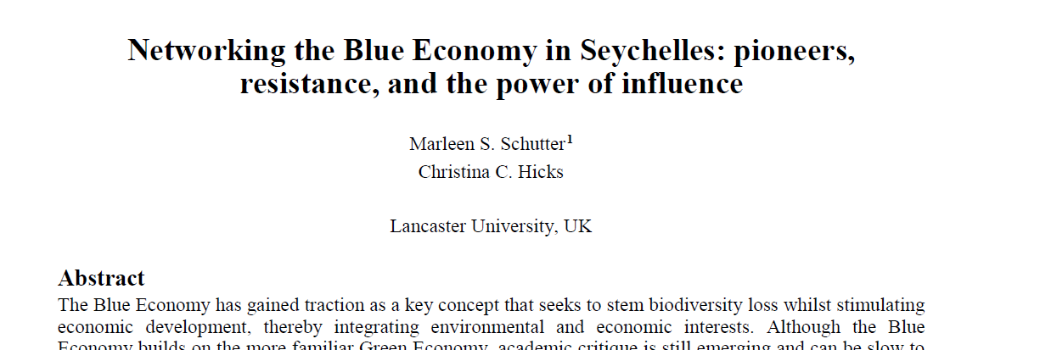
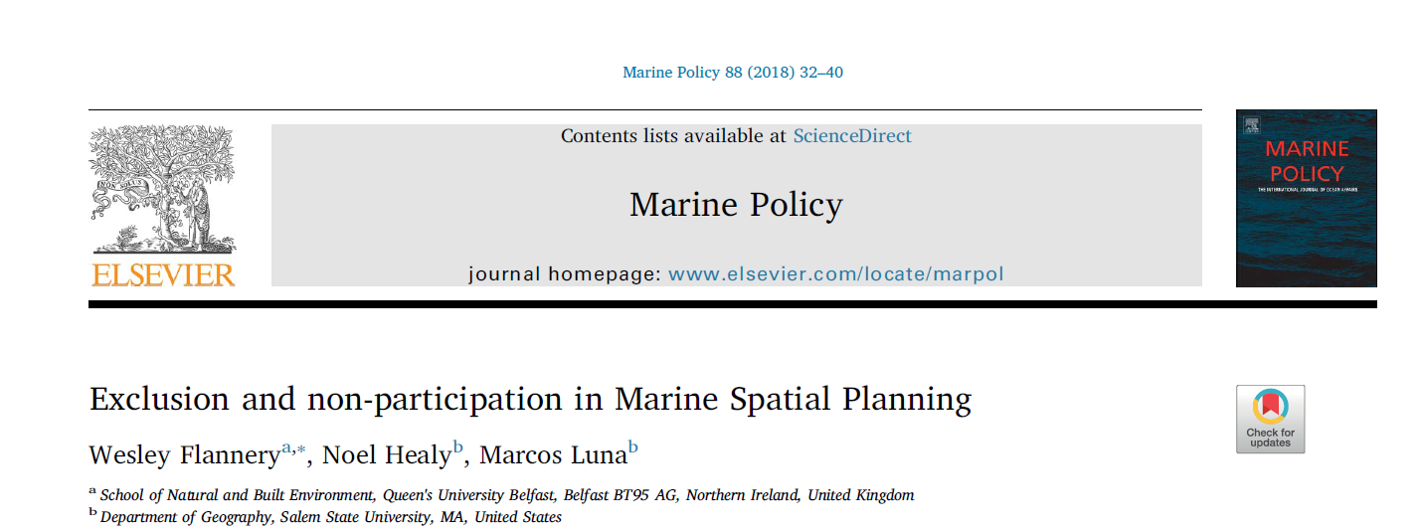
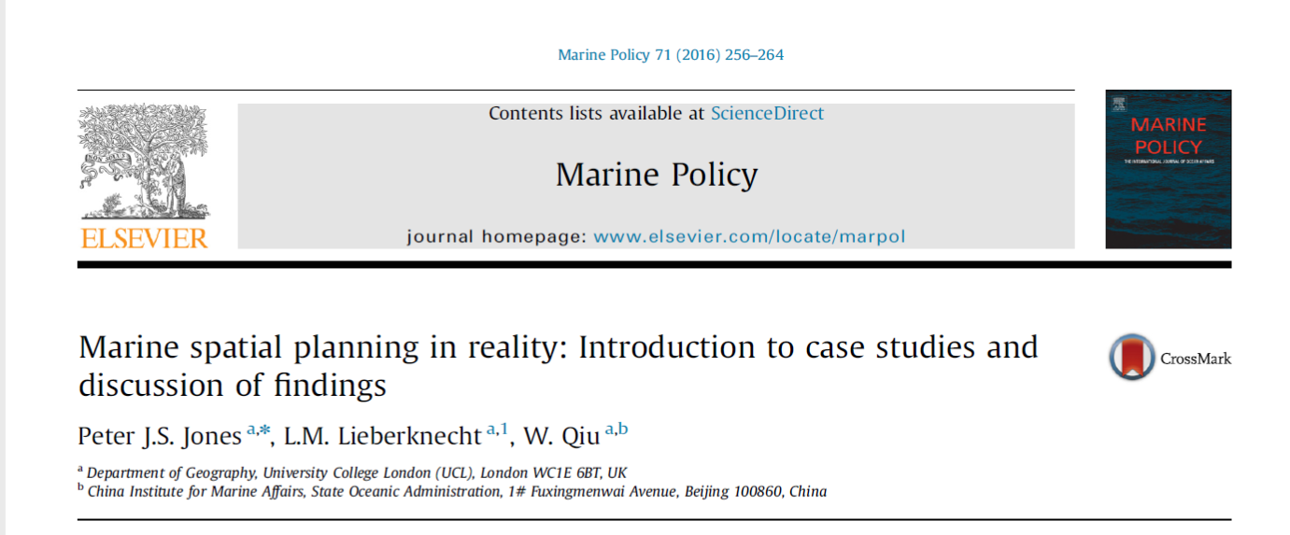
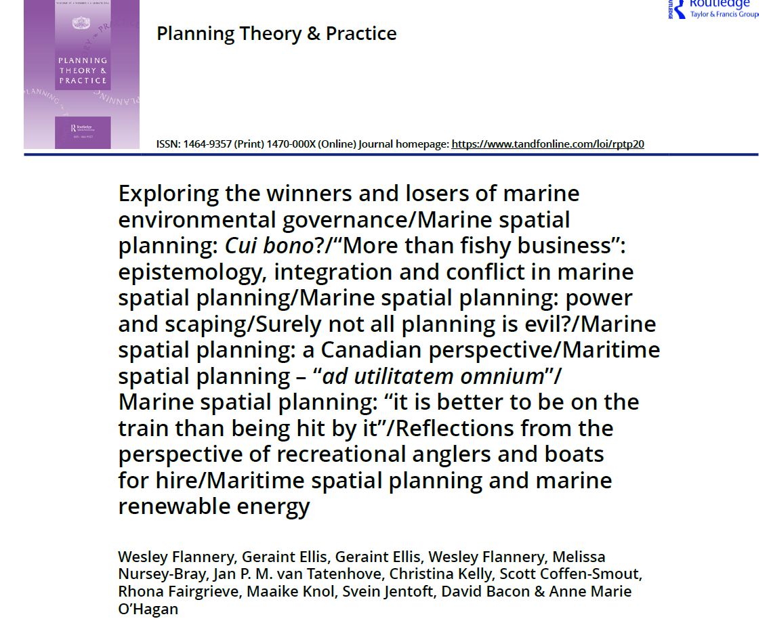
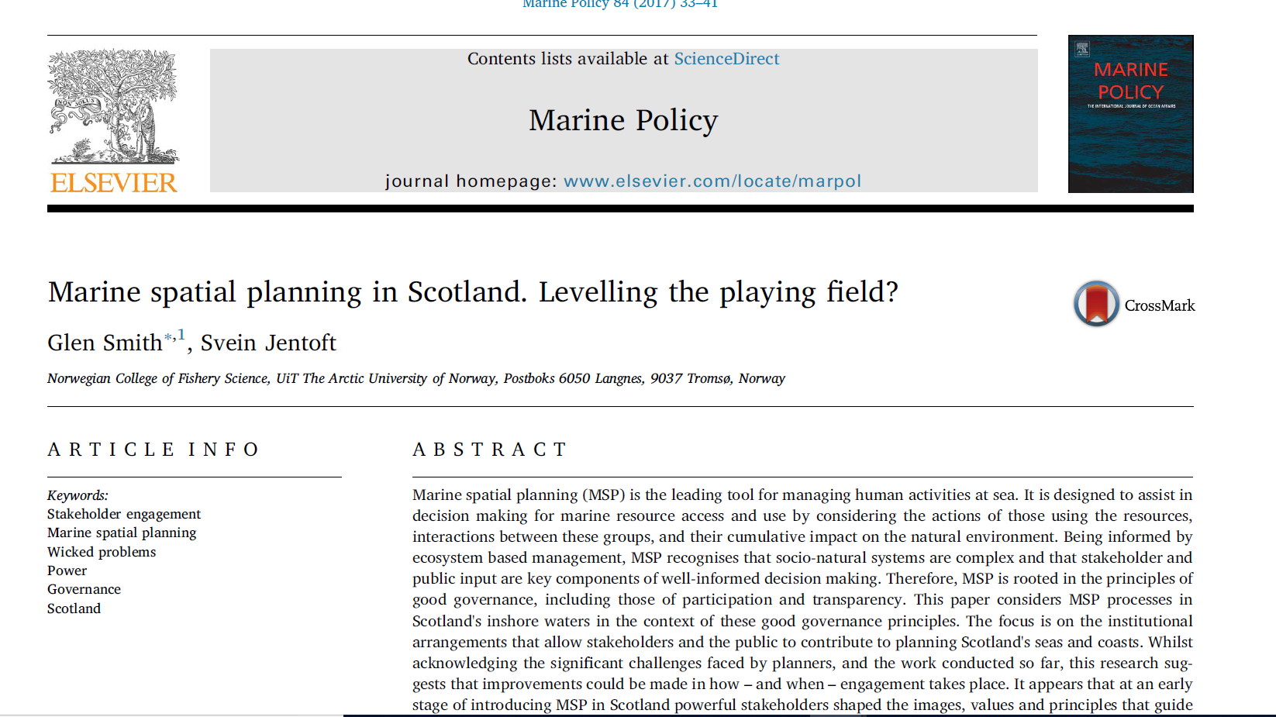
MSP in practice
MSP has:
  maintained the agendas of dominant actors through the use of empty participatory rhetoric (Ritchie & Ellis, 2010; Smith & Jentoft, 2017; Tafon, 2017);
  developed weak objectives that fail to address critical marine problems (Flannery & Ó Cinnéide, 2012a,b; Jones et al. 2016; Sander, 2018);
  deployed technocratic-managerial forms of governance that favour elite actors (Smith & Jentoft, 2018; Flannery et al., 2018; Schutter and Hicks, 2019).

Slide 13
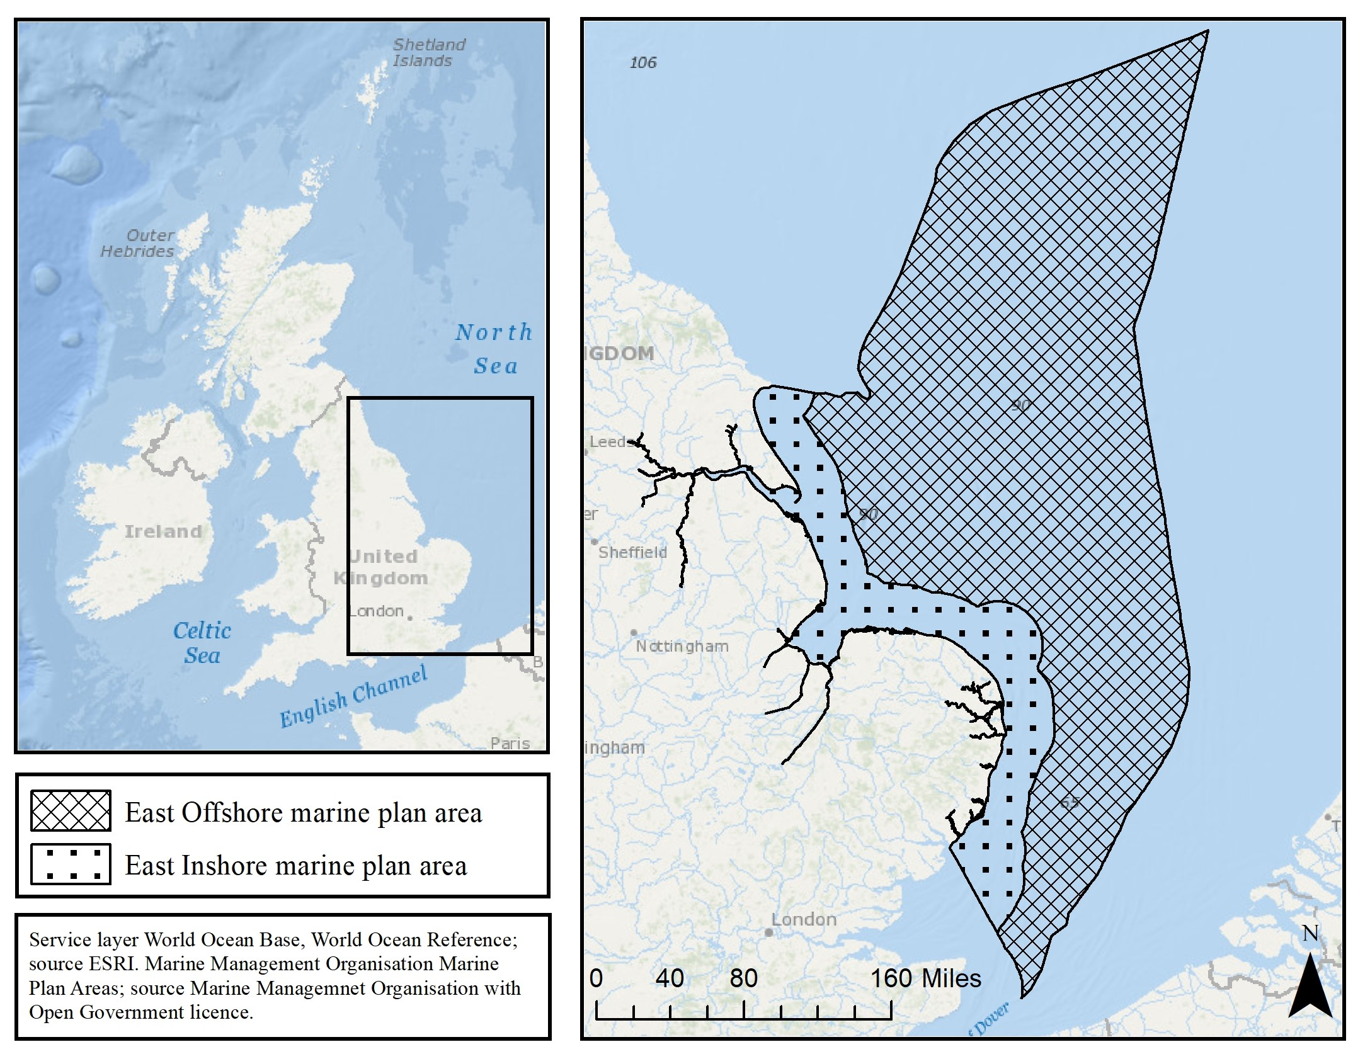
The post-political nature of MSP in England
East Inshore and Offshore Plans
First Statutory Plans in the UK
MPS – strong social element, social equality, cohesion, wellbeing, etc.
Two plans – one document published in 2014, progress reviewed 2017
Synthesising findings from two papers

Slide 14
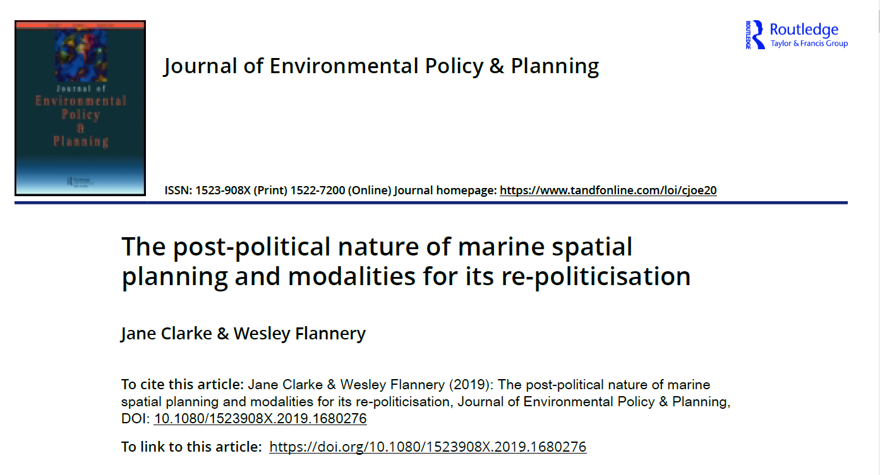
Paper 1
Post-political describes a process that appears open and progressive but is closed and cements to status quo
Based on interviews and document analysis

Slide 15
Paper 2: MSP Governmentality in England
Normative | Strategic | Operational | Monitoring
Defining Desired ends | Choose the instruments to achieve ends | Implementing instruments | Assessing Progress

Slide 16

The post-political nature of English MSP
Where are we going?
Who gains and who loses?
Through what mechanisms, processes etc do they do so?
What are we going to do about it? (adapted from Flyvbjerg, 2001).

Slide 17
Where is MSP in England Going?
Neoliberal form of planning
  Focus is on reducing ‘burden’ to industry rather than on good governance.
Path dependent decision-making:
  Plans add nothing new!
  Even those viewed as benefiting most said they can ignore the plans.
  Dominated by sectoral thinking
Technocratic-managerialism:
  Focus on GIS data sets (recollecting data), not planning

Slide 18
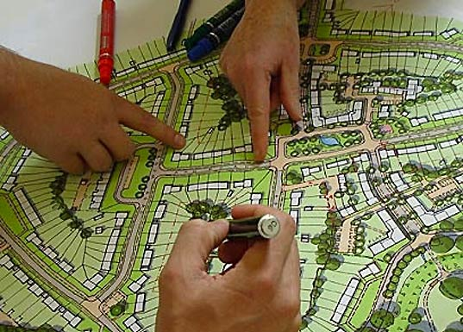
Who gains and who loses?
Tokenistic participation:
  Plans became about sign-posting ‘what was already there’;
  Did little more than collate existing policies;
  Little or no planning for the public good – focus on industry needs;
  Little need for participation when preserving status quo.
Illusion of Inclusion

Slide 19
Through what mechanisms?
Normative | Strategic | Operational | Monitoring
Radical reform of UK Marine Governance is needed: | We’d like to be more radical but our hands are tied due to: | DON’T RULE BRITANIA! Let’s preserve the status quo: | Everything is Awesome!...here’s a 16p monitoring report with 2p of results.
State: Needs to develop coordinated, consistent decision-making process is need to ensure SD. Environment: a resource which if managed correctly will maximise sustainable activity, prosperity and opportunities for all, now and in the future Society: an opportunity to develop resilient and cohesive communities that can adapt to risks and opportunities through participatory governance | State: Limited scope for governance reform and path dependent decision-making, What can we do? Environment: Complex trade-offs unresolvable due to lack of knowledge. But we’ve re-mapped the same data again!!. Society: Stakeholder fatigue – we’ll engage with them differently, in terms of their capacity/willingness. | State: reduce the overall regulatory burden; provide greater certainty for developers Environment: Marine businesses are acting in a way which respects environmental limits and is socially responsible. This is rewarded in the marketplace. Society: Benefitting from trickle down economics. | State: Strong and stable. Coordinated and consistent decision-making Environment: The evidence we used about the environment is of the highest quality and we are now maximising its use. Society: Doing better than the rest of England…but that was true before the plan, but we’ll take it!

Slide 20
What are we going to do?
Post-Political
Phase 1 Normative | Phase 2 Strategic | Phase 3 Operational | Phase 4 Monitoring
Desired ends and ideals | the means to achieve stated goals and objectives are selected | Means to achieve goals are implemented | Monitoring and assessment criteria selected.
Rationality
Participation
(Flannery and McAteer, under review)
Notes:
Example the 4 stages
Give fish example
Give MSP example
Power present in the 4 phases

Slide 21
(Governance) Innovation
The Political
Adapted from Rotmans and Loorbach, 2010

Slide 22
Inserting difference
How do we insert difference into MSP process (Boucquey et al., 2018)?
Recapture what planning should be:
  A state-led process of distributing development rights to produce public good.
Many Marine Plans have little impact on:
  Development rights; or
  The Public Good.
  Fail to capture the value created by planning.
Need for progressive framings/principles to be inserted during strategic phase
  Principles such as fairness, equity, justice – linking to SDGs, e.g. No Poverty
  Alternative models of local/coastal development – not trickle down economics.
  Citizen science, alternative data to empower stakeholders.
  Advocacy Planning (Tafon, 2019).

Slide 23

MSP Internationally
Being exported to Global South EU & UNESCO #MSPGlobal
The goal is to speed up MSP adoption….
Speed is a requirement of capital (Harvey, 1985)…not good governance.
Be vigilant as MSP is rolled out:
Where is it going?
Who gains and who loses?
Through what mechanisms, processes etc do they do so?
What are we going to do about it?
Does it distribute development rights to produce a public good?

Slide 24
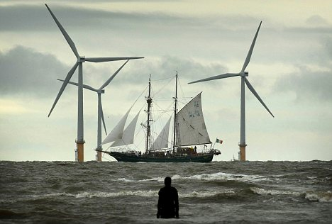
Thanks for listening
Questions/Comments?

Slide 25
References
Ehler, C. N. (2018). Marine Spatial Planning: An Idea Whose Time Has Come. In Offshore Energy and Marine Spatial Planning. In K. Yates & C. Bradshaw (Eds.), Offshore Energy and Marine Spatial Planning (pp. 6–17). London: Routledge.
Boucquey, N., Martin, K.S., Fairbanks, L., Campbell, L.M. and Wise, S., 2019. Ocean data portals: Performing a new infrastructure for ocean governance. Environment and Planning D: Society and Space, p.0263775818822829.
Flannery, W., Ellis, G., Ellis, G., Flannery, W., Nursey-Bray, M., van Tatenhove, J. P., ... & Jentoft, S. (2016). Exploring the winners and losers of marine environmental governance/Marine spatial planning: Cui bono?.... Planning Theory & Practice, 17(1), 121-151.
Flyvbjerg, B. and Richardson, T., 2002. Planning and Foucault: in search of the dark side of planning theory. In Allmendinger Philip & Tewdwr-Jones Mark (Eds.), Planning futures: New directions for planning theory (pp. 44–62). London: Routledge.
Foucault, Michel (1981). Omnes et singulatim: Towards a criticism of ‘political reason’. In McMurrin, S. (Ed.), The tanner lectures of human values (pp. 223–254). Salt Lake City: University of Utah Press.
Lemke, T., 2001. 'The birth of bio-politics': Michel Foucault's lecture at the Collège de France on neo-liberal governmentality. Economy and society, 30(2), pp.190-207.
Ritchie, H. and Ellis, G. (2010) ‘A system that works for the sea’? Exploring stakeholder engagement in marine spatial planning, Journal of Environmental Planning and Management, 53(6), pp. 701 - 723.
Rose, N. and Miller, P., 1992. Political power beyond the state: Problematics of government. British journal of sociology, pp.173-205.
Rutherford, S., 2007. Green governmentality: insights and opportunities in the study of nature's rule. Progress in human geography, 31(3), pp.291-307.

