Slide 1
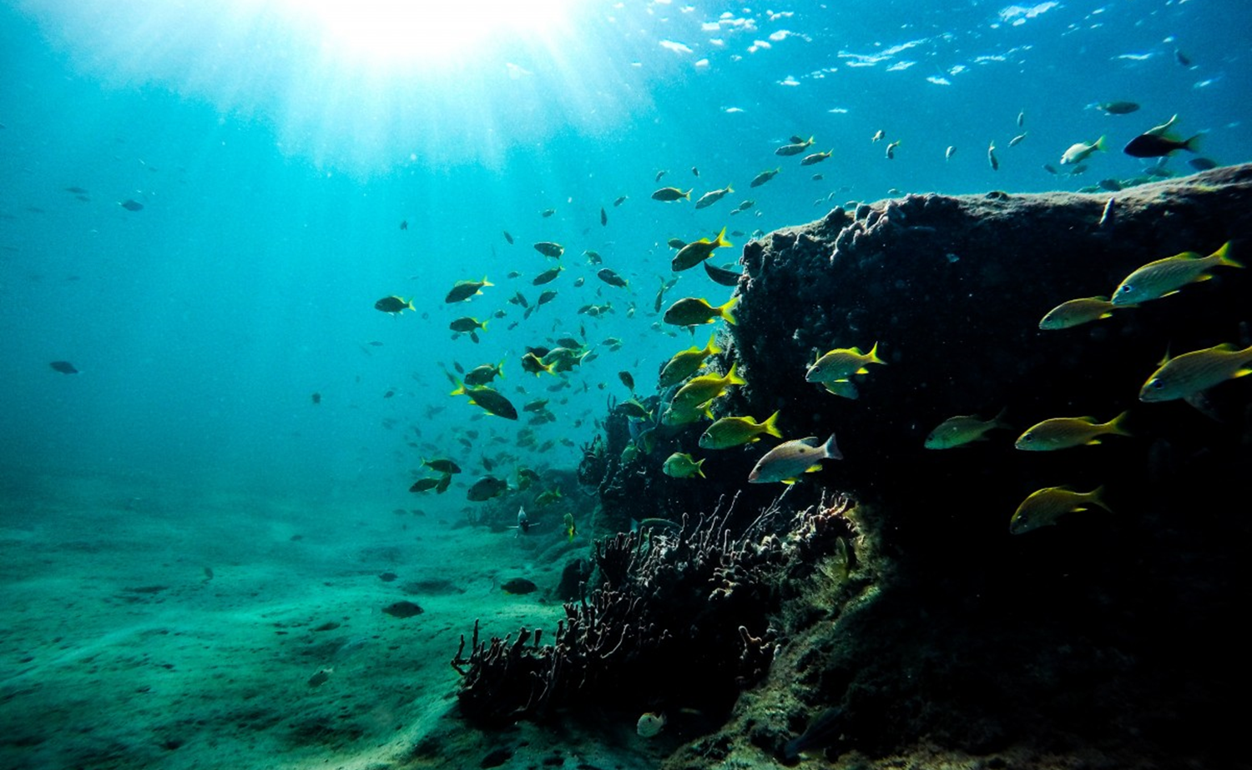
Multi-sized (and multi-type) development: Imagining governance beyond borders
Dr. Kimberley Peters drkimberleypeters@gmail.com @DrKimPeters
University of Liverpool, UK; Helmholtz Institute for Functional Marine Biodiversity, Germany

Slide 2
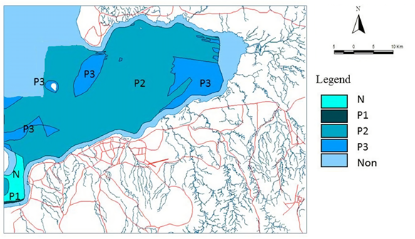
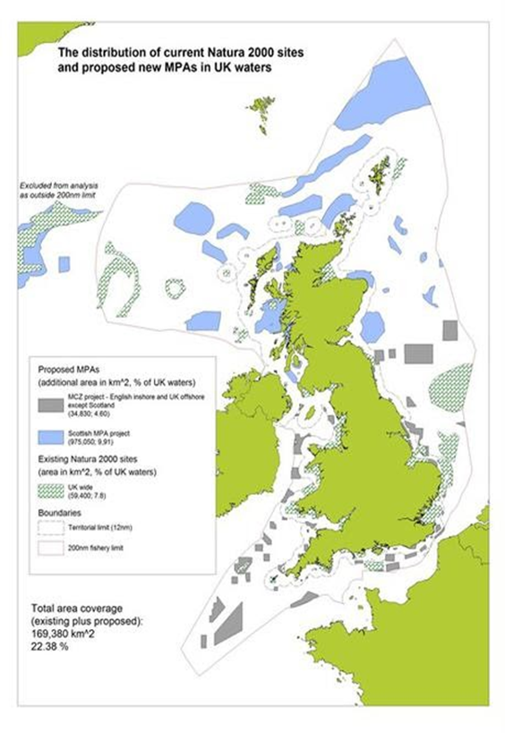
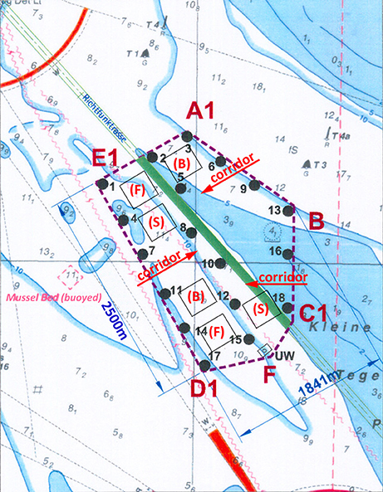
A critique of convention….
Governance beyond borders?

Slide 3
Arguing for theory
“Abstract philosophizing may strike you as irritating, distracting you from the main task in hand… Why on earth must you bother with philosophy? The short answer is that you cannot avoid it, whether you like it or not!” (Graham 1997, 7-8)
“The way to understand theory is to start by recognizing that everyone is (always and already) using it to construct meaning. All ways of looking at things – (our) ideological positions, values and morals, notions of relevance and utility, all expectations, ways of classifying – are theoretical… This applies in everyday life and in the natural sciences just as in the arts, humanities and social sciences” (Shurmer-Smith 2002, 11)

Slide 4
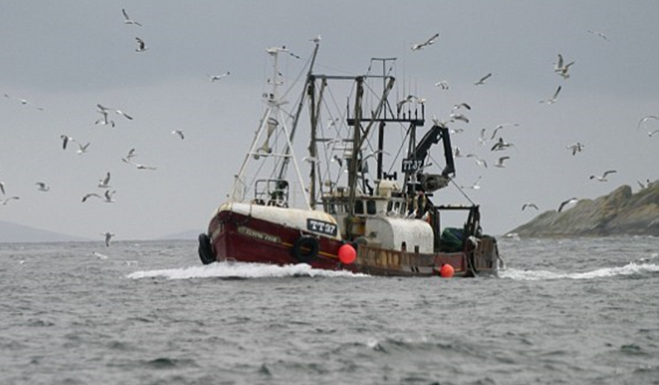
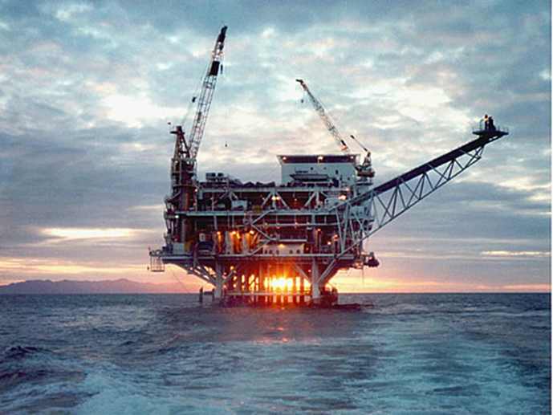
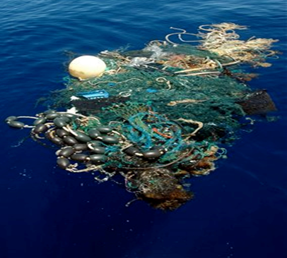
Structure of talk
Setting the scene: What is governance, what is resilience?;
One size, one type fits all: Typifying/territorialising resilience governance?
A Geo-approach: suggesting a way forwards;
Beyond the ‘one size’ fits: beyond borders?

Slide 5
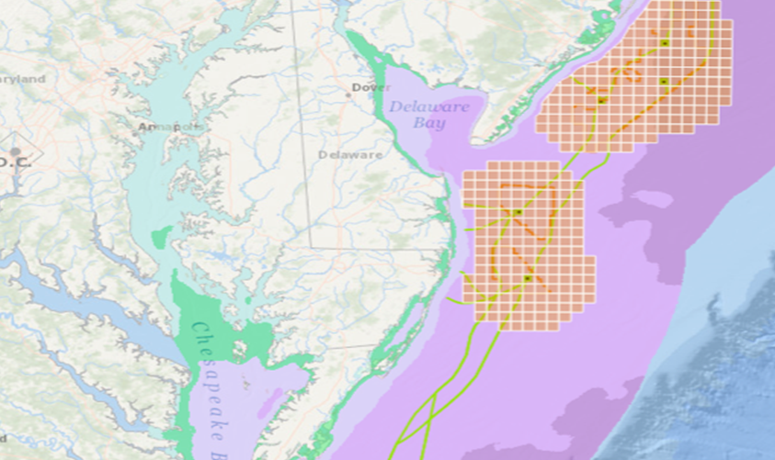
1. Setting the scene:
What is governance, what is resilience?

Slide 6
Governance
Governance is a process of deciding, managing, controlling, organising a set of activities, practices, people, resources, spaces.
It is always foregrounded on information from a variety of angles and spheres from “a wide range of actors in the production of policy outcomes, including NGOs, private companies, pressure groups, and social movements as well as those state institutions traditionally regarded as part of government” (Johnston et al. 2002, 317).
Governance refers to an ‘art or practice of governing’ (Johnston et al. 2002, 317)

Slide 7
Governance
Governance “reflects the dramatic intensification of societal [and environmental] complexity which flows from growing functional differentiations of institutional orders within a global’ world” (Jessop 1997, 569).
In other words, our world is complex, so it shouldn’t be driven by a single entity but forms of governance that reflect this complexity. Oddly though, we often end up with singular, one-type fits all, area-based tools of doing governance!

Slide 8
Resilience
Resilience refers to (post)political modes of “adapting to and living with a pathological earth” (Grove and Chandler 2017, 85).
Attention is focused on the future and to modes of responding to, coping with, surviving, planetary threats (Anderson, 2015)
‘Making resilience’ involves bringing into play different forms of adaptability within spatial and temporal scales to ensure subjects can respond to risk (Grove and Adey 2015).

Slide 9
2. One size, one type fits all: Typifying/territorialising resilience governance?

Slide 10
The ‘norm’ of area-based tools…
As a one size, one type approach.

Slide 11
The territorialising trend…
Towards oceans of enclosure.

Slide 12
Governance typically involves ‘territorialisation’ of grounded terrain.
As such, “there is an assumed correspondence of territory with land and governance with ground”. (Peters et al. 2018, 2).
The art of governing – in short – has been built on solid foundations.
But this fundamental basis on which the notion of governance is constructed has ramifications when we then seek to take governance beyond the land….

Slide 13
“Most spatial marine management techniques (e.g., marine protected areas) draw stationary boundaries around often mobile marine features, animals, or resource users. While these approaches can work for relatively stationary marine resources, to be most effective marine management must be as fluid in space and time as the resources and users we aim to manage” (Maxwell et al. 2015, 42).

Slide 14
“Like the ocean itself, maritime [and marine] subjects and objects can move across, fold into, and emerge out of water in unrecognised and unanticipated ways The ocean… through its material reformation, mobile churning, and nonlinear temporality— creates the need for new understandings of mapping and representing; living and knowing; governing and resisting (Steinberg and Peters, 2015, 2561-2)

Slide 15
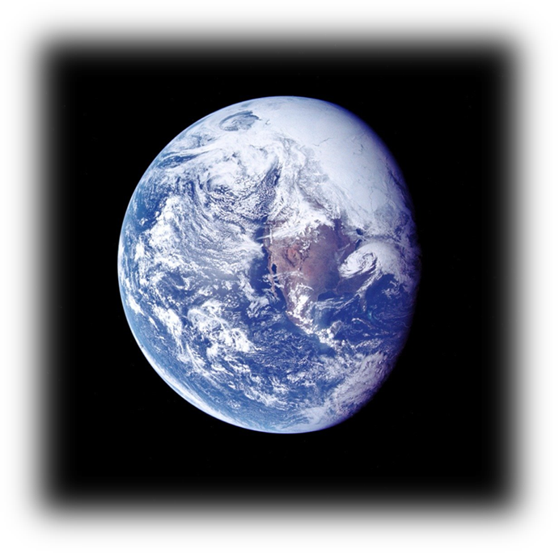
3. A Geo-approach: Suggesting a way forwards

Slide 16
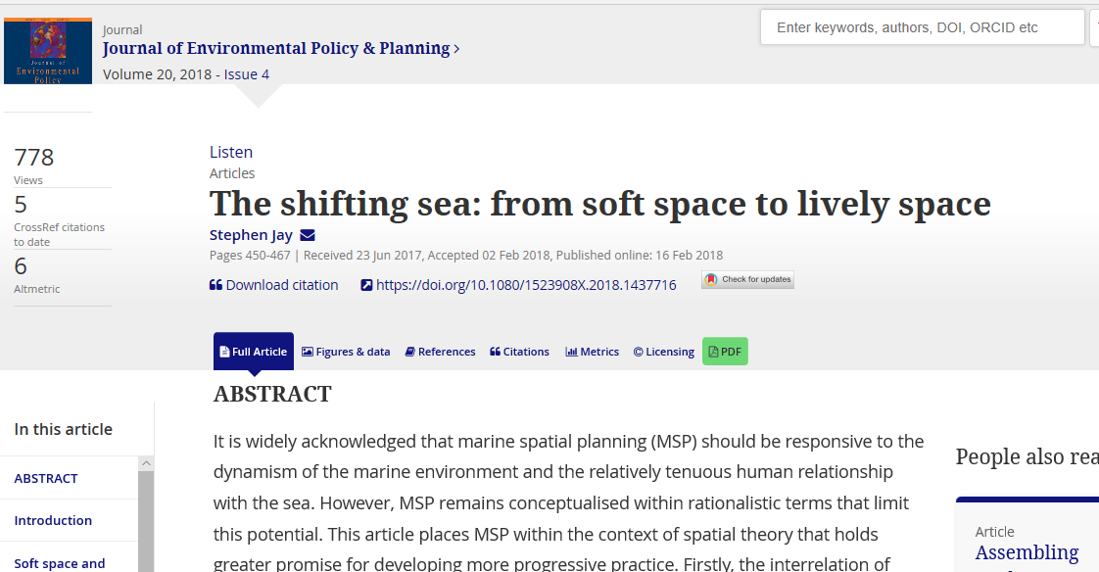
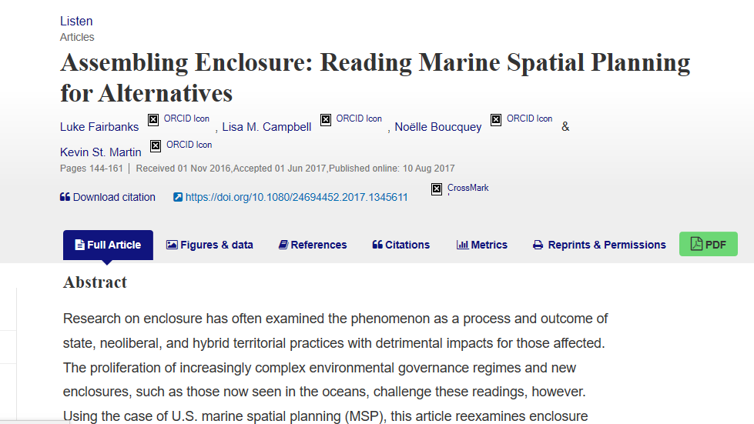

Slide 17
Spatial, rather than geographical?
Spatial relates to the “positioning and area of things” – or the “the distribution or spread of objects”, “how objects fit together in space” (Cambridge Dictionary, 2019).
The spatial is aligned with the areal: in other words, it produces, generally, a flat ontology (Marston et al. 2005) –

Slide 18
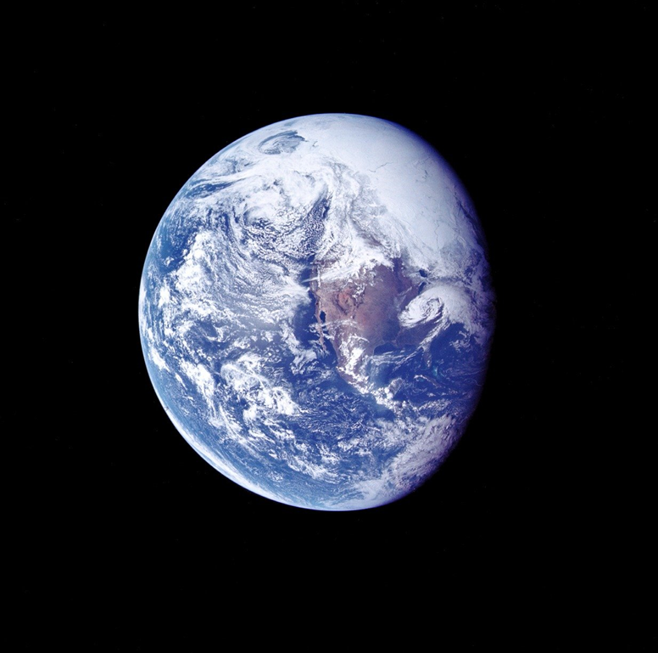
Geo-imaginaries?
The term ‘geographic’ relates to the “features of the earth” (OED, 2019).
It provides a spherical, three-dimensional, imaginary where the earth is connected in a system of related, networked, assembled and co-constituted parts.
The ‘earth’ is, as Elden notes “in flux, dynamic, indeterminate, and changeable, rather than static and fixed” (2018, xiv).

Slide 19
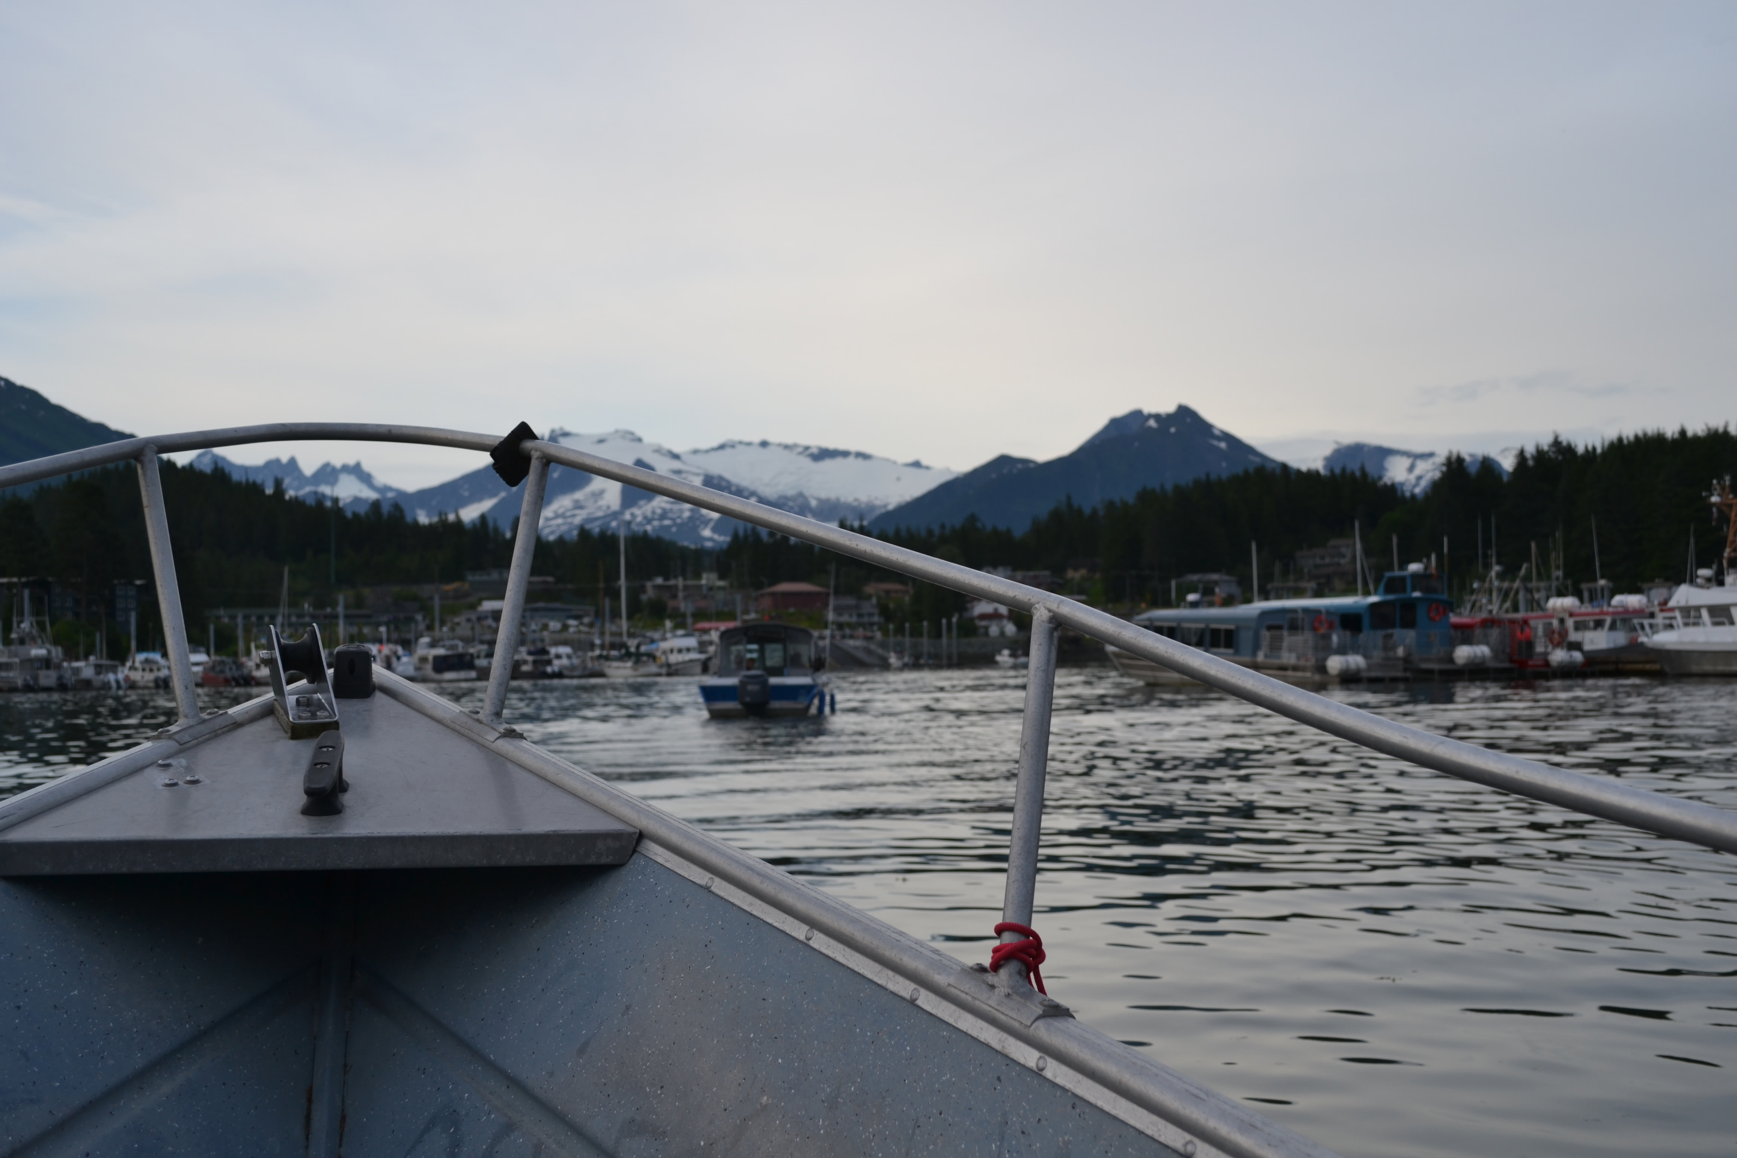
4. Being responsive, being flexible: from temperate to polar seas

Slide 20
The Bering Strait
“a highly productive marine ecosystem… Almost the entire western Arctic population of bowhead whales travels through the strait twice a year. It also provides important food for the Pacific Walrus, spectacled eider, and grey whales. An estimated 12 million seabirds nest or forage in the area each year. The strait is also home to indigenous communities who inhabitants have lived a traditional way of life along its shores for untold generations” (Pew Trust, 2014)

Slide 21
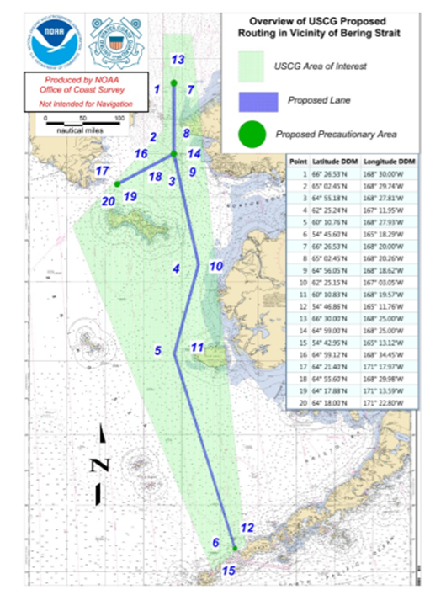
The Bering Strait
The USCG Port Access Route Study (PARS), would create a static corridor, cut through space, mapped onto the ocean as a surficial device of management. It was a solution which sought to fix in space, governance, in a realm of mobility, where whales, walrus, fish, ice, all move.

Slide 22
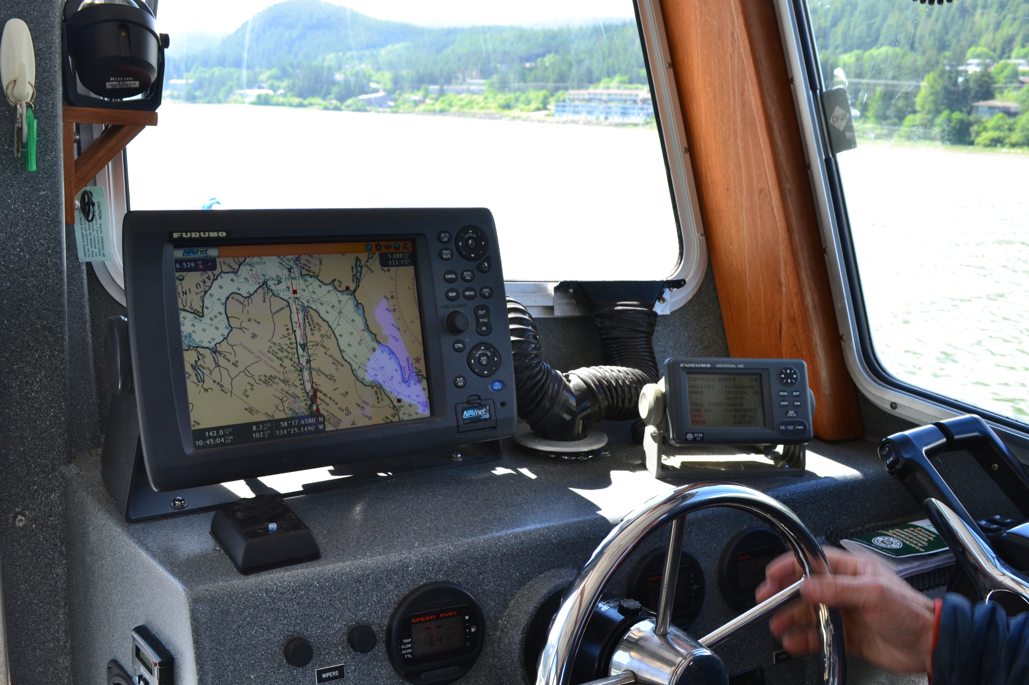
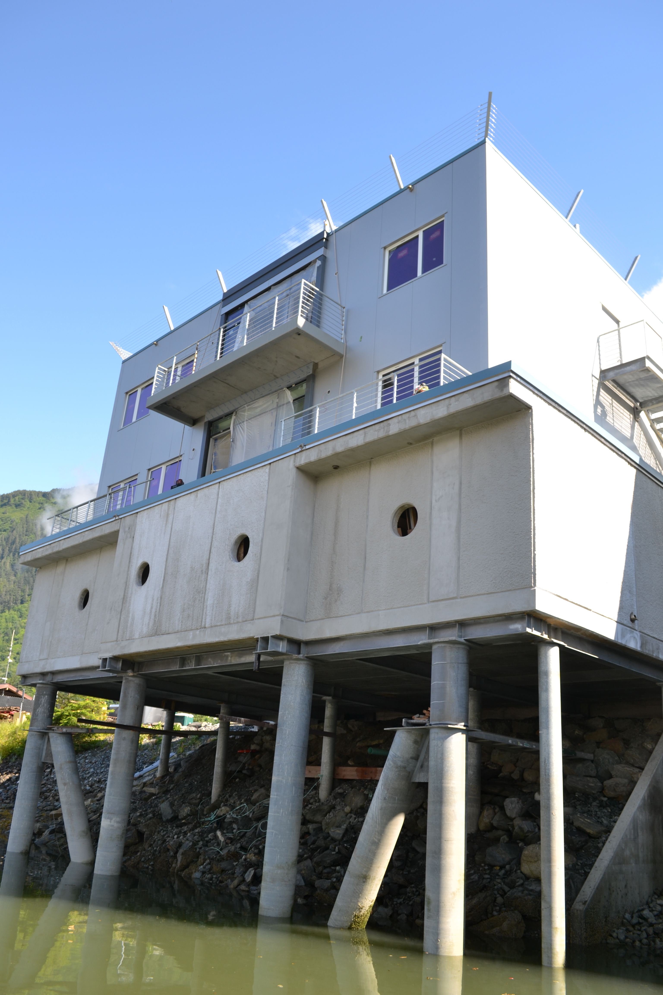
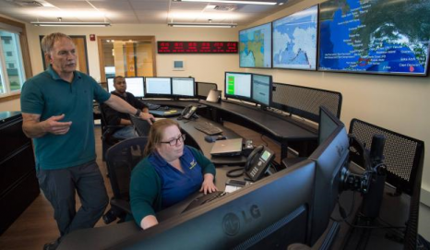
Flexible, responsive governance

Slide 23
Flexible and responsive governance
“So my point is I think the best way to manage places like the Bering Strait is actually send information … using this new technology, warn those at risk… you can say ‘you can go through the Bering Strait but here’s the guidelines now, just stay this far away from shore and … we’ll let you know where you can go when you get there because it’s a dynamic situation” (Captain Ed Page, Interview, 2017).

Slide 24
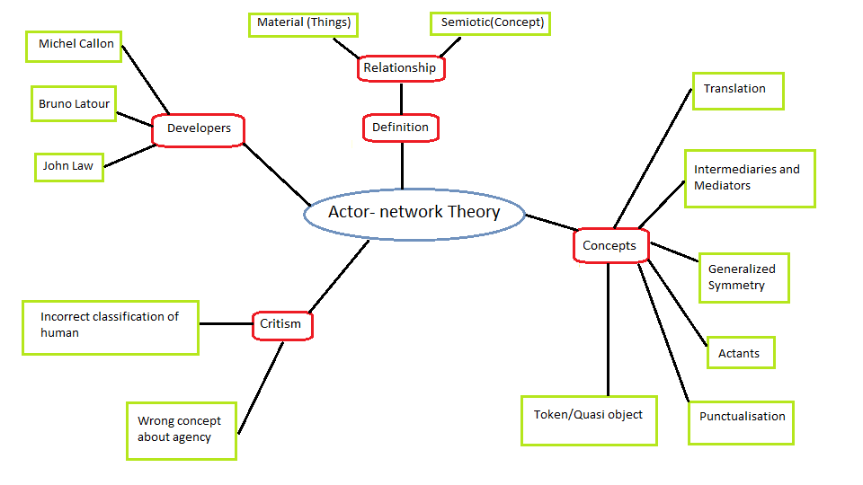
Flexible and responsive governance
An actor-network provides “more an inspirational frame than a constraining theoretical system… (which) postulates between humans and nonhumans… (in) the conﬁguration of sociotechnical network” (Callon 2001, 61).

Slide 25
Flexible and responsive governance
“a shift towards dynamic ocean management… defined as management that rapidly changes in space and time in response to changes in the ocean and its users through the integration of near real-time biological, oceanographic, social and/or economic data…. can refine the temporal and spatial scale of managed areas, thereby better balancing ecological and economic objectives”. (Maxwell et al. 2015, 42)
BUT!

Slide 26
4. Beyond ‘one size fits all’: Beyond borders

Slide 27
This presentation has raised questions about how we might otherwise do governance against a tide of normative ‘one size or type’ fits all regimes, situated within territorialising and grounded approaches to governing the marine environment.
“I mean the funny thing is that sometimes these things don’t replace something else, they just complement and supplement. They have different capabilities and different features” (Captain Ed Page, Interview, Alaska, 2017).
There may be additions and alternatives, multi-sized (and multi-type) developments which allow us to move beyond, grounded, static borders – with an equal need to be cautious of these approaches and their politics.

Slide 28
Multi-sized (and multi-type) development: Imagining governance beyond borders
Dr. Kimberley Peters drkimberleypeters@gmail.com @DrKimPeters
University of Liverpool, UK; Helmholtz Institute for Functional Marine Biodiversity, Germany

Slide 29
Thank you, any questions?

