Slide 1
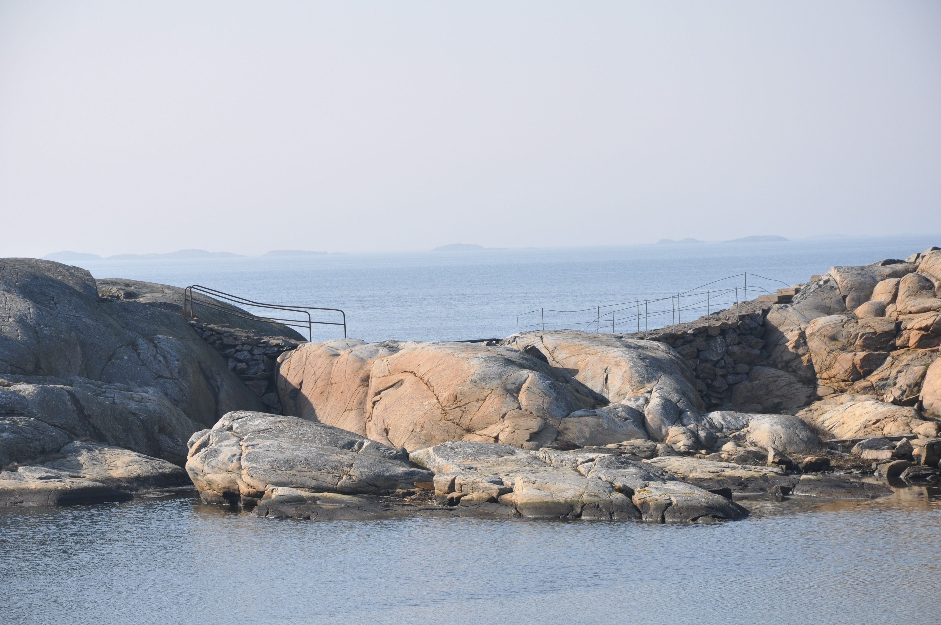

A perspective on the discussion on inclusive and equitable development
Transformed and Transformative Ocean Governance
22 – 24 January 2020
Nelson Mandela University, Port Elizabeth, SA
Lena Gipperth
Centre for Sea and Society / Department of Law
University of Gothenburg, Sweden

Slide 2
UNIVERSITY OF GOTHENBURG HAS
Closeness to the sea and a clear maritime history
Marine related research and education in all eight faculties
Unique marine infrastructure
Several platforms for collaboration with authorities and businesses
Many international partners
Focus on Agenda 2030

Slide 3
Potential of sustainable use of the ocean ….
Agenda 2030
The European Commission’s Blue Growth Strategy.
EU-directives on water and marine management and Marine spatial planning
The Commonwealth Blue Charter
FAO’s Voluntary Guidelines for Securing Sustainable Small-Scale Fisheries
UN Ocean conferences 2017 and 2020
The Sustainable Blue Economy Conference in Kenya 2018
The UN decade of ocean science for sustainable development, 2021-2030
Notes:
Organisation

Slide 4
The ocean is under severe pressure
IPBES on ocean biodiversity
FAO report on overfishing
IPPC special report on Ocean and Cryosphere in a changing climate
…..

Slide 5
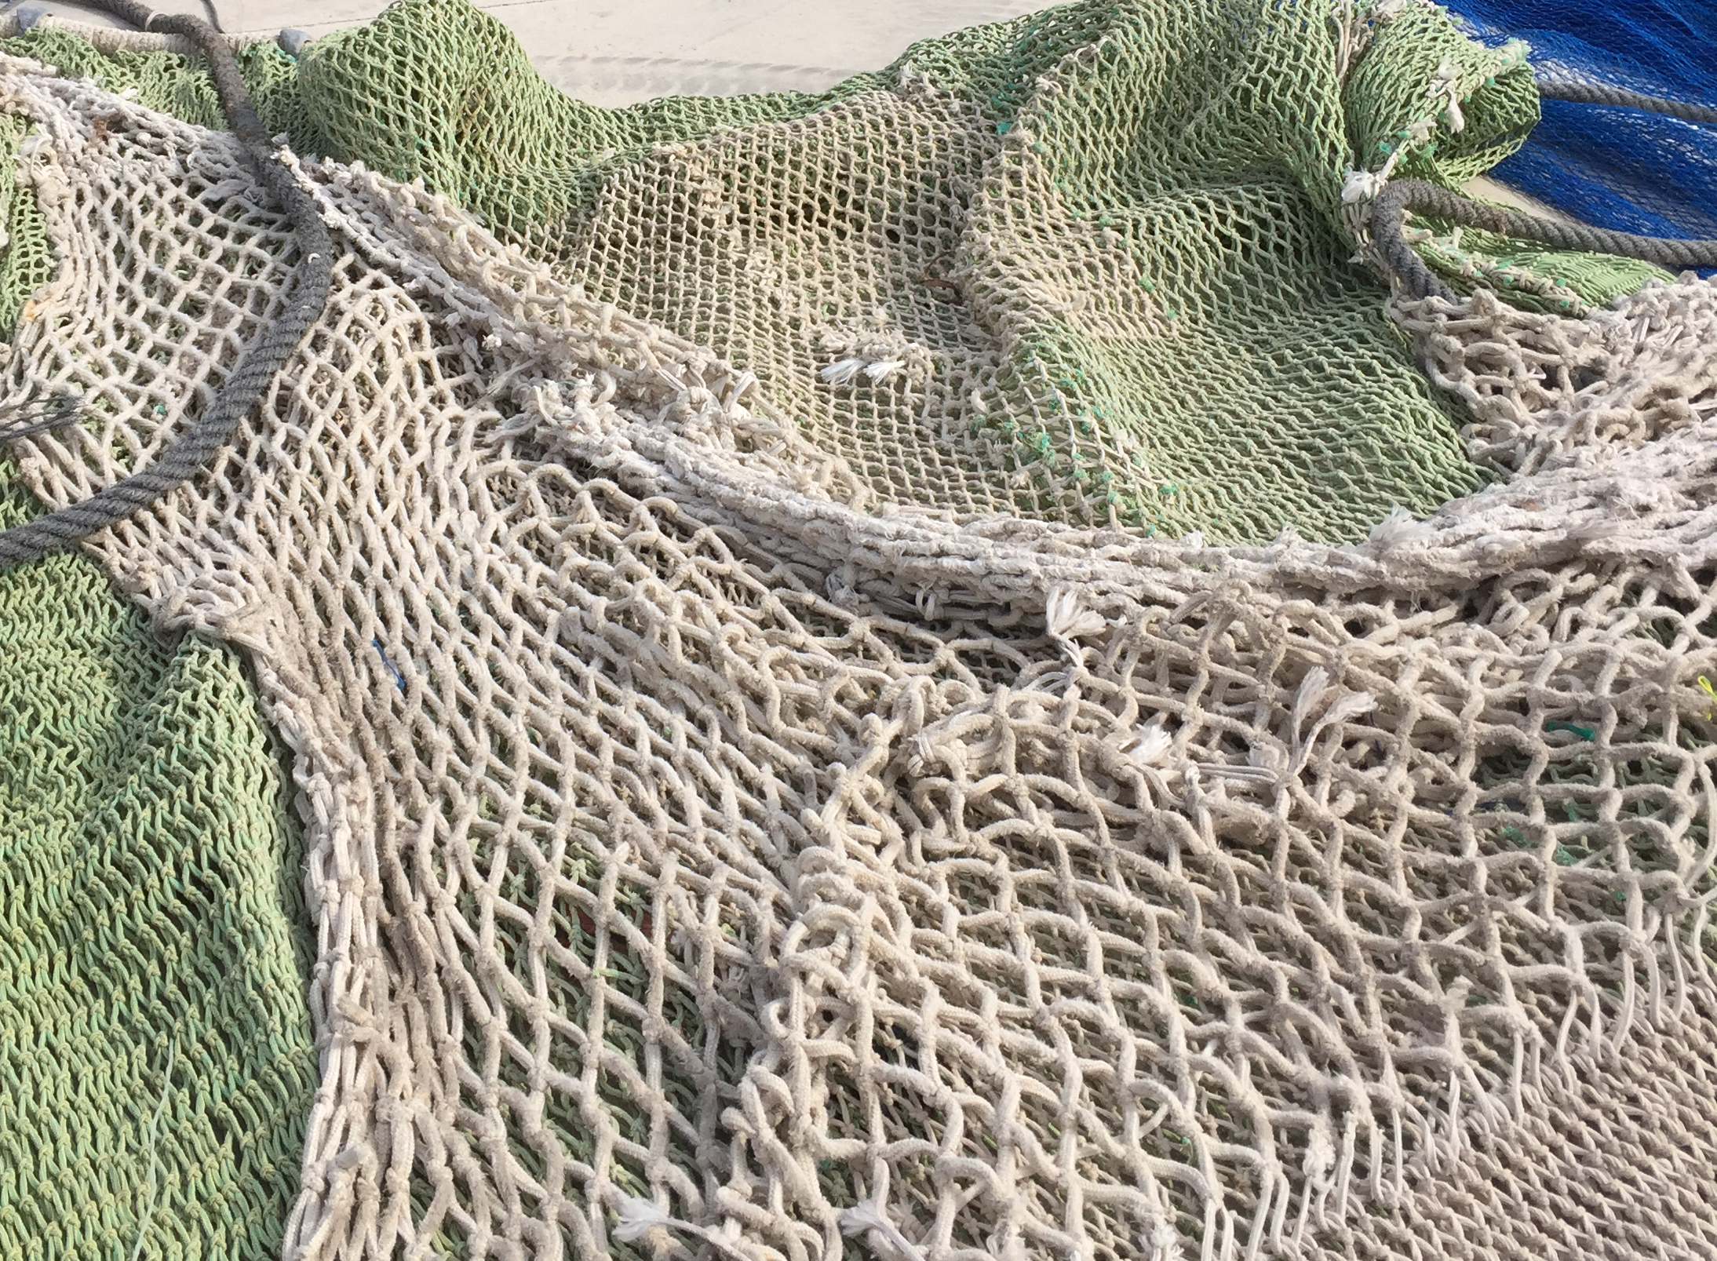
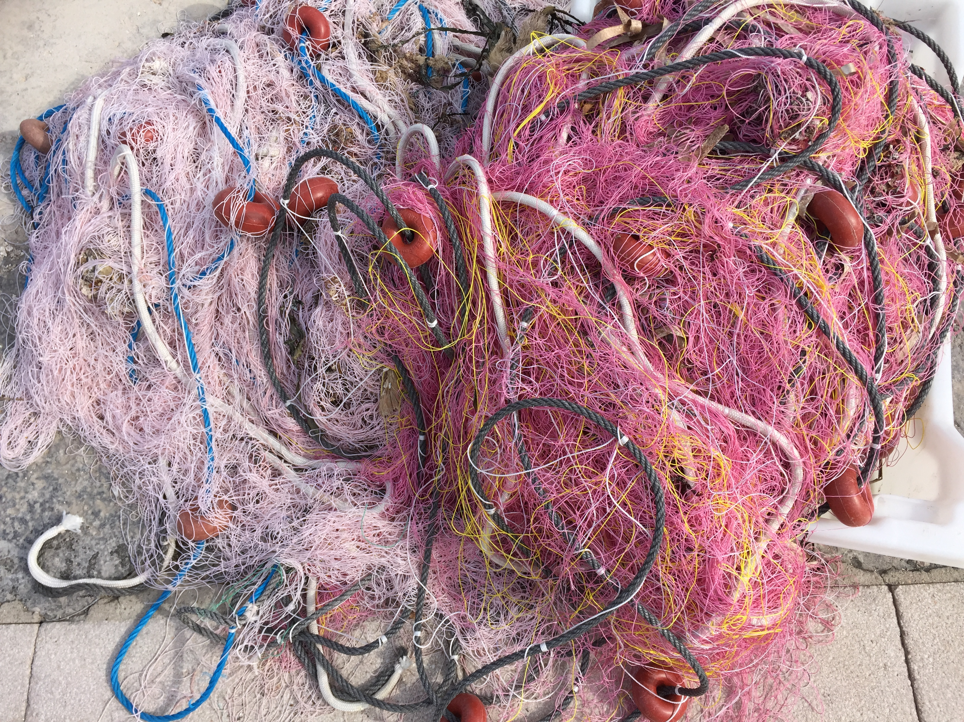
A complex network of rules and norms

Slide 6
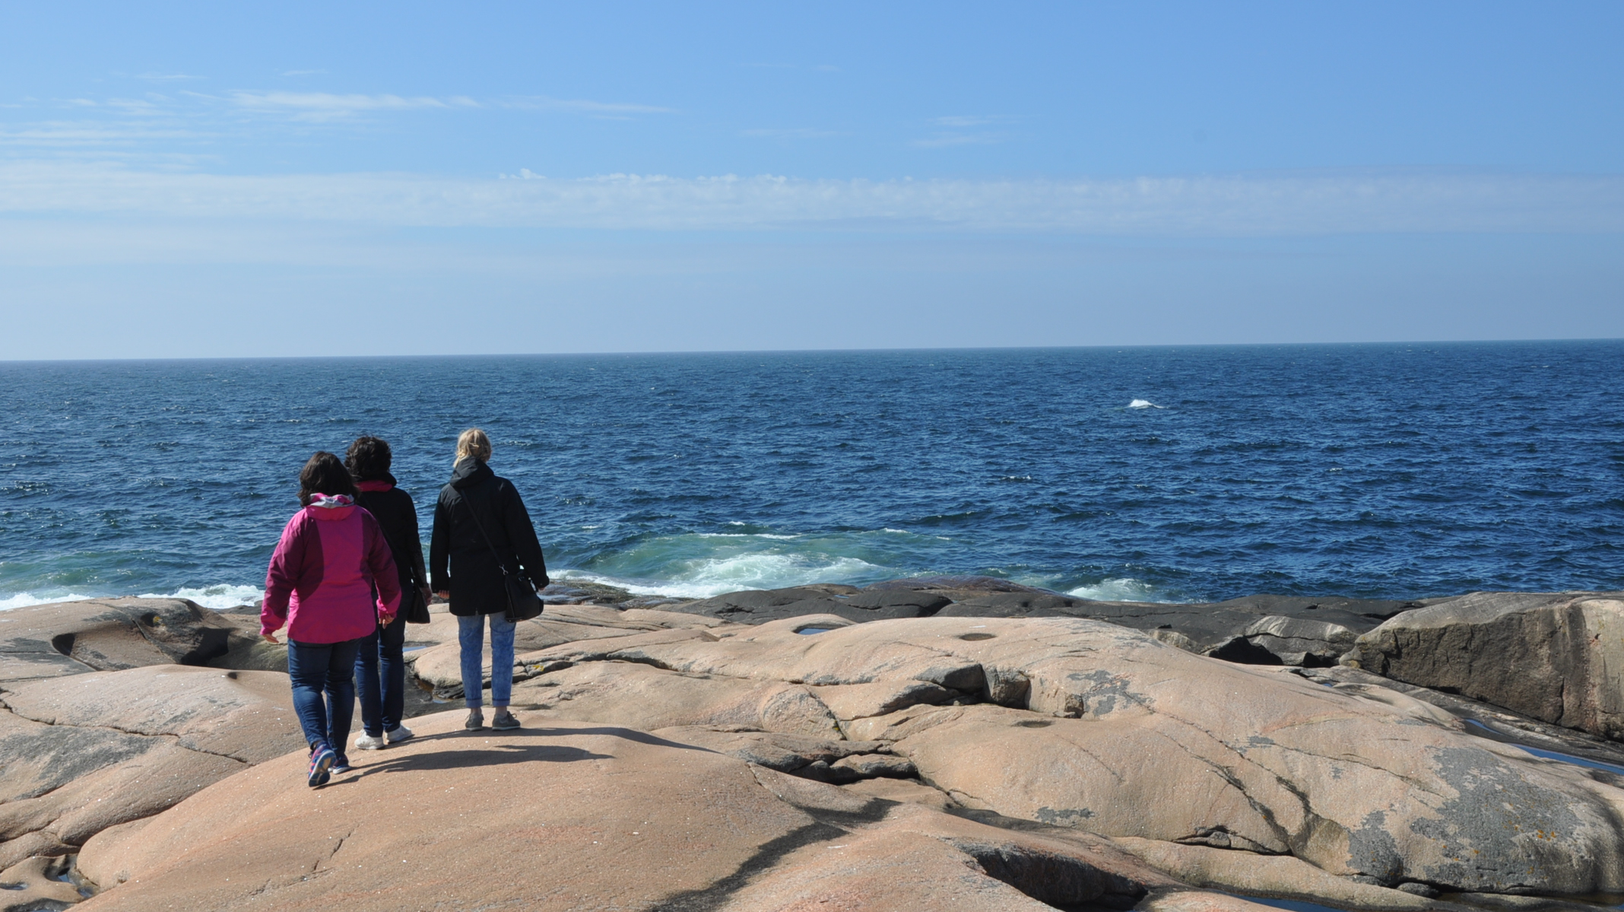
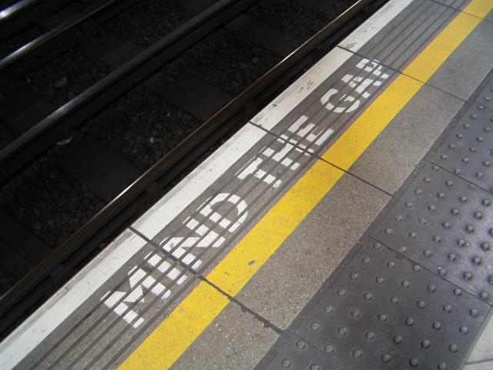
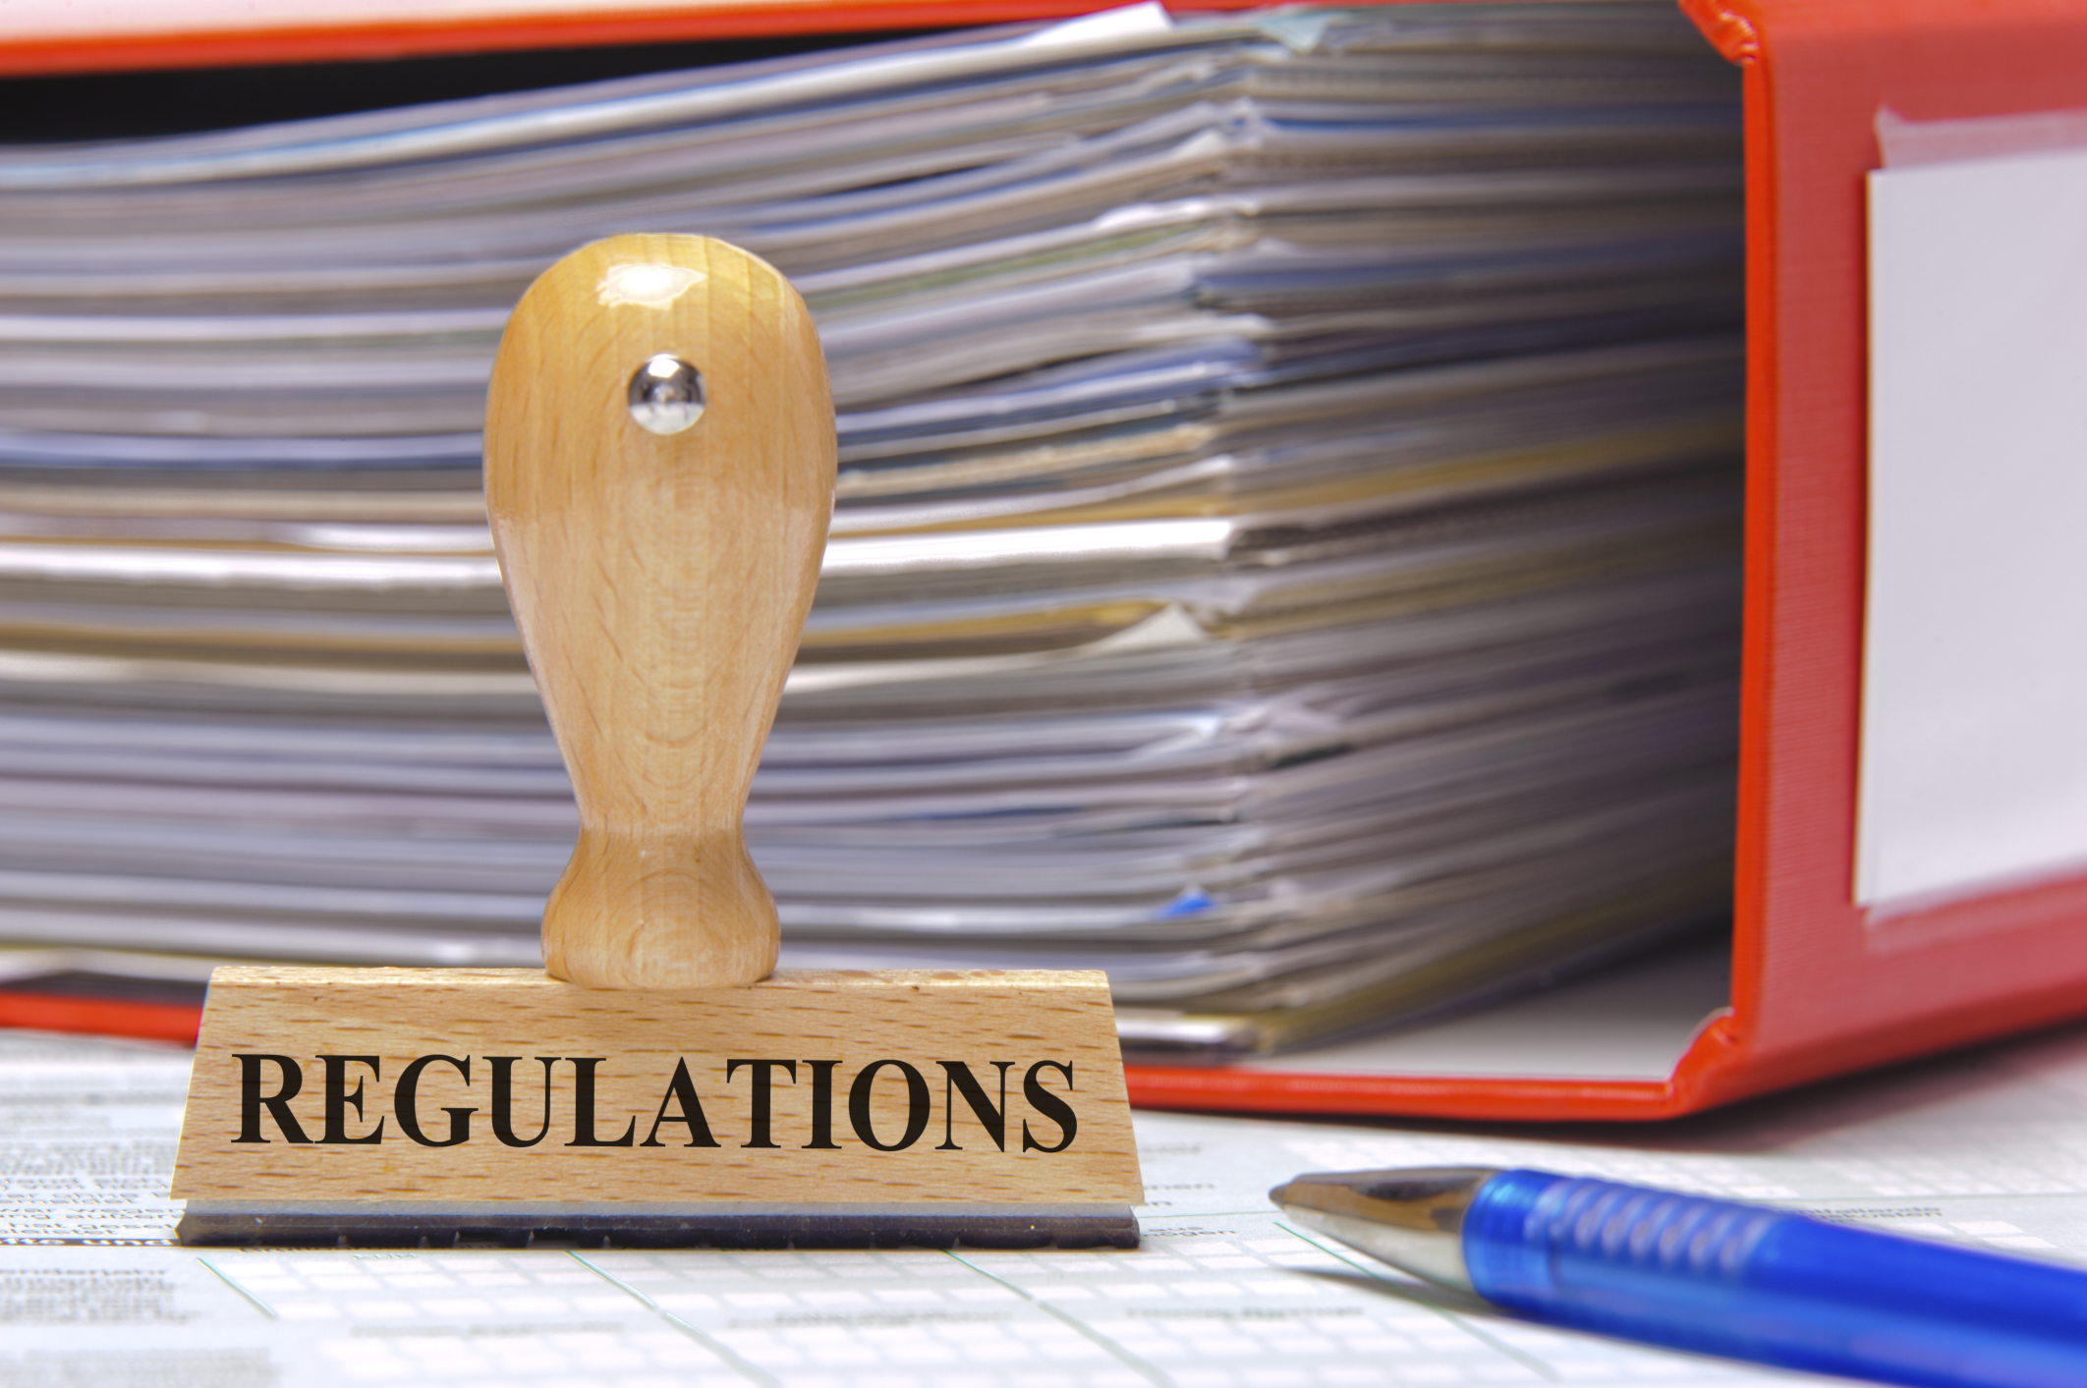

Slide 7
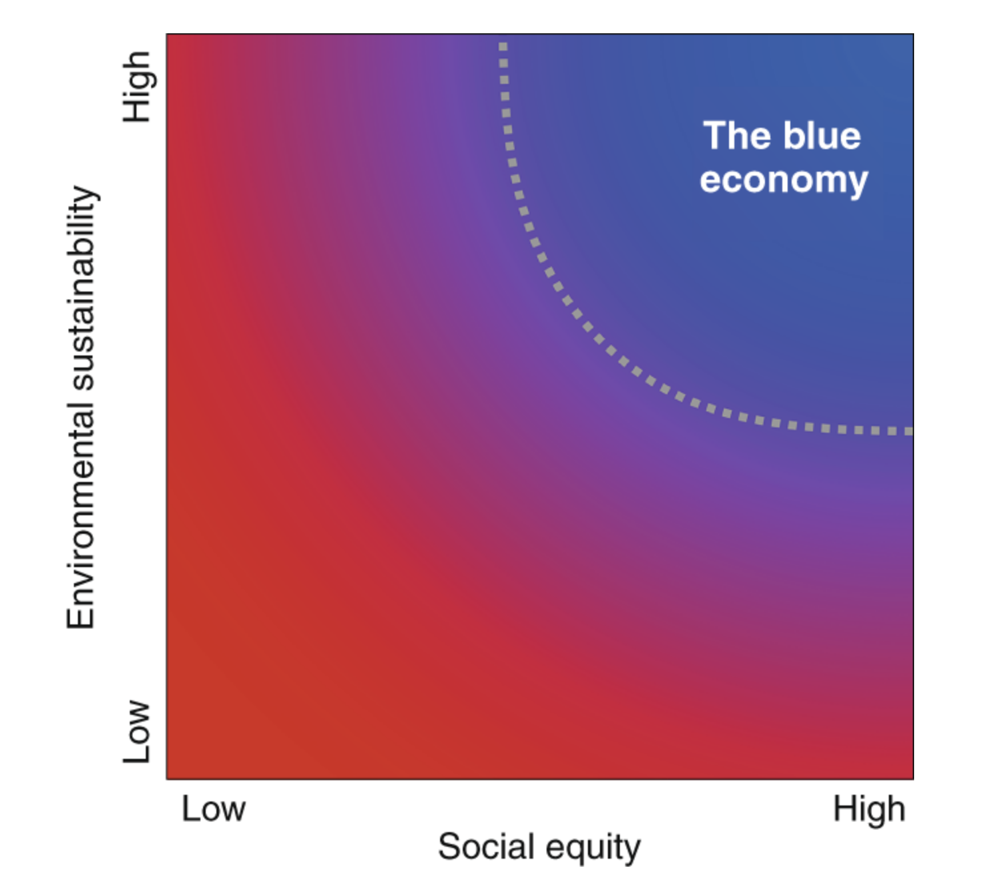
A sustainable blue economy
Environmental sustaniablity
Social equity
  Benefits from resources and natures contribution to people
  The effect of harm (less services and resources)
  Burdens of taking mearsures to stop pollution/impact and restoring habitats etc
  The use of ”pollution space” - Critical load
Direct – but ALSO indirectly (time and space)
Bennett, et al. 2019
Notes:
Bennett, N.J., Cisneros-Montemayor, A.M., Blythe, J. et al. Towards a sustainable and equitable blue economy. Nat Sustain 2, 991–993 (2019) doi:10.1038/s41893-019-0404-1

Slide 8
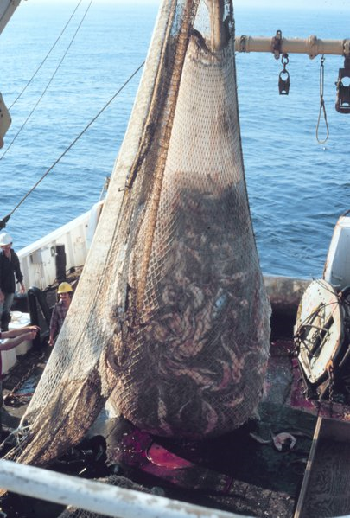

Direct and indirect actors
Driving forces
Pressure on environment
State of environment
Impact on welfare
Response via policy

Slide 9
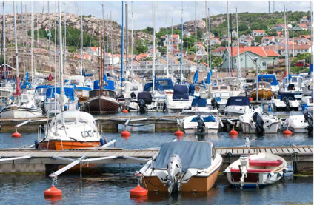
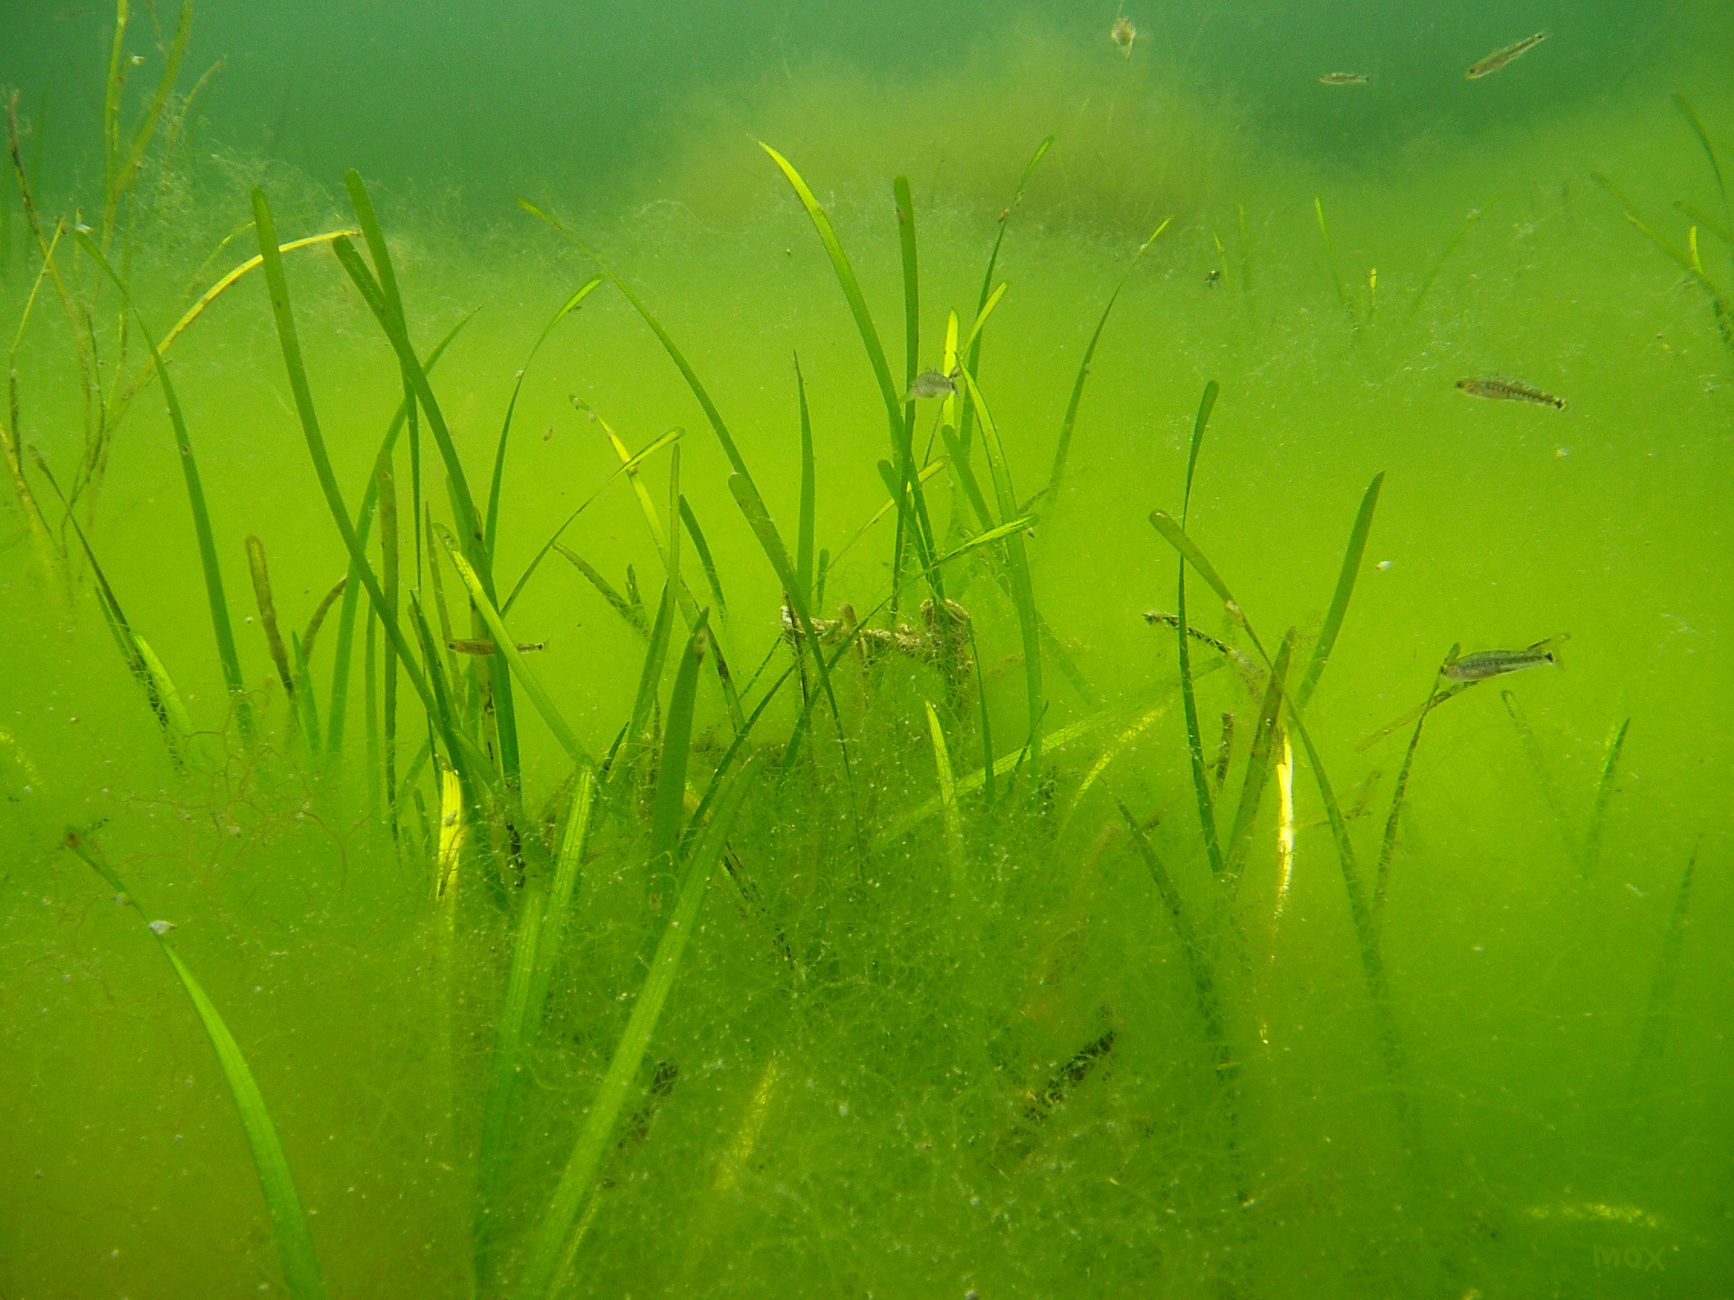
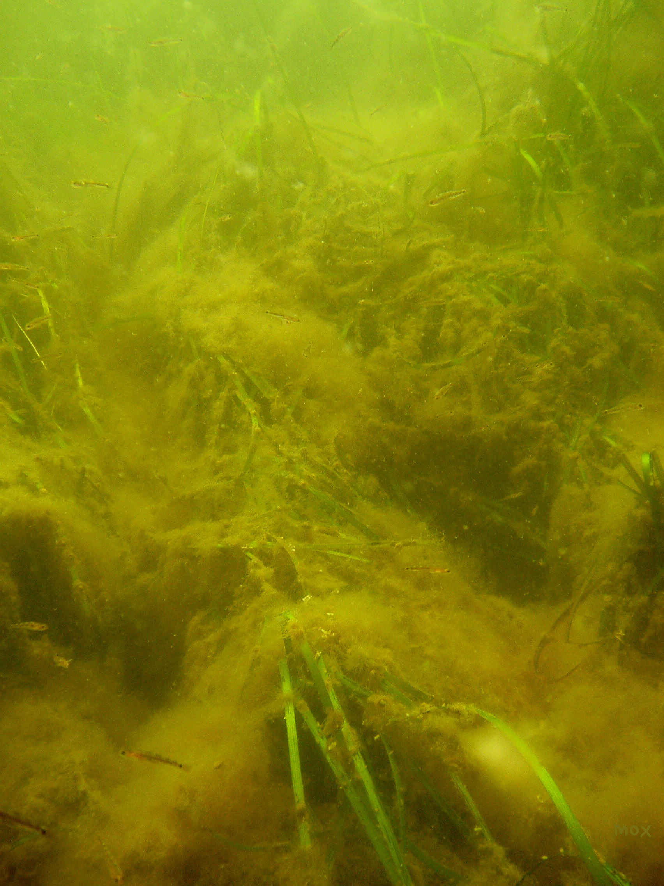
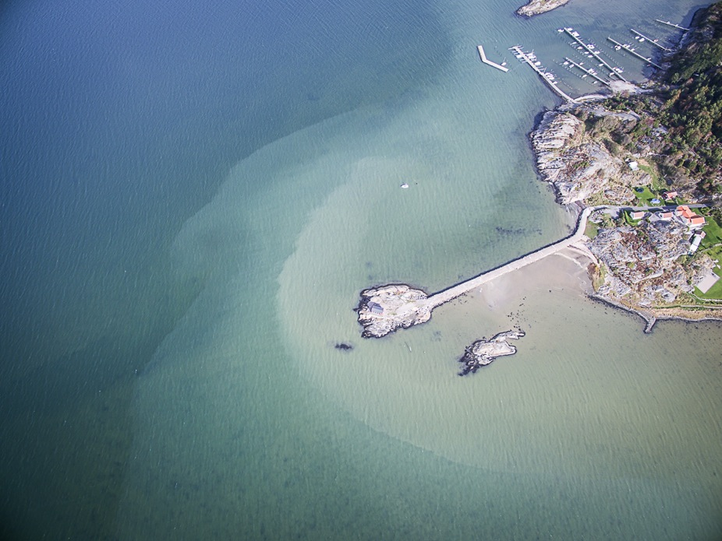
Permanent changes by small steps can give large scale and long term effects.
(Eriander et al. 2017)
(Moksnes m. fl. 2016.
Handbok för ålgräsrestaurering)

Slide 10
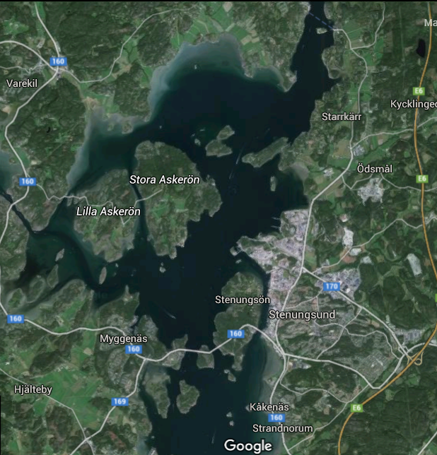

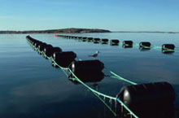
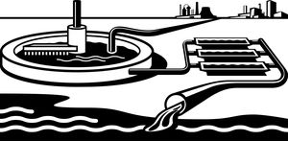


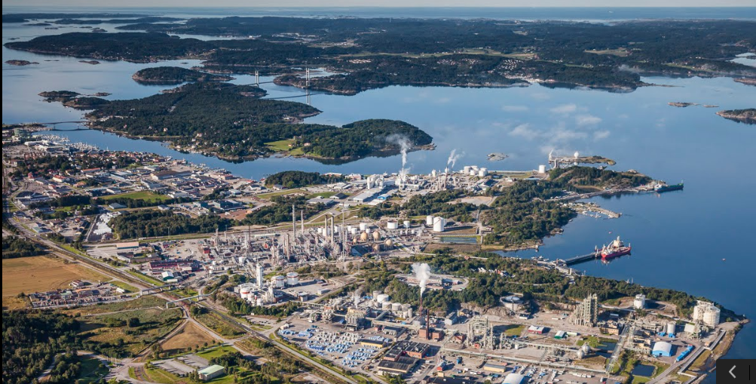

Waste water
treatment plant
Flow of chemical in Stenungsund.
Phtalates factory
EtOxide, EtAmines, surfactants, glycols, ethoxylates, etc factory
Refinary
Mercury based chlor-alkali factory, and PVC plant
Polyethylene plant

Slide 11
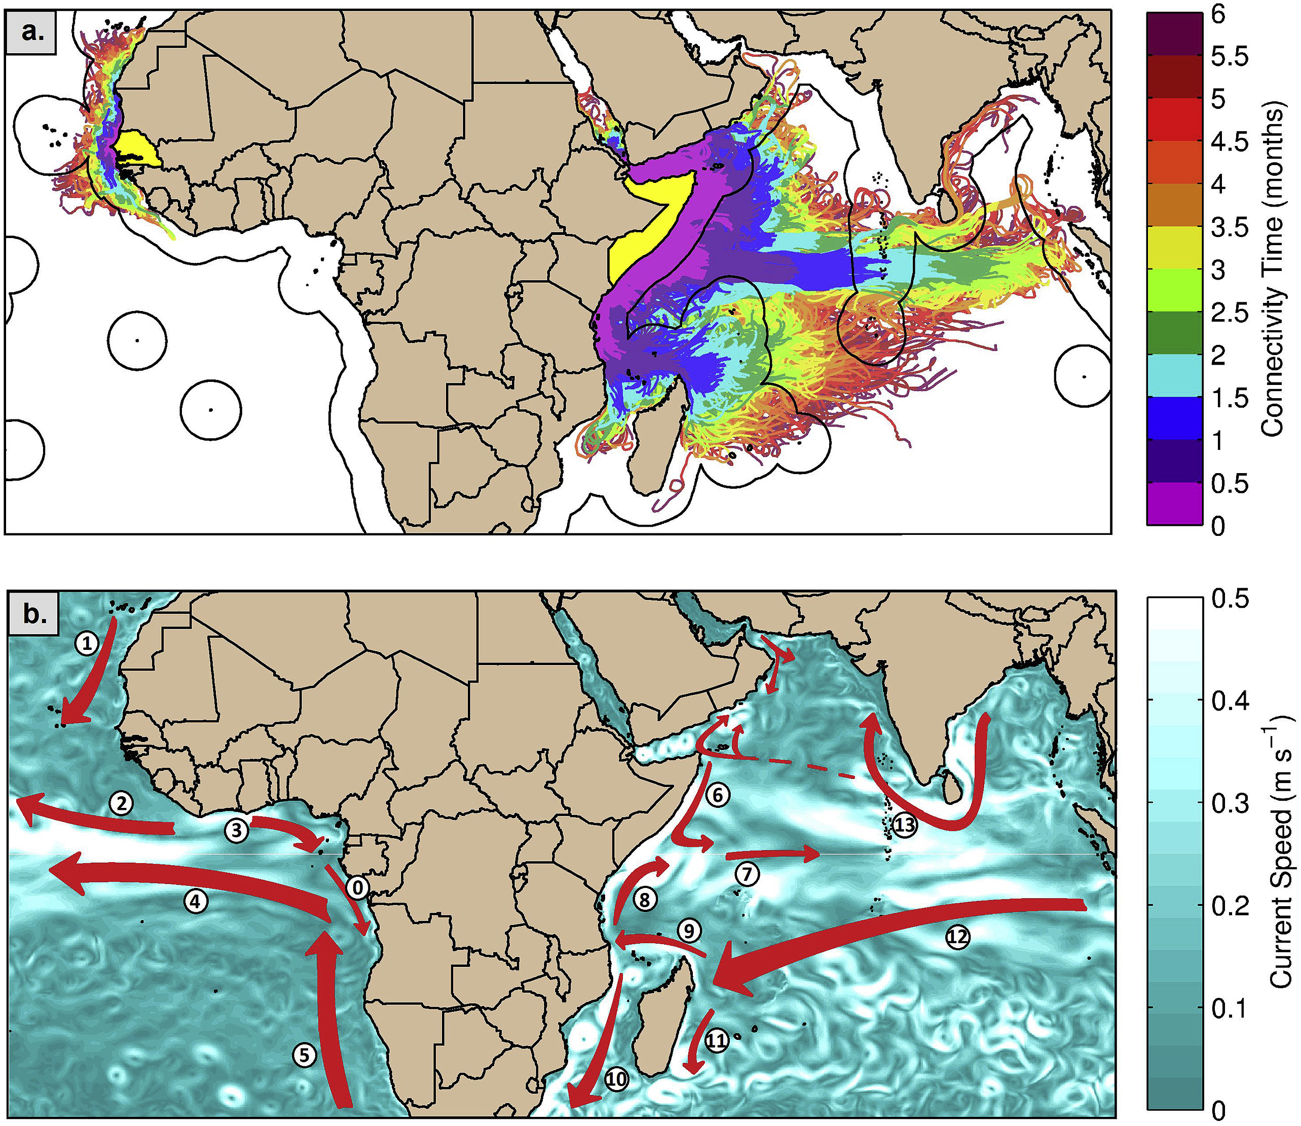
Ecological connectivity between the areas beyond national jurisdiction, coastal waters and livelihood
Popova, E. 2019

Slide 12
Some conclusions
The legal and institutional framework for the protection of the ocean is fragmented and in general not designed to achieve ambitious goals such as Agenda 2030
Equity should be better recognised in relation to the division of the critical loads and the burden of taking measures and restoring marine ecosystems
More focus on indirect actors benefitting from ocean resources and services or negatively influencing them
Further develop EIAs and SEAs, particular in relation to activities within ABNJ
Coastal livelihood should be recognised when establishing MPAs

Slide 13
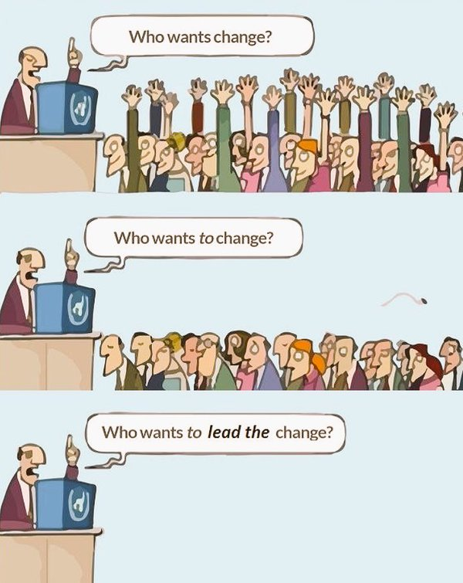
There is a role for social scientists!

Slide 14
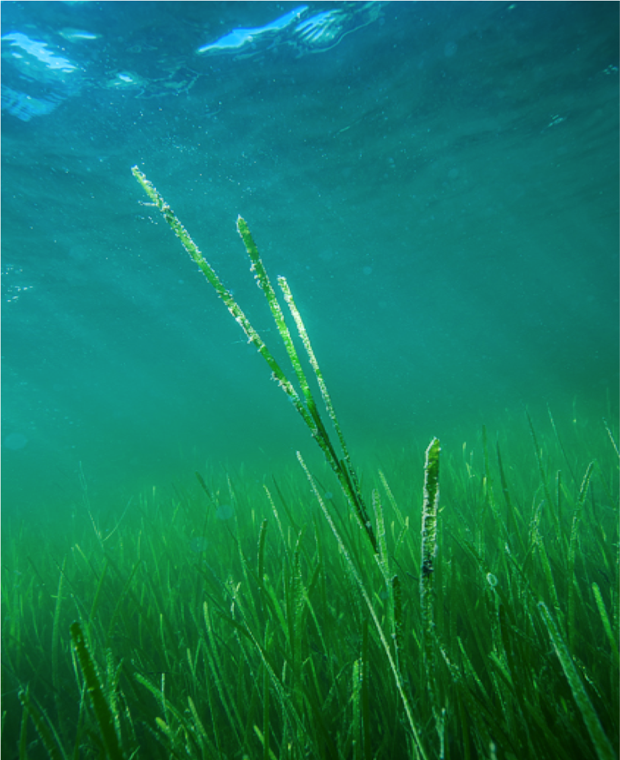
TACK!
Based on research funded by: University of Gothenburg, Formas,
Länsstyrelsen i Västra Götalands län, Swedish ency for Water and Marine Managemen
Notes:
Med?

Slide 15
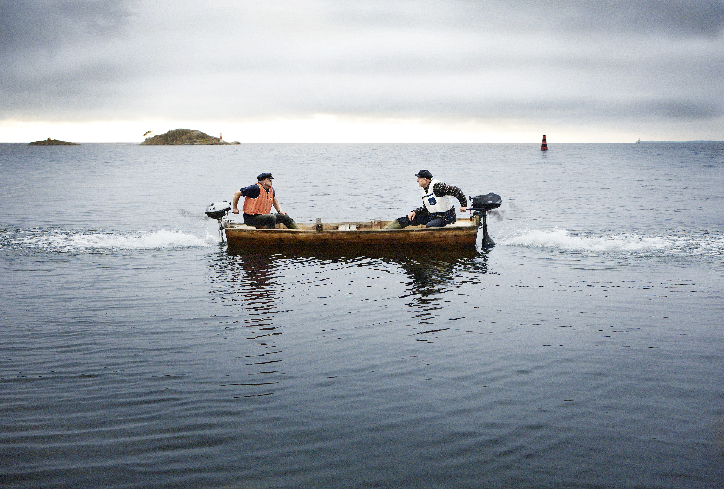
Towards a sustainable future?

