Slide 1
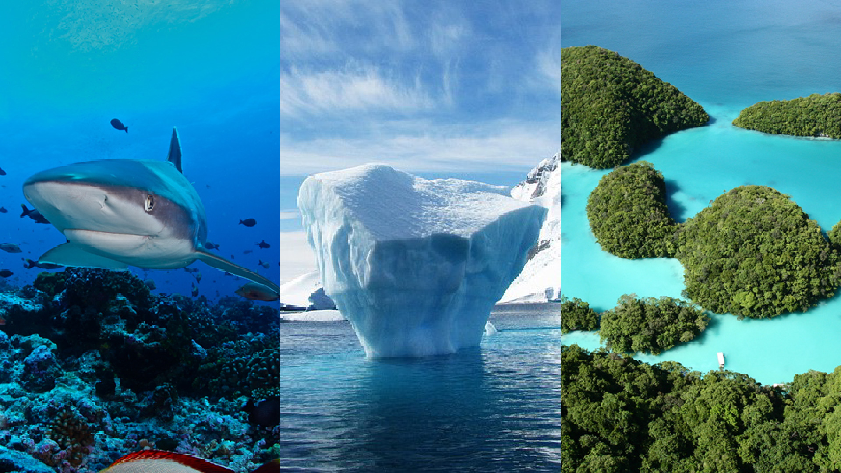






The Measurement of Ocean Health
Mandy Lombard, Kaylee Smit, Estee Vermeulen, Kelly Orgeta-Cisneros, Jai Clifford-Holmes, Teun Sluijs and Berny Snow
Ben Halpern Ant Bernard Lynne Shannon Kerry Sink

Slide 2
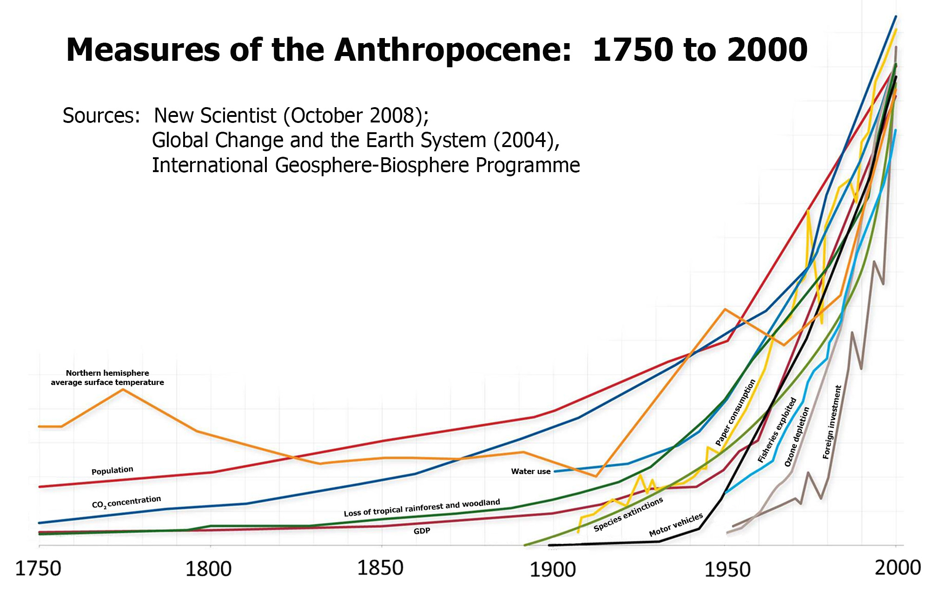
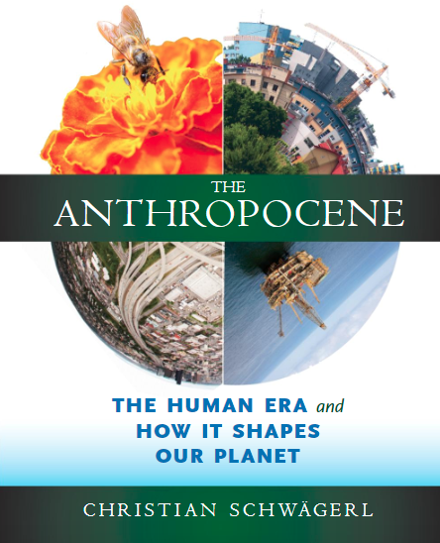
Measures of the Anthropocence: 1750-2000
NH avg surface Tº
Population
Water use
CO2 concentration
Lost tropical rainforest/woodland
GDP
New Scientist (Oct 20018); Global Change & the Earth System (2004); IGBP
Notes:
Advent of the Anthropocene:
The Anthropocene is a proposed epoch dating from the commencement of significant human impact on the Earth's geology and ecosystems, including, but not limited to, anthropogenic climate change
Various different start dates for the Anthropocene have been proposed, ranging from the beginning of the Agricultural Revolution 12,000–15,000 years ago, to as recent as the Trinity test in 1945.
The most recent period of the Anthropocene also called the Great Acceleration during which the socioeconomic and earth system trends are increasing dramatically, especially after the Second World War.
Trinity was the code name of the first detonation of a nuclear weapon. It was conducted by the United States Army in 1945

Slide 3
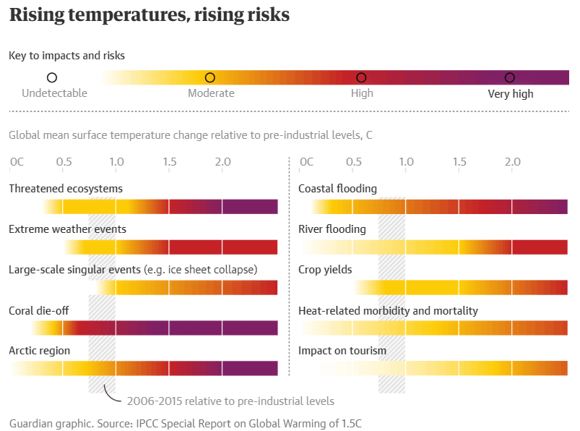


Slide 4
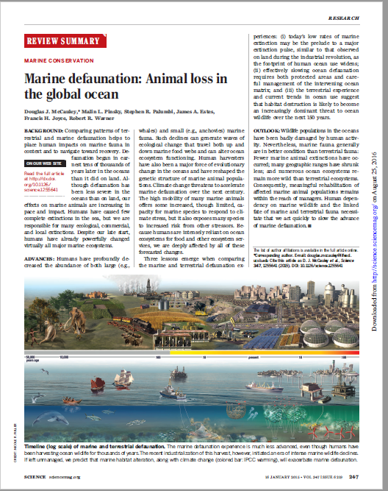
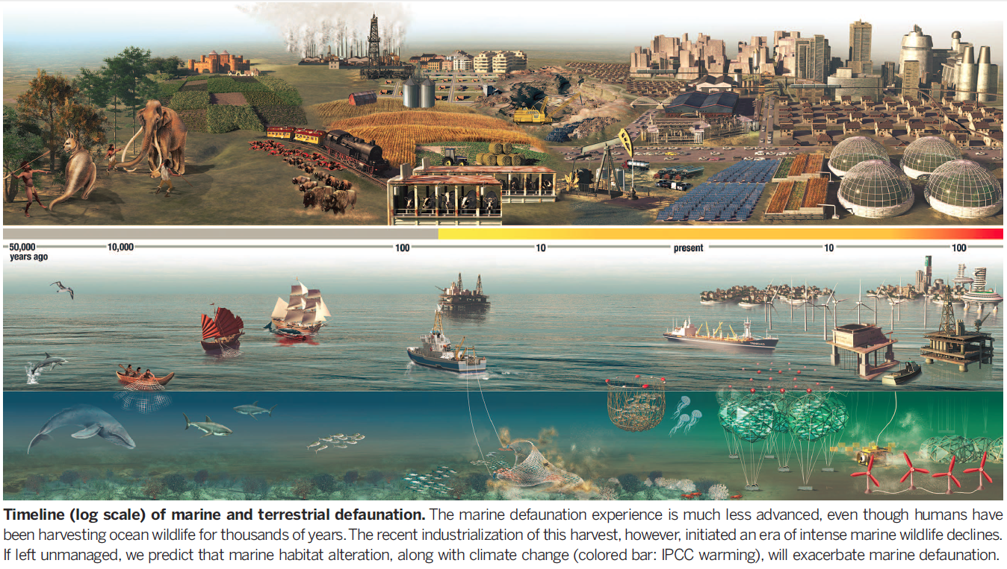
Marine defaunation:
Animal loss in the global ocean
McCauley et al. 2015. Science
Notes:
Timeline (log scale) of marine and terrestrial defaunation. The marine defaunation experience is much less advanced, even though humans have been harvesting ocean wildlife for thousands of years. The recent industrialization of this harvest, however, initiated an era of intense marine wildlife declines. If left unmanaged, we predict that marine habitat alteration, along with climate change (colored bar: IPCC warming), will exacerbate marine defaunation.
Advent of the Anthropocene:
The Anthropocene is a proposed epoch dating from the commencement of significant human impact on the Earth's geology and ecosystems, including, but not limited to, anthropogenic climate change
Various different start dates for the Anthropocene have been proposed, ranging from the beginning of the Agricultural Revolution 12,000–15,000 years ago, to as recent as the Trinity test in 1945.
The most recent period of the Anthropocene also called the Great Acceleration during which the socioeconomic and earth system trends are increasing dramatically, especially after the Second World War.
Trinity was the code name of the first detonation of a nuclear weapon. It was conducted by the United States Army in 1945

Slide 5
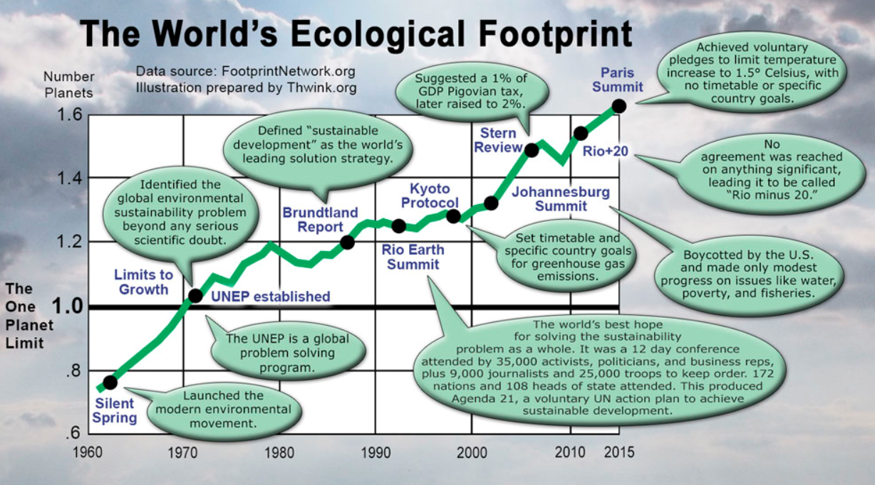
Thwink.org
Notes:
The graph tells a grim story.
Despite the best efforts of millions of dedicated activists, the world's ecological footprint keeps rising. Year after year, decade after decade, it just keeps going up. Every dot on the graph is a major effort to solve the problem. There are thousands of more dots not on the graph. But none have made more than a modest difference. The footprint is now at about 50% overshoot. If this overshoot is not brought down below the one planet limit very soon, collapse is dead ahead. (pun intended)
So what are the world's problem solvers doing wrong? Why are popular solutions failing to solve the sustainability problem?

Slide 6

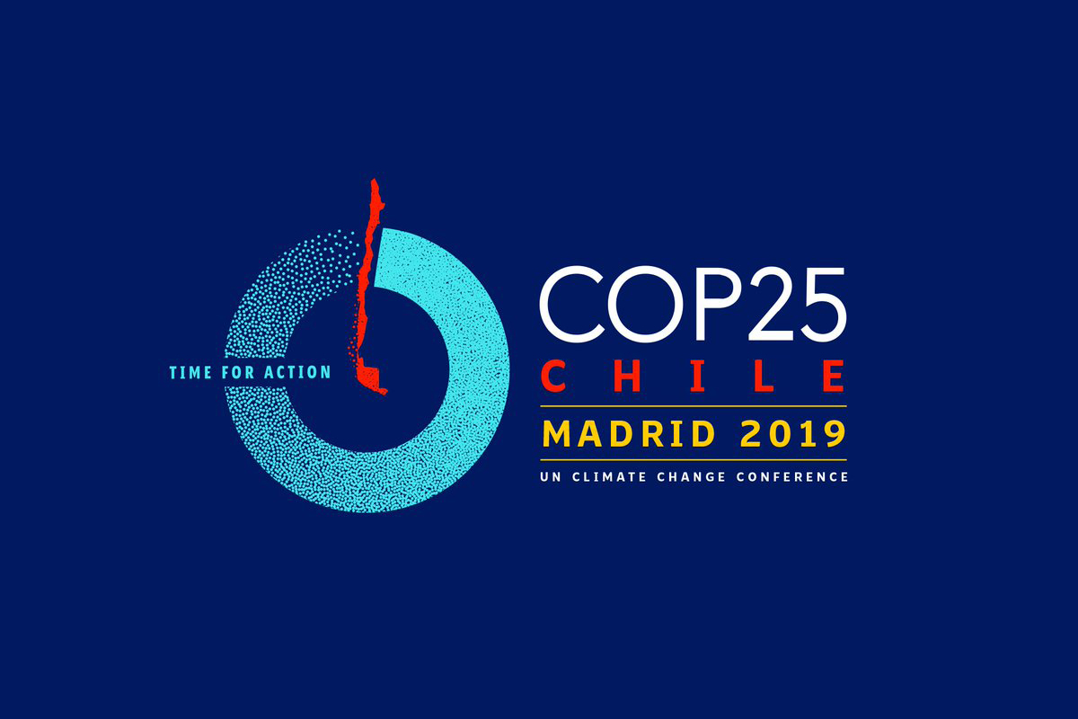
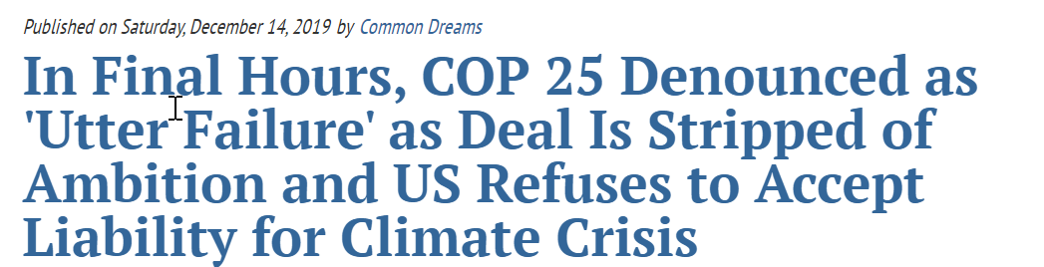
2019 United Nations Climate Change Conference

Slide 7
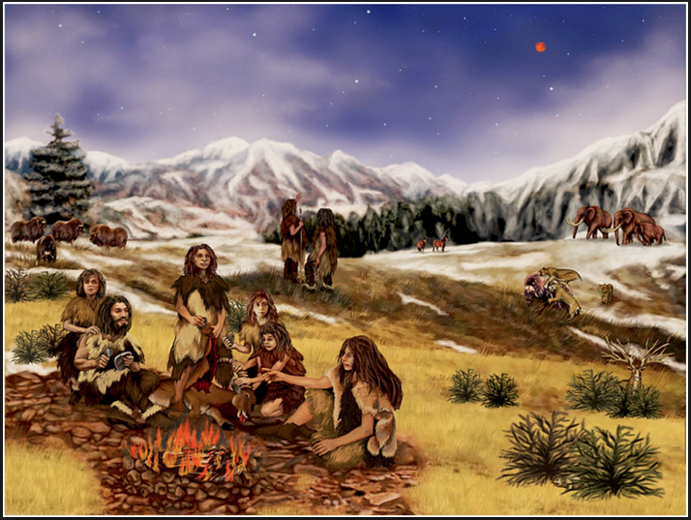
Human behaviour
Sustainability – Can Our Pleistocene Brain Handle It?
Small groups
Co-operate
Share resources
Food
Mates
Cheaters
Notes:
Easy to measure trade offs because of small groups (know cheaters)
Archaeologist Matthew Pailes
The particular brand of anthropology I work in is called Human Behavioral Ecology. Like the name suggests, we try to identify the evolutionary basis that made certain human behaviors adaptive, or beneficial. Generally we assume that, all things being equal, most behaviors arose to optimize getting food and attract potential mates.
To answer why this is so, we have to break conservation down to its most fundamental parts. When we talk of conservation today we generally are referring to public property or resources drawn upon by a large community. In order for the conservation effort to be successful we all, or at least most of us, have to agree to forgo the benefits of utilizing a resource now so that it will be available later. So in essence conservation is merely a form of cooperation in which we all trust each other not to cheat by using the resource now. The problem is, as we all know, humans love to cheat.
As I mentioned last time conservation is essentially a question of cooperation amongst members of a group, be it a local park cleanup or nations signing onto a global warming treaty. From an evolutionary standpoint then, we want to think about why groups exist and why they cooperate

Slide 8
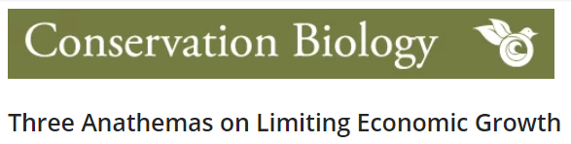
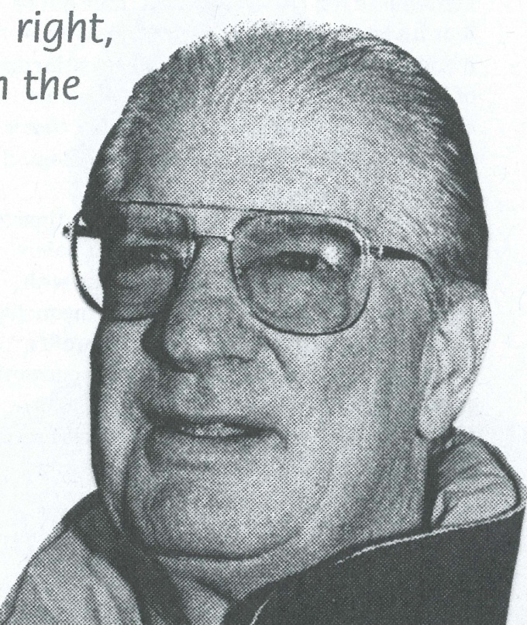
3 things that we need to do
but we find hard to do
Herman Daly 2009
1. Share
2. Control population growth
3. Reduce consumption
Notes:
This is why we find it so hard to do what we need to do, namely redistribute wealth to non-kin, control population growth, and consume less.
Daly, H., 2009. Three anathemas on limiting economic growth. Conservation Biology, 23(2), pp.252-253.
We have many problems, but apparently only one solution: economic growth, or as the pundits now like to say, “to grow the economy” (as if it were a potted plant). But let us stop right there and ask two questions that all students of economics should put to their professors. First, do you think of growth as a temporary process necessary to bring wealth to a level or state of sufficiency, which will then be maintained more or less in a steady state, or as a continuous process of getting bigger that is desirable in itself?

Slide 9
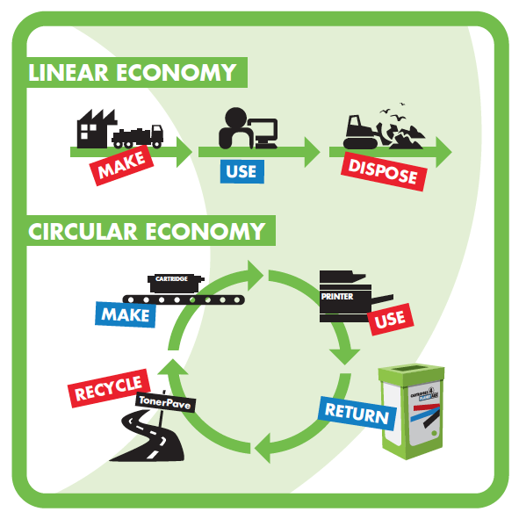
Linear economy
Steady state / circular economy
Notes:
A sustainable economy
Is of relatively stable size
Features stable population & stable consumption that remain at/below carrying capacity
Has environmental, lifestyle & moral advantages

Slide 10
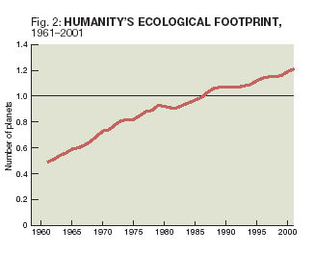
We are good at making tools but we are not good at working out the future

Slide 11
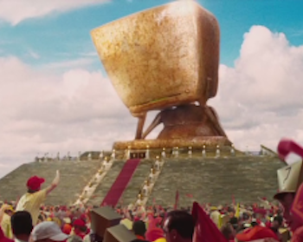
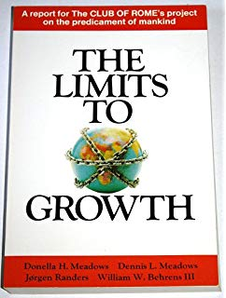
1972
Computer simulation
of exponential
economic & population growth with a finite supply of resources

Slide 12
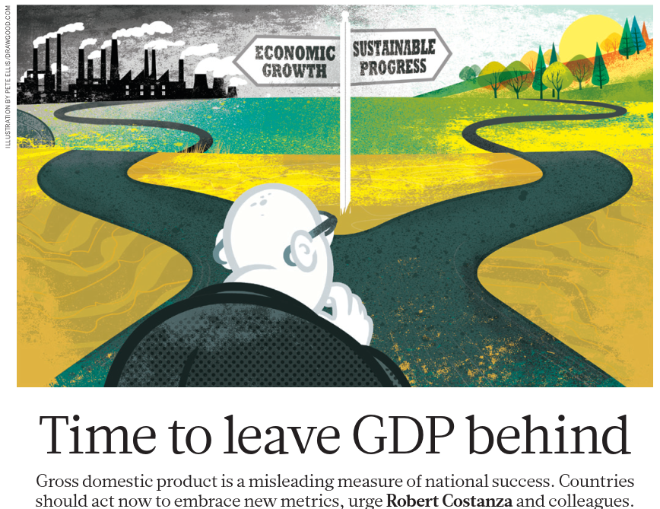
2014
The successor to GDP should be a new set of metrics that integrates current knowledge of how ecology, economics, psychology and sociology collectively contribute to establishing and measuring sustainable well-being
Constanza et al. (2014) Nature
Notes:
The successor to GDP should be a new set of metrics that integrates current knowledge of how ecology, economics, psychology and sociology collectively contribute to establishing and measuring sustainable well-being. The new metrics must garner broad support from stakeholders in the coming conclaves.

Slide 13
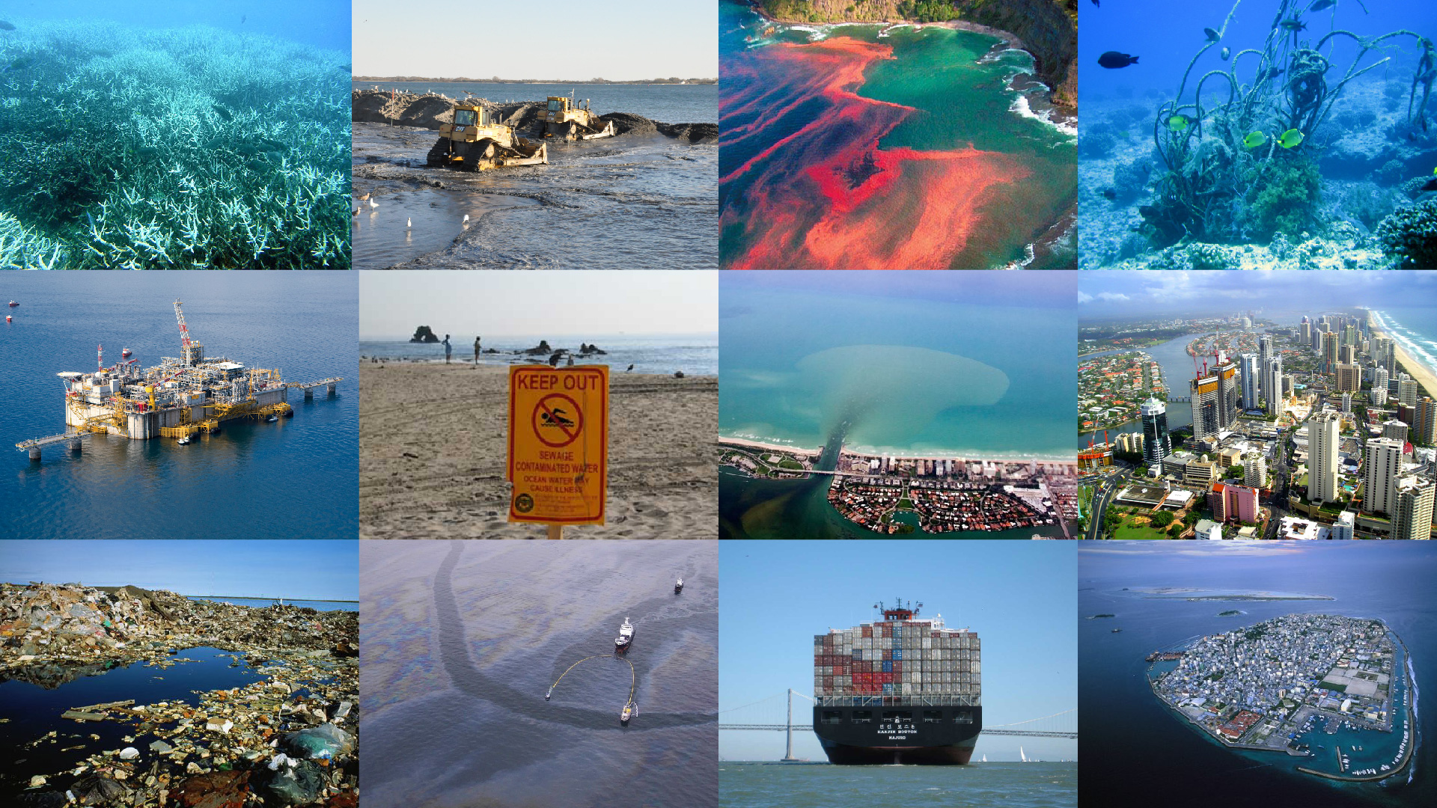
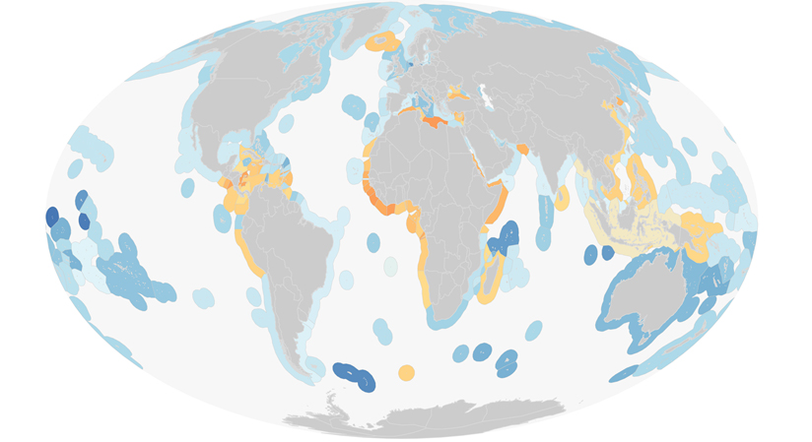
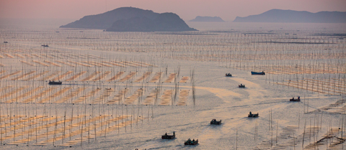
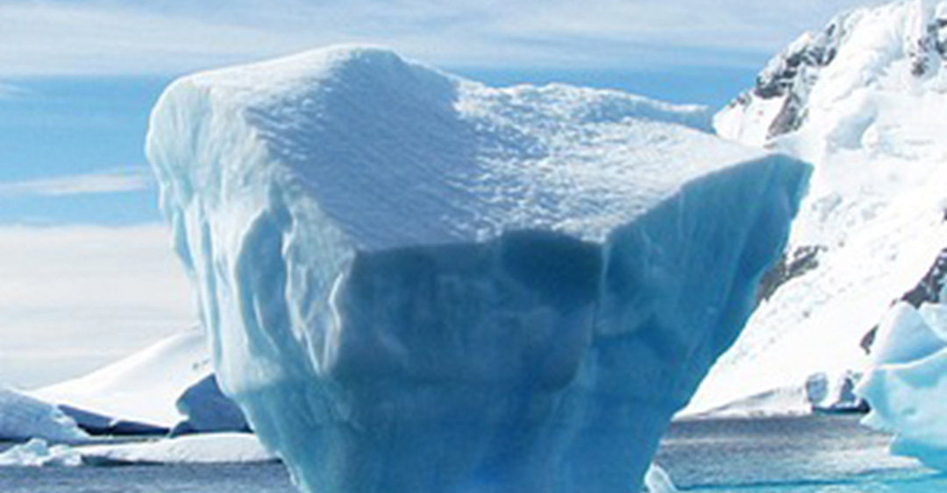
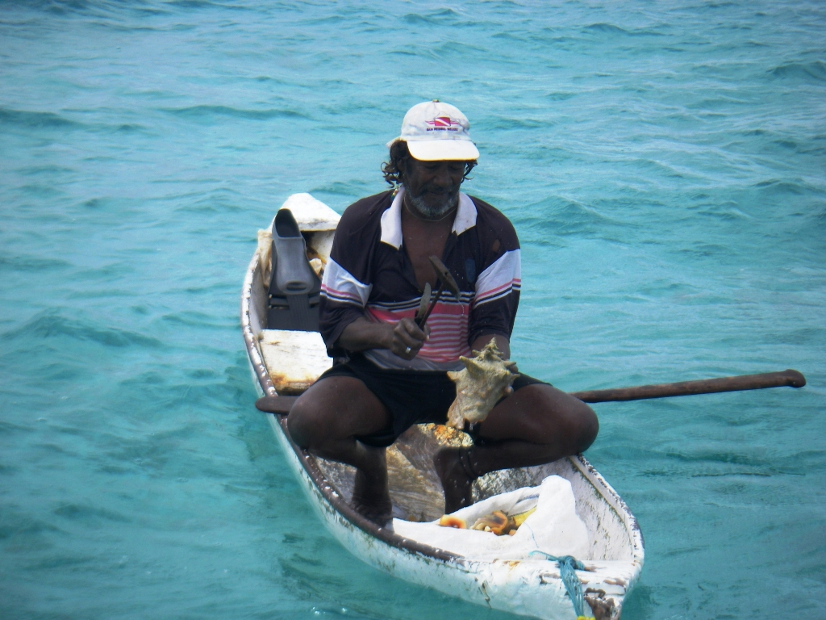
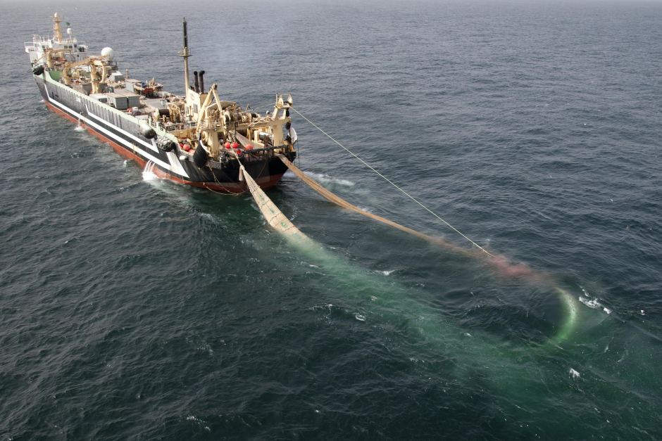
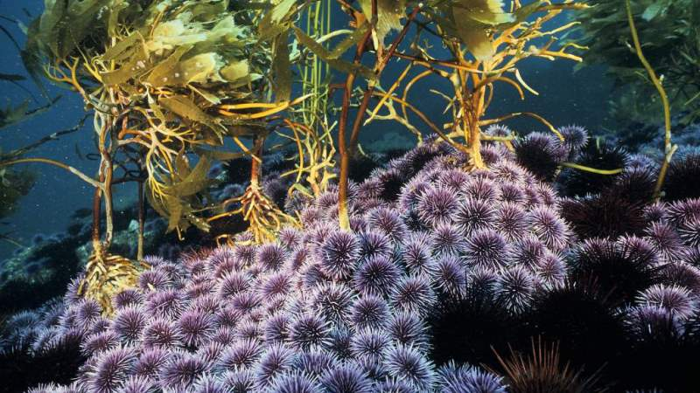
Multiple Stressors
Measuring Impact
Feeding the Planet
Climate Change
Equity
Tipping Points

Slide 14


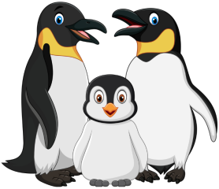

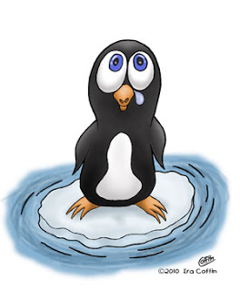
Set goals/
objectives
Concern
Intervention
Ocean health
Do nothing
Define
Do something
Do nothing
Onset of anthropocene
Now
Planning horizon
Time

Slide 15
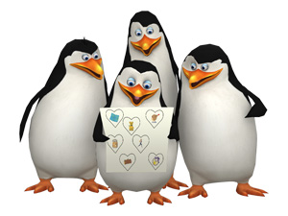


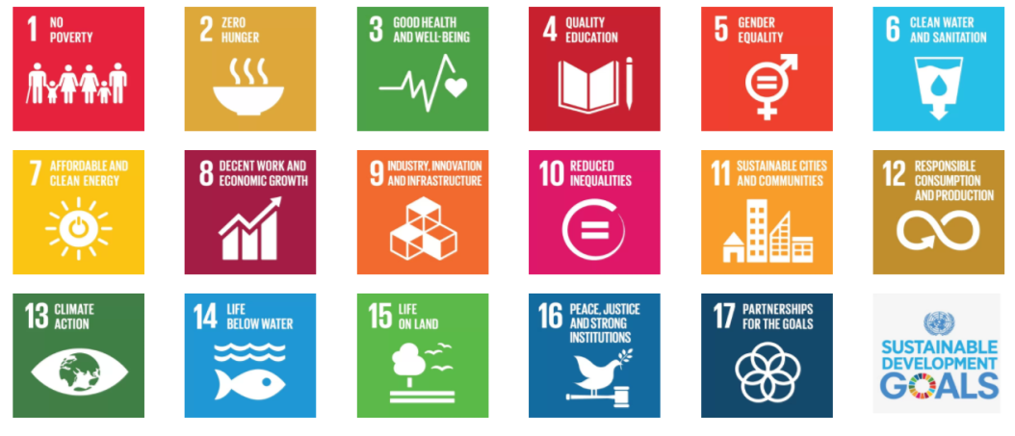
2015

Slide 16

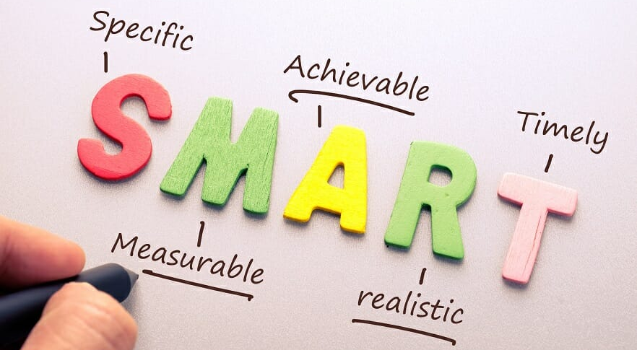
SMART objectives

Slide 17

Approach | Water quality/Physical | Structural | Functional | Ecosystem services/broad-scale proxies
Types of pressure | Pollution | Mostly fishing. Also pollution, multiple/cumulative pressures, no specific pressure (inside/outside MPAs) | Mostly fishing. Also pollution, multiple/cumulative pressures, no specific pressure (inside/outside MPAs) | Not often related to specific pressures/cumulative pressures
Type of data | Abiotic, Algae (macro-algae and phytoplankton) | Biological data. EBM - algae, invertebrates, fish, target species, fish stocks, keystone species, mammals, seabirds. One or multiple indicators | Biological traits - mostly invertebrates and fish | Provisioning, supporting, regulating and cultural service data - e.g. seafood, nutrient cycling, tourism. E.g. Ocean Health Index Cumulative impacts
Scale | Local, national, regional, global (satellite data) | Local (fine-scale), national, Regional/LME |  | National, regional, global
Measuring Ocean Health

Slide 18
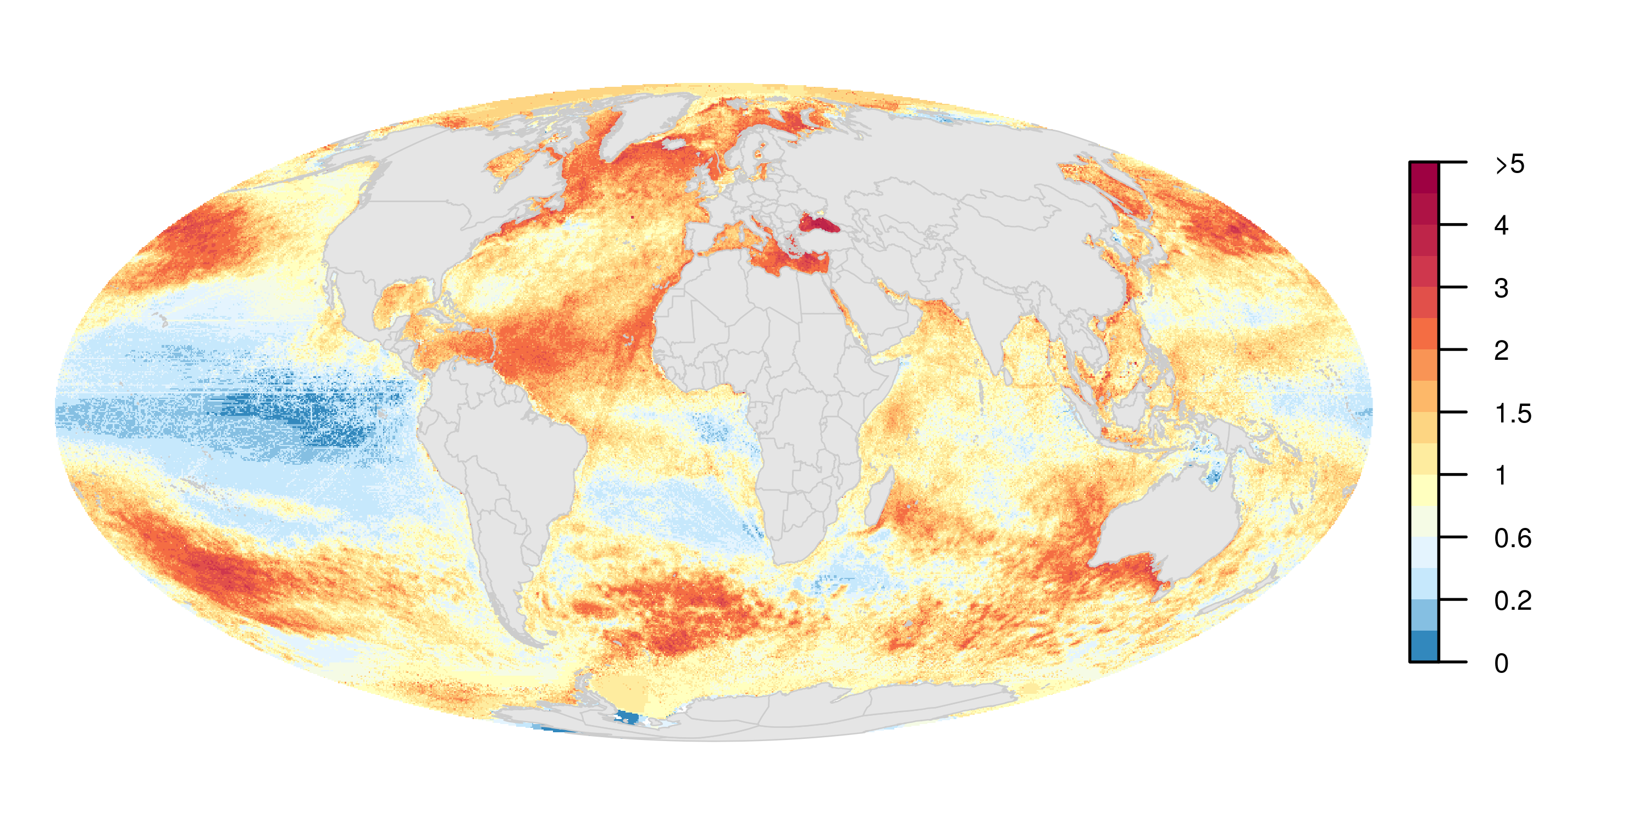
Global cumulative human impact: 2013
Halpern et al. (2008) Science
Halpern et al. (in review)

Slide 19
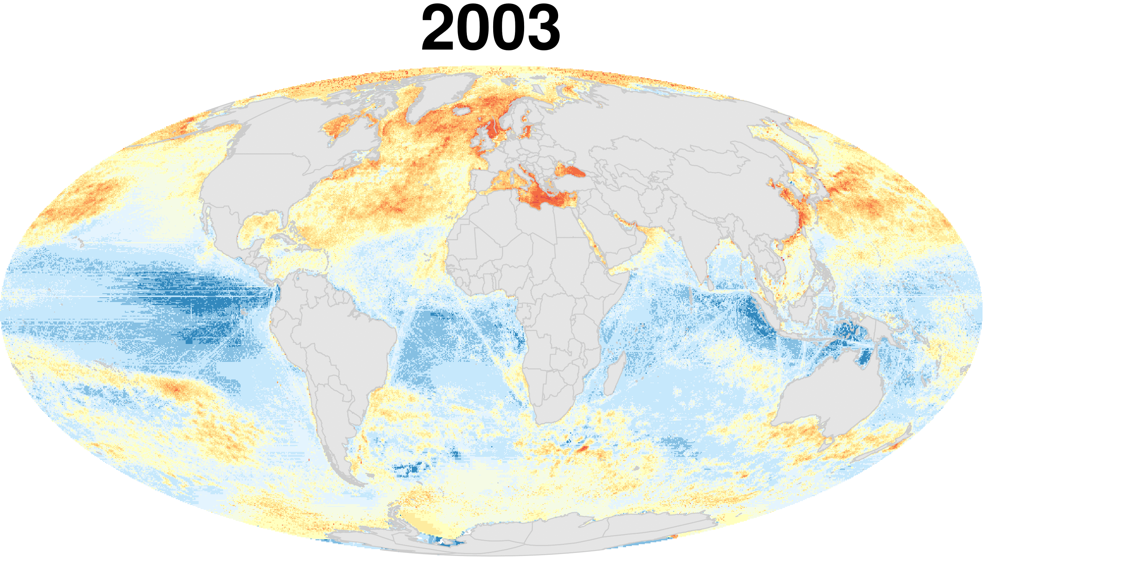
Halpern et al. (in review)

Slide 20
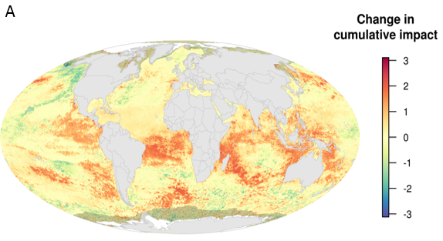
5 years later: change over time
Halpern et al. (2015)

Slide 21
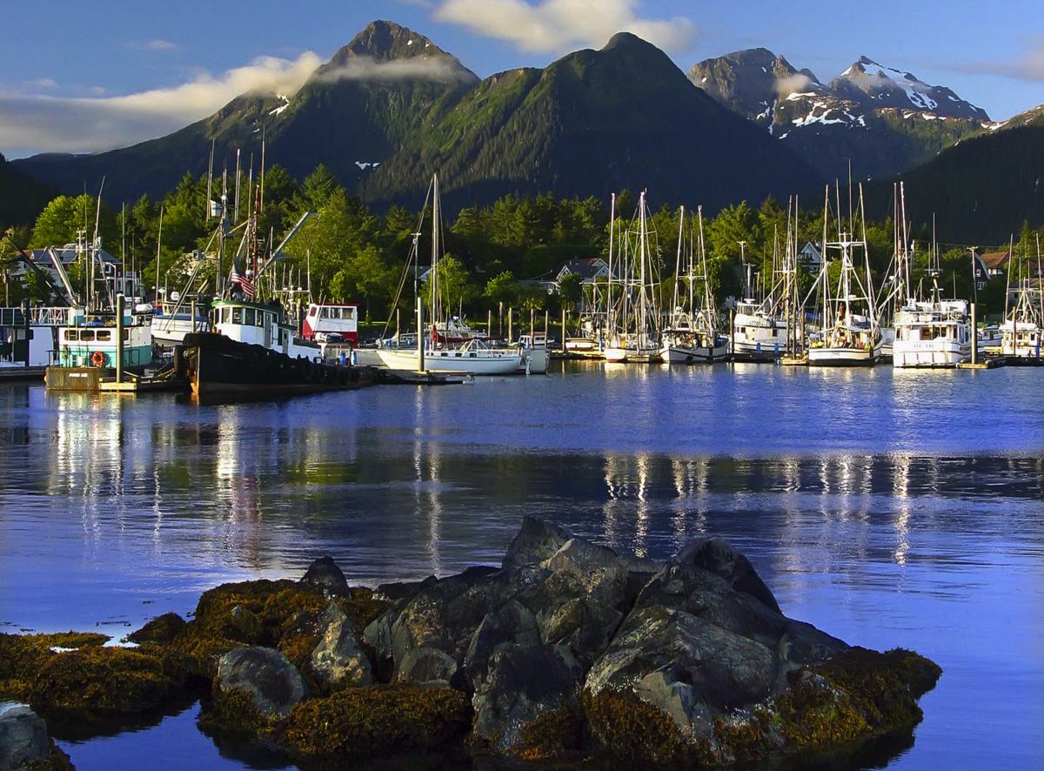
Ocean Health Index

Slide 22
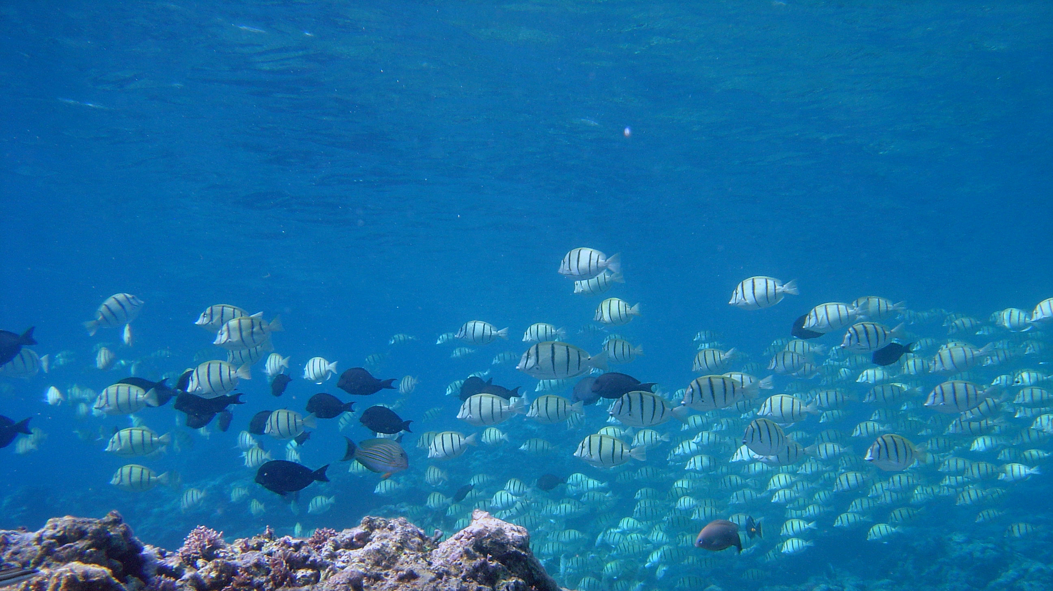
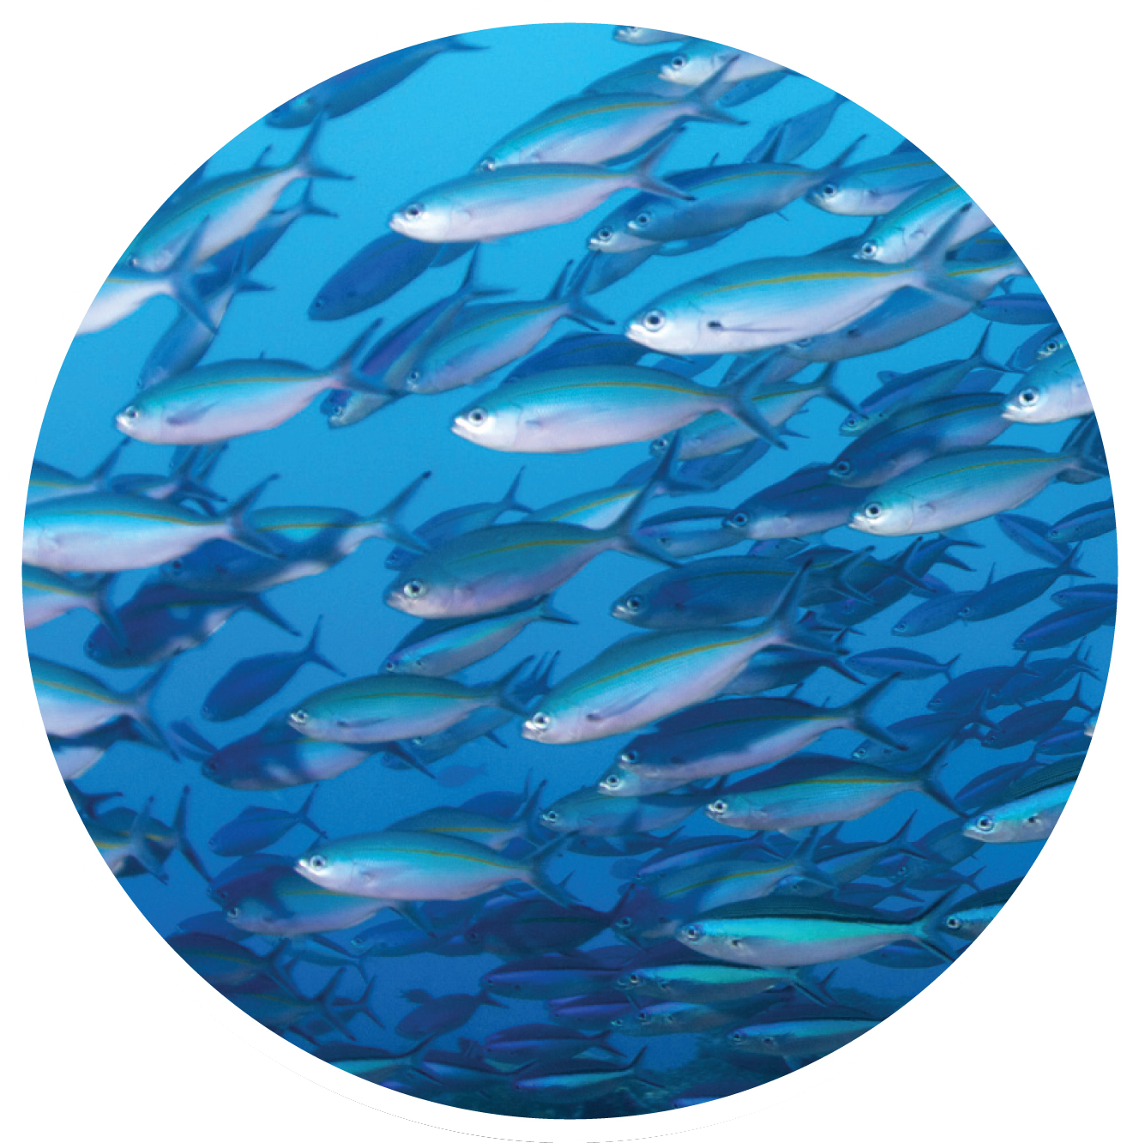
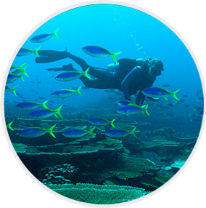
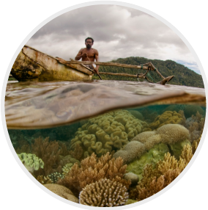
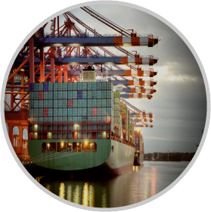
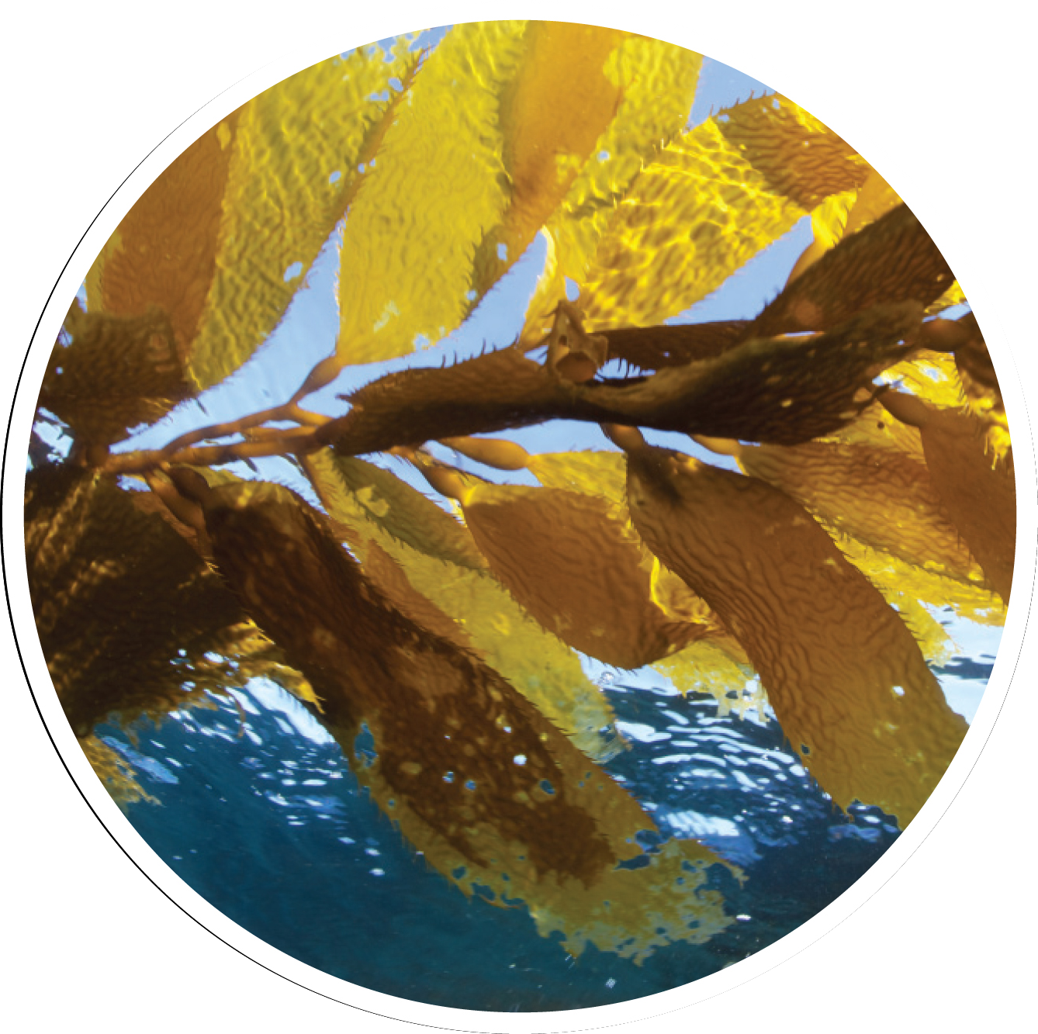
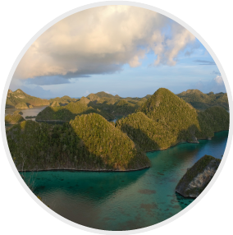
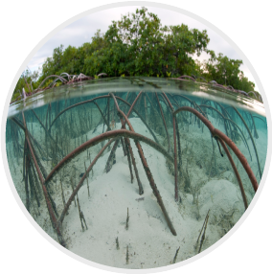


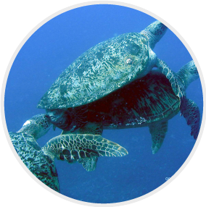
10 Global Goals & Sub-goals
Food Provision
Fisheries
Tourism and Recreation
Mariculture
Artisanal Fishing Opportunities
Livelihoods & Economies
Livelihoods
Economies
Natural Products
Sense of Place
Iconic Spp
Places
Carbon Storage
Clean Waters
Coastal Protection
Biodiversity
Species
Habitats
Notes:
This index is unique from other indicator efforts in that it organizes information and scores around the goals people have for a healthy ocean ecosystem, rather than starting with a list of potential indicators and whittling that list down. Here you can see the list of indicators that we developed for our global analysis of every coastal country in the world. These range from food provision, to tourism, to biodiveristy.
To develop these goals we first start by identifying the things people value most, then we define the goals people have for healthy ocean ecosystems based on these values, and finally we develop specific indicators to see how well the ocean is providing those goals for ecosystem health and human well-being.

Slide 23
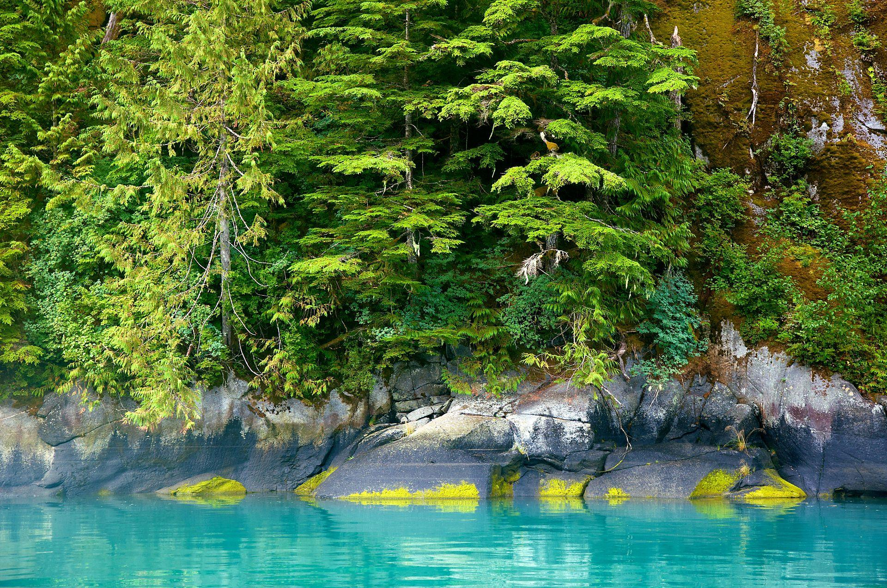
Main Objectives
Capture the human-ocean coupled system
Easy-to-understand metrics
Incorporate sustainability into all indicators
Track progress through time
Stimulate actions to improve ocean health
Notes:
The Ocean Health Index was created because no other such instrument existed. We felt that such an assessment was needed at all levels: globally as part of the planetary dashboard of indicators; and at all scales and levels of jurisdiction for use as a guide in policy making and management.

Slide 24
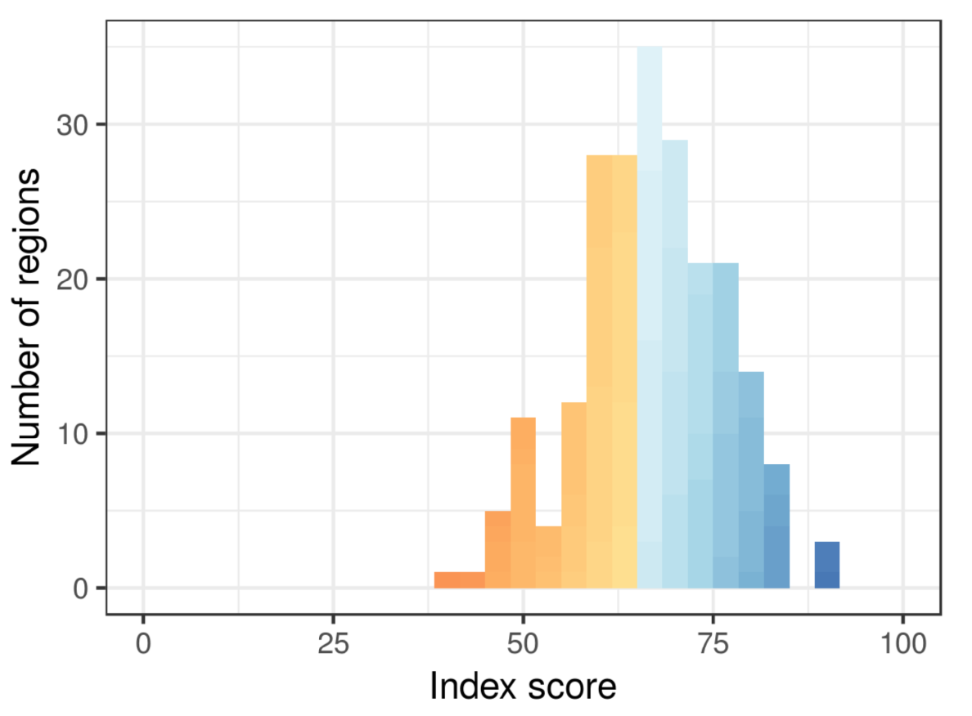
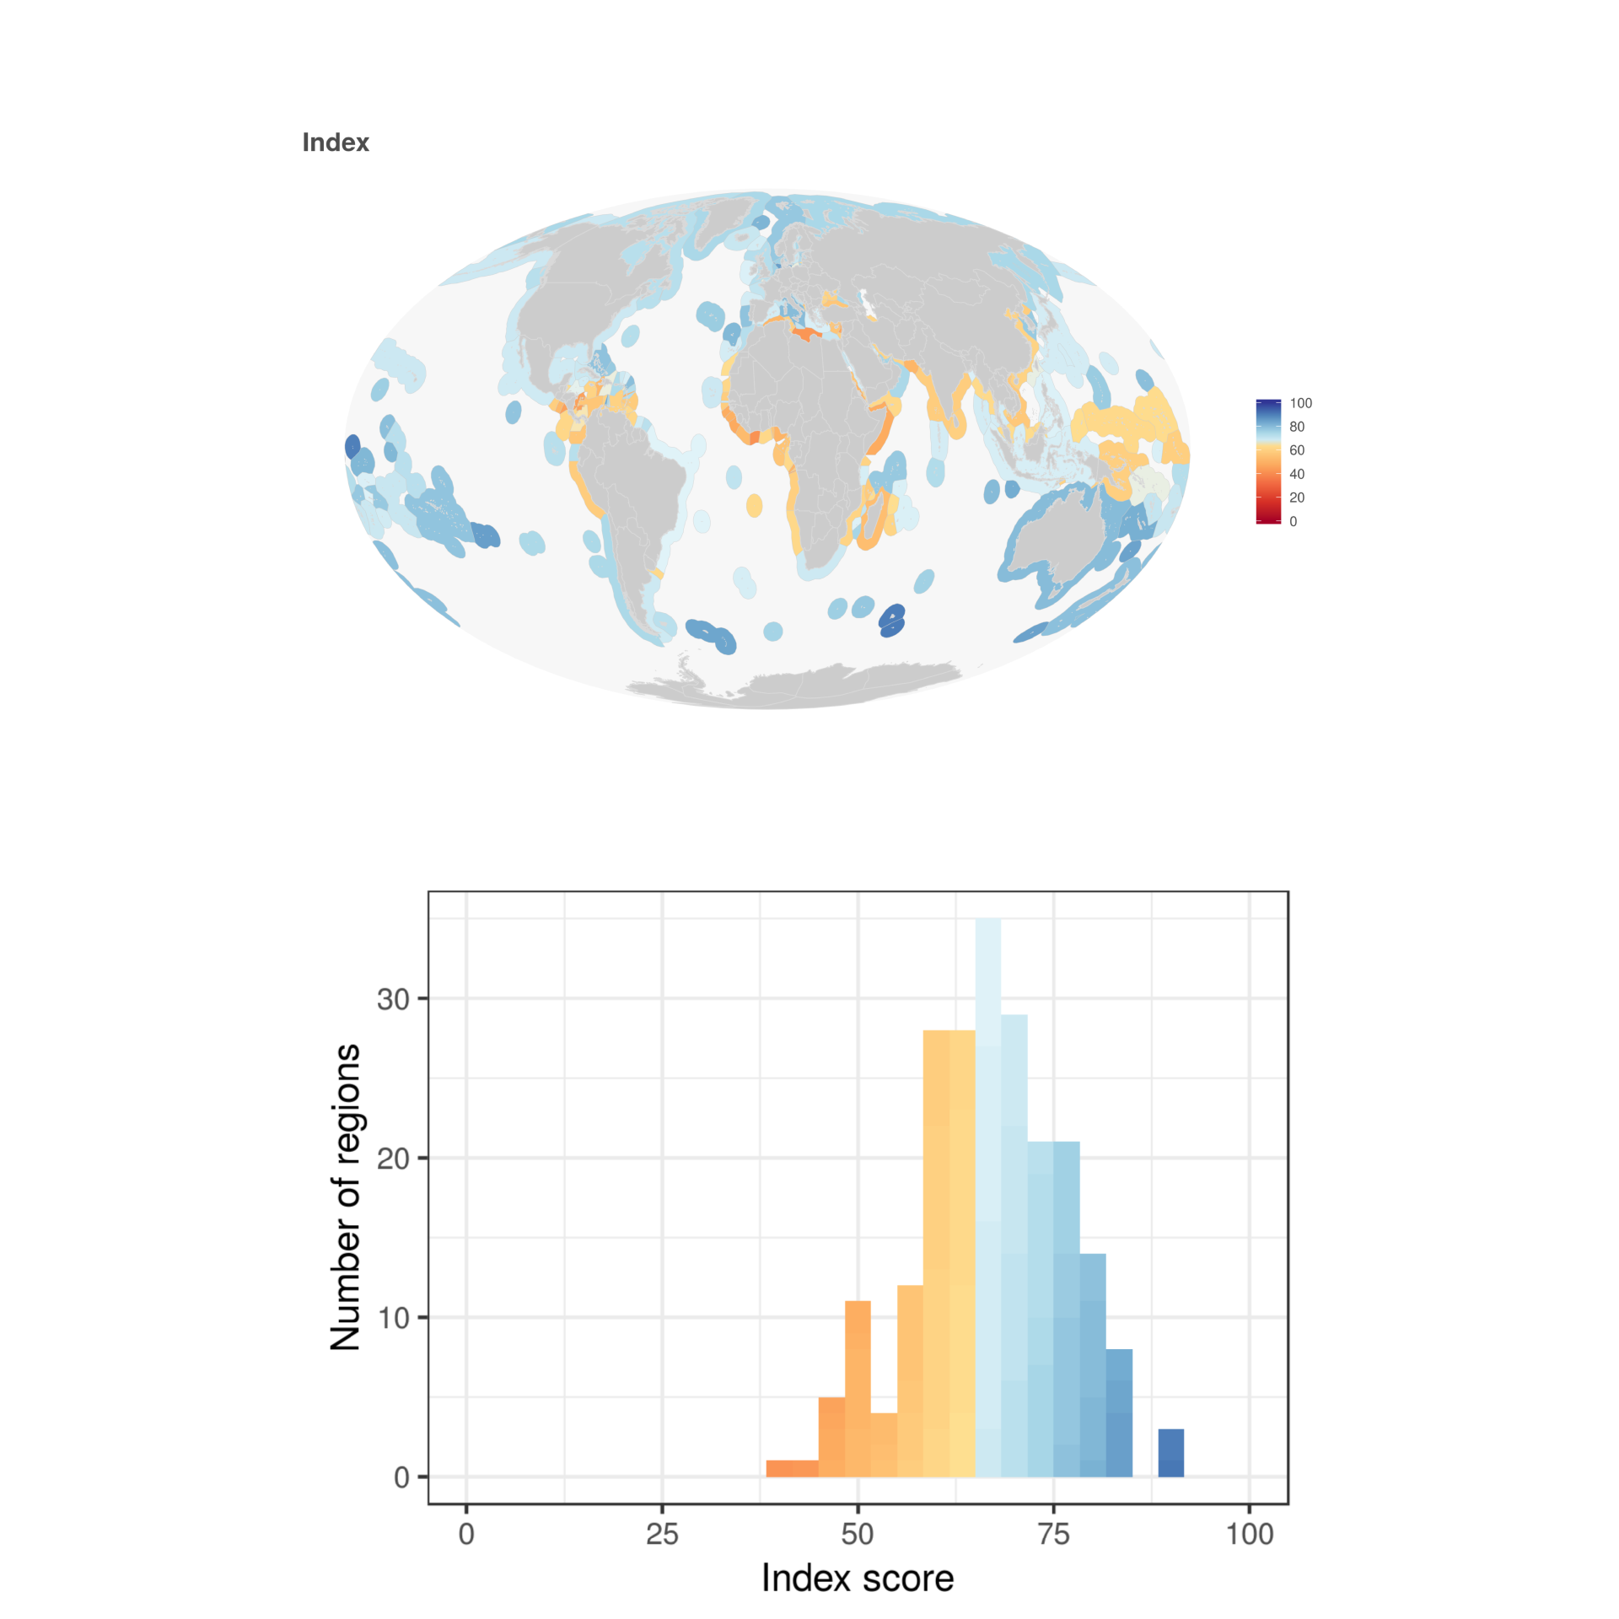
2018 Index scores
Notes:
Here are the 2016 index scores. Color scale, patterns.

Slide 25
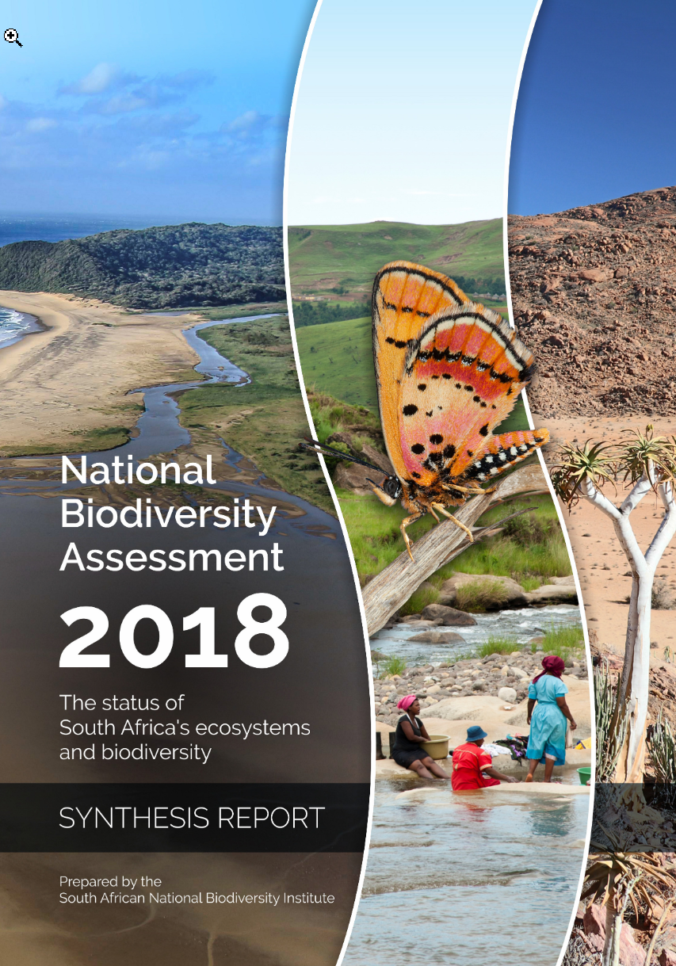
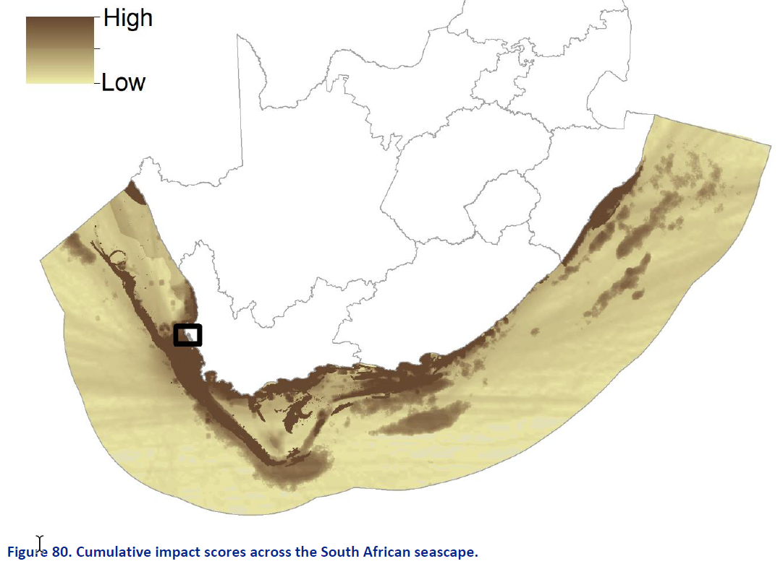
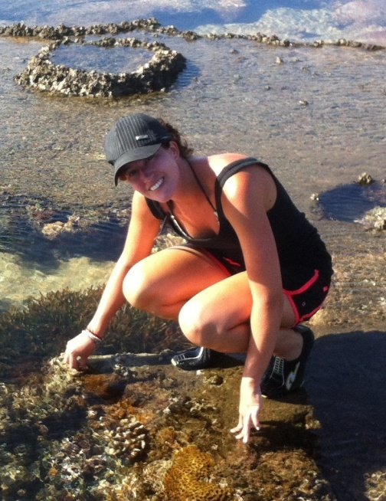
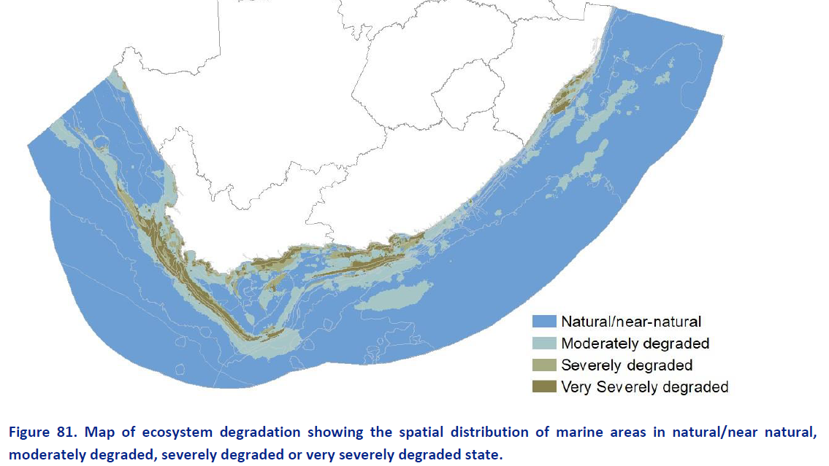
Cumulative impacts as proxy for condition
Cumulative impact score
Ecosystem degradation

Slide 26
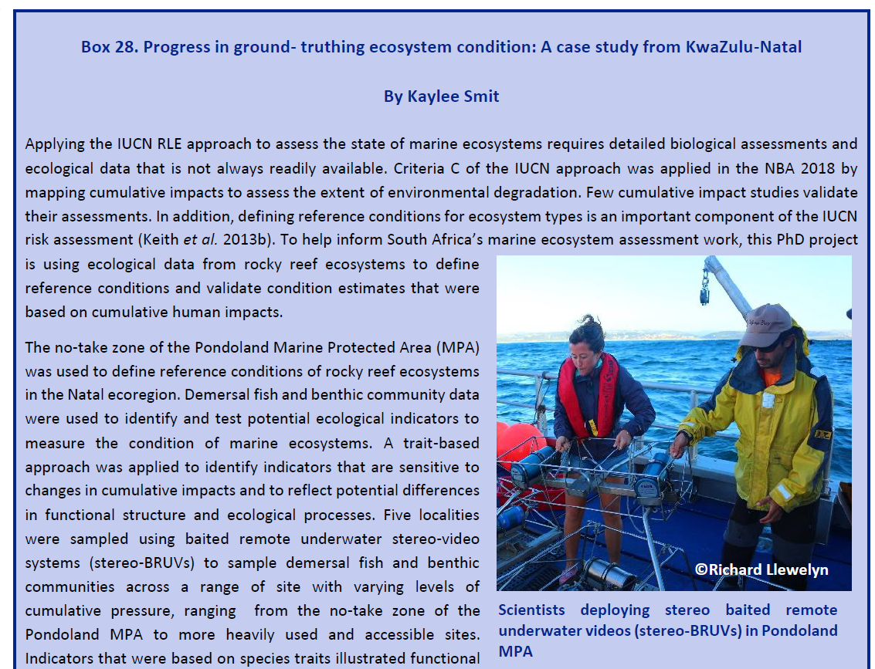


Slide 27

Functional indicators were more responsive to pressures than traditional structural indicators
Notes:
Functional is related to species traits. Structural indicators – relating to the abundance of a species themselves, or composition of the community (at a species level)

Slide 28

Reef Health Index (left) vs NBA (right)
Notes:
Dots on the graph are the different places.
NBA works for broad scale reporting, but for management effectiveness at finer scales need more details (like Kaylee’s work)

Slide 29



Food web models are simplified representations of natural systems
Help us understand how ecosystems respond to changes
(e.g. environmental change, fishing)

Slide 30



Ecopath with Ecosim
Three major components
Ecopath static mass-balanced model
Ecosim temporal dynamics
Ecospace spatial-temporal dynamics, Time dynamic spatially explicit model
Ecopath
Ecosim
Ecospace
Walters et al. (1999), Christensen and Walters (2004)
Notes:
Ecopath with Ecosim (EwE) is a free ecological/ecosystem modeling software suite. EwE has three main components: Ecopath – a static, mass-balanced snapshot of the system; Ecosim – a time dynamic simulation module for policy exploration; and Ecospace – a spatial and temporal dynamic module primarily designed for exploring impact and placement of protected areas.
The Ecopath software package can be used to
Address ecological questions;
Evaluate ecosystem effects of fishing;
Explore management policy options;
Analyze impact and placement of marine protected areas;
Predict movement and accumulation of contaminants and tracers (Ecotracer);
Model effect of environmental changes;
Facilitate end-to-end model construction
Ecospace is the dynamic, spatial version of Ecopath that incorporates all the key elements of Ecosim. Given its structure, Ecospace allows users to explore the potential role of Marine Protected Areas (MPAs) as a tool to mitigate, and perhaps reverse various ecosystem effects of fishing.

Slide 31


Ecospace (spatial-temporal dynamics) – Algoa Bay
Port
Elizabeth
B
Walters et al. (1999), Christensen and Walters (2004)
Notes:
Ecospace provides dynamic simulations at the ecosystem level, with key initial parameters inherited from the base Ecopath model. Thus, ecospace uses mass-balance results (from Ecopath) for parameter estimation, where the
Production = Predation + Fishery + Biomass accumulation + Net migration + Other mortality
consumption= production+ respiration + unassimilated food
(these are the two Ecopath ‘master equations)
Ecospace, uses the time-dynamic Ecosim model in each cell of the model area, while accounting for cell connectivity and fish movements explicitly.
Ecospace is a spatial, meso-scale version of Ecosim, and it replicates Ecosim dynamics over spatial grid of ´homogeneous´ cells (i.e. same size but different properties. Ecospace links cells through dispersal of organisms, and fishing effort movement / allocation
In ecospace, fishing effort is distributed over space. Fish migration and advection can be modeled explicitly.

Slide 32

Ecospace outputs – Algoa Bay
Distribution maps of model species
Biomass projections and spatial distribution predictions
Simulations of management actions (e.g. MPA)
Cumulative impacts (e.g. environmental change, fishing)
Structural and functional indicators of the system
Christensen et al. (2014), Serpetti (2019) Introduction to Ecospace
Notes:
The main output of ecospace are species distribution maps. All results in Ecospace are relative to the Ecopath baseline.
Ecospace projects the biomass of species and their distributions as a result of their habitat preferences, the effects of fishing and other stressors
Ecospace allows simulations of management actions such as setting MPAs
Ecospace evaluate the effects of cumulative impacts such as environmental change and fishing on species distribution and maps
The habitat capacity model (habitat preferences) allow to bridge the gap between species distribution model and food web models and thus it becomes an integrated food web/species envelope model.
The biomass and catch outputs allow to calculate a suite of indicators describing the structure and functioning of the system. Some example indicators include:
Following the marine strategy framework directive (MSFD) indicators: species distribution/range, population size (abundance and biomass), proportion of species at the top of the food web, substrate characteristics and physical damage (e.g. Extent of seabed significantly affect by human activities for the different substrate types), condition of benthic community (species diversity and richness, proportion of opportunistic to sensitive species).
Full list of indicators in the next slide

Slide 33



The Algoa
Bay Marine Planning Tool
MSI – aims to capture interconnections amongst different human uses and their impacts, using system dynamics modelling
Notes:
The Algoa Bay Marine Planning tool, a system dynamics model composed of five sub-models for the main human uses in Algoa Bay, simulates towards the overarching goal of the central model variable, the Marine Sustainability Index (MSI).
The MSI measures marine sustainability across the sectors in Algoa Bay and couples the sustainability of the marine environment to the human uses, to demonstrate potential conflicts or synergies in the socio-ecological marine system.
The term ‘marine sustainability’ in this study, interpreted from a marine spatial planning (MSP) perspective, therefore refers to the ecological integrity of the marine system and its ability to sustain human uses.

Slide 34







To foster collaborative action & systemic marine management & governance
The Algoa
Bay Collaborative Dynamic Modelling (AB CoDyM) pilot process

Slide 35

The Process
Adapted from Clifford-Holmes & Pollard (2017: 5)
Notes:
Phase 1 in the process included extensive literature research and preliminary model development
In phase 2 we hosted several initial stakeholder meetings with individuals from each human use
In between phase 2 and 3- we are hosting an academic dry run of the multisectoral workshop amongst internal researchers to test the process.
Phase 3- sectoral meetings with representatives from each human use
Phase 4- multi-sectoral meeting with all stakeholders consulted in the process
Phase5 –refining an upscaling of the model and the ABCODYM process

Slide 36

System Dynamics model interface (1)

Slide 37

System Dynamics model interface (2)

Slide 38

System Dynamics model interface (3)

Slide 39

Significance
To explore policy interventions
Stakeholders shared understanding of the system
To assist planning and management

Slide 40




Slide 41





Questions for TTOGC
Are there successes?
(have measurements improved/stopped decline in ocean health)?
At what scales ?
What have we learned?
What can we do better ?
Are there failures?

Slide 42
Thank you !!

