Slide 1
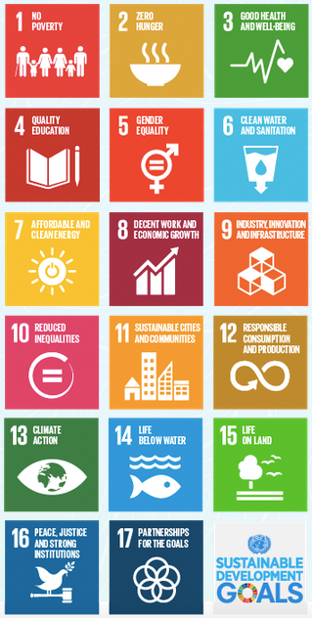
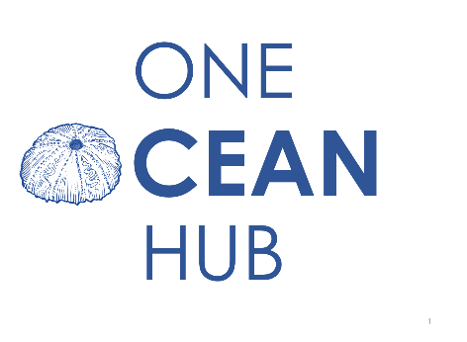
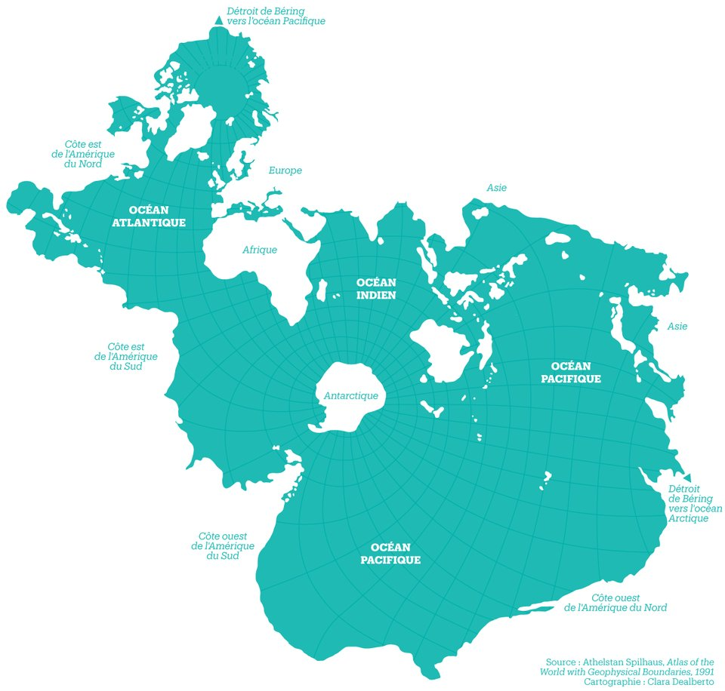


One Ocean Hub
Daniela Diz, PhD
One Ocean Hub Deputy Director
University of Strathclyde

Slide 2
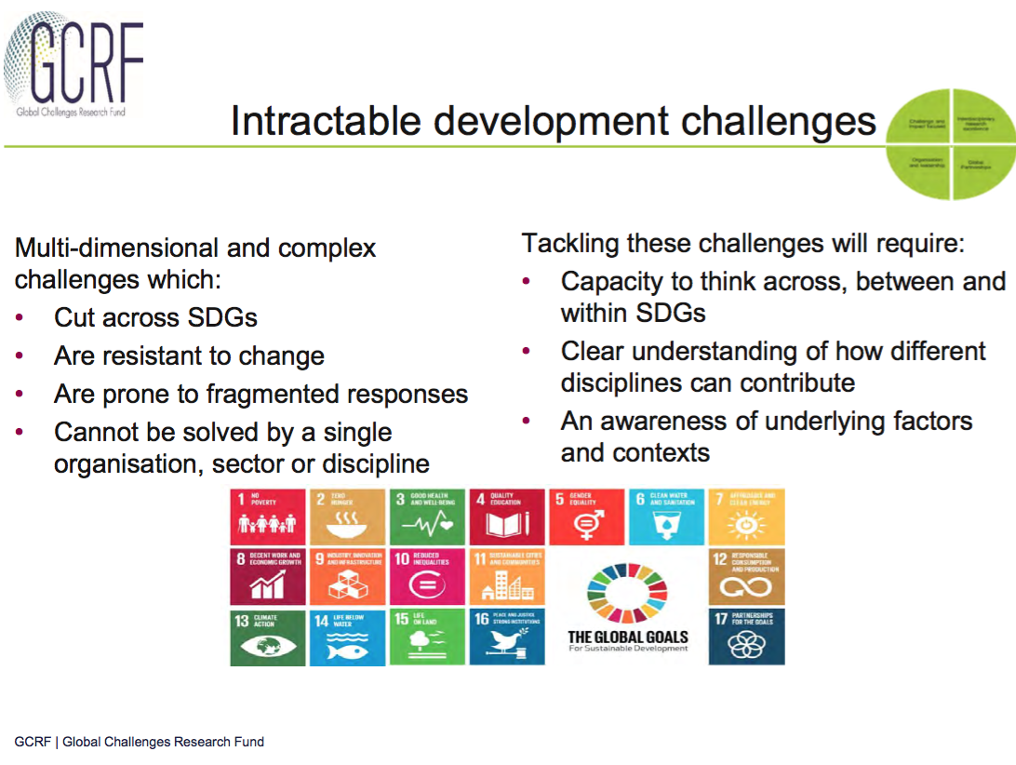

Slide 3
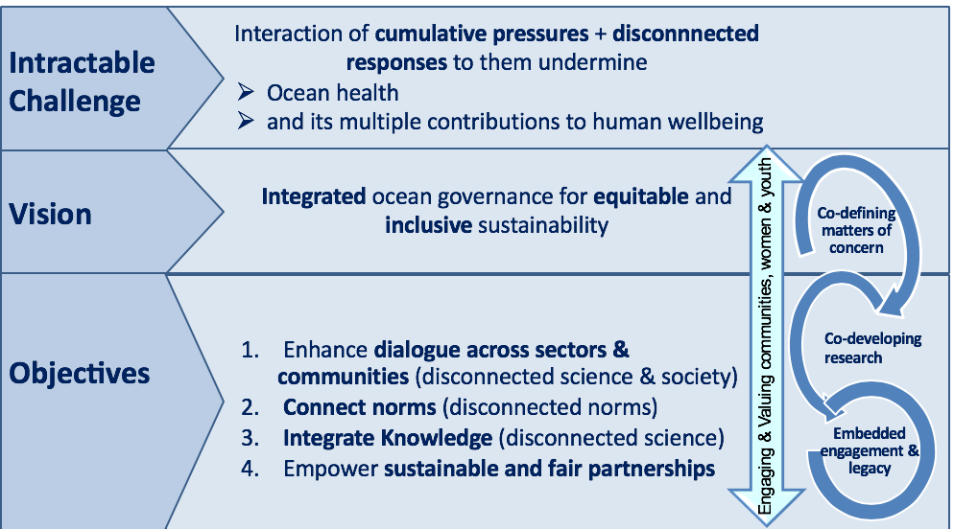
Vision & aims
ACROSS SCALES
Countries: South Africa, Ghana, Namibia, Fiji, Solomon Islands

Slide 4
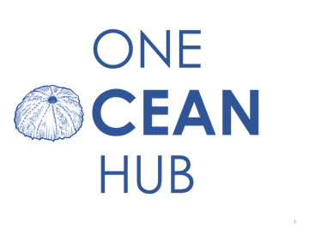
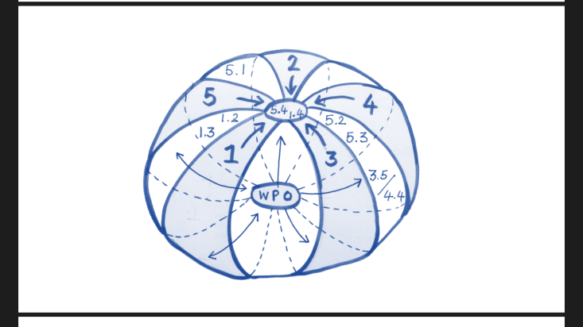
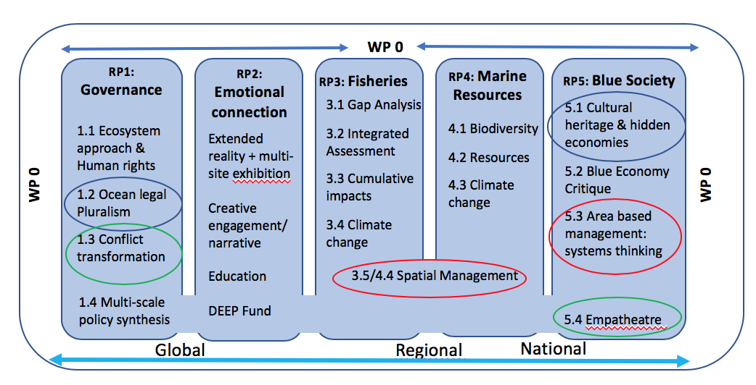
Reseach Programmes (RPs)
«Work Package 0» (WP 0)
preliminary, contextual ethnographic analysis of power and capacities
Preliminary, multi-scale legal analysis & comms/stakeholder engagement
Co-identification of issues, knowledge gaps & “vulnerable communities”

Slide 5
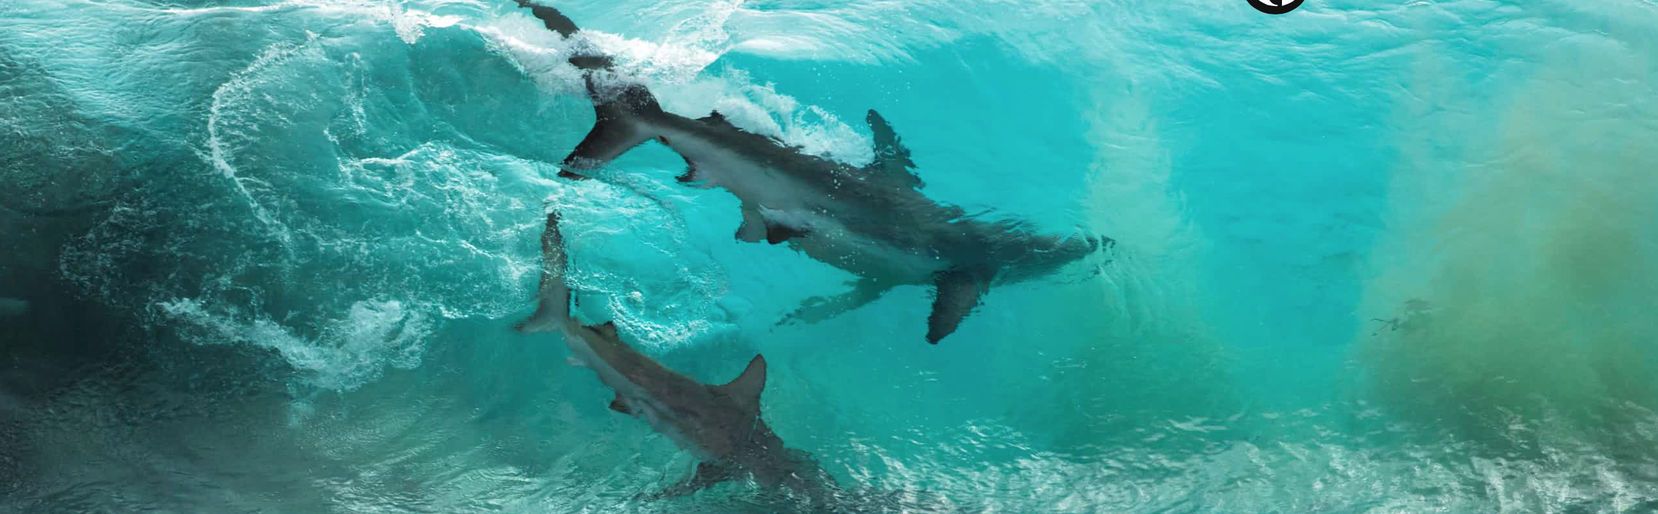
Integrated impact assessment as a tool for equitable and sustainable fisheries
  Daniela Diz, University of Strathclyde
  Transformed and Transformative Ocean Governance Conference
  PE, 23 January 2020

Slide 6
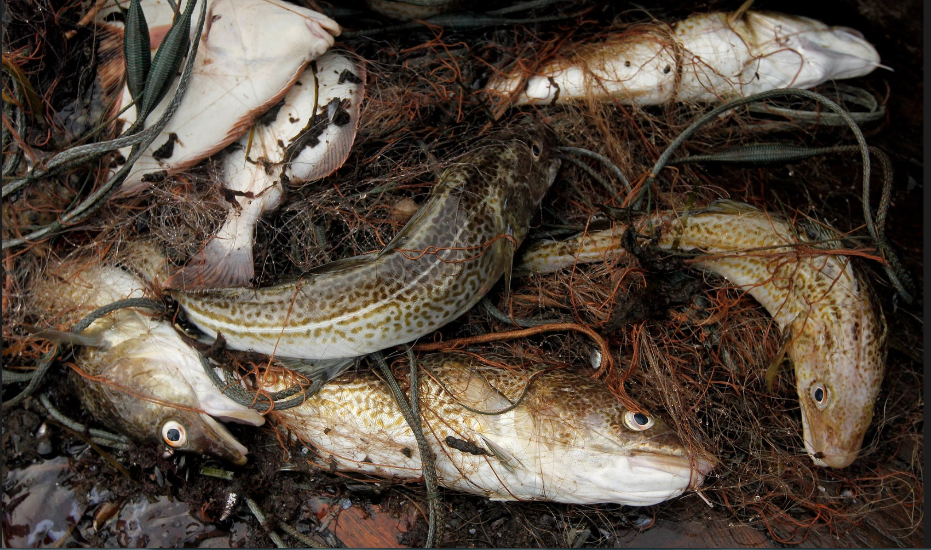
Overview
EIA obligations under UNCLOS, CBD and guidance from other international environmental instruments
Human Rights considerations
Conclusion

Slide 7
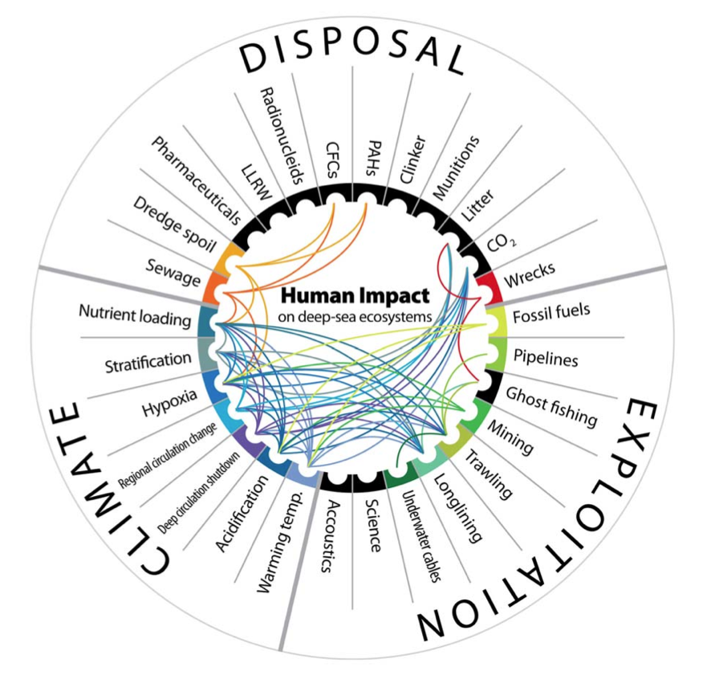
Ocean change
Synergistic
over time
1900-50s
Disposal
1950-2000s
Exploitation
2000s + future
Climate Change
Notes:
Figure 7. Synergies amongst anthropogenic impacts on deep-sea habitats. The lines link impacts that, when found together, have a synergistic effect on habitats or faunal communities. The lines are colour coded, indicating the direction of the synergy. LLRW, low-level radioactive waste; CFCs, chlorofluorocarbons; PAHs, polycyclic aromatic hydrocarbons.
doi:10.1371/journal.pone.0022588.g007

Slide 8
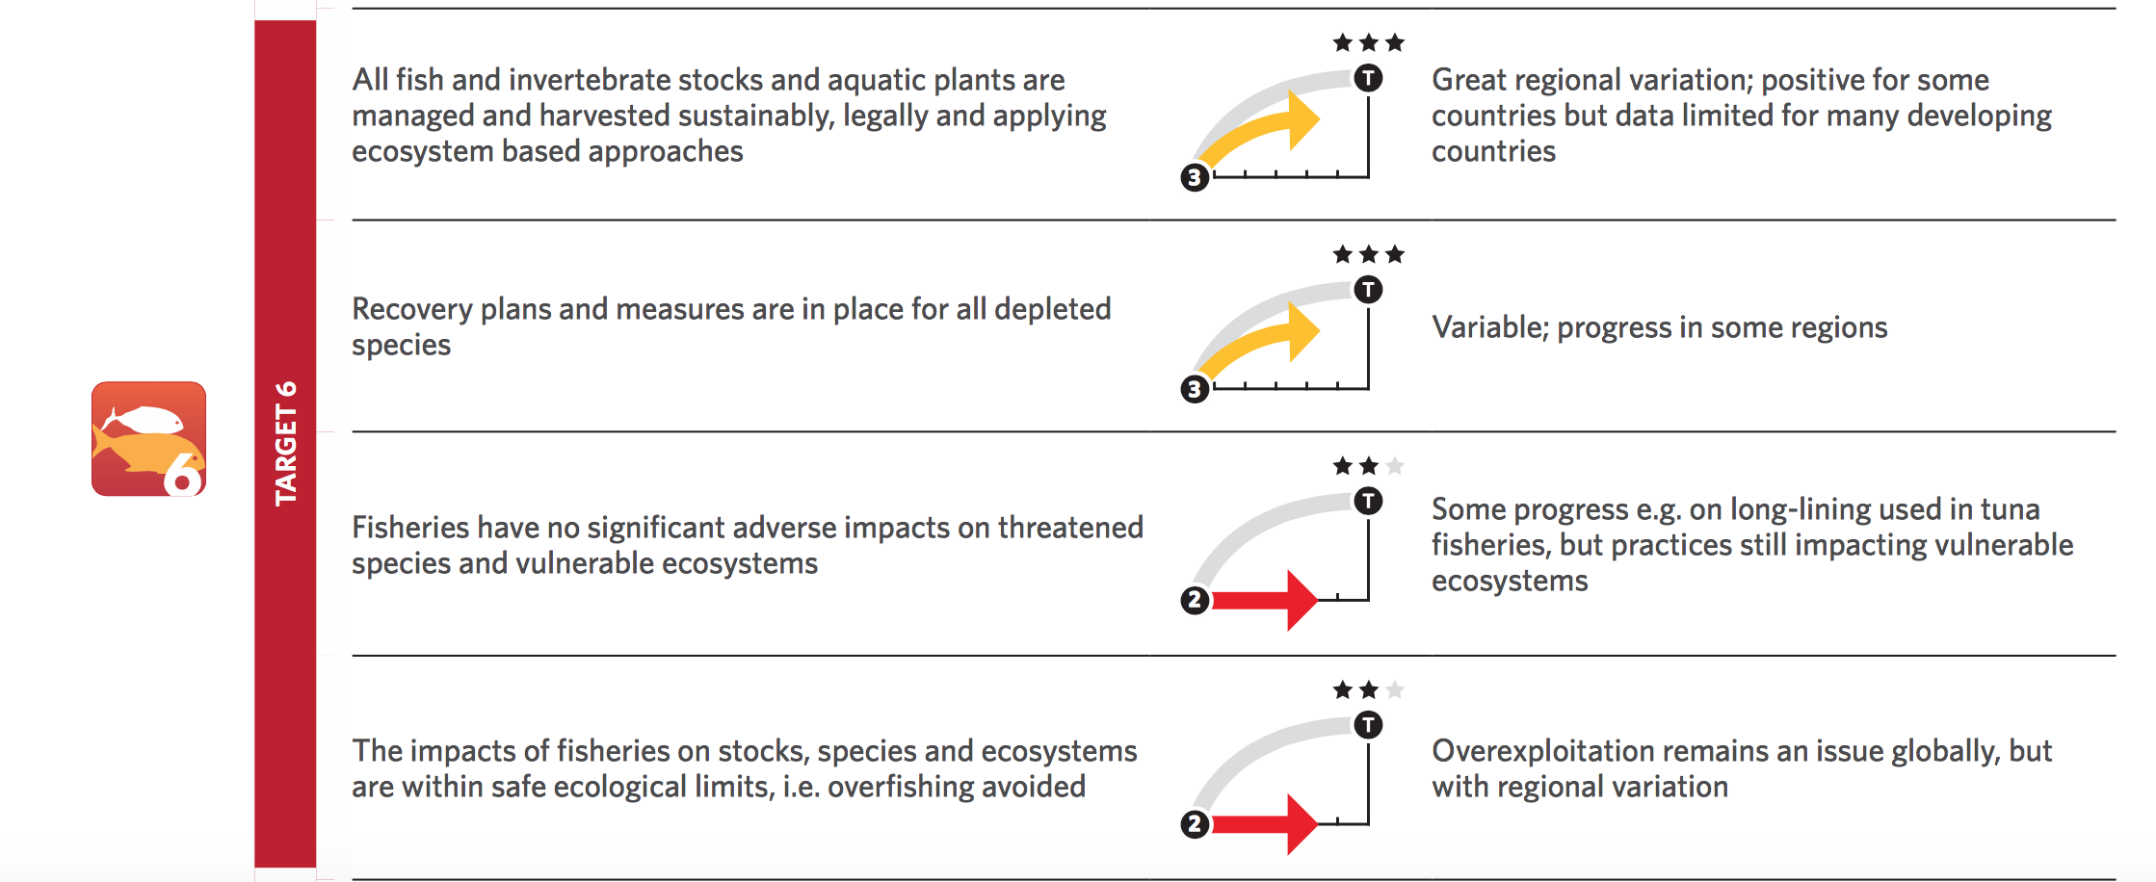
Sustainable Fisheries & Global Targets
CBD, GBO-4
Notes:
COP 13 Mainstreaming decisions

Slide 9
SDG 14.4
By 2020, effectively regulate harvesting and end overfishing, illegal, unreported and unregulated fishing and destructive fishing practices and implement science-based management plans, in order to restore fish stocks in the shortest time feasible, at least to levels that can produce maximum sustainable yield as determined by their biological characteristics

Slide 10
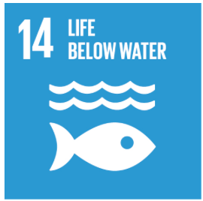
2017 UN Ocean Conference Declaration: A call for Action
Enhance sustainable fisheries management, including to restore fish stocks in the shortest time feasible at least to levels that can produce maximum sustainable yield as determined by their biological characteristics, through the implementation of science-based management measures, monitoring, control and enforcement, supporting the consumption of fish sourced from sustainably managed fisheries, and through precautionary and ecosystem approaches as appropriate, as well as strengthening cooperation and coordination, including through, as appropriate, regional fisheries management organizations, bodies and arrangements

Slide 11
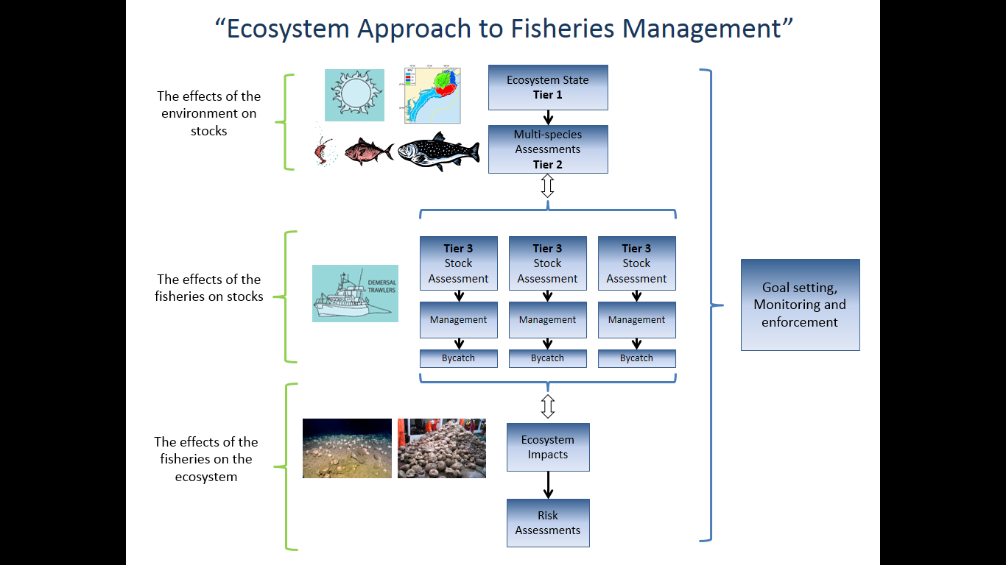
Ecosystem approach: relevant principles to EIAs
Ecosystem managers should consider the effects (actual or potential) of their activities on adjacent and other ecosystems
Ecosystems must be managed within the limits of their functioning

Slide 12
Obligation to conduct EIAs under international law
“a requirement under general international law to undertake an environmental impact assessment where there is a risk that the proposed industrial activity may have a significant adverse impact in a transboundary context” (Pulp Mills Case, para 204)
Due diligence obligation (UNCLOS Arts 205-206, UNFSA, Art. 5(d))
Minimum standards to be set on a case by case basis/regime-based (Pulp Mills Case)
Reports need to be made publicly available (UNCLOS, Art. 205)
Notes:
Are there minimum requirements for conducting EIAs?

Slide 13

EIA: Thresholds
Significant Adverse Impact:
  UNCLOS
  CBD
  FAO Deep Sea Fisheries Guidelines
  Rio Declaration
Minor or transitory effect:
  Madrid Protocol
Notes:
Article 24
Thresholds and criteria for environmental impact assessments
[1. Alt.1
1. When States have reasonable grounds for believing that planned activities under their jurisdiction or control [may cause substantial pollution of or significant and harmful changes to] [are likely to have more than a minor or transitory effect on] the marine environment [in areas beyond national jurisdiction], they shall, [individually or collectively,] as far as practicable, [assess the potential effects of such activities on the marine environment] [ensure that the potential effects of such activities on the marine environment are assessed].]
[1. Alt.2
1. When States Parties have reasonable grounds for believing that planned activities under their jurisdiction or control:
(a) Are likely to have more than a minor or transitory effect on the marine environment, they shall conduct an environmental impact assessment on the potential effects of such activities on the marine environment in the manner provided in this Part;
(b) May cause substantial pollution of or significant and harmful changes to the marine environment, they shall [conduct] [ensure that] a [full] [comprehensive] environmental impact assessment [is conducted] on the potential effects of such activities on the marine environment [and ecosystems] and shall submit the results of such assessments [for technical review] in the manner provided in this Part.
[2. Environmental impact assessments shall be conducted in accordance with the threshold and criteria [set out in this Part and as further elaborated upon pursuant to the procedure set out in paragraph […]] [, which shall be developed by the Scientific and Technical Body].]
Article 206
Assessment of potential effects of activities
When States have reasonable grounds for believing that planned
activities under their jurisdiction or control may cause substantial pollution
of or significant and harmful changes to the marine environment, they shall,
as far as practicable, assess the potential effects of such activities on the
marine environment and shall communicate reports of the results of such
assessments in the manner provided in article 205.
SECTION 4. MONITORING AND ENVIRONMENTAL
ASSESSMENT
Article 204
Monitoring of the risks or effects of pollution
1. States shall, consistent with the rights of other States, endeavour, as
far as practicable, directly or through the competent international
organizations, to observe, measure, evaluate and analyse, by recognized
scientific methods, the risks or effects of pollution of the marine environment.
2. In particular, States shall keep under surveillance the effects of any
activities which they permit or in which they engage in order to determine
whether these activities are likely to pollute the marine environment.
Article 205
Publication of reports
States shall publish reports of the results obtained pursuant to article 204
or provide such reports at appropriate intervals to the competent international
CBD:
Article 14. Impact Assessment and Minimizing Adverse Impacts
1. Each Contracting Party, as far as possible and as appropriate,
shai1 :
(a) Introduce appropriate procedures requiring environmental impact
assessment of its proposed projects that are likeiy to have significant
adverse effects on biological diversity with a view to avoiding or
minimizing such effects and, where appropriate. allow for public
participation in such procedures;
(b) Introduce appropriate arrangements to ensure that the
environmental consequences of its programmes and policies that are likely
to have significant adverse impacts on biological diversity are duly
taken into account:
(c) Promote, on the basis of reciprocity, notification, exchange nf
information and consultation on activities under their jurisdiction or
control which are likely to significantly affect adversely the biological
diversity of other States or areas beyond the limits of national
jurisdiction, by encouraging the conclusion of bilateral, regional or
multilateral arrangements, as appropriate;
(d) In the case of imminent or grave danger or damage, originating
under its jurisdiction or control, to biological diversity within the
area under jurisdiction of other States or in areas beyond the limits of
national jurisdiction, notify immediately the potentially affected States
of such danger or damage, as well as initiate action to prevent or
minimize such danger or damage; and
(e) Promote national arrangements for emergency responses to
activities or events, whether caused naturally or otherwise, which
present a grave and imminent danger to biological diversity and encourage
international cooperation to supplement such national efforts and, where
appropriate and agreed by the States or regional economic Integration
organizations concerned, to establish joint contingency plans.

Slide 14
Rio Declaration
“EIA, as a national instrument, shall be undertaken for proposed activities that are likely to have a significant adverse impact on the environment and are subject to a decision of a competent national authority”
(Principle 17)
EIAs
P2
P10
P19
P15
Notes:
Principle 2
States have, in accordance with the Charter of the United Nations and the
principles of international law, the sovereign right to exploit their own
resources pursuant to their own environmental and developmental policies, and
the responsibility to ensure that activities within their jurisdiction or
control do not cause damage to the environment of other States or of areas
beyond the limits of national jurisdiction.
Principle 15
In order to protect the environment, the precautionary approach shall be
widely applied by States according to their capabilities. Where there are
threats of serious or irreversible damage, lack of full scientific certainty
shall not be used as a reason for postponing cost-effective measures to prevent
environmental degradation.
Principle 10
Environmental issues are best handled with the participation of all
concerned citizens, at the relevant level. At the national level, each
individual shall have appropriate access to information concerning the
environment that is held by public authorities, including information on
hazardous materials and activities in their communities, and the opportunity
to participate in decision-making processes. States shall facilitate and
encourage public awareness and participation by making information widely
available. Effective access to judicial and administrative proceedings,
including redress and remedy, shall be provided.
Principle 19
States shall provide prior and timely notification and relevant
information to potentially affected States on activities that may have a
significant adverse transboundary environmental effect and shall consult with
those States at an early stage and in good faith.
South China Sea: absence of EIA (publicly available) made the Arbitral Tribunal believe there was not EIA.

Slide 15
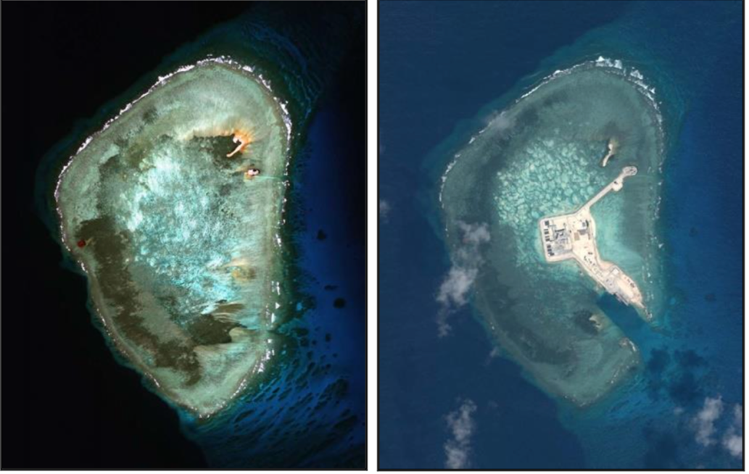
UNCLOS
When States have reasonable grounds for believing that planned activities under their jurisdiction or control may cause substantial pollution of or significant and harmful changes to the marine environment, they shall, as far as practicable, assess the potential effects of such activities on the marine environment and shall communicate reports of the results of such assessments in the manner provided in article 205 [publication of reports]. (UNCLOS Art. 206)

Slide 16
CBD
Each party, as far as possible and as appropriate, shall:
  Introduce procedures requiring EIAs of its proposed projects that are likely to have significant adverse effects on biodiversity to avoid or minimize such effects, and where appropriate, allow for public participation in such procedures
  Introduce SEAs
  Promote notification/exchange of information and consultation with other States on potential transboundary impacts of activities under their jurisdiction or control
  Promote arrangements for emergency responses (Art. 14)

Slide 17
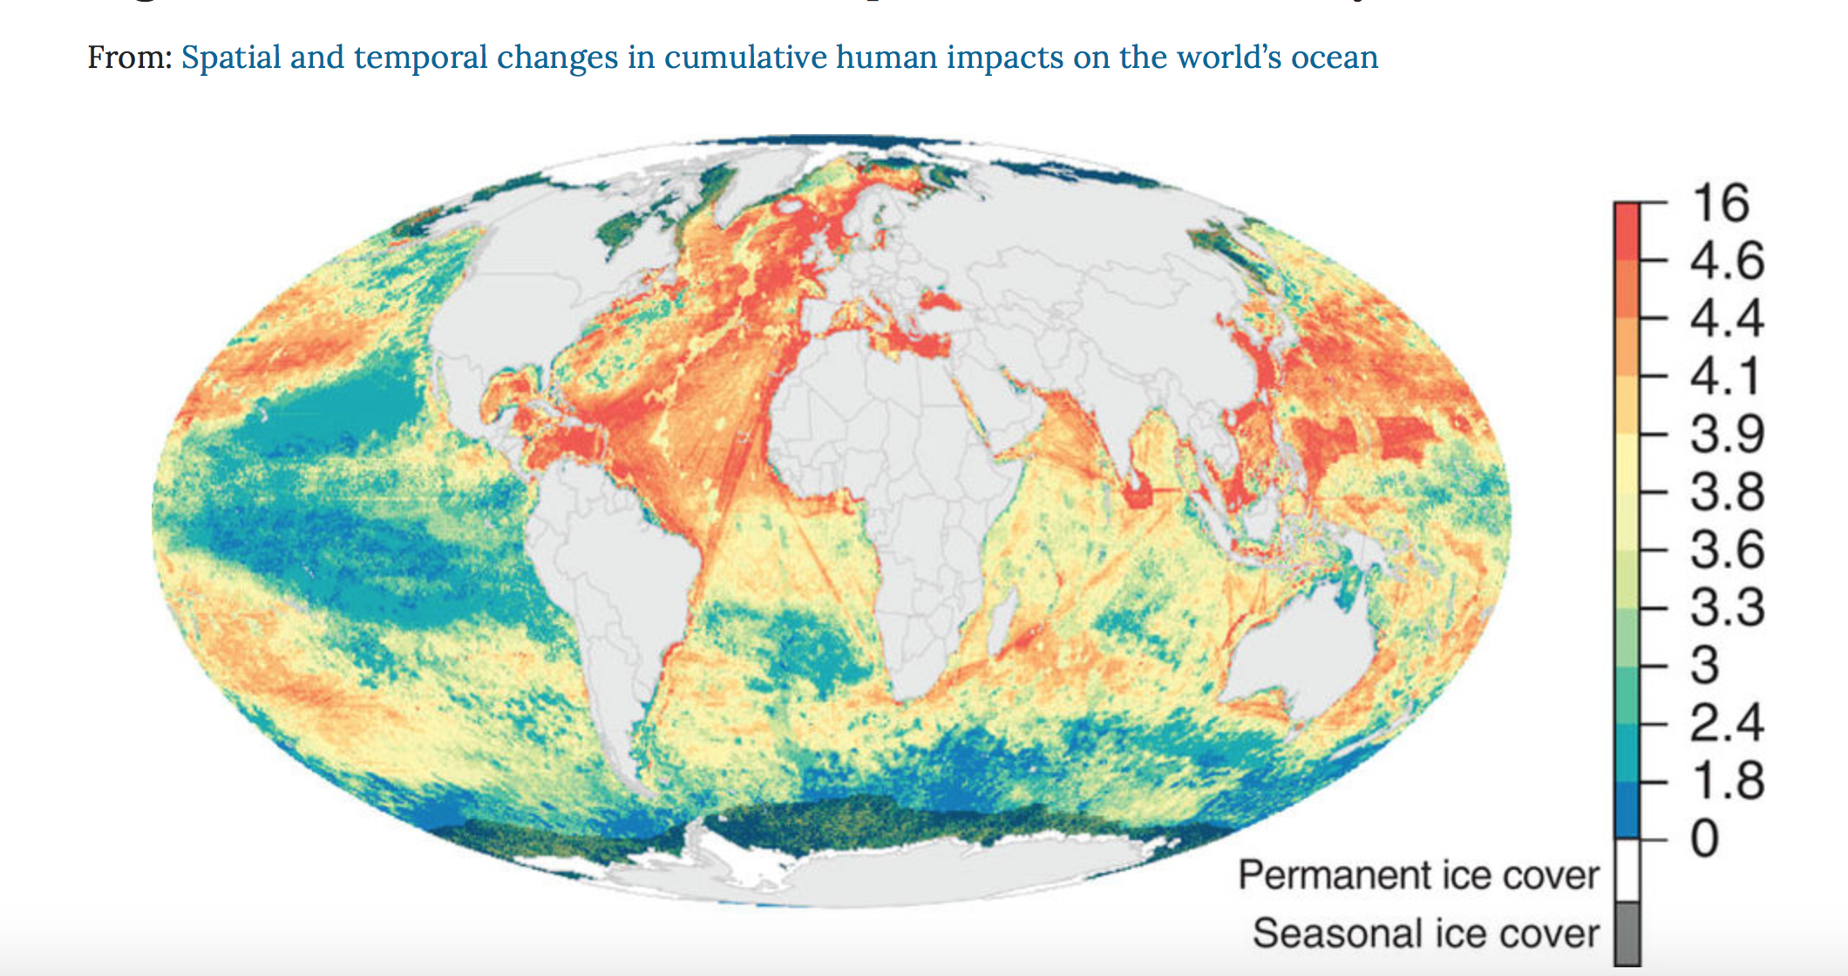
CBD Voluntary guidelines for the consideration of biodiversity in environmental impact assessments (EIAs) in marine and coastal areas
Specific marine and ecological features (such as ecologically or biologically significant marine areas, and vulnerable marine ecosystems) should receive special attention in EIA processes
Cumulative impacts need to be assessed, including CC & OA effects
Cultural, environmental and social impact assessments should be integrated as a single process
Halpern et al 2008
Notes:
Cultural heritage impact assessment - is a process of evaluating the
likely impacts, both beneficial and adverse, of a proposed development
on the physical manifestations of a community's cultural heritage
including sites, structures, and remains of archaeological, architectural,
historical, religious, spiritual, cultural, ecological or aesthetic
value or significance;

Slide 18

CBD Akwé: Kon Voluntary Guidelines
  IPLCs should be invited to participate in all stages of the planning and implementation of a project that could impact sacred sites, lands and waters they traditionally occupy or use.
  Civil society should also be consulted with since conservation of biodiversity is a common concern of humankind.
Notes:
Voluntary guidelines for the conduct of cultural, environmental and social impact assessments regarding developments proposed to take place on, or
which are likely to impact on, sacred sites and on lands and waters traditionally occupied or used by indigenous and local communities.
The present Guidelines are voluntary and intended to serve as guidance for
Parties and Governments, subject to their national legislation, in the development
and implementation of their impact-assessment regimes. The
guidelines should be taken into consideration whenever developments are
proposed to take place on, or which are likely to impact on, sacred sites and
on lands and waters traditionally occupied or used by indigenous and local
communities.

Slide 19
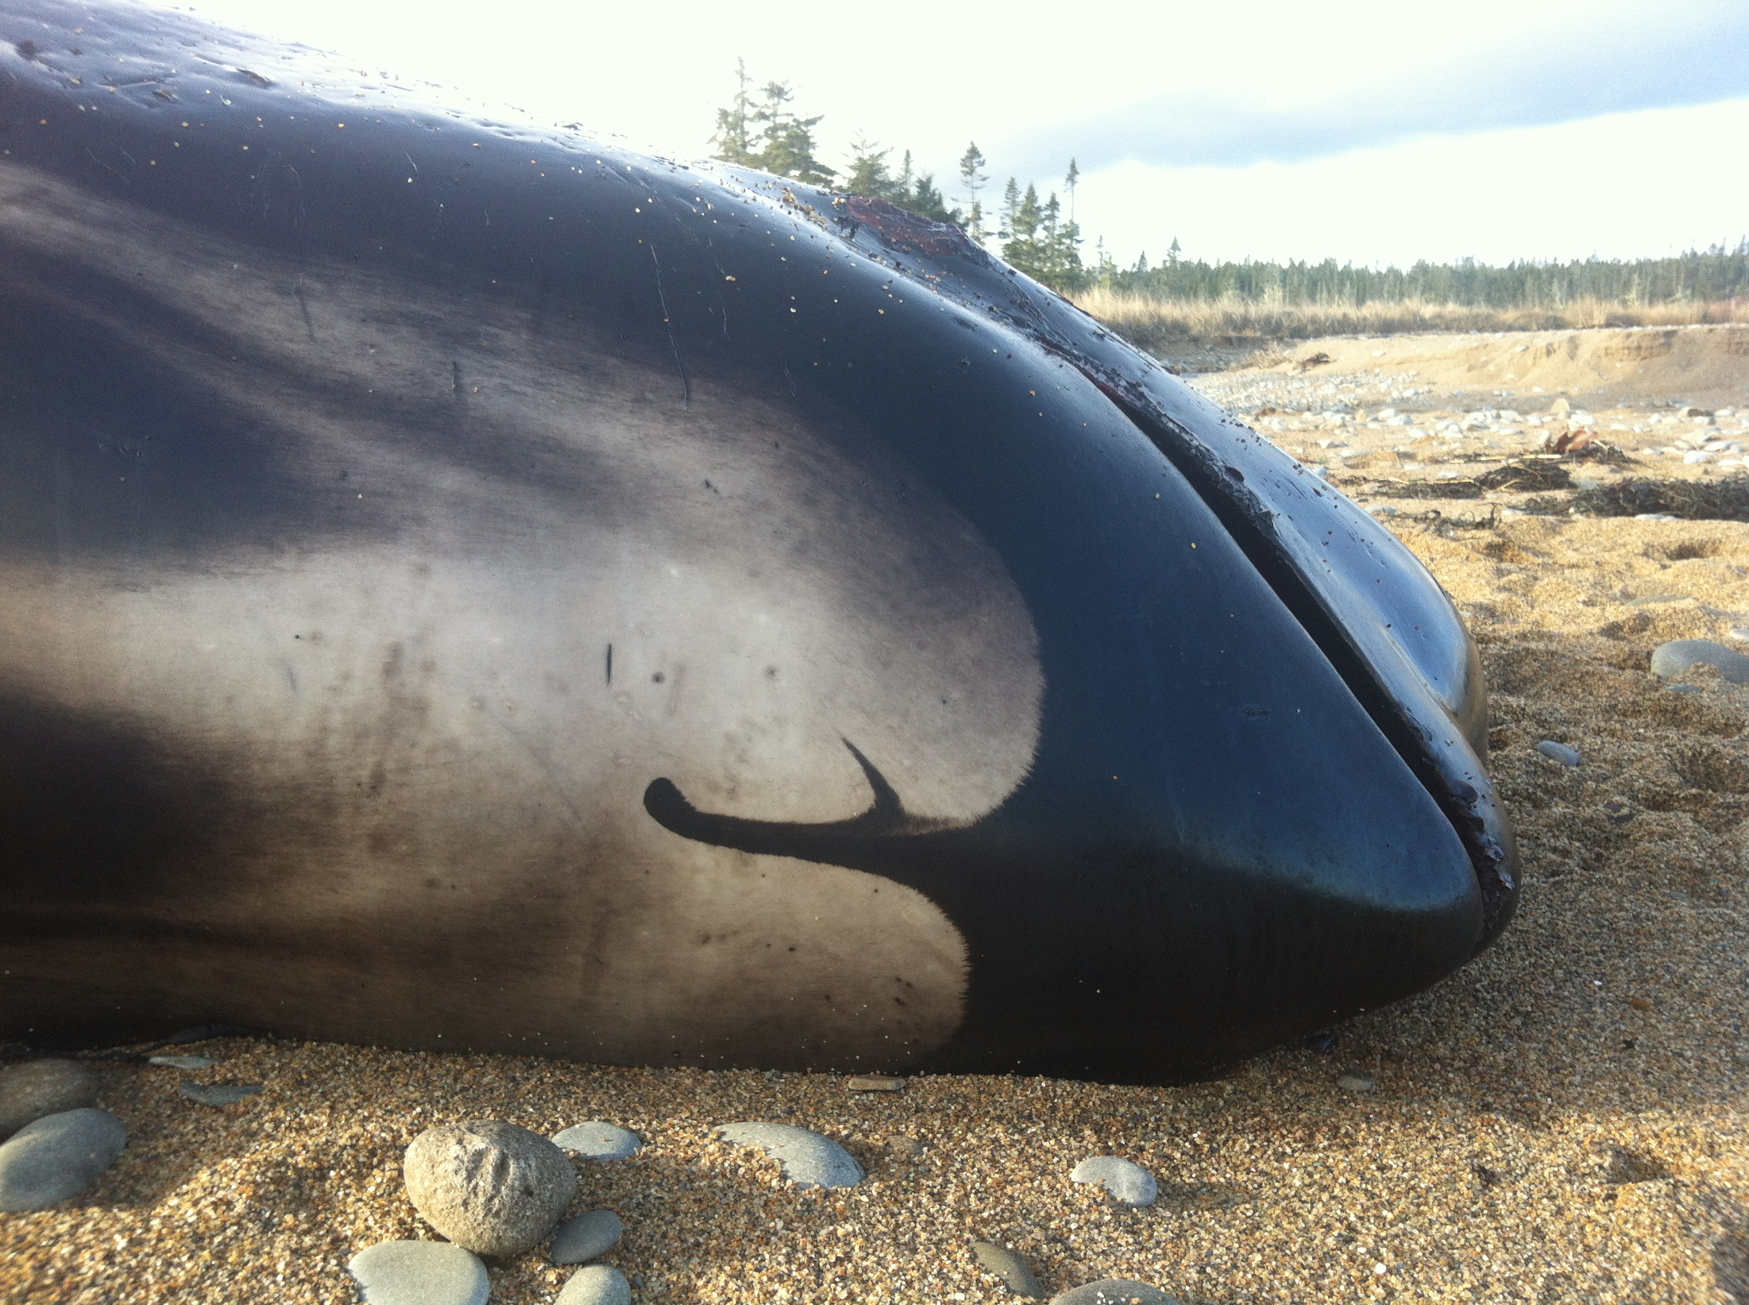
CMS
CMS Family Guidelines on Environmental Impact Assessments for Marine Noise-generating Activities & Technical Support Information to the CMS EIA Guidelines:
Noise propagation considerations: distance, noise frequencies, water depth, topography, temperature, salinity, other environmental variations.
Exclusion zones

Slide 20
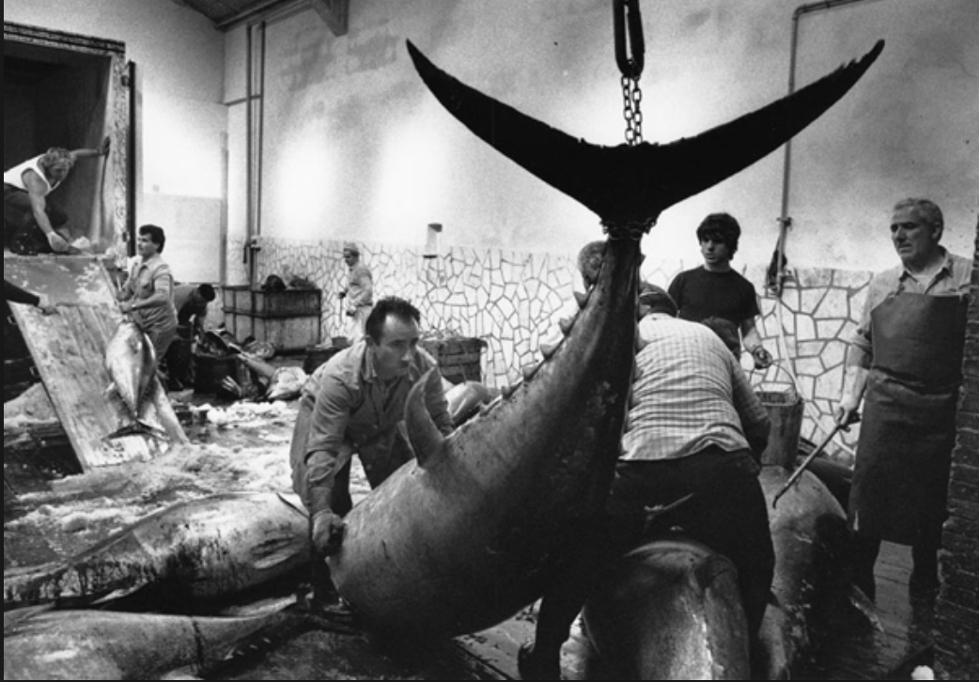
UN Fish Stocks Agreement
In order to conserve and manage straddling fish stocks and highly migratory fish stocks, coastal States and States fishing on the high seas shall, in giving effect to their duty to cooperate in accordance with the Convention:
assess the impacts of fishing, other human activities and environmental factors on target stocks and species belonging to the same ecosystem or associated with or dependent upon the target stocks
(Art. 5 (d))

Slide 21
Deep Sea Fisheries EIAs
Vulnerable Marine Ecosystems protection (corals, sponges, seamounts, hydrothermal vents, canyon heads, etc): UNGA Res. 61/105; 64/72; 66/68; 71/123
Encounter protocols
VME closures
EIA/Risk Assessment
Notes:
Talk about UNCLOS evolution, UNFSA, UNGA resolutions leading to this change. NGOs strategy towards the unga res 61/105. it also influenced change in national waters through national policies and legislation.

Slide 22
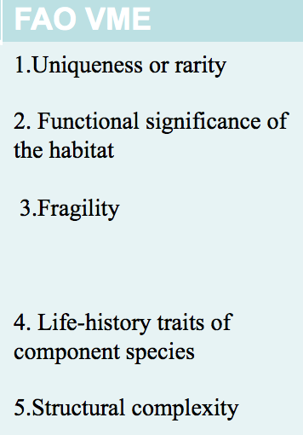
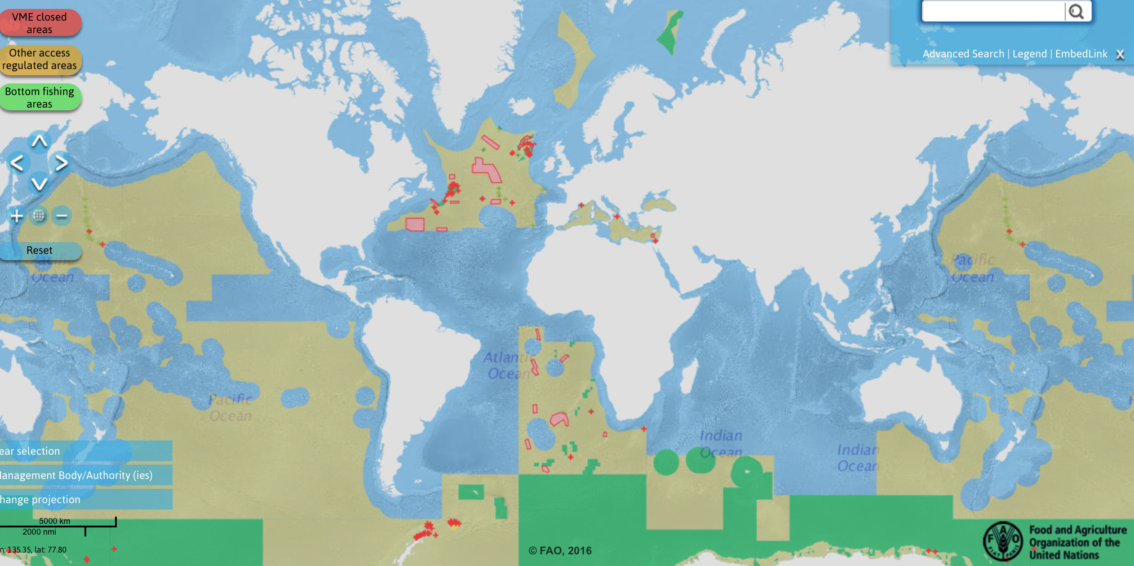
VULNERABLE MARINE ECOSYSTEMS
Notes:
FAO, Guidelines para 47:
…Such an impact assessment should address, inter alia:
(i) type(s) of fishing conducted or contemplated, including vessels and gear types, fishing areas, target and potential bycatch species, fishing effort levels and duration of fishing (harvesting plan);
(ii) best available scientific and technical information on the current state of fishery resources and baseline information on the ecosystems, habitats and communities in the fishing area, against which future changes are to be compared;
(iii) identification, description and mapping of VMEs known or likely to occur in the fishing area;
(iv) data and methods used to identify, describe and assess the impacts of the activity, the identification of gaps in knowledge, and an evaluation of uncertainties in the information presented in the assessment;
(v) identification, description and evaluation of the occurrence, scale and duration of likely impacts, including cumulative impacts of activities covered by the assessment on VMEs and low- productivity fishery resources in the fishing area;
(vi) risk assessment of likely impacts by the fishing operations to determine which impacts are likely to be significant adverse impacts, particularly impacts on VMEs and low-productivity fishery resources; and
(vii) the proposed mitigation and management measures to be used to prevent significant adverse impacts on VMEs and ensure long- term conservation and sustainable utilization of low-productivity fishery resources, and the measures to be used to monitor effects of the fishing operations.

Slide 23
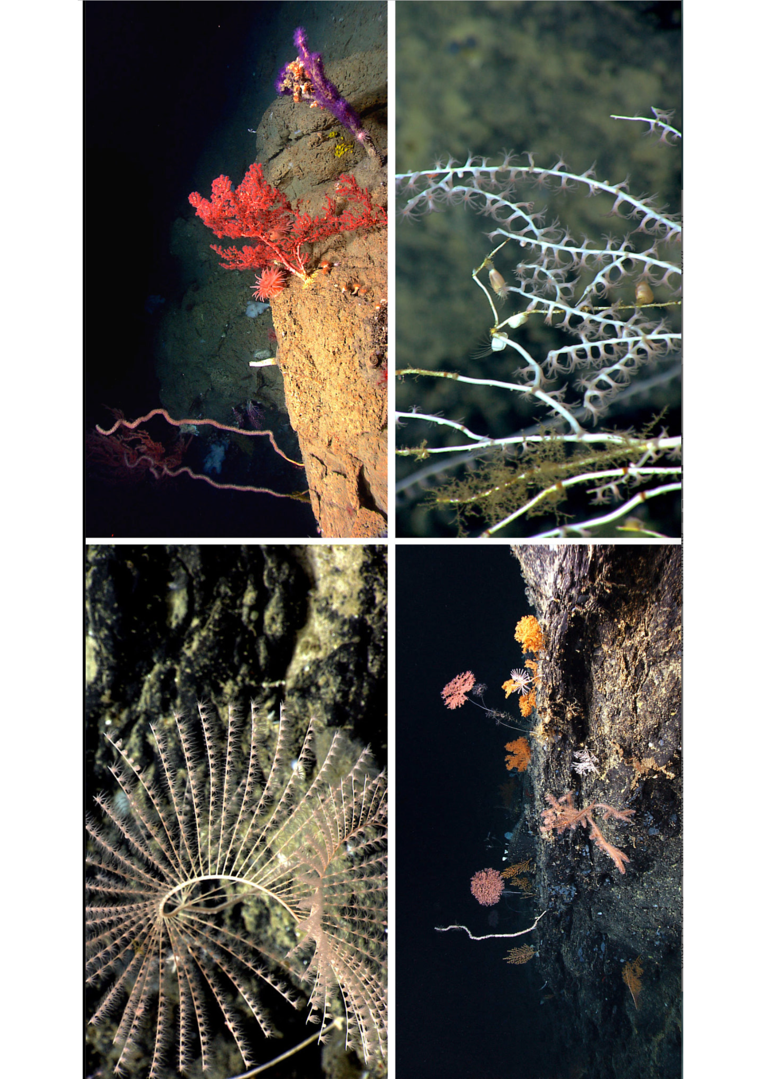
Deep Sea EIA elements:
type(s) of fishing conducted or contemplated
ii. state of fishery resources and baseline information on the ecosystems, habitats and communities in the fishing area, against which future changes are to be compared
iii. identification, description and mapping of VMEs known or likely
to occur
iv. data and methods used to identify, describe and assess the impacts of the activity, the identification of gaps in knowledge, and an evaluation of uncertainties
v. occurrence, scale and duration of likely impacts, including cumulative impacts of
activities covered by the assessment on VMEs and low productivity fishery resources
vi. risk assessment of likely impacts by the fishing operations to determine which impacts are likely to be significant adverse impacts, particularly impacts on VMEs and low-productivity fishery resources
vii. the mitigation and management measures to be used to prevent significant adverse impacts on VMEs and ensure long term conservation and sustainable utilization of low-productivity fishery resources, and the measures to be used to monitor effects
of the fishing operations.
Notes:
i. type(s) of fishing conducted or contemplated, including vessels
and gear types, fishing areas, target and potential bycatch species,
fishing effort levels and duration of fishing (harvesting plan);
ii. best available scientific and technical information on the current
state of fishery resources and baseline information on the
ecosystems, habitats and communities in the fishing area, against
which future changes are to be compared;
iii. identification, description and mapping of VMEs known or likely
to occur in the fishing area;
iv. data and methods used to identify, describe and assess the
impacts of the activity, the identification of gaps in knowledge,
and an evaluation of uncertainties in the information presented in
the assessment;
v. identification, description and evaluation of the occurrence, scale
and duration of likely impacts, including cumulative impacts of
activities covered by the assessment on VMEs and lowproductivity
fishery resources in the fishing area;
vi. risk assessment of likely impacts by the fishing operations to
determine which impacts are likely to be significant adverse
impacts, particularly impacts on VMEs and low-productivity
fishery resources; and
vii. the proposed mitigation and management measures to be used to
prevent significant adverse impacts on VMEs and ensure longterm
conservation and sustainable utilization of low-productivity
fishery resources, and the measures to be used to monitor effects
of the fishing operations.

Slide 24
FAO Deep sea guidelines: Significant Adverse impacts
Significant adverse impacts are those that compromise ecosystem integrity (i.e. ecosystem structure or function) in a manner that:
Impairs the ability of affected populations to replace themselves;
degrades the long-term natural productivity of habitats; or
causes, on more than a temporary basis, significant loss of species richness, habitat or community types. Impacts should be evaluated individually, in combination and cumulatively. (para 17)
Notes:
following six factors should be considered:
i. the intensity or severity of the impact at the specific site being
affected;
ii. the spatial extent of the impact relative to the availability of the
habitat type affected;
iii. the sensitivity/vulnerability of the ecosystem to the impact;
iv. the ability of an ecosystem to recover from harm, and the rate of
such recovery;
v. the extent to which ecosystem functions may be altered by the
impact; and
vi. the timing and duration of the impact relative to the period in
which a species needs the habitat during one or more of its lifehistory
stages.
19. Temporary impacts are those that are limited in duration and that
allow the particular ecosystem to recover over an acceptable time frame.
Such time frames should be decided on a case-by-case basis and should be
in the order of 5-20 years, taking into account the specific features of the
populations and ecosystems.
20. In determining whether an impact is temporary, both the duration and
the frequency at which an impact is repeated should be considered. If the
interval between the expected disturbance of a habitat is shorter than the
recovery time, the impact should be considered more than temporary. In
circumstances of limited information, States and RFMO/As should apply
the precautionary approach in their determinations regarding the nature and
duration of impacts.

Slide 25
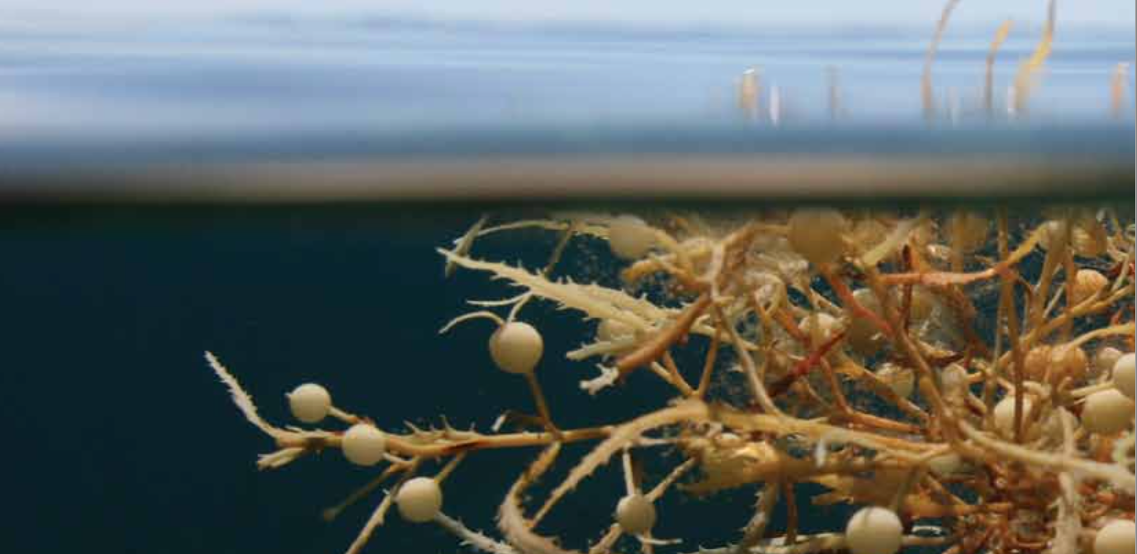
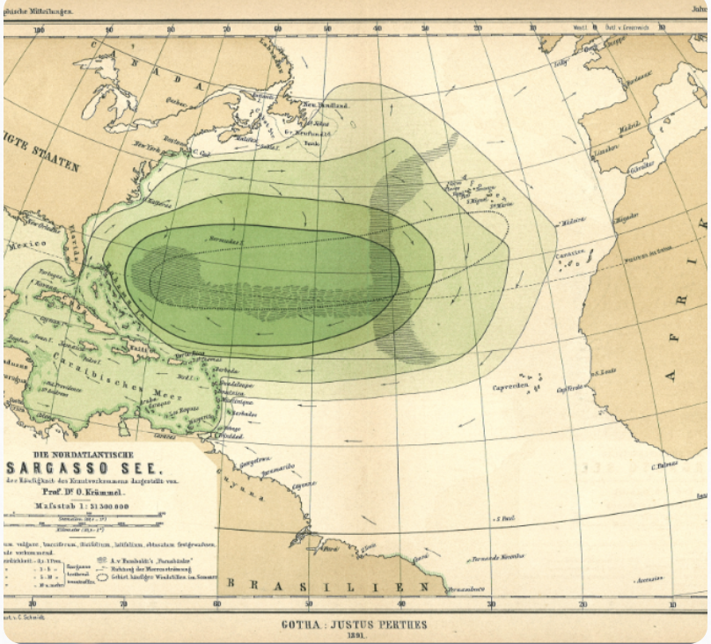
THE SARGASSO SEA SEAMOUNTS: THE CBD CONTRIBUTION to NAFO

Slide 26
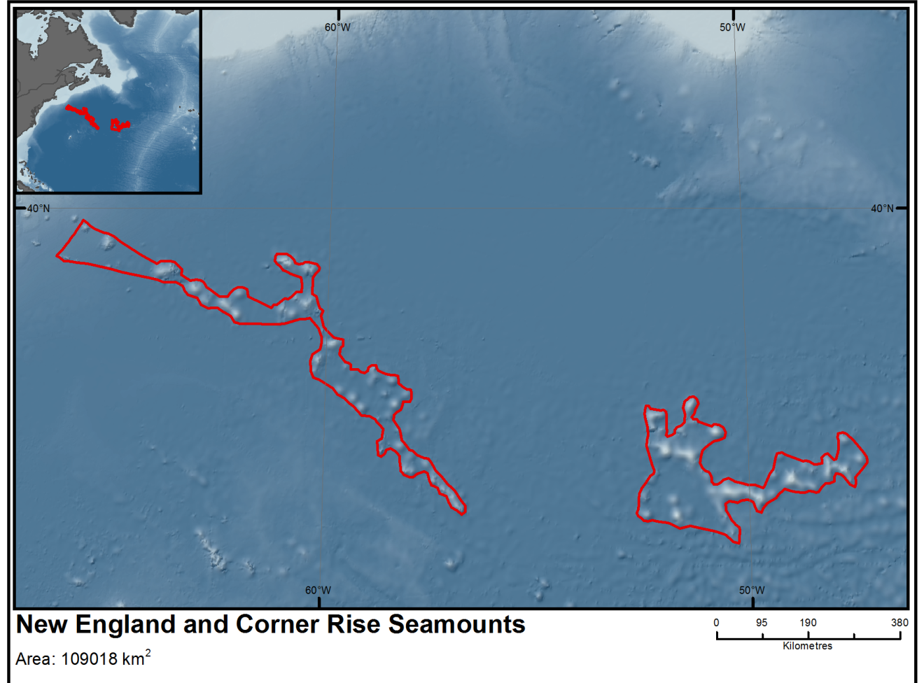
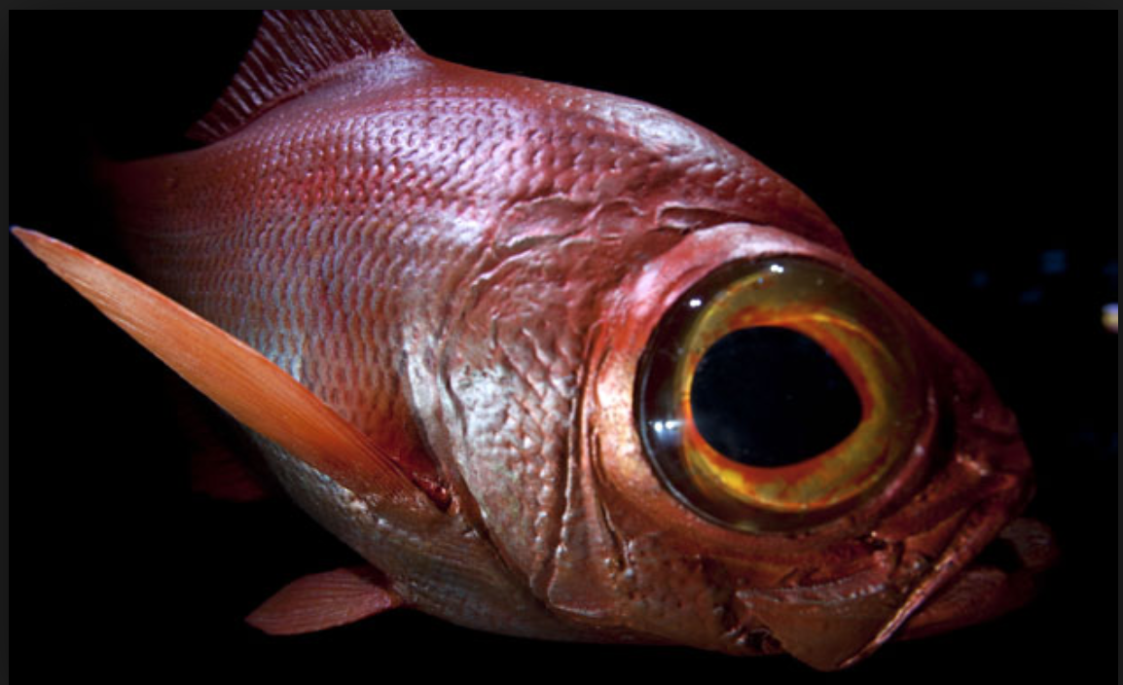
Measures Adopted:
- Seamounts closed to bottom trawling
- Mid-water trawling allowed, but gear modification was adopted to prevent impacts from eventual bottom contact
- Alfonsino is being subject to stock assessments to inform TAC
Notes:
In the Atlantic work is underway to integrate EBSAs, Vulnerable Marine Ecosystems (VMEs) and High Seas MPAs with ‘Blue Growth’ scenarios. This will be taken forward by the EU ATLAS Project, with 12 case studies intended to demonstrate options for integration at an appropriate scale.
Portugal is proposing the establishment of large national EBSAs on its extended continental shelf. These proposals have to be consistent with national marine spatial planning objectives and the development of indicators to ensure conservation and delivery against targets and measures set out by the EU Marine Strategy Framework Directive.
In Mauritanian waters, EBSA data are being used to support the case at the International Maritime Organization to create a Particularly Sensitive Sea Area on the basis that biodiversity in that area is vulnerable to impacts from international shipping.
In South Africa, a national process ‘Operation Phakisa’ has used EBSA data to contribute to baseline information as part of a holistic planning exercise resulting in conservation measures.
The North-western Mediterranean Pelagic Ecosystems EBSA illustrates how EBSA criteria can underpin advocacy for detailed management options (further research, fisheries gear specifications, seasonal closures, MPAs).

Slide 27
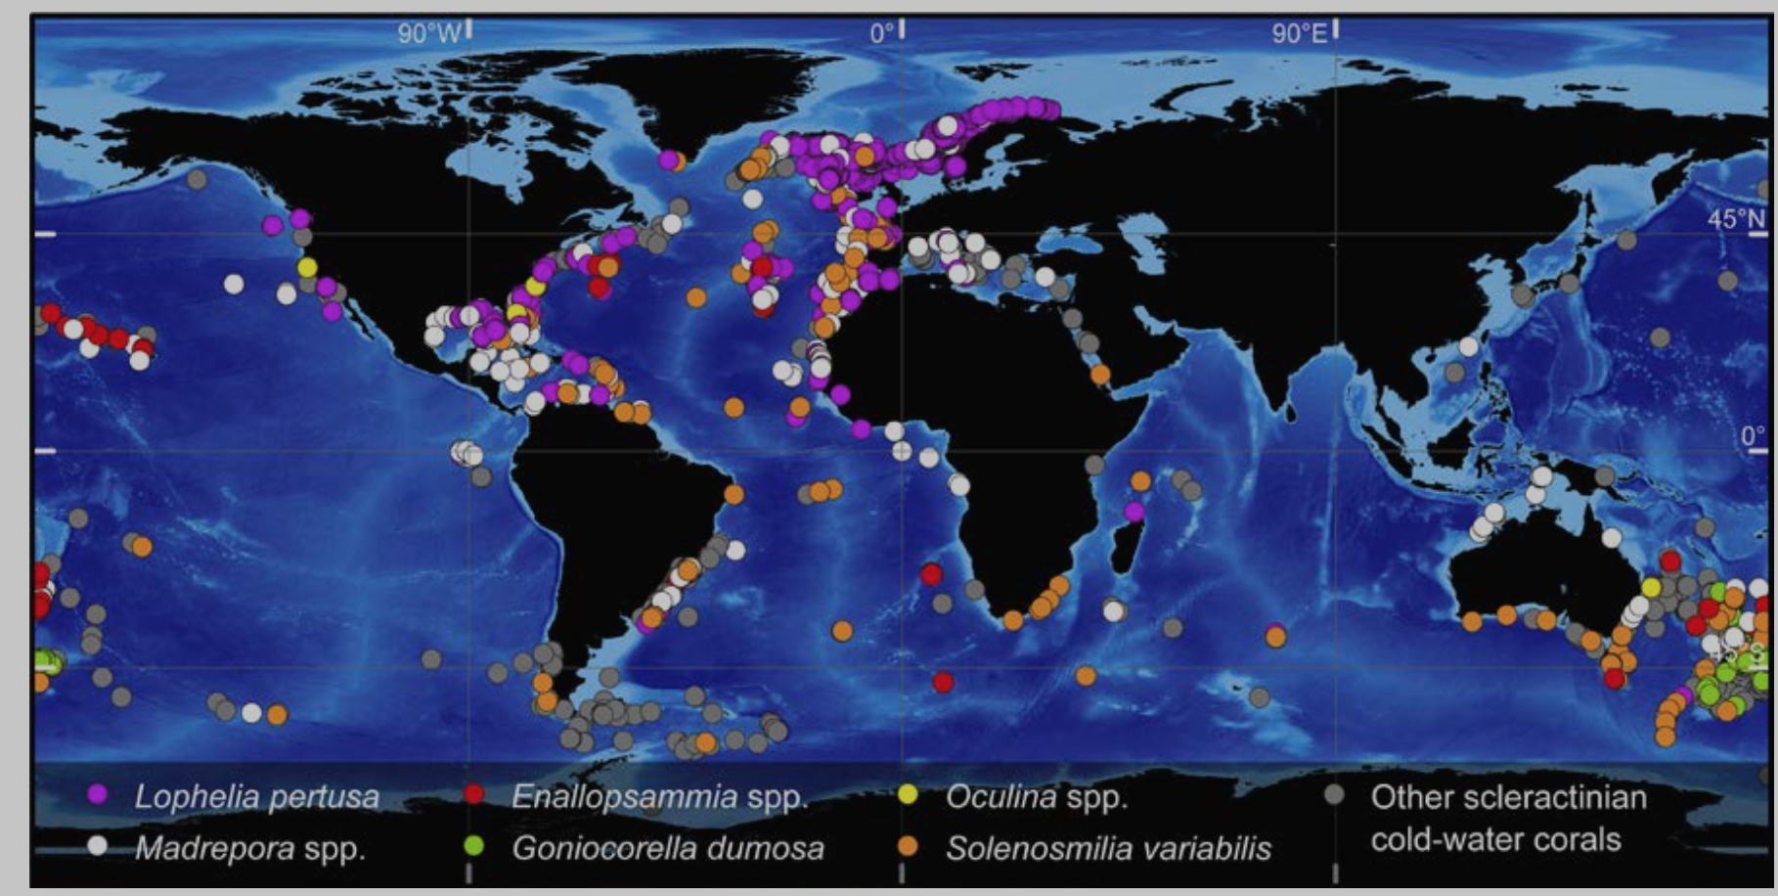
World Ocean Assessment (2016) http://www.un.org/Depts/los/global_reporting/WOA_RPROC/Chapter_42.pdf

Slide 28
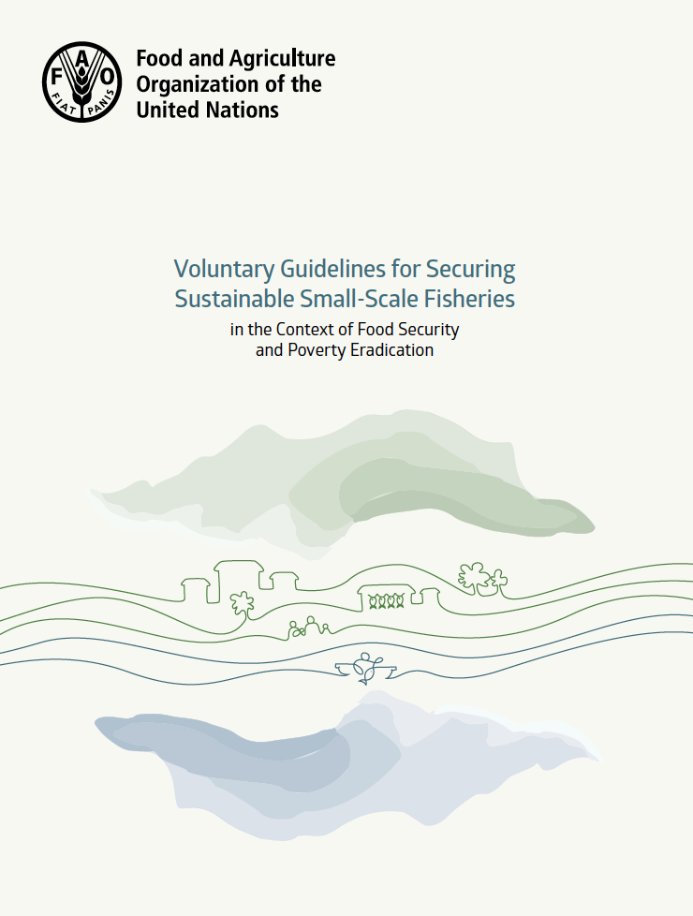
SSF Guidelines
States and other parties should, prior to the implementation of large-scale development projects that might impact small-scale fishing communities, consider the social, economic and environmental impacts through impact studies, and hold effective and meaningful consultations with these communities, in accordance with national legislation.
(para 5.10)
Notes:
Talk about de Schutter here and the need for bilateral fisheries agreement to be subject to EIAs

Slide 29
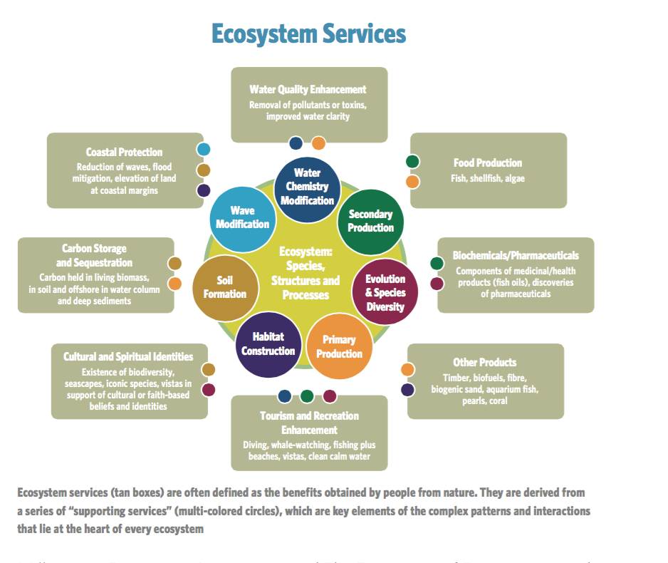
Framework Principles on Human Rights and the Environment
EIAs as procedural human rights tools
States should require prior assessment of the possible environmental impacts of proposed projects and policies, including their potential effects on the enjoyment of human rights, including the right to food, life, health and culture
Assessment of impacts should include transboundary and cumulative effects that may occur
Findings should be made public and subject to review by an independent body before the final decision
Monitoring to ensure compliance with any conditions should be put in place

Slide 30
Concluding remarks
EIAs
Human Rights
Biodiversity-Inclusive
Cumulative impacts
Ecosystem Services
-UNCLOS
-UNFSA
- CBD
-CBD SEA/EIA Guidelines
-CBD Akwé: Kon Guidelines
-FAO Deep-Sea Fisheries Guidelines
-SSF Guidelines
-
  Human rights and biodiversity; Framework Principles (J Knox, 2017; 2019)
  Human right to food (De Schutter, 2012)
Notes:
The ecosystem approach as defined by the CBD: is a strategy for the integrated management of land, water and living resources that promotes conservation and sustainable use in an equitable way. The application of the EA will help to reach a balance of the 3 objs of the convention: conservation; sustainable use; and the fair and equitable sharing of the benefits arising out of the utilisation of genetic resources. In addition the EA has been recognised by the WSSD(and Rio+20) as an important instrument for enhancing sust development and poverty alleviation. The ecosystem approach is based on the application of appropriate scientific methodologies focused on levels of biological organisation, which encompass the essential structure, processes, functions and interactions among organisms and their environment. It recognizes that humans, with their cultural diversity, are an integral component of many ecosystems.
Managing fisheries sustainably requires protection of ecosystem structure and function while also giving consideration to the current and future needs of people as part of marine ecosystems. Sustainable fisheries can also directly contribute to the maintenance or restoration of a wide range of ecosystem services beyond provisioning services. For instance, poorly managed catches of protected, endangered or threatened species represent an economic cost to fisheries, particularly in developing countries, both through a loss of amenity value of charismatic species, and through the generation of negative perceptions of the products of the fishery. Furthermore, key ecosystem functions and services can be disrupted by the collapse of certain species within their respective functional groups. For instance, top predators have an important regulatory role in the food chain, and large-bodied species play key roles in nutrient cycling and sediment bioturbation (Payne et al., 2016).
Identifying and adopting appropriate (effective and equitable) conservation and management measures for areas important for biodiversity and ecosystem services can increase food security.
However, many barriers to sustainable fisheries exist, including data deficiencies, particularly with regard to catch data, overcapacity, ecosystem effects of fishing like bycatch and habitat destruction, and the frequent disconnect between social and ecological goals (Hazen et al., 2015), and power imbalances often favoring industrial fisheries in detriment of SSF/artisanal/subsistence fisheries.
In light of this,
Questions and links with relevant SDGs and other instruments
How can developing states with limited capabilities implement the ecosystem approach to fisheries, as a precondition for that approach to contribute to poverty alleviation? We have been exploring (through the preparation of a Marine Policy Special Issue on SDGs) how methodologies for data-poor places can be effectively implemented, while also suggesting tools and technologies for improving data collection especially catch data in artisanal fisheries).
How do inter-State relations affect access to fishing resources in ways that trickle down to small-scale fishermen? This issue is linked with the concept of fisheries surplus and how the total allowable catch is calculated (e.g. having ‘maximum sustainable yield’ as a target (as described under UNCLOS) or as a limit (Fish Stocks Agreement, Art. 6 and Annex II, and SDG 14.4). An ecosystem approach to fisheries can challenge the assertion that MSY can be a target for all stocks in the same ecosystem. Ecosystem-level total catch ceilings have been suggested in some regions of the world (NW Atlantic) as an ecosystem rebuilding tool in addition to specific habitat protection (vulnerable marine ecosystems) (also linked with SDG 14.2 and 14.5).
As part of the ecosystem approach: Increase the capacity of developing states and SSF communities (SDG 3) in fish catch data collection including through long-term training and technology transfer (GPS/phone apps) (SDG 14.a; SDG 17), as well as mapping/habitat suitability models (e.g. random forest), multi-species models (Ecosim, Gadget, etc), while making use of existing publicly available information (e.g. satellite data on primary productivity, EBSA and VME data).
Current focus and future work on EIAs as an integrative tool:
Several of the multiple dimensions of poverty (SDG 1) rest also on international human rights law (notably the right to food (linked with SDG 2 and the FAO SSF Guidelines)). In pursuing this approach, we are currently exploring the role of impact assessments (e.g. human rights impact assessments (HRIAs), environmental impact assessments (EIAs), cultural impact assessments, strategic environmental assessments (SEAs), etc) as a potential integrative tool for ecosystem services for poverty alleviation in the context of an ecosystem approach:
The former UN Special Rapporteur on Right to Food Oliver De Schutter, in his report on the right to food and fisheries, recommended that fisheries agreements be subject to human rights impact assessments (HRIAs) led by the coastal State and supported by the flag state, with the involvement of fishing communities potentially affected.
The recommendation to conduct HRIAs with respect to fishing access agreements was not incorporated in the SSF Guidelines. However, impact assessments in more general terms have been embraced by the Guidelines when referring to: ‘large-scale development projects that might impact small-scale fishing communities’, trade agreements, and monitoring the implementation of the Guidelines. It is unclear whether distant water fleets fishing in a third country’s EEZ are considered to be ‘large-scale development project’ as per the Guidelines to trigger an impact assessment. States can interpret the SSF Guidelines in a systemic manner, and incorporate the recommendations of the Special Rapporteur if they wish to be diligent in fulfilling their obligations to right to food. Furthermore, HRIAs are supposed to be comprehensive, interlinking civil and political rights just as much as to economic, social and cultural rights, which would help address also issues related to the multi-dimensions of poverty in small-scale fishing communities.
No specific guidance or minimum standards for HRIAs currently exist in the context of fishing access agreements. On the other hand, however, the guidance developed under the CBD on impact assessments can complement the impact assessment requirements under UNFSA and the SSF Guidelines, since they are aligned with the ecosystem approach, and assist in the fulfilment and protection of the right to food, and contribute to sustainability and poverty reduction. For instance, the Akwé: Kon Voluntary guidelines for the conduct of cultural, environmental and social impact assessments regarding developments proposed to take place on, or which are likely to impact on, sacred sites and on lands and waters traditionally occupied or used by indigenous and local communities (Akwé: Kon Guidelines) are supposed to provide guidance on the incorporation of these issues in new or existing impact assessment procedures. The Akwé: Kon Guidelines are to be read in conjunction with the CBD Guidelines for incorporating biodiversity–related issues into the environmental impact assessment (EIA) legislation or process in strategic environmental assessment (SEA), which has been more recently revised to incorporate marine and coastal biodiversity considerations.
An innovative approach utilised by both the Akwé: Kon Guidelines and the Marine and Coastal EIA/SEA Guidelines is the incorporation of ecosystem services concept. While the Akwé: Kon Guidelines do not use this terminology per se, they suggest undertaking “economic valuation of cultural resources” as part of the screening phase of cultural impact assessments. The Marine and Coastal EIA/SEA Guidelines are more explicit and call for efforts to be made in the incorporation of latest work on ecosystem services and values. They also recommend that in the screening phase of the proposed project or activity questions concerning the risk of ecosystem services of scientific/ecological value, or of cultural value be investigated. However, given the limited knowledge regarding ecosystem functions and scientific constraints regarding marine ecosystem services scalability, they recommend making use of the information contained in the EBSA descriptions for the purpose of assessing those impacts on ecosystem services. Furthermore, the Guidelines connects EBSAs and vulnerable marine ecosystems (VMEs) to ecosystem services, especially regulating and supporting services in a number of instances. The guidelines contain indicative list of screening criteria to be further elaborated at the national level, recommending that EIAs be mandatory for activities in MPAs, EBSAs, VMEs, ecological corridors, areas known to provide important ecosystem services. A long (indicative) list of ecosystem services is provided in Annex III of the Guidelines. On this basis, industrial fishing activities that could affect the ecosystem services that small-fishing communities depend upon should then trigger an EIA if states decides to incorporate this guidance into their own legislation. The identification of these areas important for ecosystem services can be facilitated by the description of EBSAs and VMEs as well as traditional knowledge.
To ensure long-term sustainability of the resources and of the livelihoods dependent on these resources, we argue that in addition to human rights impact assessments, large-scale fisheries (object of fishing agreements or not) could be subject to environmental impact assessments, and only authorized to proceed if significant adverse impacts are not likely to occur on the marine ecosystems and associated services. In assessing the impacts of large-scale fisheries, it is important to also take into account cumulative effects of existing activities or impacts such as climate change and ocean acidification impacts. Such an approach to comprehensive EIAs is consistent with UNFSA, Art. 5, SDG 13 (climate change), SDG 14.3 (ocean acidification), Aichi Biodiversity Target 10 (climate change and ocean acidification), CBD EIA/SEA Revised Voluntary Guidelines, among others. Therefore, it could also contribute towards the achievement of relevant SDGs, including those mentioned above (SDGs 1, 2, 4, 13, 14 and 17), and potentially SDGs 3 (on well-being), 10 (reduced inequalities), 12 (responsible production), and 16 (peace, justice and reduced inequalities). Such connections require further research.
- FAO TECHNICAL GUIDELINES FOR RESPONSIBLE FISHERIES
4 Suppl. 2, 2003 (EAF)
Strengths of incorporating ES into SEAs/EIAs identified in literature:
Ecosystem services is an integrating concept which instead of dealing with discrete environmental ‘topics’ considers bundles of services that flow from the environment
Stakeholders and the public are well placed to engage with this alternative description
Ecosystem services may be of particular value where there are clear conflicts between traditional environmental and economic arguments
Incorporating ecosystem services into environmental assessment helps practitioners and decision-makers to reflect on the impact of the environment on their plan, programme or project rather than just vice versa
Weaknesses:
The complexity of ecosystem services as a concept
The contested nature of ecosystem service valuation may not be robust enough for environmental assessment which operates within a legal framework
Doing comprehensive ecosystem service assessment is potentially very resource intensive
- Impact assessment is a very important element in bringing together ecosystem services valuation, poverty, human rights and environmental issues partly arising from the UN Special Rapporteur on the Right to Food.
The project has led to original thinking around justice and institutions, partnerships, sharing data and experience, and building capacity. A key issue is decision-making, who decides where to give priority? There is a need to cement the linkages.
There is not enough work done on valuation of ES, particularly non-provisioning services, which would contribute to make impact assessments more fit for the purposes of assessing also different dimensions of poverty. Ecosystem services can help to connect the dots.
Chennai Guidance for the Integration of Biodiversity and Poverty Eradication, explicitly promotes the integration of biodiversity and ecosystem services and functions into poverty eradication and development strategies, initiatives and processes at all levels.
CBD, Decision XII/5.
Knowing the limits of and the potential of fisheries productivity in a given area, even in data-poor situations, can help decision-makers and communities identify the appropriate choices (or trade-offs) among ecosystem services (e.g. specific stocks) without compromising ‘safe ecological levels.’ This should be at the heart of the required paradigm shift in fisheries governance. This argument supports our previous findings about the urgent need to fill gaps in marine ecosystem services research identified in our science-policy report.
NAFO, SC WGESA (2013) Roadmap to EAF.

Slide 31

Thank you

